Slide 1



N
CONTENT
INTELLIGENCE
DASHBOARD
Netflix Global Content Insights · 2016 – 2025
200
Titles
10
Years
15
Countries
7.70
Avg IMDb
Internship EDA Assignment | Task 2 | EDA & Business Intelligence

Slide 2
📊 KEY PERFORMANCE INDICATORS
SLIDE 2 / 7
200
Total Titles
2016–2025 · 20/yr
7.70
Avg IMDb Score
Range: 4.3 – 9.3
81.9M
Avg Viewership
Per title · Max 792M
18%
Excellent Titles
IMDb ≥ 8.5 · 36 titles
15
Countries
USA leads at 62%
🇰🇷Korean Content ROI
S.Korea produces 10% of titles but averages 143.9M views — nearly double USA's 76M avg.
☀️Summer Release Effect
June–July releases avg 113M views vs 34M in October — a 3.3× difference from timing alone.
📺Longer = More Views
Content 500+ min averages 122M views vs 34M for short content. Season renewals = high ROI.
🎭Crime Genre Dominates
Heist/Crime averages 388M views per title — more than double Fantasy Drama in 3rd place.
⭐Quality Drives Views
Excellent-rated titles (IMDb ≥ 8.5) earn 2.8× more views than Below Average titles.
Source: Netflix Global Content Insights Dataset 2016–2025 | Analysis by Intern

Slide 3
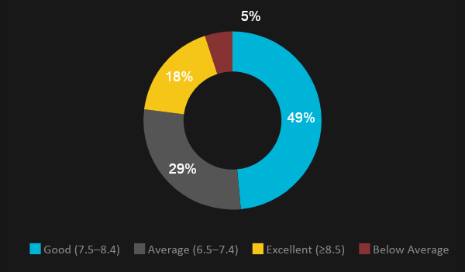
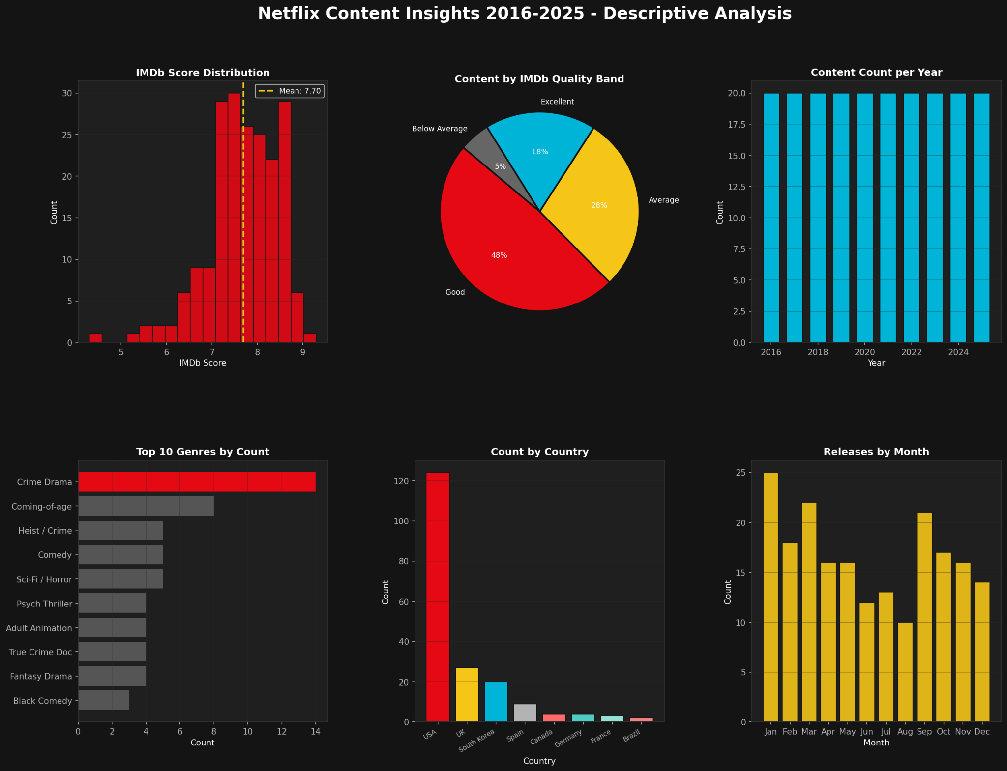
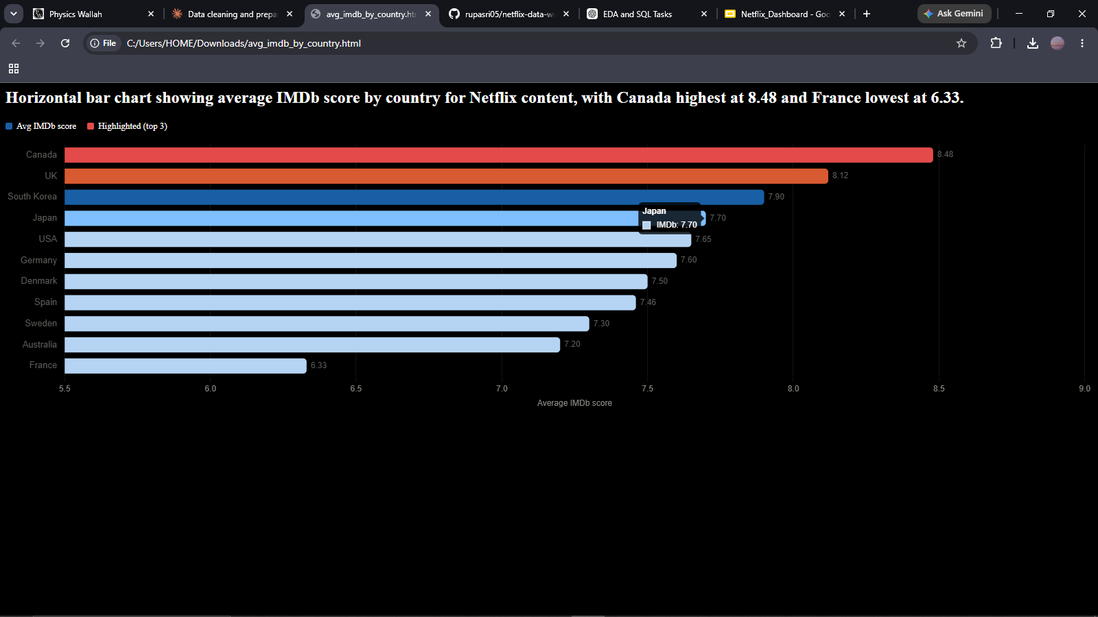
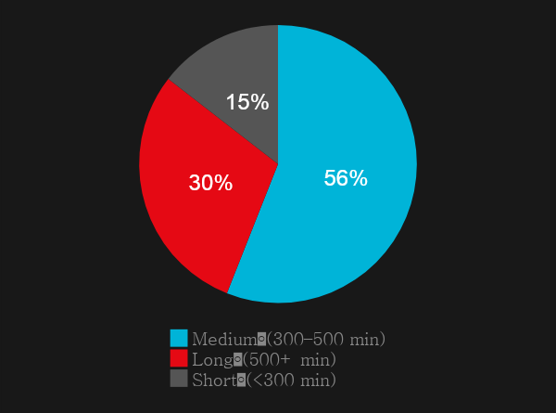
🎬 CONTENT ANALYSIS
SLIDE 3 / 7
IMDb Quality Band
Top Genres by Title Count
Releases by Month
% of 200 titles
Number of titles per genre
When does Netflix release most?
Avg IMDb Score by Country
Content Duration Split
💡 Key Insight
Countries with ≥ 2 titles
Crime Drama is the most produced genre with 14 titles. UK & Canada produce fewer titles but score highest on IMDb — signaling a quality-over-quantity strategy. January is Netflix's busiest release month with 25 titles.

Slide 4

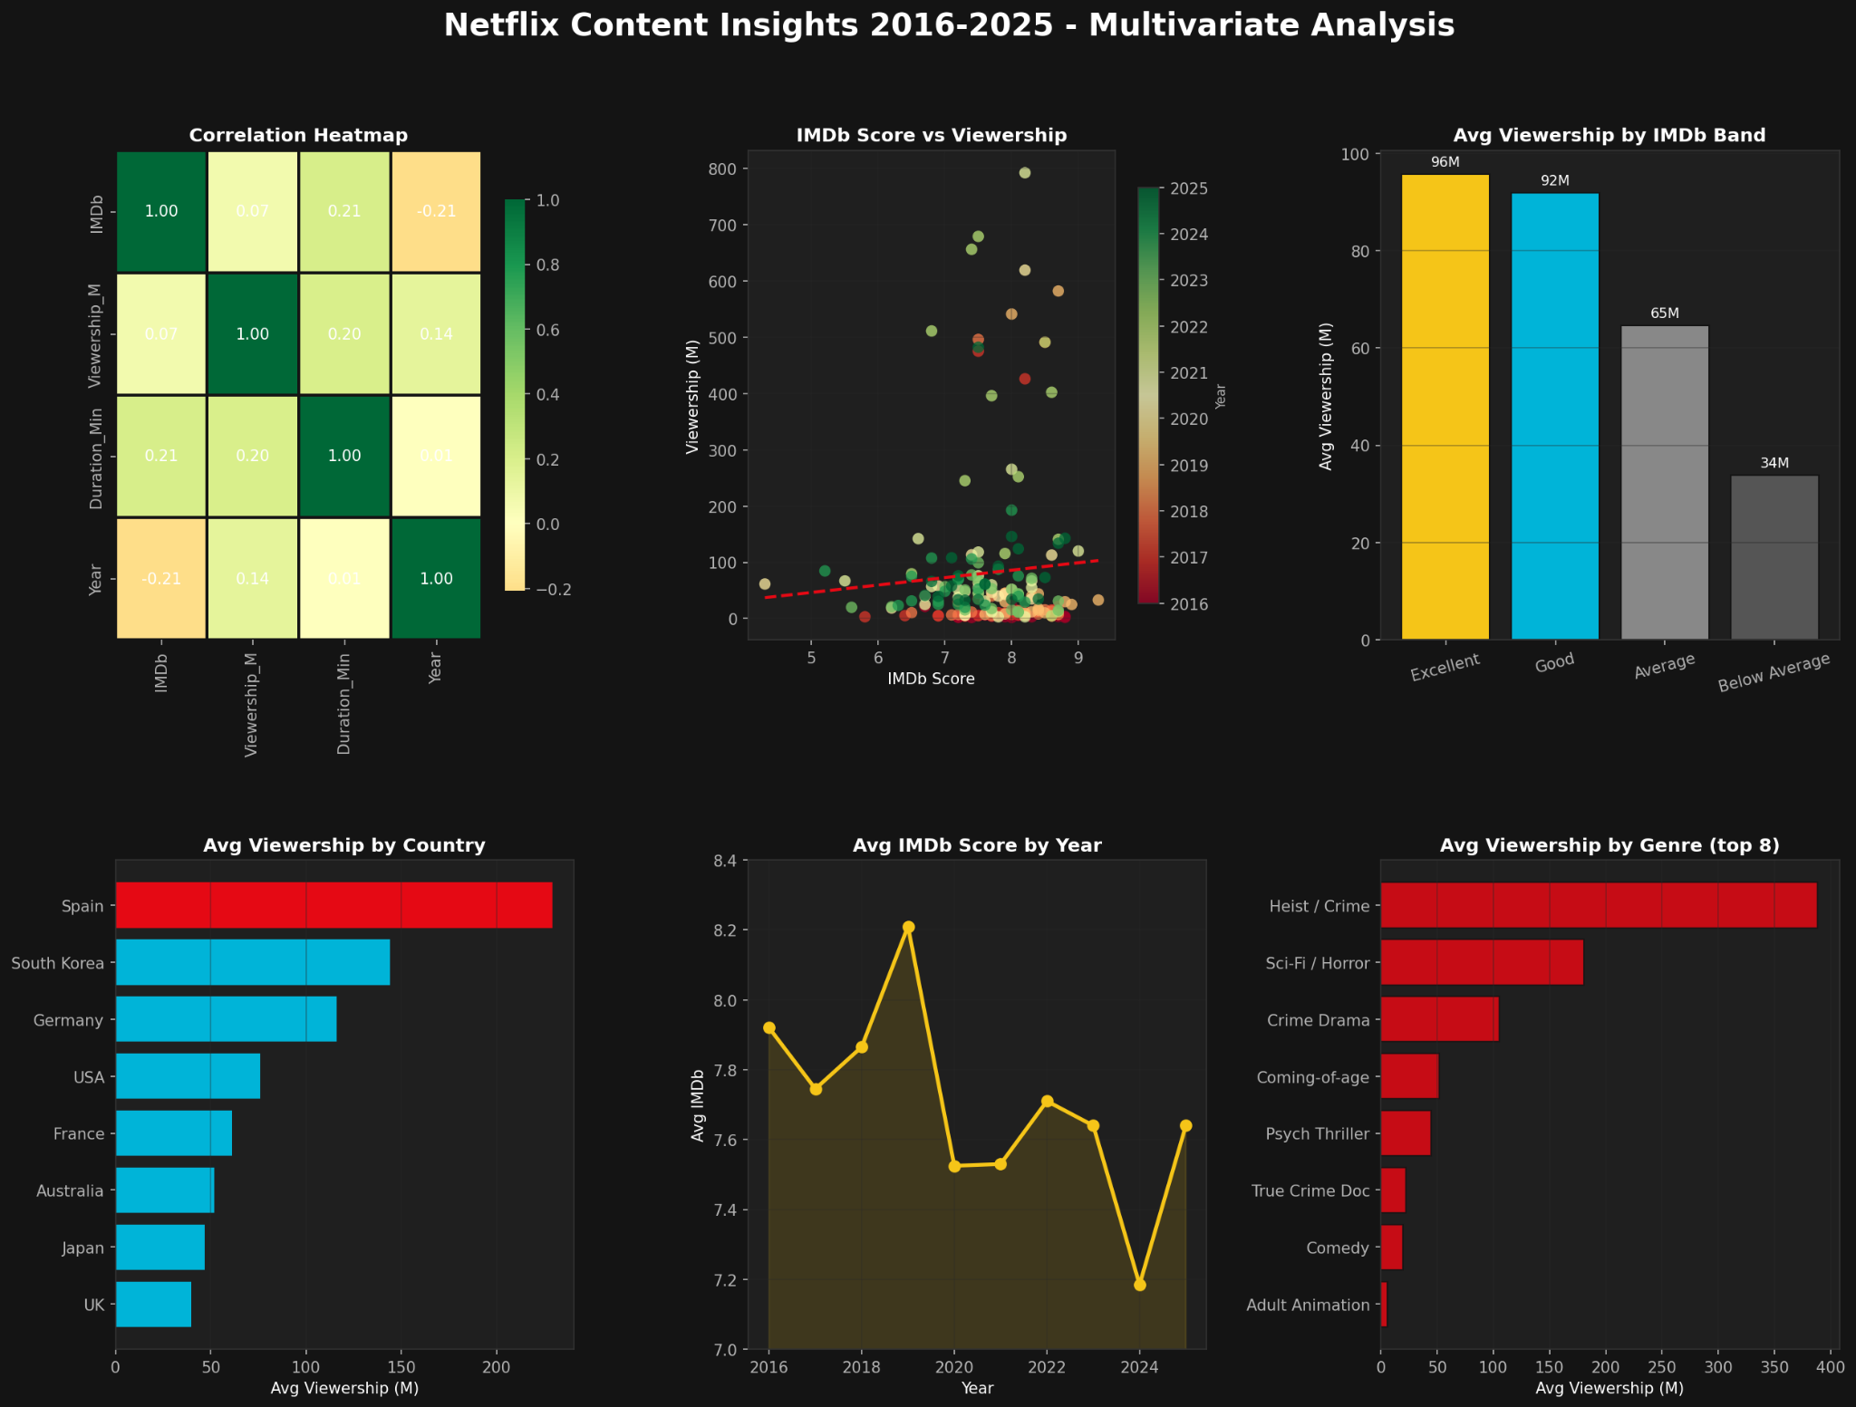
👁️ VIEWERSHIP ANALYSIS
SLIDE 4 / 7
Total Viewership by Year (Millions)
Sum of all title viewership per year — Note: 2023 unit changed from Hours to Views
Avg Viewership by Genre (Top 8)
IMDb Band vs Avg Viewership
Avg Views by Country
Avg millions of views per title by genre
Does quality drive views?

Slide 5
🗄️ SQL BUSINESS QUESTIONS
SLIDE 5 / 7
#1 Title Each Year
Best Country by IMDb
Genre Performance
SELECT Year, Title, MAX(Viewership_M)
FROM netflix
GROUP BY Year ORDER BY Year;
SELECT Primary_Country, AVG(IMDb)
FROM netflix
GROUP BY Primary_Country
HAVING COUNT(*) >= 2
ORDER BY AVG(IMDb) DESC;
SELECT Genre, AVG(IMDb),
AVG(Viewership_M), MAX(Viewership_M)
FROM netflix GROUP BY Genre
HAVING COUNT(*) >= 3
ORDER BY AVG(Viewership_M) DESC;
Q1
Q2
Q3
→ Crime/Thriller genres top the chart every single year since 2017.
→ Canada 8.47 · UK 8.12 · S.Korea 7.90 lead quality rankings.
→ Heist/Crime avg 388M views — nearly double Fantasy Drama.
Yearly Trend
Best Release Month
Excellent + Popular
SELECT Year, COUNT(*) AS titles,
AVG(IMDb), SUM(Viewership_M)
FROM netflix GROUP BY Year
ORDER BY Year;
SELECT Release_Month,
AVG(Viewership_M) AS avg_views
FROM netflix
GROUP BY Release_Month
ORDER BY avg_views DESC;
SELECT Title, IMDb, Viewership_M
FROM netflix
WHERE IMDb_Band = 'Excellent'
ORDER BY Viewership_M DESC LIMIT 15;
Q4
Q5
Q6
→ 2022 was peak viewership at 3,985M total. 2024 shows recovery.
→ June 115.8M avg · July 110.2M · October 34.2M — worst month.
→ Stranger Things 3 (582M) leads. Ozark 2nd at 491M views.

Slide 6
🏆 TOP TITLES — EXCELLENCE + VIEWERSHIP
SLIDE 6 / 7
Top 10 Critically Acclaimed Titles by Viewership (IMDb Band: Excellent ≥ 8.5)
# | Title | Year | Genre | Country | IMDb | Viewership
1 | Stranger Things 3 | 2019 | Sci-Fi / Horror | USA | 8.7 | 582M Hours
2 | Ozark | 2017 | Crime Drama | USA | 8.5 | 491M Hours
3 | Extraordinary Attorney Woo | 2022 | Legal Drama | South Korea | 8.6 | 402M Hours
4 | Arcane | 2021 | Animation/Action | USA | 9.0 | 120M Views
5 | The Queen's Gambit | 2020 | Period Drama | USA | 8.6 | 112M Views
6 | Adolescence | 2025 | Crime Drama | UK | 8.8 | 142.6M Views
7 | Stranger Things 4 | 2022 | Sci-Fi / Horror | USA | 8.7 | 140.7M Hours
8 | Our Planet | 2019 | Nature Doc | UK | 9.3 | 33M Views
9 | When They See Us | 2019 | Drama / Legal | USA | 8.9 | 25M Views
10 | Peaky Blinders | 2019 | Period Crime | UK | 8.8 | 30M Views
📅 #1 Most-Watched Title Each Year
2016: Orange Is the New Black (23M Streams)
2020: Money Heist (619M Hrs)
2023: Night Agent (99M Views)
2017: Ozark (491M Hrs)
2021: Money Heist (792M Hrs) ★
2024: Squid Game 2 (192M Views)
2018: 13 Reasons Why (496M Hrs)
2022: All of Us Are Dead (679M Hrs)
2025: KPop Demon Hunters (482M Views)
2019: Stranger Things 3 (582M Hrs)

Slide 7
💡 KEY INSIGHTS & RECOMMENDATIONS
SLIDE 7 / 7
01
🇰🇷 Double Down on Korean Content
02
☀️ Prioritise Summer Releases
South Korea produces 10% of titles but averages 143.9M views — nearly 2× the USA average. Invest in more Korean originals.
June–July releases average 113M views vs 34M in October — a 3.3× difference from timing alone. Schedule premium titles for summer.
03
📺 Renew for More Seasons
04
🎭 Commission More Crime/Heist Originals
Long-form content (500+ min) averages 122M views vs 34M for short content. Season renewals offer the best viewership ROI.
Heist/Crime genre averages 388M views per title — nearly double Fantasy Drama. This genre is significantly underserved.
05
🇪🇸 Expand Spanish-Language Originals
06
⭐ Maintain Quality Standards
Spain averages 229M views with only 9 titles — the highest viewership-to-volume ratio of any country. Strong ROI signal.
Excellent titles (IMDb ≥ 8.5) earn 2.8× more views than Below Average. Quality investment pays off in engagement.
Netflix Content Intelligence Dashboard · EDA & Business Intelligence · Internship Task 2 · Dataset: Netflix Global Content Insights 2016–2025

