Slide 1


PRE-IDEATHON TEMPLATE
GENESIS
IDEATHON
TEAM & DOMAIN
Introduce your team and the domain you have chosen
  Team Name – BUGLORDS
  Team Members :
  Selected Domain – 2
  Problem Statement – AI-Based Priority-Aware Electricity Allocation During Power Shortages.
DHARUNEASHWAR E | CB.AI.U4AAR26019
RUPESH S | CB.SC.U4CYS26143
S M SRIHARIPRASATH | CB.AI.U4AAR26047
SHABHARISH J M | CB.SC.U4CYS26156

Slide 2



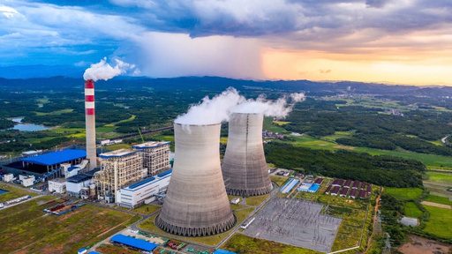
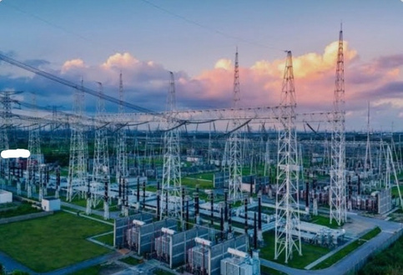
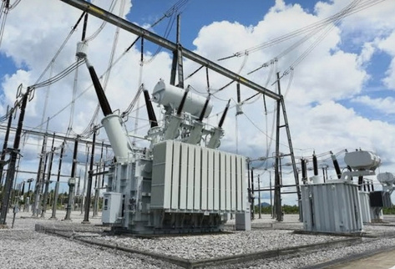


TEAM
BUGLORDS
DOMAIN PROBLEM IN OUR WORDS
A hospital and a shop lose power the same way. It shouldn’t be
01
Problem
04
Why now
When power is short, feeders are cut blindly, with no thought for who needs it most.
Heatwaves, peak loads and variable renewables are causing more shortages.
03
Our fix
Predict each tier’s demand from IoT data, then share the limited power supply by priority.
02
Result
05
Why it’s possible
Hospitals and water supply lose power the same way as shops.
Smart meters now give real-time data.
2
Genesis Ideathon

Slide 3
TEAM
BUGLORDS
WHO IS AFFECTED?
Everyone is hit by a power cut, but not equally.
  Must never lose power: hospitals, water supply, emergency services, telecom towers,etc,.
  Need extra care: patients on oxygen or dialysis, the elderly,etc,.
  Can handle a short cut: homes, shops, offices, factories,etc,.
  Hit hardest by blind cuts: people who depend on power for health and safety, not just comfort.
  Utilities and government: get fairer load shedding, fewer complaints and better planning.
  Who gains: patients and citizens stay safe, and the economy loses less.
TIER 1 | CRITICAL
Hospitals, Water supply, Emergency services
TIER 2 | COMMERCIAL
Shops, Offices, Factories, Food storage
TIER 3 | DOMESTIC
Homes, Schools, Parks
3
Genesis Ideathon
3
Notes:
3

Slide 4



CURRENT SITUATION & CONTEXT
TEAM
BUGLORDS
A critical user on a shared feeder can still lose power, and a non-critical user on a protected feeder keeps it
Shortages are handled by load shedding
Blunt on/off cuts.
Shortages are handled reactively, with little priority or advance notice
Current workflow, step by step:
Priority is fixed and manual
STEP 1
Shortfall is noticed by the grid operator
STEP 2
Cuts follow fixed feeder lists or rotation
STEP 3
Consumers get little or no advance notice
STEP 4
Power returns when supply recovers
Decision is geographic, not need-based.
Genesis Ideathon
4
Notes:
4

Slide 5
KEY CHALLENGES
TEAM
BUGLORDS
Blind cuts put critical services at risk and erodeS THE public trust
Main difficulties
  Blanket cuts ignore how critical each load is
  Demand is uncertain, so decisions come late
  The same areas are cut again and again
Root causes
  Planning is reactive, not predictive
  No tier-wise view of demand
  Priority rules are not enforced by software
If left unsolved
  Risk to patients and essential services
  Economic and industrial losses
  Public frustration and loss of trust
OUR SOLUTION AND KEY FEATURES WE PROVIDE TO SOLVE THE CHALLEngeS :
Prioritizing Important Areas Instead of giving the current supply to all areas alternatively
Anomaly detection & Fault prediction
Real-time forecast correction
Genesis Ideathon
5
Notes:
5

Slide 6
TEAM
BUGLORDS
EXISTING SOLUTIONS / APPROACHES
Existing approaches help a little, but none forecasts and prioritises together
Existing approach | Where it fails
Rotational / scheduled load shedding | Fixed schedules are ignoring real demands, and how critical each consumer is
Dedicated priority feeders | Static and limited to a few consumers; costly to extend; not adaptive
Diesel generators and UPS backup | Expensive, polluting, limited duration; only for those who can afford it
Peak-demand pricing programs | No guarantee of reduction of power at the critical moment like peak hours
The gap: no system combines demand forecasting, tiered priority bands and fair rotation in real time.
Genesis Ideathon
6
Notes:
6

Slide 7
TEAM
BUGLORDS
PROBLEM INSIGHTS & OPPORTUNITY AREAS
Resources required to solve the problem
Hardware
  IoT smart meters, current and voltage sensors (ESP32-class)
  Edge gateways
  Smart switches / relays for remote control
  LoRa, NB-IoT or GSM modules
Other resources
  Weather and calendar data
  Utility policy for tiers and bands
  Embedded, ML and web developers
  A utility or campus partner for a pilot
Software
  SQLite (prototype) to (PostgreSQL/InfluxDB (time-series)
  MQTT protocol
  Python, scikit-learn (Random Forest / Gradient Boosting); LSTM or Prophet for advanced versions
  Python rule-based engine with tier minimums and maximums
  Streamlit + Plotly
  Pandas, NumPy
  GitHub, Streamlit Community Cloud
Genesis Ideathon
7
Notes:
7

Slide 8
TEAM
BUGLORDS
INITIAL DIRECTION & EXPECTED OUTCOME
Forecast demand, protect critical loads, share the shortage fairly
  What we will do: forecast tier-wise demand from IoT data and allocate limited supply using minimum and maximum priority bands.
  What we will improve: replace blanket load shedding with predictive, fair, explainable allocation, with anomaly detection and advance alerts.
  Success looks like: Tier 1 always gets at least 90% of its demand, cuts are rotated fairly, and operators see why each decision was made.
Tier (example at 6 PM) | Forecast demand | Band | Allocated | % of demand met
Tier 1: critical | 1000 kW | 90-100% | 1000 kW | 100%
Tier 2 commercial | 500 kW | 40-90% | 300 kW | 60%
Tier 3: Domestic | 500 kW | 40-60% | 200 kW | 40%
Total (supply 1500 kW) | 2000 kW |  | 1500 kW
Genesis Ideathon
8
Notes:
8

