Slide 1

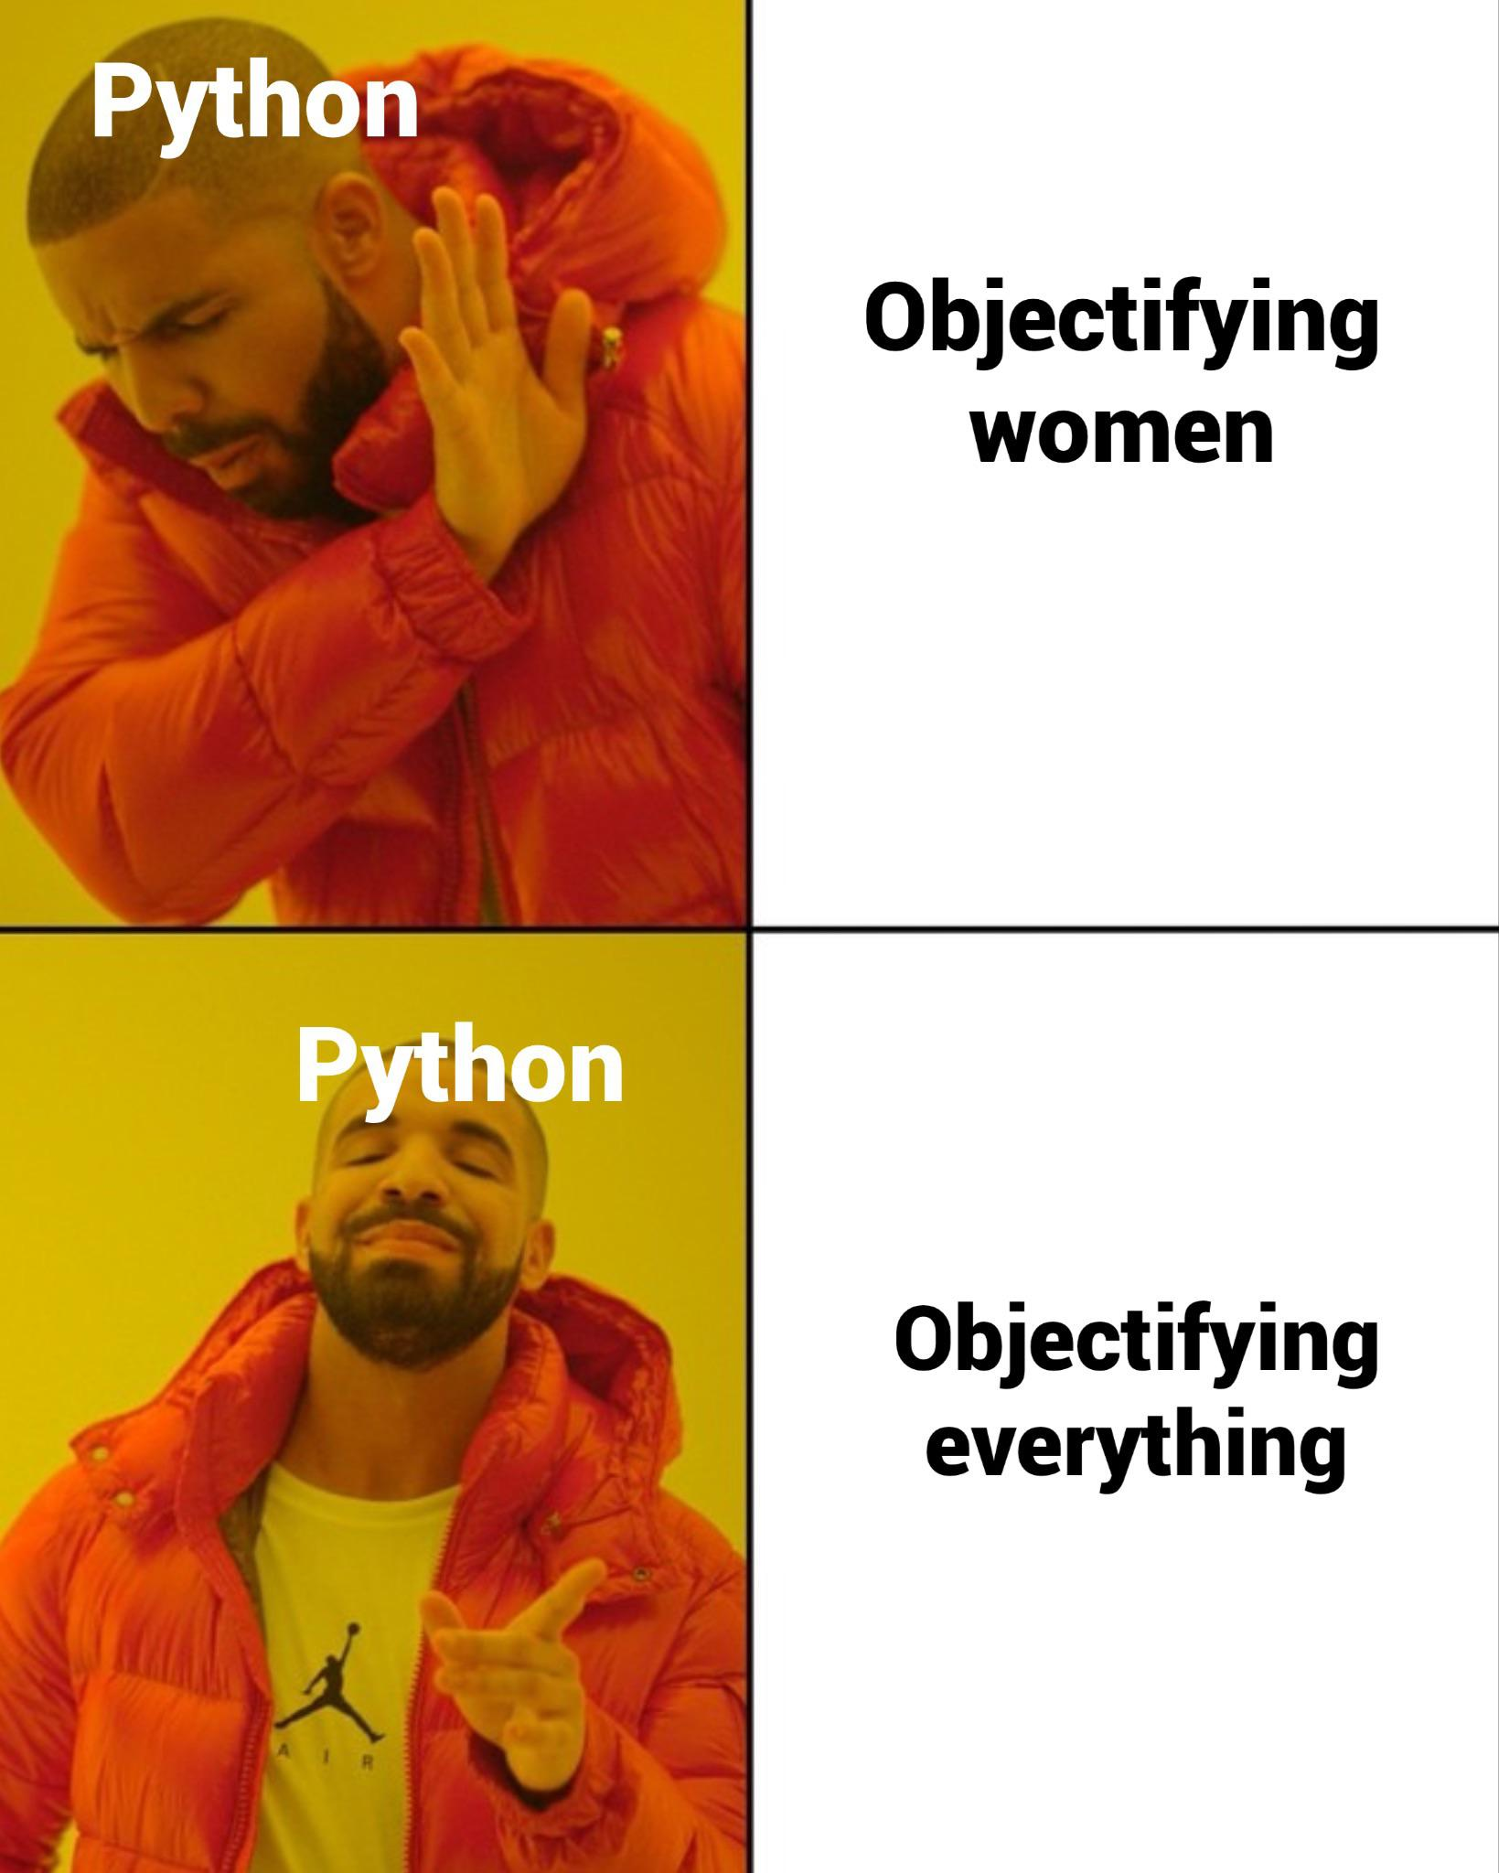
Mod 6 - Libraries and classes
OOP
Classes and objects
Methods vs Functions
import
Libraries and modules
Notes:
If everything is an object, how are objects created?

Slide 2
Functions VS Methods
A function is a piece of code that is called by name. Data are explicitly passed.
A method is a piece of code that is called by a name that is associated with an object.
In most respects it is identical to a function except for two key differences:
A method is implicitly passed the object on which it was called.
A method is able to operate on data that is contained within the class (remembering that an object is an instance of a class - the class is the definition, the object is an instance of that data).
Notes:
When we talked about list and dictionaries, we mentioned their methods. Methods works like functions and they have a very similar syntax but they are associated with an object.
For example, List methods only works with list because they are functions built specifically to work with that specific data structure.
This is possible because methods are part of a class and their behaviour is defined by the class itself. Lists as well are generated by a specific class (you can see that using the type() function) and the list class is the one defining the behaviour of a list.
Key differences between functions and methods are:
Context: functions are standalone blocks of code, while methods are associated with objects and defined with classes.
Invocation: functions are called by name, methods are called on objects using the dot notation.
First Parameter: functions can take any number of parameters, while methods have ‘self’ as the first parameter, referring to the instance of the object.
Organisation: functions can be organised in modules or as standalone entities, while methods are organised within classes and contribute to defining the behaviour of those classes.
In this module we will understand how classes work.

Slide 3
Classes
Classes are blueprint to create objects.
Think of it as an “object-factory” that contains collection of functions:
to access those functions, you need the class to give you an object (class instance).
Because the object is an instance of the class, it will give you access to all the functions collected inside the class.
Ex
numbers = [1, 2, 3, 4] this list is an instance of the class <list>
append() is a method (function) of the class <list>, therefore is available to be used with the list I just created:
numbers.append(5) will add the number 5 to my list of numbers
Notes:
A class is a blueprint or template that defines the attributes and behaviours common to all objects of that type.
Objects are created based on these class definitions and represent real-world entities with specific characteristics and behaviors.
A class is a user defined data-type that defines a blueprint for creating objects. Data (attributes) and behaviours (methods) that are common to all objects are encapsulated.
So the class defines what are the properties of the objects and what each objects can do.
For example, a graphics program will have objects such as circle, square, menu. An online shopping system will have objects such as shopping cart, customer, product. The shopping system will support behaviors such as place order, make payment, and offer discount.

Slide 4
Dunder methods
These methods are used to define various behaviours of objects. They are invoked implicitly by the Python interpreter in response to certain operations on objects.
__init__ : constructor method, called when an object is created
__str__ : returns a human readable string representation of the object
__getitem__ and __setitem__ : define the behaviour for indexing and item assignment.
__iter__ : implement and iterable object
By implementing these methods in your classes, you can customize the behavior of your objects in response to various operations, making your classes more powerful and flexible.

Slide 5
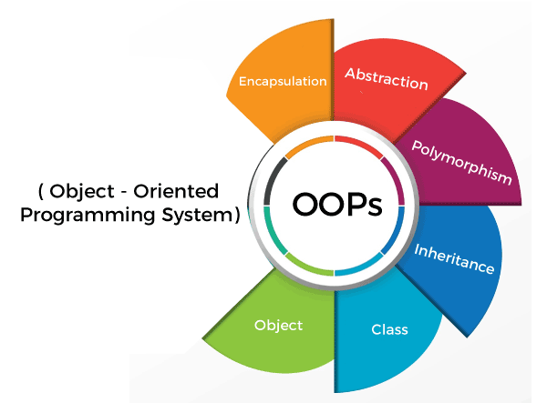
Object Oriented Programming - OOP
Object Oriented Programming is a programming paradigm that uses objects, which are instances of classes, to design and organise code.
Many feature of Python are built around the principles of OOP.
By following these principles, you can create code that is modular, extensible, and easy to maintain and understand.
Notes:
The main principles of OOP are often summarized using the following concepts:
Encapsulation: is the bundling of data (attributes) and methods (functions) that operate on the data into a single unit, known as a class.
It hides the internal details of an object and exposes only what is necessary. This helps in reducing complexity and makes the code more modular and maintainable.
Polymorphism: Polymorphism allows objects of different types to be treated as objects of a common type. It can be achieved through method overloading and method overriding.
It provides flexibility in method implementation, allowing a single interface to represent different types of objects. This promotes code extensibility and adaptability.
Abstraction: Abstraction involves simplifying complex systems by modeling classes based on the essential properties and behaviors relevant to the problem domain.
Abstraction provides a clear separation between what an object does and how it achieves its functionality.
Inheritance: Inheritance is a mechanism by which a class can inherit the properties and behaviors (attributes and methods) of another class.
It promotes code reuse by allowing a new class to use the characteristics of an existing class. It establishes a relationship between a base class (parent) and a derived class (child).
More about this here:
Object-Oriented Programming (OOP) in Python 3 – Real Python
An important distinction in programming languages is the difference between an object-oriented language and an object-based language.
A language is usually considered object-based if it includes the basic capabilities for an object: identity, properties, and attributes.
A language is considered object-oriented if it is object-based and also has the capability of polymorphism, inheritance, encapsulation, and, possibly, composition.

Slide 6
OOP vs Procedural
Code organisation
OOP - Code is organised around objects (instances of a class)
Procedural - Code is organised around procedures or routines
Data and Functions
O - encapsulation is a key principle, objects hide their internal details
P - data and functions are separate entities, data often declared globally or explicitly passed to functions.
Reuse and modularity
O - Inheritance promotes code reuse.
P - Functions are typically standalone and might not be easily reusable
Focus
O - Focus on modelling real-world entities as objects and their interactions.
P - Focuses on procedures or routines that manipulate data.
Notes:
Until now, the way you have been building your script can be considered “procedural”.
Procedural programming, as the name suggests, follows procedures (routines and subroutines), a sequence of instructions to be carried out. These instructions are grouped in functions and called when needed.
In procedural programming, data and operations on the data are separate, and this methodology requires sending data to methods. Object-oriented programming places data and the operations that pertain to them in an object. This
approach solves many of the problems inherent in procedural programming.
OOP is based on the concept of objects, which contain data in the form of attributes and code in the form of methods. Python is a class based object-oriented programming language, meaning that objects are instances of classes, which also determine their types.
The object-oriented programming approach organises programs in a way that mirrors the real world, in which all objects are associated with both attributes and activities. Using objects improves software reusability and makes programs easier to develop and easier to maintain. Programming in Python involves thinking in terms of objects; a Python program can be viewed as a collection of cooperating objects.
REMEMBER: functions do specific things, classes are specific things

Slide 7
Python - Libraries
Libraries are a collection of precompiled codes that can be used later on in a program for some specific well-defined operations.
Modular components of code that can be imported into your Python code are referred to as modules. Modules are packaged into zip archives known as packages, along with metadata, installation parameters, test code, etc.
Libraries contains many modules. A module is basically a single purpose library.
Notes:
The Python Standard Library — Python 3.12.0 documentation

Slide 8
Common python’s module/libraries:
Python JSON library: built-in package that makes easy parse, handle and visualise JSON files.
Python boto3 SDK: boto3 is the name of the Python SDK for AWS. It allows you to directly create, update, and delete AWS resources from your Python scripts.
Python CSV module: provides functionality to both read from and write to CSV files.
Python IO module: This module is quite useful when you want to perform file-related I/O operations (eg. file reading/writing).
Python OS module: provides functions for interacting with the OS.
Python standard library: collection of packages that come already installed with Python.
Notes:
Python Module Index — Python 3.12.0 documentation

Slide 9
Installing external libraries
Sometimes what you need is not included in the python standard library and you have to install an external library.
To do that, you can use a python package manager called pip
pip comes already installed with Python and allows you to install most of the libraries simply typing pip install name_of_the_library directly from the terminal.
Packages can be also installed directly from the IDE.
Notes:
The packages that you can install with pip are listed here: https://pypi.python.org/pypi

Slide 10
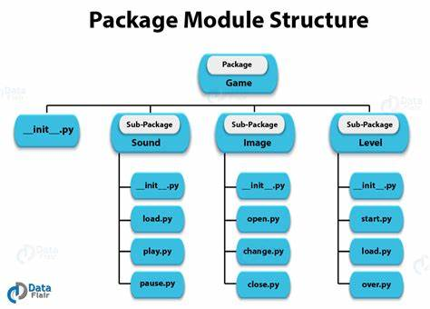
Creating and importing custom modules
When your script contains a lot of functions (or classes), you might want to start separating it in modules.
Each module can contain functions that are task-related.
Modules are stored in separate folder, each class in a separate file.
Notes:
Structuring your code is essential because it reduces the effort required to maintain and extend it. It ensures that new developers can quickly get up to speed with a project and its internals.
Structuring your code is, ultimately, about making you more efficient.
The most useful code structuring tools are simply files and folders. Dividing your programs into (appropriately named) files and folders helps with discoverability.
Generally speaking, you want each class in a separate file, and that file to be named the same as the class. If that isn’t feasible or desirable, put a group of logically connected classes in the same file with an appropriate name.
It is also important that classes, functions/methods, and variables are all named logically. The names should tell a story.
A module is the executable code and the class/function definitions contained within a single Python file. At the same time, a package is a collection of modules that are logically grouped in a directory that share a configuration file (_init__.py).
__init__.py is a special Python file that is used to indicate that the directory it is in should be treated as a Python package.
For more information about the __init__.py file, check the documentation here:
5. The import system — Python 3.12.0 documentation

Slide 11
Homeworks 1/2
Design a class called Rectangle to represent a rectangle. The class contain:
Two data field named width and height
A constructor that creates a rectangle with the specified width and height. The default values are 1 and 2 respectively.
A method named getArea() that returns the area of this rectangle
A method named getPerimeter() that returns the perimeter
Creates multiple instances of the class and test the methods.

Slide 12
Homeworks 2/2
Design a class called Atm to represent a working ATM machine.
Feel free to add as many data field and method as you like, but the minimum requirements are:
The ATM machine shows your balance after each operation.
Calling the method getMoney() I can withdraw some money.
Calling the method depositMoney() I can put money back into my account.

Slide 13
Practice
Take some of the script you have already written and try to “convert” them in classes.
Practice with saving functions and/or classes in a separate file and import them in your script as an external module.

