Slide 1

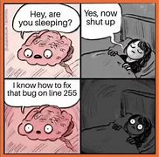
Mod 4 - Data structures
Tuple
Sets
Lists
Dictionaries

Slide 2
Data structures (built-in) - Python
A data structure is a way to organise, manage and store data in a structure that helps to make data access more efficient.
Concepts:
Mutable/Immutable: some structures can be changed after creation, meaning you can access elements inside the structure and change their values.
Ordered/Unordered: in ordered structures, elements are stored in specific ordered, meaning that no matter how many times you loop through them, the order doesn’t change.
Storing any data type: in Python, data structures can hold any data types, other objects and you can nest data types inside. You can mix and match.
Sequences: allows indexing and slicing.
Notes:
Data structures are helpful in organising and manipulate data efficiently. The four main data structures comes already with features and properties.
Mutable vs immutable: some data structures can be changed after creation. In mutable data structures, the elements or contents can be modified (added, removed, changed). In immutable structures, data cannot be changed after creation. To make changes, a new structures has to be created. Immutable data structures are useful to guarantee predictability, making sure that once a structure is created, it won’t be changed inadvertently. String are another example of immutable structure.
Ordered vs unordered: in ordered data structures, elements are stored in specific order and this order is maintained when you iterate over or access the elements. If you iterate through an unordered data structure, the order of elements may not be the one you expect. Dictionaries are now ordered since version 3.6
Duplicates: Sets don’t allow duplicates, only storing unique elements. Duplicated elements will not be included in the set.

Slide 3
Comparison
List [ … ]
Ordered
Mutable
Allows duplicates
Dictionary { … }
Ordered - v3.6
Mutable
Key must be unique
Tuple ( … )
Ordered
Immutable
Allows duplicates
Set { … }
Unordered
Mutable
Doesn’t allow duplicates

Slide 4
Data structures (built-in) - Python
Quick overview
List: stores multiple items of different data types in sequential manner. Data are accessed using indexes.
Dictionary: stores data in key-value pairs. Data are accessed by key.
Tuple: like lists, stores multiple items in one variable but they are immutable.
Set: collection of unordered, unique elements.
Notes:
Lists are the most widely used data structure, making them a general purpose tool. They are similar to arrays in other programming languages and they can grow and shrink in size when needed.
They are a sequence type of structure and they are sortable.
Sets are designed to store a collection of unique items, potentially of mixed data types, in a single variable. Note that while a Python set itself is mutable, its items must be immutable data types, like integers, floats, tuples or strings.
The main applications of sets include the following:
Removing duplicates
Checking set membership
Performing mathematical set operations like union, intersection, difference, and symmetric difference.
Sets have faster access compared to lists.
Tuples, being immutable, make good dictionary keys when you need to combine more than one piece of data into your key, for instance if each key is a set of coordinates. Tuples are used as well whenever you want to return multiple results from a function.
Tuples are also faster than lists:
performance - Why is tuple faster than list in Python? - Stack Overflow
Dictionaries store data in key-value pairs so they are similar to associative arrays in other languages (like Java HashMap). Dictionaries are very useful to store data that can be associated to each other.
Lists are similar to array implementations in other programming languages, Dictionaries are implemented as hash tables.
The different implementation produces a difference in the lookup speed making dictionaries significantly faster than lists.
Hash tables are made up of hash functions, which map data of any length to a fixed-length value (hashes). It doesn’t matter what your input is (10, 1000, or 10000); the result will always be a predetermined, fixed-length hash. Since the same string will always produce an exact hash, they’re incredibly fast to compute, especially compared to lists, as seen in our previous example.

Slide 5
Lists
A list is a mutable data structure used to store multiple items in a single variable. Items can be of a different data type.
Ex
my_list = [1, 2, 3, ‘hello’]
Lists are sequence type, making them accessible by index. Are also mutable and allow duplicates.
You can create lists with square brackets [ ] or using the function list().

Slide 6
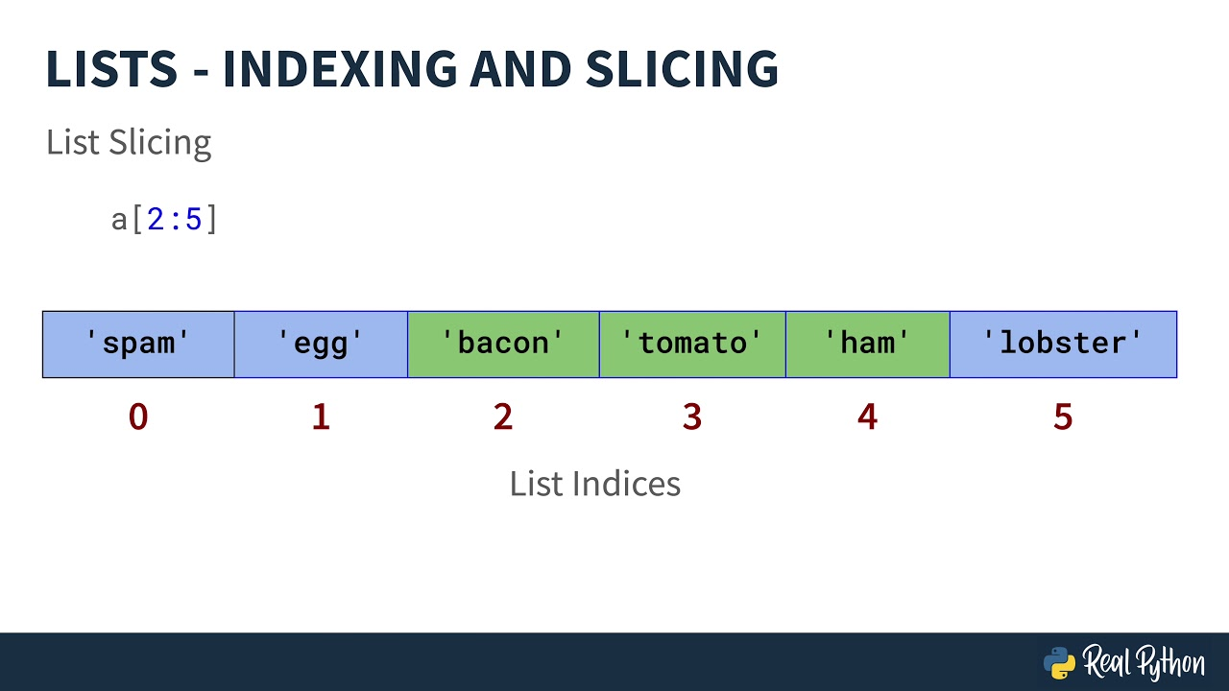

Slide 7
Lists comprehension
List comprehension offer a shorter syntax for creating a new list from an existing list.
Syntax
newlist = [expression for item in iterable if condition == True]
Remember: list comprehension makes your code shorter and more “Pythonic”, but the extensive use of short syntax might affect readability.
Notes:
List comprehension are often defined as “syntactic sugar” (a syntax change which makes coding easier).
They allow you to condense the code needed for creating a new list, especially when conditions and filtering are applied. Instead of using a for loop in multiple lines, you can condense everything in one line.
It also avoid having to use the append() method.
List comprehension are useful with things like unwrapping a matrix into a vector, filtering lists etc, and overall improving the performance against for loops.
Check this link for more details about everything you can do with list comprehension:
List Comprehension in Python Explained for Beginners (freecodecamp.org)

Slide 8
Lists methods
append() Adds an element at the end of the list
clear() Removes all the elements from the list
copy() Returns a copy of the list
count() Returns the number of elements with the specified value
extend() Add the element of a list, to the end of the current list
index() Returns the index of the first element with the specified value
insert() Adds an element at the specified position
pop() Removes the element at the specified position
remove() Remove the item with the specified value
reverse() Reverses the order of the list
sort() Sorts the list

Slide 9
Dictionaries
A dictionary is a mutable data structure for storing a group of key-value pairs:
Keys must be unique and each key has a single associated value.
General concept: mapping keys to values.
Ex
mydict = {
"brand": "Ford",
"model": "Mustang",
"year": 1964
}
You can use the empty { } or the dict() function.
Notes:
Unlike sequences, which are indexed by a range of numbers, dictionaries are indexed by key.
Keys can be of any immutable type (strings and numbers can always be keys). Tuples can be used as keys if they contain only strings, numbers or tuples.
If a tuple contains any mutable object, it cannot be used as a key.
You can’t use lists as keys since lists can be modified in place using index assignments.

Slide 10
Dictionaries comprehension
Like lists, dictionaries allows dictionaries comprehension:
Syntax
newdict = {newkey:newvalue for item in iterable if condition == True}

Slide 11
Dictionaries methods
clear() Removes all the elements from the dictionary
copy() Returns a copy of the dictionary
fromkeys() Returns a dictionary with the specified keys and value
get() Returns the value of the specified key
items() Returns a list containing a tuple for each key value pair
keys() Returns a list containing the dictionary's keys
pop() Removes the element with the specified key
popitem() Removes the last inserted key-value pair
setdefault() Returns the value of the specified key. If the key doesn’t exist: insert the key, with the specified value
update() Updates the dictionary with the specified key-value pairs
values() Returns a list of all the values in the dictionary

Slide 12
Exercises
Take all the letters of a given string and split each character into a list.
Given the following list of numbers, remove all occurrences of item 20
list1 = [5, 20, 15, 20, 25, 50, 20]
3 )Given a dictionary, calculate the sum of all items.

Slide 13
Tuple
A tuple is a sequence data type, consisting of a number of values separated by commas.
Ex
my_tuple = 12345, 54321, ‘hello’
Tuples allows slicing and indexing, but they are immutable.
You can create tuples using:
Empty parentheses: my_tuple = ()
Using the tuple() function: my_tuple = tuple()
Notes:
Though tuples may seem similar to lists, they are often used in different situations and for different purposes.
Tuples are immutable, and usually contain a heterogeneous sequence of elements that are accessed via unpacking or indexing.
Lists are mutable, and their elements are usually homogeneous and are accessed by iterating over the list.

Slide 14
Sets
Sets are unordered collection with no duplicate elements.
my_set = {1, 2, 3}
If duplicates are included when creating a set, they will be automatically removed.
Sets are unordered and they can’t be accessed by index. To access data in a set you will have to loop through it. They are mutable using built-in methods.
To create a set, you can’t use the empty parentheses { } (it will create a dictionary).
You can use the set() function.
Notes:
As mentioned before, sets are normally used for membership testing and eliminating duplicate entries. Sets also support mathematical operations like union, intersection, difference, and symmetric difference:
Union: the union of two sets returns a new set of all the unique items for both sets.
Intersection: the intersection returns a new set of the items common to both sets.
Difference: the difference returns a new set containing all the items from the first set that are absent in the second set (in the case of more than two sets, the operation is performed from left to right)
Symmetric Difference: returns a new set of items present in either the first or second set, but not both.
Check this link for more info about sets:
https://www.dataquest.io/blog/tutorial-everything-you-need-to-know-about-python-sets/

Slide 15
Mod 4 Homeworks 1/2
Rock paper scissors.
Write a program that plays the game of rock, paper, scissors.
Input example:
Choose between ‘rock’, ‘paper’, ‘scissors’
Output example:
Player choice: rock
Computer choice: paper
Computer wins!
Requirements:
The program must ensure the user only insert accepted values. If a wrong value is inserted, a message should be returned and the user should be asked to insert a value again.
The computer must choose rock, paper or scissors randomly. Hint: check the random library.

Slide 16
Mod 4 Homeworks 2/2
Create a program based on the binary search algorithm.
The program should take a list as the number to be found in such list as inputs and returns the index with the position of such number in the (sorted) list.
Ex lst = [0, 34, 56, 2, 4, 9, 78]
num = 56
Output:
“The number 56 is included in the list in position 5”

Slide 17
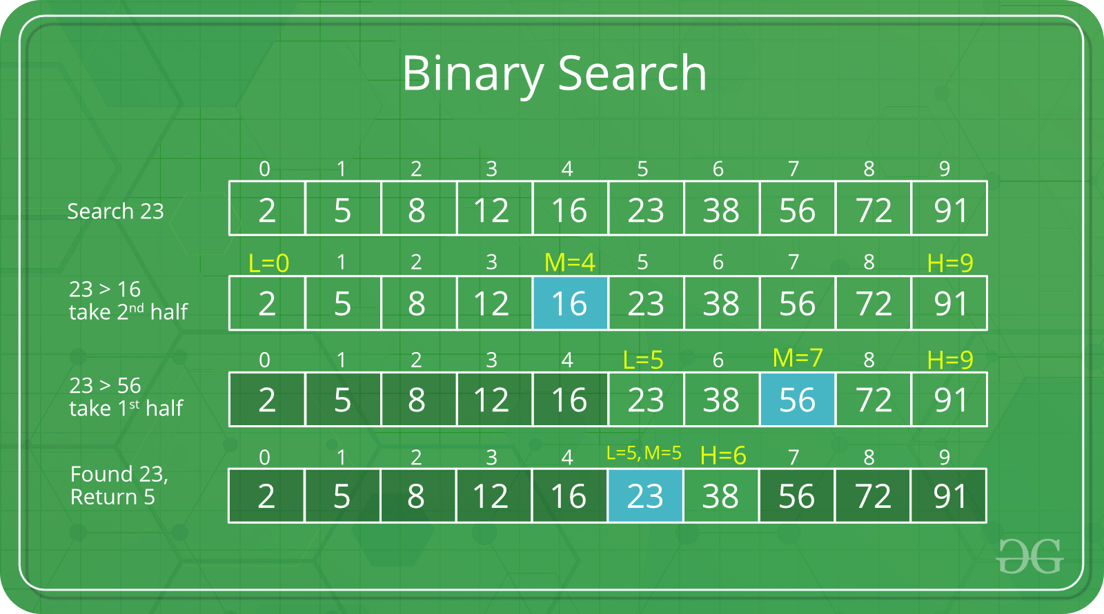
Mod 4 Homeworks 2/2

