Slide 1


Mod 5 - Functions
What is a function
Built-in functions
Defining functions
Scope
Recursion

Slide 2
Functions: definition
Functions are reusable chunks of code that contains instructions used to create the output from it’s input.
A group of related statements that performs a specific task.
Functions can simply perform a task, return an output or both.
INPUT
FUNCTION
OUTPUT
Notes:
One of the golden rule of coding is to reuse block of code when possible.
If you find yourself writing the same line(s) of code multiple time, there is a very good chance that block of code can be made into a function.
Functions are created to group lines of code that perform a specific task. You have already encounter built-in functions and you have been used them in the same fashion: every time you want to print something on screen, you used the print() function.
This function is built to perform specific instructions allowing you to print on screen. These instructions are hidden from you, but everytime you need that specific functionality, you just call the function instead.
In this module we will see how we can build our own functions.

Slide 3
User-defined functions
A function can be defined using the def keyword as follow:
def name_of_the_function():
code to execute
return value returned by the function
Remember: function must be called to be executed. To call a function you just need the following syntax:
name_of_the_function()
Notes:
Programming languages allow you to create your own functions.
This is very useful when you have a task being performed multiple times, avoiding the necessity to write the same line of code over and over again.
To “define” a new function in Python, you can use the keyword def, followed by the name of the function (commonly lowercase).
The indented block of code is now part of the function and gets executed only when the function is invoked (or “called”).
The return keyword allow the function to return an output, exactly like any of the built-in functions you are familiar with which returns a value.

Slide 4
What a function can do:
Functions can either:
Simply execute some code
Execute some code and return a value
Call another function

Slide 5
Why are they useful?
Abstraction and reusability: a useful block of code can now be represented with a single function and reused everywhere.
Easier code management: the code is in one place.
Flexible: provide proper argument values each time is used.
Modularity: allows complex process to be broken into smaller pieces.
Namespace separation.
Notes:
Suppose you have written a very useful piece of code, something that you’re probably going to want to use again. At first you might will copy it and paste it.
But what if some variables name changes? What if you want to improve your code adding some new features, or simply some changes needs to be done to fix an issue? You now have to go and find everytime that code is being paste it and make those changes.
So, perhaps, this might not be the most efficient way to reuse code.
If your code perform a series of tasks, for example reading from a file, process some data and then write to another file. This might be too much to look at for one big block of code. Splitting each of this task into a function, would break everything down into smaller, more manageable units, improving not only readability but troubleshooting and maintenance as well.
Also, variables defined inside a function don’t interfere with other variables in other functions. This will be explained in details in another slide.

Slide 6
Built-In Functions
type() returns the type of a data
print() print message to the screen
int() change the value to an integer
float() change the value to a float
str() change the value to a string
len() returns the number of items in an object
sum() returns the sum of all items in an iterable
dict() creates a dictionary
list() creates a list
Notes:
Built-in functions are always available. They don’t need to be defined before using them.
Even if you might have been using them without knowing much about functions, you might have noticed that there are some commonality in the syntax:
Each function terminates with parentheses ( )
When you pass an argument to these functions, you type them inside the parentheses

Slide 7
Function’s arguments and parameters 1/2
We can define functions that accepts some data to be processed inside and then returned.
A function must be called with the correct number of argument:
If 2 arguments are expected, 2 arguments must be passed
Default values can be set to ensure that if no arguments are passed, the default value will be used
Notes:
The term “argument” and “parameters” are sometimes use to express the same thing: information that are passed into a function.
In Python, parameters are the placeholders defined in a function definition, while arguments are the actual values passed to the function when its called.
Default values are useful for providing a default behaviour or initial state for a function’s parameters. When a parameter has a default value, it becomes optional.
Some examples of what they can be used for:
Customised behaviour.
Optional arguments: users can choose to provide a value for the optional parameter or use the default if they don’t need to customise it.
Handling default or optional inputs: default values are often used when a function has many parameters, and some of them are optional or have reasonable default values.
Avoiding none checks: default values can help avoid checks for ‘None’ and provide a more concise and readable function definition.

Slide 8
Function’s arguments and parameters 2/2
If you don’t know how many arguments will be passed, you can use the *args syntax (arbitrary arguments)
Keyword arguments are also accepted. If you don’t know how many keyword arguments will be passed, you can use the arbitrary keyword arguments syntax, **kwargs
Notes:
Arbitrary arguments allow the function to accept a variable number of positional arguments. Functions become more flexible and can handle different input scenarios without having to modify the function code.
Keywords arguments allow functions to accept a variable number of keyword arguments.
It allows passing key-value pairs as arguments, facilitating the use of dictionaries.
What is the difference between passing a dictionary and using kwargs?
readability (you can simply pass keyword arguments even if they weren't explicitly defined),
flexibility (you can support some keyword arguments explicitly and the rest using **kwargs),
argument unpacking helps you avoid unexpected changes to the object "containing" the arguments

Slide 9

Using mutable objects as default values
Be careful:
The following code has an unexpected behaviour.
Notes:
When you define a function with a mutable default argument, such as a list or a dictionary, Python creates that object only once and assigns it to the parameter.
This means that every time you call the function without specifying a value for that parameter, you are actually using the same object that was created when the function was defined.
This can lead to unexpected behavior if you modify the object inside the function, because the changes will persist across different function calls.
Check this links if you want to explore further:
https://youtu.be/_JGmemuINww?si=vZG2j1uhVX61Ntgf
python - "Least Astonishment" and the Mutable Default Argument - Stack Overflow

Slide 10
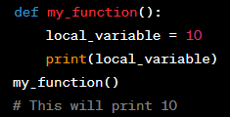
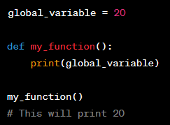
Scope
Local scope
Variables defined within a function or method have local scope. They are only accessible within that function or method.
Global scope
Variables defined at the top level of a script or module have global scope. They are accessible throughout the entire module.
Notes:
A namespace is a container that holds a set of identifiers (names) and their corresponding objects. It serves as a mapping between names and objects, allowing you to organize and manage the names used in your Python program. Namespaces help avoid naming conflicts and provide a way to encapsulate and isolate variables, functions, classes, and other objects.
The existence of multiple, distinct namespaces means several different instances of a particular name can exist simultaneously while a Python program runs. As long as each instance is in a different namespace, they’re all maintained separately and won’t interfere with one another.
But that raises a question: Suppose you refer to the name x in your code, and x exists in several namespaces. How does Python know which one you mean?
The answer lies in the concept of scope. The scope of a name is the region of a program in which that name has meaning. The interpreter determines this at runtime based on where the name definition occurs and where in the code the name is referenced.
Namespaces and Scope in Python – Real Python

Slide 11
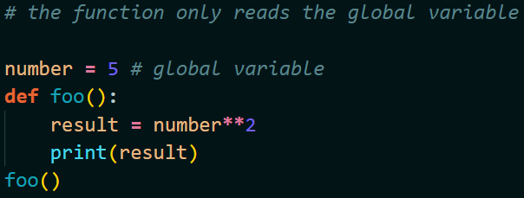
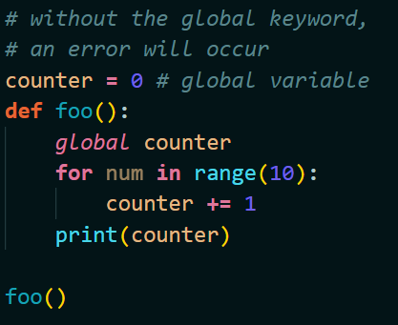
One important distinction
Reading a global variable
Global variables are globally accessible. That means they can be read and printed, as long as you are not trying to change them.
Changing a global variable
If you try to change a global variable, an error will occur. To change a global variable, you can use the global keyword.
Notes:
Python looks for the variable in the local scope first and then in the global scope.
If a variable with a given name is not found in the local scope, Python looks for it in the global scope.
However, if you try to modify the value of a global variable within a function, Python assumes that you are creating a new local variable with the same name, unless you explicitly declare the variable as global using the global keyword. This behaviour is a safety feature to avoid accidental modification of global variables.
Python follows the LEGB rule (Local, Enclosing, Global, Built-in):
This rule defines the order in which Python looks for variable names when they are referenced in code.
Local: This is the innermost scope, which represents the current function or block of code. When you reference a variable inside a function or a block, Python first looks for it in the local scope.
Enclosing: This refers to the scope of the enclosing function. If a function is defined inside another function, the inner function has access to variables in both its local scope and the enclosing function scope.
Global: This is the global scope, which includes variables defined at the top level of a module or script. If a variable is not found in the local or enclosing scopes, Python looks for it in the global scope.
Built-in: This is the outermost scope and includes Python's built-in names like print, len, int, etc. If a variable is not found in any of the above scopes, Python finally looks for it in the built-in scope.
It's important to note that the search stops as soon as the variable is found in one of the scopes. If the variable is not found in any scope, Python raises a NameError.

Slide 12
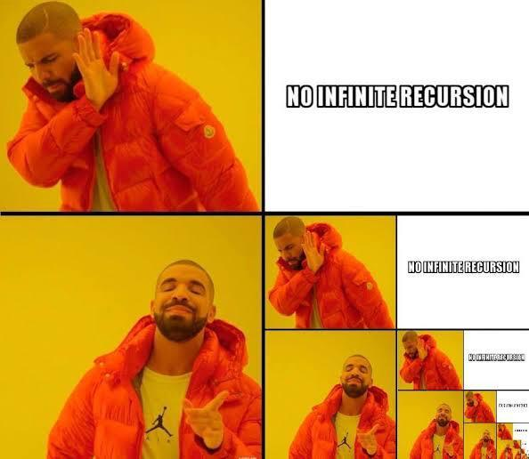
Recursion

Slide 13
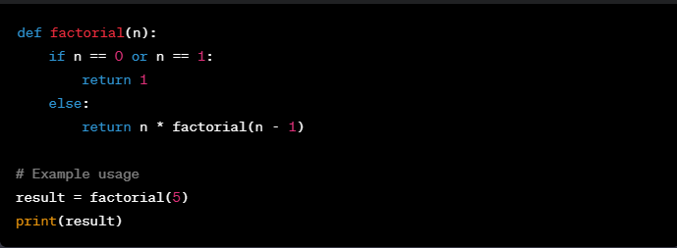
Recursion
Recursion is a programming concept where a function calls itself in its own definition.
Here’s a classic example of an algorithm easily implemented using recursion.

Slide 14
Recursion
PRO
Splits complicate functions into smaller sub-problems
Sequence creation is simpler through recursion than utilizing nested iteration
Recursive functions render the code look simple, elegant and effective
CONS
Memory and time expensive
Challenging to debug
Sometimes difficult to grasp
Notes:
When should we use recursion? Here’s some cases:
When the problem can be broken down into smaller sub-problems: Recursion is particularly useful when a problem can be divided into smaller instances of the same problem. Each recursive call solves a smaller sub-problem.
When the problem exhibits self-similarity: If the problem structure is such that it contains smaller instances of the same problem, recursion is a natural fit. Examples include tree structures and certain mathematical problems (like the factorial).
When it leads to cleaner and more readable code: In some cases, using recursion can result in more elegant and readable code compared to iterative solutions. Recursive solutions often mirror the problem statement more closely.
However, it's important to note that recursion comes with a cost in terms of memory usage and can lead to a stack overflow if not managed properly. In Python, there is a recursion limit, and exceeding it will result in a RecursionError. Additionally, some problems can be solved more efficiently using iterative approaches.

Slide 15
Exercise / homeworks
Exercise:
Take all the scripts you have written so far and change them using functions.
Homeworks:
Write one working example for each of this function cases:
With no parameter,
multiple parameters,
*args and **kwargs
default values and using a mutable object as default value
Function that invokes another function
A recursive function
Extra: re write the binary search program, recursively.

