Slide 1

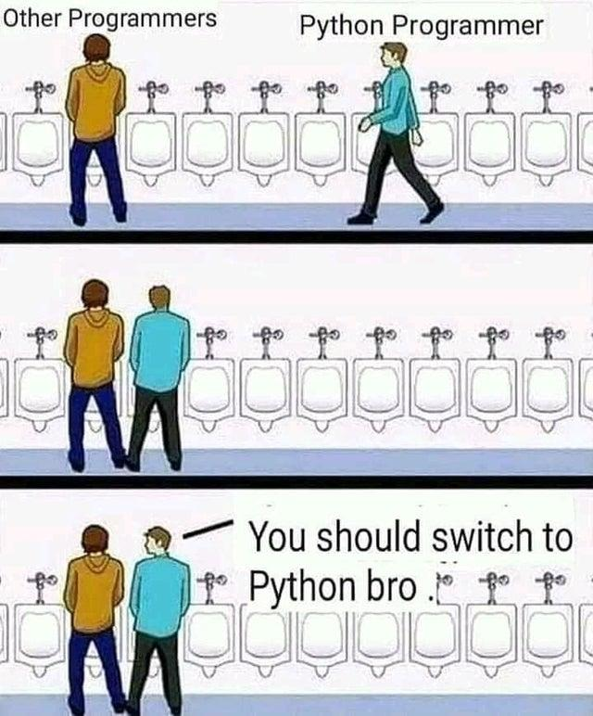
Python Course

Slide 2
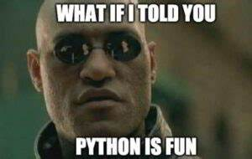
Course Overview
Mod 1 - Introduction and basic syntax
Mod 2 - Flow control
Mod 3 - String manipulation
Mod 4 - Data structures
Mod 5 - Functions
Mod 6 - Libraries and Classes
Mod 7 - AWS SDK + Lambda function
Mod 8 - Final project

Slide 3
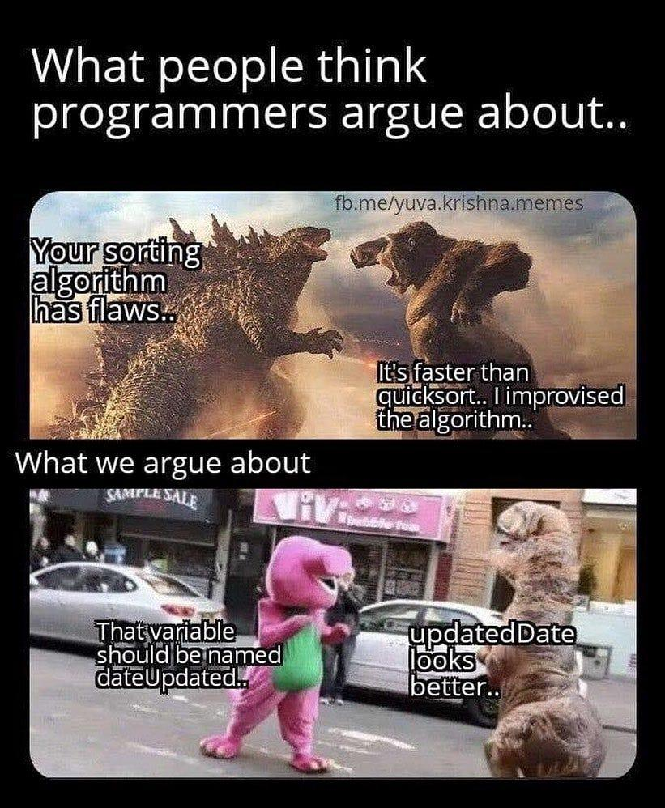
Mod 1 - Introduction and basic syntax
Why coding? Why Python?
IDE and resources
Operators
Variables
Data types

Slide 4
Poll question
What is your level of coding knowledge?
A - I never code before
B - I know a little bit
C - I wrote some little programs for fun
D - I’ve code many times already

Slide 5
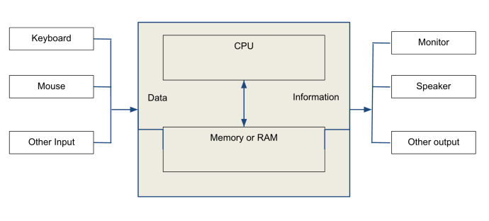
What is a computer?
“Computers are stupid, but they are always right.”
Notes:
Computers are machines designed to process and store information, or more simply, performing tasks.
The device takes some data as input, perform some operations against the data and return some information as output (or store them for later usage).
To pass data to the computer we use input peripherals, like mice, keyboards, touchscreens, microphones, webcams.
Data are then processed and new information is returned to the user via output peripherals: monitors, speakers, printers.

Slide 6
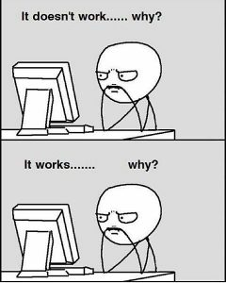
What does “coding” means?
Coding is the act of passing a list of instructions to computers to get them completing a task.
Notes:
When we write instructions to tell the computer what to do, we do it using a language the computer understand.
There are many different programming languages, all sharing a single foundation: each language follows a specific set of rules that determines how code should be written, and then uses back-end software to translate it into binary (the computer’s native language).

Slide 7
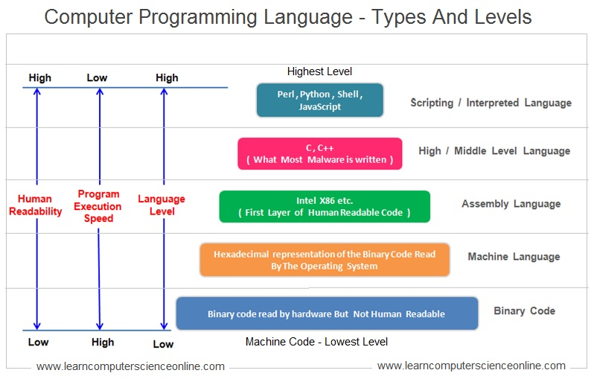
Different levels of abstraction
Notes:
Machine language: is the only language that computers can understand and receive instructions. These machine languages are often either binary or hexadecimal code.
Assembly: is the closest language to machine code. Assembly gets converted into machine code by an assembler so it can pass instructions to the computer that are low enough level for the computer to understand.
Middle level languages: some languages, previously considered high-level language, gets sometimes referred as mid-level languages because they maintain characteristics of lower level languages, such as low-level memory and hardware manipulation.
Higher level languages: often divided between high level and very high level languages (VHLL), are languages with higher level of abstraction. They offer more easy-to-read syntax and managed features.
Languages needs to be compiled or interpreted before computers can process them.
Interpreted languages: the source code is executed line by line by an interpreter. The interpreter reads each line of code, translates it into machine code or a lower level representation and the immediately executes it.
These languages usually have slower execution because code is translated and executed at runtime.
Examples: Python, Ruby, JavaScript, PHP
Compiled languages: the source code is translated into machine code or a lower-level representation by a compiler before it executed. The result is an executable binary file that can be run independently.
Execution time is generally faster because the code has been optimised during compilation.
Examples: C, C++, Rust

Slide 8
Why coding?
Problem Solving mindset:
Practice logical thinking and the ability to break down complex problems into manageable steps.
Automation:
Allows the automation of repetitive tasks (save time, reduce errors)
Low-level interaction:
Allows low level interaction with tools. Faster, more powerful interaction

Slide 9
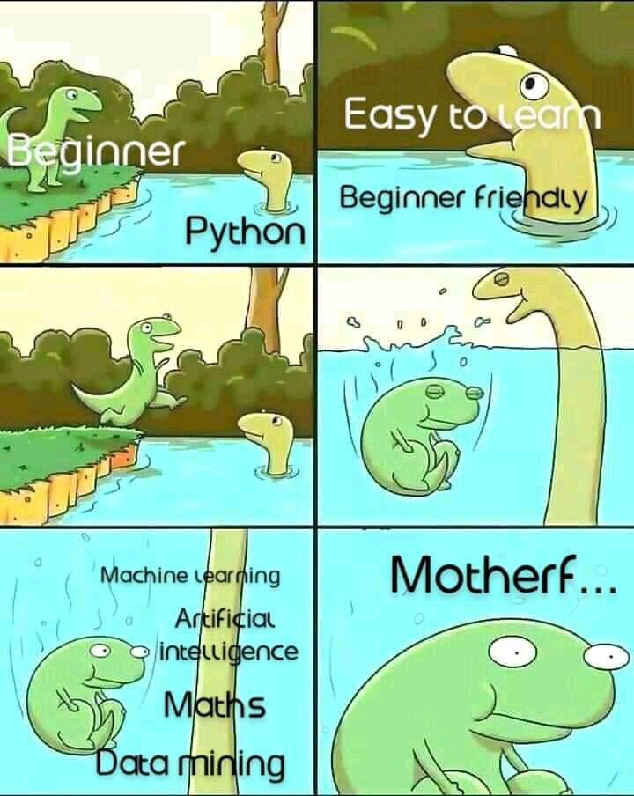
Why Python?
Versatile, high-level, object-oriented
designed to be highly extensible via modules.
Simpler, less-cluttered syntax and grammar, with English-like keywords.
Large standard library + vast selection of third-party libraries (very active community)
Python can be used for many type of development:
Web applications
Data Science
Machine Learning
Business Application
Scripting and utility software (automating tasks)

Slide 10
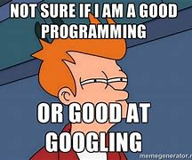
Resources
Python docs
python.org
StackOverflow
stackoverflow.com
YouTube:
Fireship, Computerphile (computer science)
Coding with Lewis, Tech With Tim, Corey Schafer (programming)
Popular tutorials platform:
W3schools, programiz, geeksforgeeks, Real Python
Notes:
3.12.0 Documentation (python.org)
Stack Overflow - Where Developers Learn, Share, & Build Careers
Python Tutorial (w3schools.com)
Learn Python Programming (programiz.com)
Python Tutorial | Learn Python Programming (geeksforgeeks.org)
Python Tutorials – Real Python

Slide 11
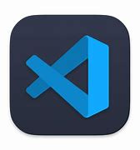
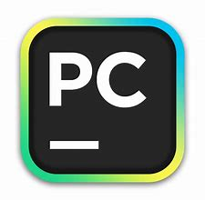

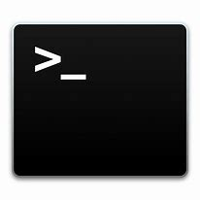

Where do I run my code?
An IDE (Integrated Development Environment) is a software application that combines all the tools in a single graphical user interface.
It can be downloaded on your computer (Visual Studio, PyCharm, Sublime) or
it can run on the cloud and be accessed via browser (Cloud9).
You can run code using your command line (CLI) as well.

Slide 12
Data Types
Data types are the classification or categorisation of data items. It represents the kind of value that tells what operations can be performed on a particular data.
Examples:
Integers (int)
Float (float)
Strings (str)
Boolean (bool)
var_name = 20 integer numbers
var_name = 20.5 floating point numbers
var_name = “hello” array of characters
var_name = True True or False, Boolean logic
Notes:
Python is strongly typed as the interpreter keeps track of all variables types.
In a weakly typed language a compiler / interpreter will sometimes change the type of a variable.
For example, in some languages (like JavaScript) you can add strings to numbers 'x' + 3 becomes 'x3'. This can be a problem because if you have made a mistake in your program, instead of raising an exception execution will continue but your variables now have wrong and unexpected values. In a strongly typed language (like Python) you can't perform operations inappropriate to the type of the object - attempting to add numbers to strings will fail. Problems like these are easier to diagnose because the exception is raised at the point where the error occurs rather than at some other, potentially far removed, place.

Slide 13
Operators
A symbol or combination of symbols that allow you to perform a specific operation.
Arithmetic operators: perform mathematical operations on numerical values
+ - * / % ** //
Comparison operators: used to compare two values
== != > < >= <=
Logical: combine or modify the result of logical expressions
and or not
Notes:
When using the ‘>’ and ‘<’ operators with strings, the lexicographical ordering will be applied.

Slide 14
Variables
A variable is an abstract storage location with an associated name: a sort of box with a label where you can save data (value) to be referenced and manipulated.
In more technical terms: the name you give to computer memory locations.
Ex:
num = 3
breakfast = “eggs”
REMEMBER: make sure the name of your variables are accurately descriptive and understandable.
Dynamic typing: no need to declare the type of the variable.
Python is case sensitive.
Notes:
You can name a variables anything as long as it obeys the following three rules:
1 - It can only be one word
2 - It can use only letters, numbers, and the underscore character
3 - It can’t begin with a number
Python allows to assign multiple data types to multiple variables, as follow:
a, b, c = 1, 2, 3

Slide 15
Operators
Assignment: assign values to variables
= += -= *= /= %= //= **= &= |= ^= >>= <<=
Identity: compare the memory location of two objects
is is not
Membership: check if a value is present in a sequence
in not in
Bitwise: perform operations on the individual bits of integers
& | ^ ~ << >>
Notes:
Example for membership operator:
x = 3
y = 4
x = y

Slide 16
Built-In Functions
type() returns the type of a data
print() print message to the screen
int() change the value to an integer
float() change the value to a float
str() change the value to a string
len() returns the number of items in an object
sum() returns the sum of all items in an iterable
dict() creates a dictionary
list() creates a list

Slide 17
Mod 1 - Homeworks
Install Python (latest version) and Visual Code
Play with variables, operators and data types
- Write your first program:
Write a program that calculates perimeter and area of a triangle.
Result must be printed on screen.
Bonus:
Can you make it dynamic? Hint: input()

Slide 18
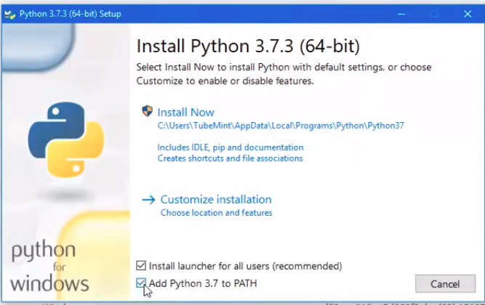
When installing Python

