Slide 1

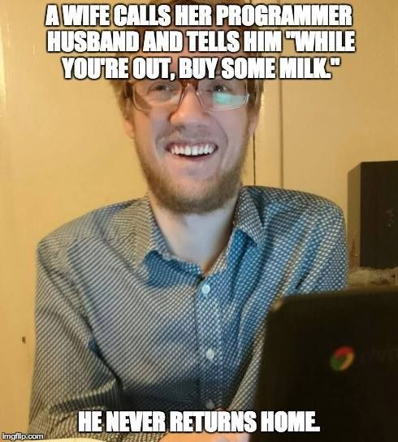
Mod 2 - Flow control
Conditions
Indentation
Loops

Slide 2
Before we start…
Have you installed Python and Visual Studio Code?
Is everything from Mod 1 clear?
Tell me about your experience with the homeworks
Remember to save everything you’ve done in the previous module, you can always come back to it and implement it further.

Slide 3
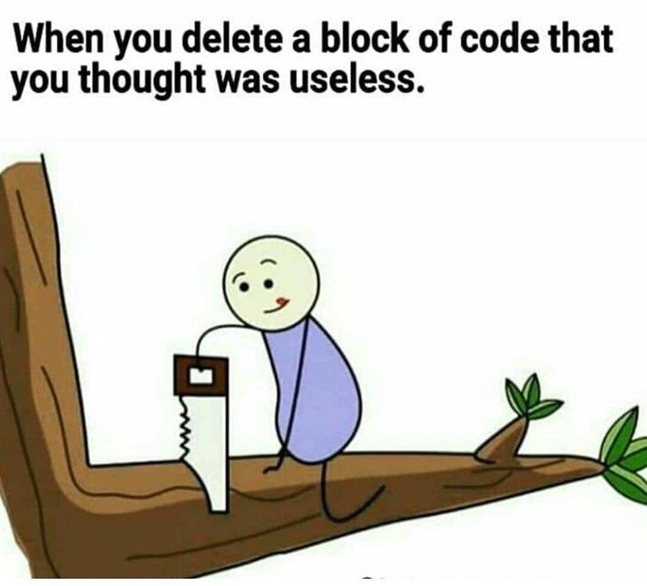
How Python runs code
Python is an interpreted language, meaning that the instructions are passed to the interpreter line by line and executed right away.
This allows more interactive programming and better debugging, but also means that you have to be careful where you declare your variables in the code.
Notes:
Interpreted languages allow for line-by-line execution, which enables more interactive programming with tools like Jupyter Notebook.
This feature also allows for better debugging experiences, as you can check the output at each step of the execution.
We will discuss debuggers and Jupyter Notebook in more detail later in the course.
It’s important to note that interpreted/compiled is not a property of the language itself, but rather how it is implemented.
Compiling is the process of translating code from one language to another, which means that some languages may have both implementations at the same time. For example, Python is considered an interpreted language, but it has a level of compilation (it’s compiled to bytecode).
For more information:
Internal working of Python - GeeksforGeeks

Slide 4
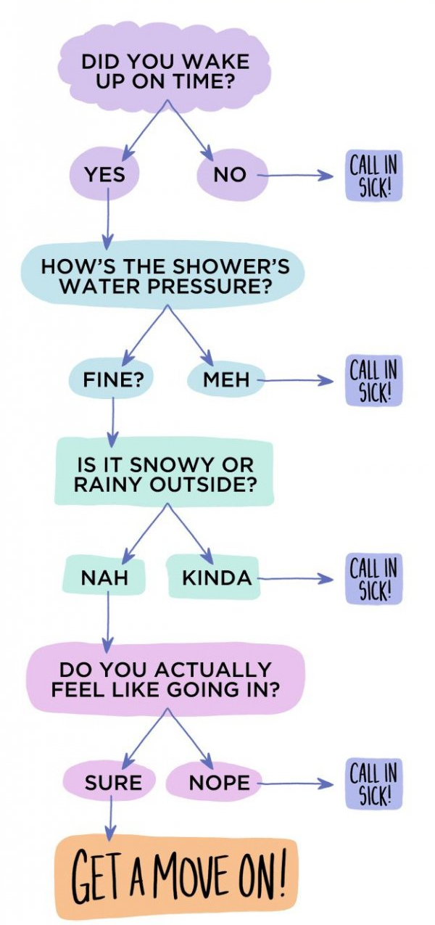
Flow in a computer program
A computer program often have to deal with many possible routes that goes from Start to Finish.
These branches represent possible different outcomes set by a specific condition.
To represent and manage all the branching naturally occurring in the flow of a program, we use a combination of
Boolean Values
Operators
Conditions
Indentation
Notes:
A program is just a series of instructions. But the real strength of programming isn’t just running (or executing) one instruction after another.
Based on how the expression evaluate, the program can decide to skip instructions, repeat them, or choose one of several instruction to run.
In fact, you almost never want your programs to start from the first line of code and simply execute every line, straight to the end.
Flow control statements can decide which Python instructions to execute under which conditions.

Slide 5
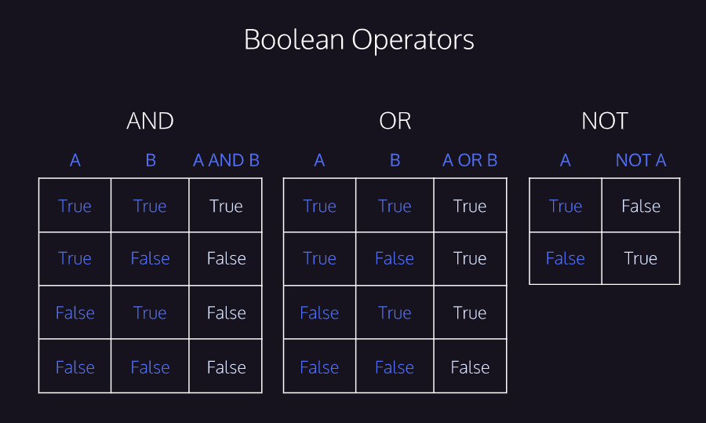
Boolean Logic

Slide 6
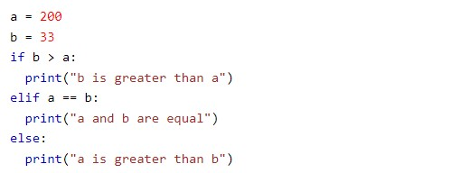
If, elif, else statement
If - elif - else are “conditional statements”.
Together with the conditions “equal/not equal” and “greater/less than” these statements allow you to control the flow of your program.

Slide 7
If statement
if name == ‘Alice”:
print(‘Hello’ + name)
Keyword + condition (expression that evaluates True or False) + colon
Indented block of code (if clause)
Notes:
Conditional statements are made of:
Keywords - if, elif, else
Condition - an expression that evaluates to either True or False
Colon - the colon character is necessary to close the condition. If not typed, it will result in a syntax error
With the use of conditional statements, we introduce the concept of indentation, discussed in the next slide.

Slide 8
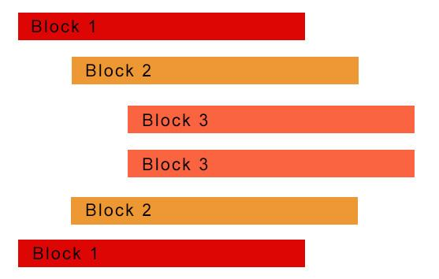
Indentation.
Indentation refers to the spaces at the beginning of a code line.
Where in other programming languages the indentation in code is for readability only, the indentation in Python is very important.
Python uses indentation to indicate a block of code.
Incorrect indentation will throw an IndentationError
Notes:
Indentation is a widely used method to structure code in many programming languages.
It is employed to enhance the readability of the code and make it easier to comprehend.
Python, on the other hand, mandates the use of indentation to define a block of code.
Failure to use proper indentation will result in an indentation error.
Guido Van Rossum, Python’s creator, has often mentioned that one of the goals of creating Python was to develop a language that is easy to read and where readability-enhancing solutions are preferred. Using indentation instead of brackets was a design decision made in this regard.
Suggested read / view:
Guido Van Rossum chat with Lex - https://youtu.be/-DVyjdw4t9I?si=thuYTRogvlPBpNyC
The Zen of Python: guiding principles for Python’s design PEP 20 – The Zen of Python | peps.python.org

Slide 9
If - if VS if - elif
With multiple if statements, your code will check all the conditions, whereas in case of an if-elif, if one condition is True, it would not check other conditions.
So if-elif-else is used when conditions are mutually exclusive.
If-if-else is used when more than one condition can be true.
Notes:
The IF statement is evaluated first:
If the condition evaluates to True, the indented block (if clause) is executed.
If the condition evaluates to False, the clause is skipped.
The ELIF statement is evaluated ONLY if the IF condition is not executed:
The IF condition evaluates to False
The ELIF condition is evaluated
If the ELIF condition evaluates to true, the indented block is executed
The ELSE statement has no condition because is used as a sort of failsafe:
If ANY of the statements before the ELSE are not executed, the block of code after the ELSE statement is executed.

Slide 10
try - except - else - finally
The try statements lets you test a block of code that you know it might throw an error.
The except statement allows you to handle the error.
The else statement includes the block of code that will be executed if there is no error.
The finally statement includes the code that will be executed regardless what happens in the try - except block.

Slide 11
exercise
Write a program that takes two numbers, checks which one is the biggest and return a message.
Output should tell the biggest number or if the numbers are equals.
Extra:
Make it dynamic.
Implement exception handling

Slide 12
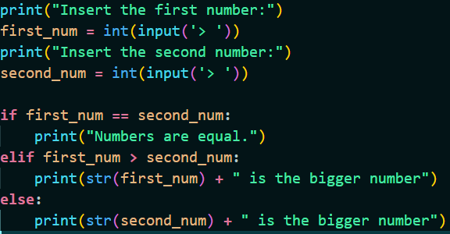
Solution A
Notes:
This solution utilise the combination of if, elif and else.
int() and str() are used to convert the user input (string) to an integer and convert it back to strings to allow string concatenation.
What if you change if, elif in if,if?
What happens and why?

Slide 13
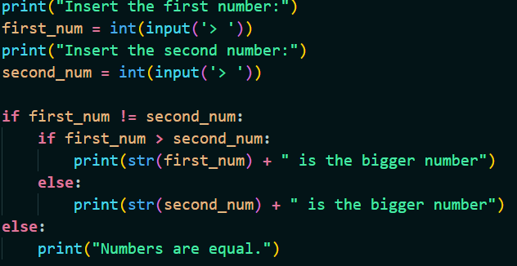
Solution B
Notes:
This solutions works, but compared to solution A requires a nested if statement.
When writing code, always try to avoid nesting when possible.
More readable solutions are always preferred because they facilitate troubleshooting and debugging, especially when working in teams where other developers might have to debug your code.

Slide 14
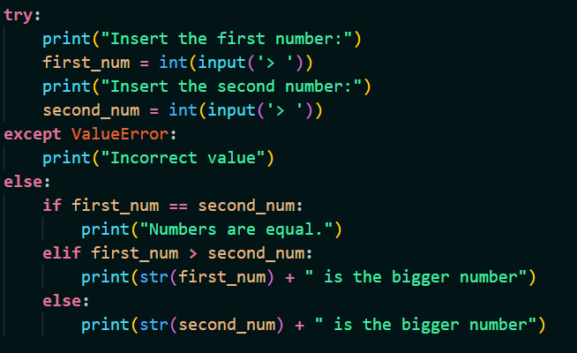
Extra
Notes:
In this solution, the block of code responsible for the user input is being included into a try-except block.
If an error occur, Python will normally stop and generate an error message.
The try - except block allow us to catch a specific error (or any error) that could be raised and print a message to the user instead of stopping the program execution.

Slide 15
Loops
A loop is an instruction that repeats until a specified condition is reached.
Loops are used to avoid repeating the same line of code multiple times.
While loops
A loop that is repeated as long as the expression is true (the given condition is satisfied).
WARNING: can generate infinite loops
For loops
A loop that is repeated for a specific amount of time. It’s used for sequential traversal (traversing iterable objects, like strings or arrays)

Slide 16
While loops
For loops
While loops are used when the number of iteration to complete a task is unknown.
break would stop the loop even if the condition is true.
continue can stop the current iteration and continue with the next one.
else runs a block of code when the condition is not longer true
For loops allows you to perform a set of statements per each element of an iterable object.
break would allow you to stop the iteration and exit the loop
Notes:
For loops are generally faster than while loops in Python.
This is because for loops are optimised for iterating over a sequence of elements, whereas while loops are optimised for executing a block of code repeatedly until a condition is met.
List comprehension are generally faster than loops because they use optimise C code under the hood to perform the transformation.
However, in same cases, list comprehensions can be slower than for loops due to overhead of creating and extending the list.

Slide 17
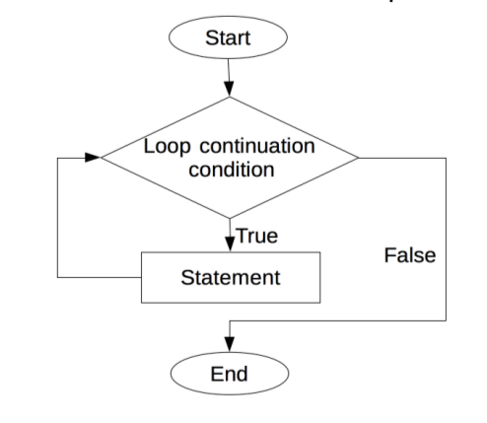
While loop - flow chart
Notes:
The block of code included in While loop, will be executed as long as the condition is evaluated as True.
Because while loops are normally used for cases where the number of execution is unknown (therefore it might vary according to each case), while loops might lead to infinite loops if not carefully designed.
To stops while loops, the following strategies are used:
Break statement: a keyword that will immediately stop the loop when executed. It’s a way to “force the way out” from a loop. Very effective but considered bad practice by some developers.
The break statement can be used with for loops as well.
Sentinel variables: a variable that in loops, is used as a way to change the condition from True to False, resulting in stopping the loop.
Return statements: when a loop is inside a function, you can use the return statement to exit the function, interrupting the loop. We will discuss user-defined functions later on in the course.

Slide 18
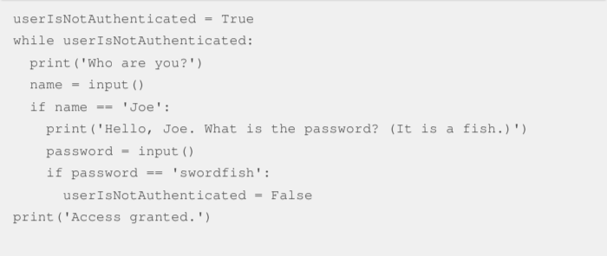
Using flags instead of break/continue
It’s better to avoid using break statements unless strictly necessary.
You can structure your code to avoid breaking.

Slide 19
For loops - range()
The range() function is a very useful function that returns a sequence of numbers, starting from 0 (by default) and increments by 1 (by default) and stops before a specified number.
for num in range(11):
print(num)
Syntax: range(start, stop, step)
start (optional) - Default is 0
stop (required)
step (optional) - Default is 1

Slide 20
Nested loops
Nested loops are useful when dealing with nested arrays, matrixes (grids of numbers) and/or printing patterns of characters.
For example:
for i in range(6):
for j in range(6):
print(i, j)
Remember: with the print function you can use parameters like sep and end to specify a separator or what to print at the end. This would be very handy when creating grids and patterns.
Notes:
When you nest loops, the number of times your code gets executed increases exponentially.
This can lead to increased time complexity, more computational strain, and code that is difficult to read and debug.
Although Python allows you to nest many loops, you should only use nested loops when it is strictly necessary.
If you find yourself nesting more than three times, it might be worth considering if there is a better way to organize your code.

Slide 21
Mod 2 - Homeworks 1/2
If, elif, else statement:
Write a program that is going to give the grade of a student according to the score obtained.
Score >= 90 : ‘A’ 80<=score<=89: ‘B’ 70<=score<=79 : ‘C’ 60<=score<=69: ‘D’ score<59: ‘F’
Write a program that, given a number, it will play the fizz buzz game
Hint: check again what the modulo operator does
Hint: check for loops and the range() function
Notes:
Rules of the Fizz Buzz game:
Given a number, print each number starting from 1 to the given number.
If a number is divisible by 3, print “FIZZ” instead.
If a number is divisible by 5, print “BUZZ” instead.
If a number is divisible by both, print “FIZZ BUZZ”
The original game checks for numbers divisible by 3 and 5 (or both) but you will find version using 2 and 3 instead. Feel free to use whatever version you prefer, as long as the output correct.

Slide 22
Mod 2 - Homeworks 2/2
While loop:
Create a program to ask the user to guess the number that has been randomly generated. The user will be able to try continuously until it finds the correct number. The program should stop as soon as the number is found.
At each iteration the program will tell the user if the number is too high, too low or the correct one.
Extra:
Implement a way to assign only 5 attempts to the user. Each iteration should show the attempt left.
Hint: check what the random library does

