Slide 1

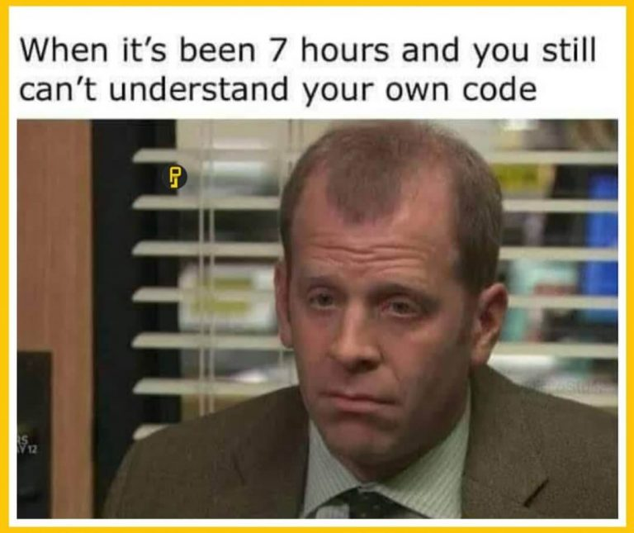
Mod 3 - String manipulation
Working with strings
Indexing and slicing
String methods

Slide 2
Working with strings
Text is one of the most common forms of data. Manipulating strings allow you to extract useful information or transform strings for improved efficiency.
At this stage, you are already familiar with:
String concatenation:
print(‘hello’ + name)
Single and double quotes:
print(“That is Alice’s cat.”)
Notes:
Text is one of the most common forms of data your program will handle.
Strings are used to store text data and they are in almost every program that deals with text.
String manipulation allows you to extract useful information from strings, manipulate and transform strings as needed, and perform various string-related operations efficiently.

Slide 3
Escape characters
Escape characters allow you to use characters that are otherwise impossible to put into a string.
\’
\”
\t
\n
\\
Single quote
Double quote
Tab
Newline (line break)
Backlash
Notes:
Escape characters allow you to include special characters in strings. To do this, you can simply add a backlash before the character you want to escape.
On top of allowing the insertion of special characters, escaping allow you to print on a new line, print a tab and correctly pass file path.
If you want to print a directory path in Windows, you'll need to escape each backslash in the string. If you find yourself working often with file path, you might want to consider using the pathlib module: this module offers classes representing filesystem paths with semantic appropriate for different operating systems.
pathlib — Object-oriented filesystem paths — Python 3.12.0 documentation
We have been mentioning libraries and modules, here is a little definition for clarity:
Module: is a file containing Python definitions and statements. The file name is the module name with the suffix .py appended. In Python there is only one type of module object, no matter if the module is implemented in other languages.
A module is a single file of code that is meant to be imported.
A collection of modules under the same namespace is called package.
Library: The term library is simply a generic term for a bunch of code that was designed with the aim of being usable by many applications. It provides some generic functionality that can be used by specific applications.
When a module/package/something else is "published" people often refer to it as a library. Often libraries contain a package or multiple related packages, but it could be even a single module.

Slide 4
Multiline strings
While you can use the \n escape character to put a new line into a string, it is often easier to use multiline strings.
Indentation rules for blocks do not apply to lines inside a multiline string.
print(‘’’Dear Alice,
Eve’s cat has been arrested for catnapping, cat burglary, and extortion.
Sincerely,
Bob’’’)
Notes:
Multiline strings are often use to provide a description of a specific piece of code.
Some scripts starts with a brief description of what the program does or a function can contain a multiline description of how the function works.
If you want to leave some useful information to another developer (or your future self) when checking the code, you can include it as multiline strings.

Slide 5
str.format() and f-strings
str.format() and f strings allow you to insert variable directly into strings.
Ex.
name = ‘Bob’
age = 30
print(“Hello, my name is {} and I’m {} years old”.format(name, age))
print(f”Hello, my name is {name} and I’m {age} years old”)
Notes:
This two method of passing variable inside a string are very useful and very powerful.
str.format() is the oldest of the two and even if is a legacy method, currently, is being stated that it will not be deprecated.
f-strings were introduced in Python 3.6 and they are easier to read. The latest version of Python (currently 3.12) introduced even more feature to this tool.
Even if format() will not be deprecated, it is very likely it will not receive any further implementation, so you might want to use f-strings to benefit from newer, useful features.

Slide 6
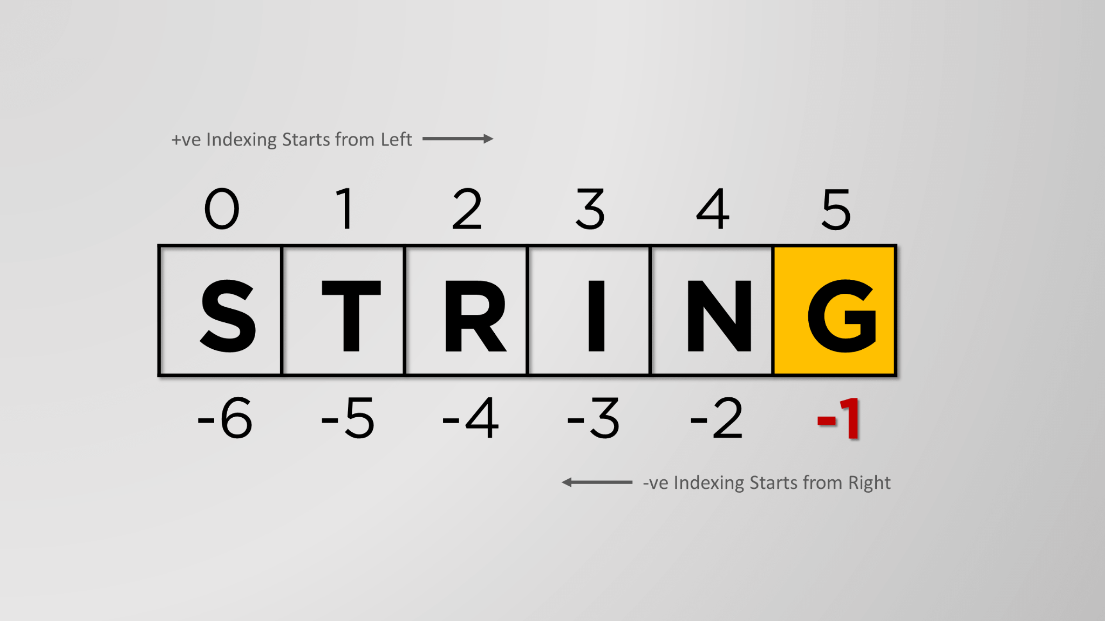
Indexing and slicing
Strings are arrays of characters: each character’s position can be referred using the corresponding index.
Indexing and slicing are very powerful techniques that allow you to access subsequence of a sequence.
Notes:
Strings are arrays of characters. Like any other array, they are iterable, meaning we can loop over each character.
They also support indexing and slicing:
Indexing and slicing are two fundamental concepts that help you access specific elements in a sequence. By using these techniques, you can extract substrings from strings.
Indexing is the process of accessing an element in a sequence using its position in the sequence (index). Indexing starts from 0 (first element).
Slicing is the process of accessing a subsequence of a sequence by specifying a starting and ending index.

Slide 7


str.split()
str.split() allows you to break a string into smaller strings based on a specified separator.
Output:

Slide 8


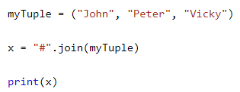

str.join()
str.join() is used to join, concatenate a sequence of strings with a specific separator.
Notes:
Using join() with lists of strings has lots of useful applications. For instance, we can use it to remove extra spaces between words or combine immutable types (like tuples) into a string (mutable).
Keep in mind that:
join() can’t be used to combine iterables with element that aren’t strings
Or to combine nested iterables

Slide 9
exercise
Palindrome:
Write a program that checks if a word is a palindrome.
Split a string on hyphens:
Write a program to split a given string on hyphens and display each substring
Input:
Str1 = “Emma-is-a-data-scientist”
Output must have each sub-string on a new line

Slide 10
Exercise 2/2
Remove extra spaces between words:
Given the following sentence, find a way to remove all the extra spaces and print the same sentence with just one space between words.
paragraph = "Argentina wins football world cup 2022 in a nail biting final match that led to a spectacular penalty shootout. Football lovers across the world hailed it as one of the most memorable matches."

Slide 11
Useful string methods
upper() / lower() returns a new string converted to upper/lower case
isupper() / islower() returns True if upper/lower case
isalpha() returns True if the string is only letters (and not blank)
isalnum() returns True if only letters and numbers (and not blank)
isdecimal() returns True if only numeric characters (and not blank)
isspace() returns True if only spaces, tabs and newlines (...)
istitle() returns True if only words beginning with an uppercase
letter followed by lowercase letters
startswith() / endwith() returns True if begin/ends with the passed string
Notes:
These methods are particularly useful to perform checks on user (or other functions) inputs.
A wrong input can break the flow of our program. Using these methods, we can check that the user’s input is formatted correctly and eventually modify it.
startswith() and endwith() are useful alternatives to the == equals operator if you need to check only whether the first or last part of the string, rather than the whole thing, is equal to another string.

Slide 12
Mod 3 - Homeworks 1/2
Count letters, digit and special symbols:
Write a program that count all letters, digits and special symbols from a given string:
Input:
“P@#yn26at^&i5ve”
Output:
Chars = 8
Digits = 3
Symbol = 4

Slide 13

Mod 3 - Homeworks 2/3
Check if a name is in a sentence:
Write a script that, given a sentence and a word it will tell if the word is included in the sentence and how many time appears in the sentence.
Output example
Extra: make it dynamic.

Slide 14
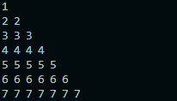
Mod 3 - Homeworks 3/3
Print a staircase:
Write a script that given an integer, print a staircase made of number as shown below:
Given the number 7:
Hint: can you nest for loops?

