Slide 1
Steps to Follow For User Experience
First, Click on power key to start the laptop.
Wait for two second, Cover screen will appear.
Click on cover screen, Sign in screen will appear.
Sign in with password “1234” or click on Finger Scanner.
After successful sign in, Desktop screen will appear.
Click on notification icon, Celebration window will open.
Click on Window Icon to shutdown, refresh the laptop.

Slide 2
Laptop Design Implementation Approach
Tailwind CSS Styling.
React Functionality.

Slide 3
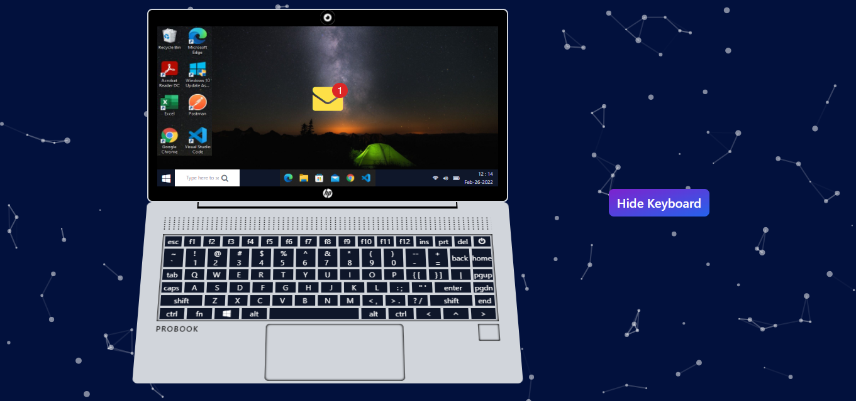
Foreground and background
{ Live Background
Import Particles from ‘react-tsparticles’,
absolute -z-10
(z-index : -10) }
{ flex xs:flex-col sm:flex-row gap-24 items-center justify-center w-screen h-screen }

Slide 4
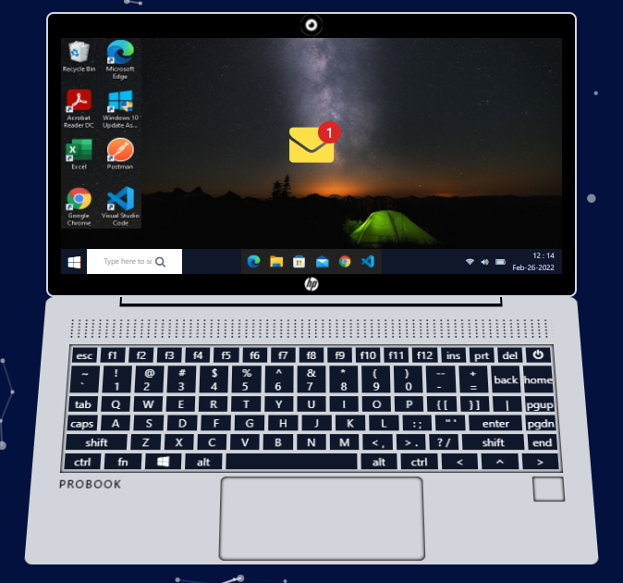
Laptop-wrapper
TopPanel
{ Laptop-wrapper flex flex-col w-4/5 h-3/4 }
BasePanel

Slide 5
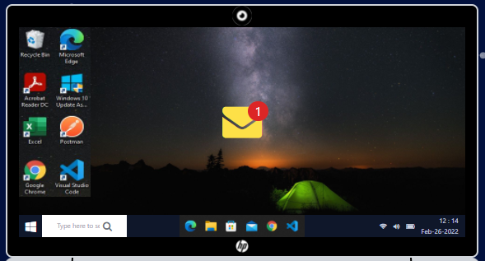
Top-Panel Wrapper
{ camera absolute rounded-full top-0 }
{ top-wrapper flex relative justfly-center items-center basis-1/2
rounded-lg
Border-gray-300 }
Screens
{ hp_logo absolute rounded-full bottom-0 }

Slide 6
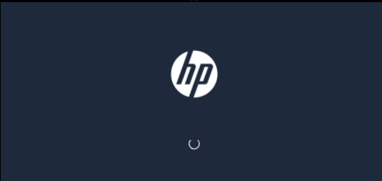
Screen 1 - Loading Screen
{ screen1 h-full w-full flex flex-col justify-around items-center }
useEffect(()=>{
If(power){
setFirst(true)
setTimeout(()=>{
setSecond(true)
},2000)
}else{
setAllscreens(false)}
},[power])
{ logo w-1/5 h-1/5 }
{ spinner w-4 h-4
(4 == 1rem) }

Slide 7
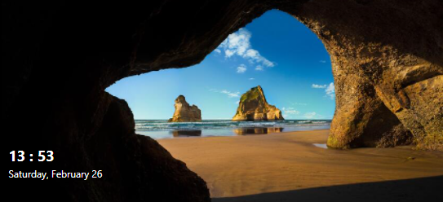
Screen 2 - cover Screen
{ screen2 bg-cover
bg-coverImage
bg-no-repeat
bg-center h-full w-full relative }
{ dateTime absolute left-0 bottom-0 w-2/5 h-2/5 flex flex-col justify-center pl-2 }
{ dynamic date and time with new Date() }

Slide 8
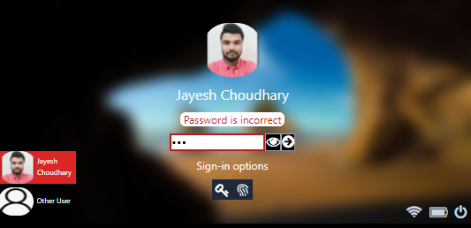
Screen 3 – Sign in Screen
{ <input> tag of type password,
Password validation on Submit,
Handling error on wrong password }
{ screen3 bg-cover
bg-coverBlur
bg-no-repeat
bg-center h-full w-full p-[1%] }
{ left basis-2/12 flex flex-col justify-end }
{ middle basis-8/12 flex flex-col justify-center gap-2 items-center }
{ right basis-2/12 flex flex-col justify-end }

Slide 9
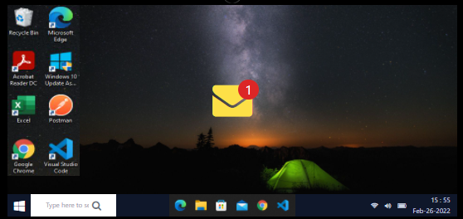
Screen 4 - Desktop Screen
basis-[1/5]
{ basis-[3/5] grid place-content-center }
{ screen basis-[87%]
Flex relative }
{
onClick = {
setNotification(true)
handleCelebrate(true)
}
}
{ start basis-[13%]
bg-slate-900 flex }
{ left basis-[30%]
Pl-1 flex }
{ middle basis-[40%] grid place-content-center place-items-center }
{ right basis-[30%]
cursor-pointer items-center gap-2 text-xxs }

Slide 10
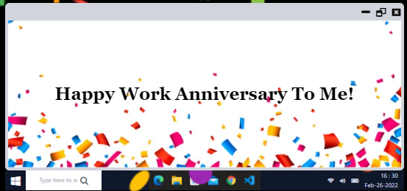
Notification Modal Screen
{ onClick={()=>{
setNotification(false)
handleCelebrate(false)
}} }
{ onClick={()=>setResize(!resize)} }
{ basis-[8%] }
{ `modal absolute ${notification ? ‘visible’ : ‘invisible’}
flex flex-col z-20 rounded-md overflow-hidden }
{ basis-[92%] grid place-content-center bg-celebrate bg-no-repeat bg-bottom bg-cover border-x-4 text-center capatalize px-2 }

Slide 11
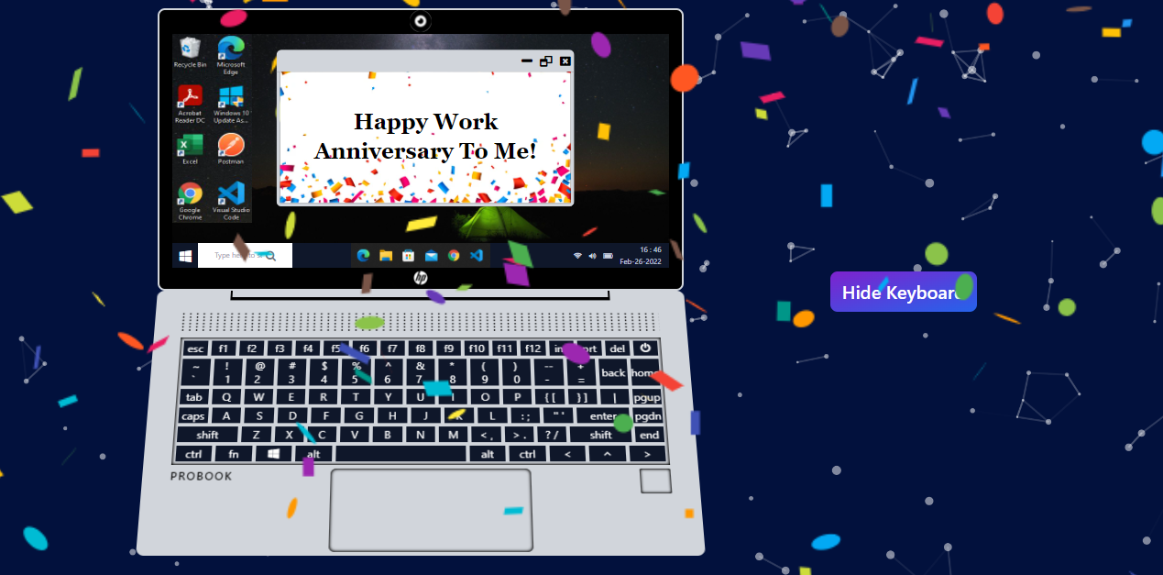
Resize Modal and celebration
{ `modal absolute ${resize ? ‘w-[60%] h-[75%] translate-y-[10%] translate-x-[35%]’
: ‘w-full h-full’}` }
{ import Confetti from ‘react-confetti’
{celebrate && <confetti className = ‘absolute w-full h-full’/>}
}

Slide 12
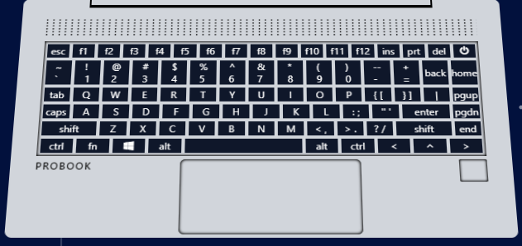
Base panel
{ speaker basis-1/6 flex flex-col width-[90%] mb-2 }
{ keyboard flex flex-col basis-3/6 w-[90%] gap-1 shadow-inner p-1}
{ base flex flex-col items-center basis-1/2 bg-gray-300
rounded-lg }
{ touchpad flex justify-between basis-2/6 w-[90%] py-1 }

Slide 13
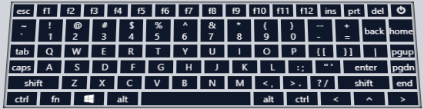
keyboard
{ onClick={handlePower} }
{ row1 row }
{ row2 row }
{ row3 row }
{ row4 row }
{ row5 row }
{ row6 row }
@layer components {
.key {
@apply bg-slate-900 hover:bg-black hover:scale-110 active:scale-100 text-white text-xxs lg:text-xs grid place-content-center overflow-x-hidden;
}
.row {
@apply basis-1/6 flex gap-1 justify-between;
}
}

Slide 14

Touchpad and finger scanner
{ onClick={handleFingerScan} }
{ probook uppercase font-semibold tracking-widest }
{ finger rounded-sm hover:bg-green-400 active:bg-inherit h-[30%] w-3/4 }
{ touchpad basis-2/5 shadow-inner rounded-md }

Slide 15
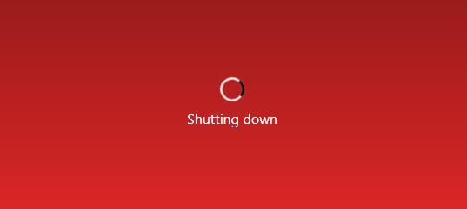
Shutting down Screen
{ w-7 h-7 text-gray-200 animate-spin dark:text-gray-600 fill-black }
{ shutdown h-full w-full flex flex-col justify-center gap-2 items-center text-white bg-gradient-to-b from-red-800 to-red-600 }
{ const handleShutDown = () => {
setShuttingDown(true);
setTimeout(() => {
setPower(false)
setShuttingDown(false)
}, 2000)
} }

Slide 16
Thank You
View source code for detailed implementation https://github.com/jayesh2906/laptop-design

