Slide 1

RNS INSTITUTE OF TECHNOLOGY
BENGALURU - 98
DEPARTMENT OF INFORMATION SCIENCE & ENGINEERING
Presentation on Internship
Finance App
Rupesh Pandey
USN: 1RN17IS079
ENMAZ Engineering Services Pvt. Ltd.
Internal Guide
Mr. T.S.Bhagwath Singh
External Guide
Dr. Bhagyashree Ambore
Software Engineer, ENMAZ

Slide 2
AGENDA
Abstract
About the Company
Introduction
Literature Survey
Requirements
System Design
Detailed Design
Conclusion and Future Enhancements
References
Q & A
VIII Semester, Department of ISE, RNSIT
2021 - 2022

Slide 3
ABSTRACT
Money management is an important and unavoidable activity which most people dread. Money management not only involves handling investments but also includes managing multiple accounts and tracking expenses. Each of these activities involves accessing information from different locations and so collecting and consolidating monetary information is not easy.
Currently, there are some stand alone personal finance applications which address different issues of financial management. There are individual software packages available for portfolio management, budgeting and investment tracking. But each of these applications is limited to only a specific aspect of personal finance. Also, these applications being stand-alone in nature, their usage is limited to the specific system on which they have been installed.
VIII Semester, Department of ISE, RNSIT
2021 - 2022

Slide 4
About the Company
Enmaz has a simple yet robust solution that helps any Industry / Factory digitise their workfloor in no time. The products offered will help in remote monitoring, controlling and also analysing any machinene parameter or process
Converts Industry standard protocols like Modbus and OPCUA to Wireless helping in connecting PLCs and machines for monitoring and analysis to Cloud without hassle.
Measures Vibration, Surface Temperature, Current, Voltage, 0-10VDC, 0-24VDC and sends to cloud. Helping in monitoring any machine or process.
Picks up data from multiple sensors and pushes to cloud securely. Also having local storage for intermediate data storing in case of network failure.
AI and ML enabled customisable dashboards including MIS report generation and settable alerts.
VIII Semester, Department of ISE, RNSIT
2021 - 2022

Slide 5
INTRODUCTION
Managing your money isn’t the easiest thing to do. Now that many of us no longer balance a checkbook, tracking and expenses and keeping up with the bank balance can get a little difficult. Personal finance apps can connect with your bank account and help you keep up with your spending. Not only that, personal finance apps can help you pinpoint areas that you’ve been spending, track upcoming bill payments (some allow you to pay your bills directly through the app)
VIII Semester, Department of ISE, RNSIT
2021 - 2022

Slide 6
LITERATURE SURVEY
Native Mobile App Development for a Banking Platform
Usability of mobile applications: literature review and rationale for a new usability model
The PACMAD usability model aims to address some of the shortcomings of existing usability models when applied to mobile applications
VIII Semester, Department of ISE, RNSIT
2021 - 2022

Slide 7
Requirements
Flutter
GIT BASH
Android Studio
OS: Windows 10
RAM: 1GB
VIII Semester, Department of ISE, RNSIT
2021 - 2022

Slide 8
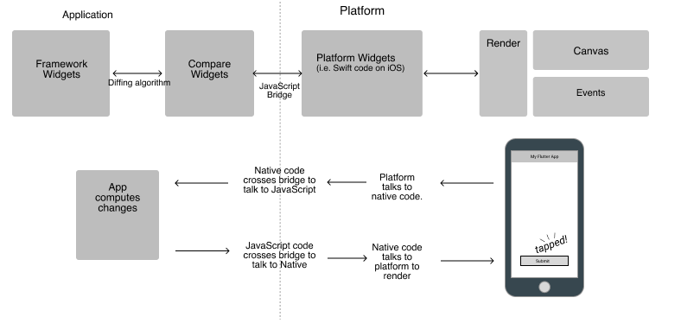
System Design
VIII Semester, Department of ISE, RNSIT
2021 - 2022

Slide 9
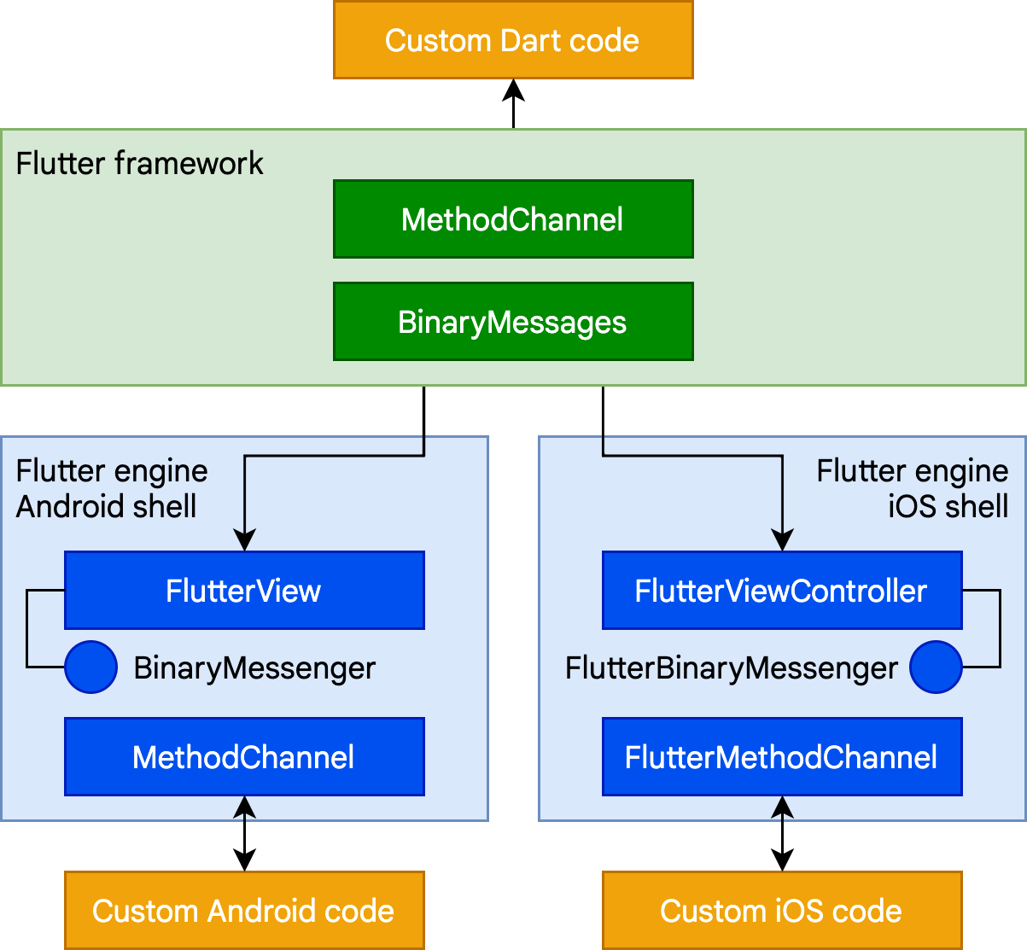
Detailed Design
VIII Semester, Department of ISE, RNSIT
2021 - 2022

Slide 10
CONCLUSIONS
When a customer is financially sound, then only a financial institution can remain financially well. So, most of the features that shall become part of the personal finance app should focus on the financial well-being of the customers
Besides thinking about financial health, increasing the online transaction speed, making the app more and more personalized and the inclusion of more options in payroll will surely lead personal payment apps to become an integral part of peoples day to day useage
VIII Semester, Department of ISE, RNSIT
2021 - 2022

Slide 11
Future Enhancements
Have a login system
Integration of AI and ML to make the app more automated
Implementation with cloud and the IoT
End to end Encryption.
Add a multi-authentication feature
Offer real time alerts
Utilize behavioral analysis
VIII Semester, Department of ISE, RNSIT
2021 - 2022

Slide 12
REFERENCES
[1] Youtube
[2] Google
[3] w3schools
.
.
.
.
.
VIII Semester, Department of ISE, RNSIT
2021 - 2022

Slide 13
Question and Answer
VIII Semester, Department of ISE, RNSIT
2021 - 2022

Slide 14
THANK YOU
VIII Semester, Department of ISE, RNSIT
2021 - 2022

