Slide 1

From Software to Hardware: Side-Channel Attacks on Ascon-128 via FPGA
By: Rupesh Hemant Bhusare, 2203106
Guided by: Prof. Sharad Sinha
Indian Institute of Technology, Goa

Slide 2
Agenda
1. Problem Statement
Why physical security matters
5. Design Space Exploration
4 architectures benchmarked
2. Phase 1 Recap (Software SCA)
CW Nano + SPA/DPA/CPA on AES
6. Results & Selection
Winning architecture for SCA
3. The Hardware Leap
Moving to FPGA (CW305 Artix-7)
7. Future Roadmap
Next steps to complete the attack
4. Ascon-128 & HLS Workflow
NIST standard + Vitis HLS

Slide 3
the security flaw in physical devices
The Math is Strong
But Hardware Leaks!
Modern encryption (AES, Ascon) is mathematically unbreakable.
Brute-forcing a 128-bit key takes longer than the age of the universe.
No known mathematical weakness.
Real chips leak power, EM radiation & timing during operations.
Side-Channel Attacks (SCA) exploit these physical emissions.
No code access needed — just a measurement probe!
Attacker recovers the secret key from the physics, not the math.

Slide 4
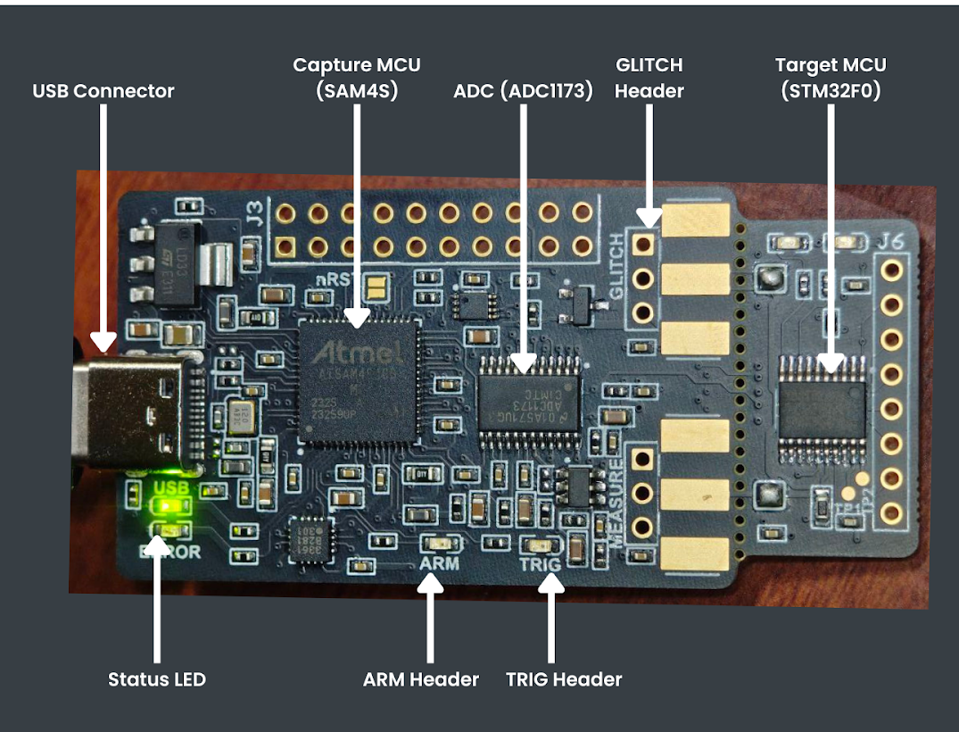
Phase 1: Chipwhisperer nano
Target: STM32F0 Microcontroller running firmware AES.
CPU executes instructions sequentially — one operation at a time.
Sequential execution creates predictable, measurable power patterns.
ChipWhisperer Nano captures power traces via built-in ADC at up to 10 MS/s.
Phase 1: CW Nano + STM32 (Software) → Phase 2 (Current): CW305 + Artix-7 FPGA (Hardware)

Slide 5
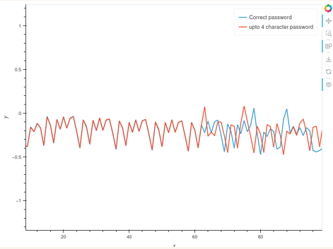
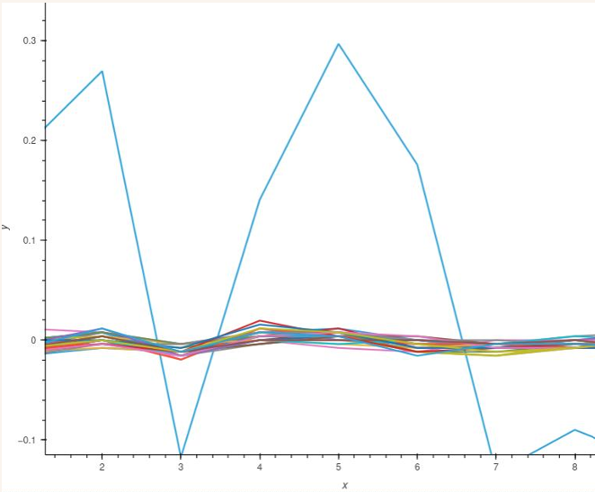
Simple power analysis (spa)
Directly observed power trace differences based on instruction type.
Successfully bypassed firmware passwords by spotting branch timing variations.
Correct vs incorrect character → different code path → different power waveform.
Identified direct power differences based on Hamming Weights (0x00 vs 0xFF).
0x00 → HW = 0 → low switching → low power.
0xFF → HW = 8 → high switching → high power.

Slide 6
Differential power analysis (dpa)
1. Capture N power traces while device runs AES encryption.
Full AES Key
Recovered!
2b 7e 15 16 28 ae d2 a6...
2. For each key guess (0–255), predict the AES S-Box output bit.
3. Split traces into two groups based on the predicted bit (0 or 1).
4. Compute: |avg(Group1) − avg(Group0)|
Limitation
Needed ~2,500 traces due to noise.
Ghost peaks from wrong key guesses.
Required careful trace windowing.
5. Correct key guess → sharp peak at S-Box time point.
6. Repeat for all 16 key bytes → recover full 128-bit key.

Slide 7
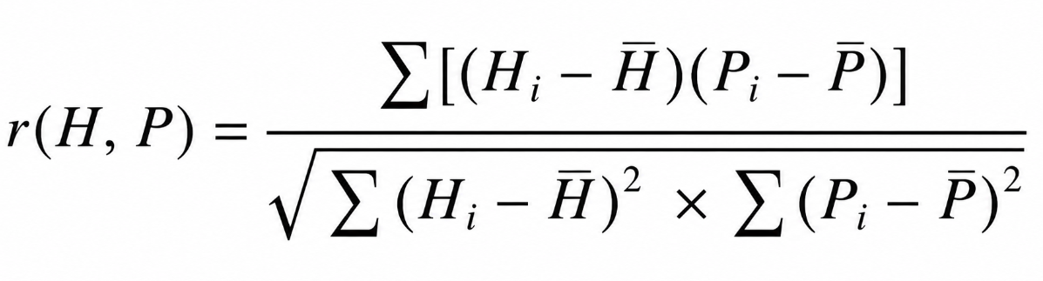
Correlation power analysis
DPA (Old)
CPA (New)
Uses single bit from prediction. Noisy. Needs many traces. Ghost peaks common.
Uses full 8-bit Hamming Weight. Pearson Correlation replaces difference-of-means. Stronger, cleaner peaks with fewer traces.
Pearson Correlation Formula:
H = Predicted Hamming Weight | P = Measured Power Sample | r → ±1 = strong correlation

Slide 8
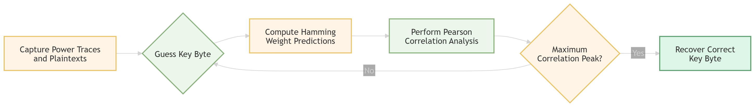
CPA vs Firmware aes
CPA Attack Flowchart
200
16 / 16
~40×
Traces needed
Key bytes recovered
Fewer traces vs DPA
Pearson correlation filtered system noise far more effectively than DPA.
Highest correlation peaks clearly identified for all 16 key bytes.
Wrong key guesses produced near-zero correlation — no ghost peaks.

Slide 9
Moving to hardware (cw305 artix-7 fpga)
Software CPU (CW Nano)
FPGA Hardware (CW305)
Sequential execution — one gate at a time.
Background OS noise contaminates traces.
CPU pipeline blurs the signal-of-interest.
Easier to attack but less relevant for IoT hardware.
Thousands of gates switch simultaneously.
No OS noise — bare-metal custom hardware.
Deterministic, clean power signature.
Realistic target for modern IoT cryptographic chips.

Slide 10
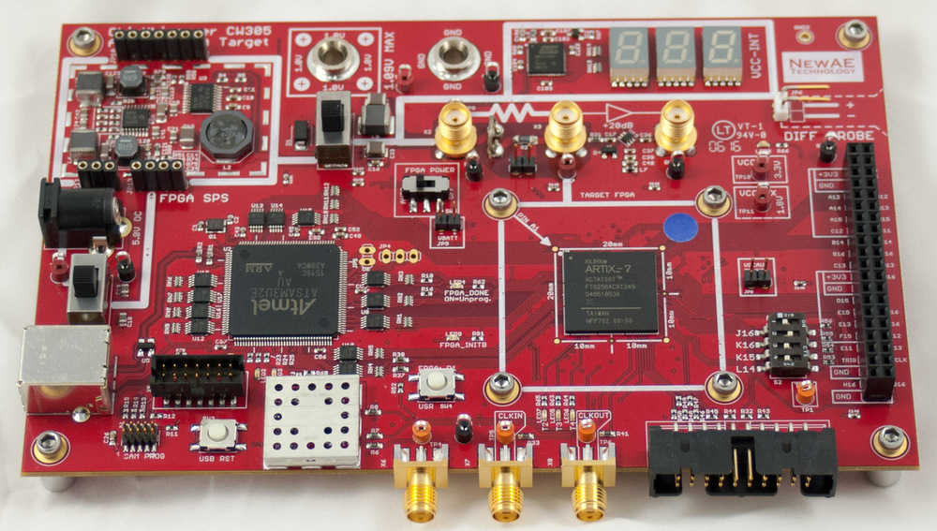
cw305 artix-7 fpga target board

Slide 11
Target: ascon-128 (nist winner 2023)
NIST Lightweight Cryptography Competition Winner Selected as the global standard for IoT security
Key Size
128 bits
Nonce
128 bits
Tag
128 bits
Rate
64 bits (8 bytes/block)
State
320 bits (5 × 64-bit words)
Permutations
P12 (init/final), P6 (data)

Slide 12
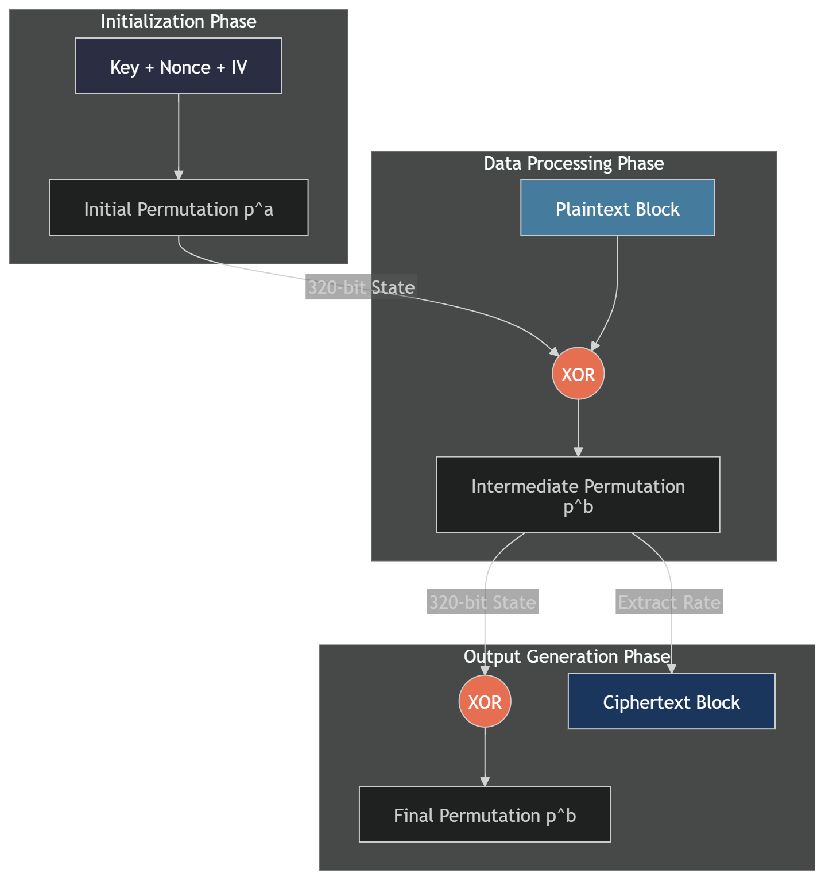
Ascon sponge construction
Permutation-based sponge construction (not AES rounds).
320-bit internal state split into: rate (64-bit) + capacity (256-bit).
Initialization: Load IV ∥ Key ∥ Nonce → apply P12 → XOR key.
Associated Data: Absorb blocks via XOR + P6 permutation.
Encryption: XOR plaintext into state → output ciphertext → P6.
Finalization: XOR key → P12 → XOR key → output 128-bit tag.

Slide 13
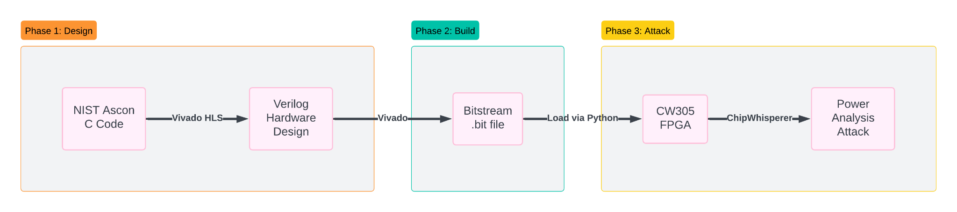
Automated hardware workflow (vitis hls)
Writing raw Verilog/RTL by hand is slow, error-prone, and complex.
Vitis HLS (High-Level Synthesis) translates C code directly into hardware.
Allows fast design iteration without hardware expertise.
Output: Verilog IP core ready for Vivado block design.

Slide 14
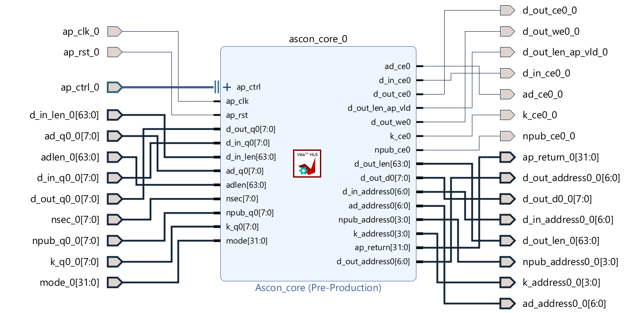
IP Core Interface

Slide 15
Software to hardware bridging
Extracted clean reference C implementation from official NIST Ascon submission.
Created ascon_core.c — a unified top-function without OS-dependent overhead.
Removed stdio.h, malloc, and all dynamic memory — hardware has no OS.
Added HLS interface pragmas to define memory ports for the Verilog testbench.
// HLS Interface Pragmas — critical for Verilog port mapping #pragma HLS INTERFACE ap_memory port=d_in depth=100 #pragma HLS INTERFACE ap_memory port=k depth=16 int ascon_core(..., int mode); // mode: 0=Encrypt, 1=Decrypt

Slide 16
CORE HARDWARE MODIFICATIONS FOR SCA
Merged Encrypt/Decrypt Logic
MUX Bridging
Trigger Synchronization
Combined both modes into a single ascon_core() function. One hardware core handles both via a mode flag. Reduces area, ensures identical timing for SCA.
Input and Output MUX blocks route data through the same Shared Permutation Core. Forced identical leakage profiles for encrypt and decrypt paths.
Added a physical hardware wire (ap_start / ap_done signal). Directly drives oscilloscope trigger for perfectly aligned power traces.

Slide 17
DESIGN SPACE EXPLORATION (DSE)
Goal: Find the architecture that maximizes power side-channel leakage.
Used Vitis HLS #pragma directives to generate 4 distinct hardware architectures from the same C source.
Each architecture trades off latency, area (LUTs/FFs), and clock frequency.
The key SCA metric: which design switches the most transistors simultaneously → loudest power spikes.
Sol 1: Baseline
Sol 2: Unrolled
Sol 3: Pipelined
Sol 4: Dataflow
Sequential loops. No optimization. Minimal resource usage.
Loop unrolling. All iterations execute in parallel.
Continuous throughput. Overlapping execution stages.
Ping-pong memory buffers. Task-level parallelism.

Slide 18
THE FOUR HLS ARCHITECTURES
Sol 1: Baseline
Sol 2: Unrolled
None
#pragma HLS UNROLL
Loops run sequentially. Minimal area. Slow. Predictable but weak SCA signal.
All loop iterations execute simultaneously. Largest parallel switching activity. Best for SCA.
Sol 3: Pipelined
Sol 4: Dataflow
#pragma HLS PIPELINE
#pragma HLS DATAFLOW
New data accepted every clock cycle. Continuous throughput. High FF usage from registers
Producer consumer task parallelism. Ping-pong buffering between pipeline stages.

Slide 19
Performance & area metrics
Metric | Sol 1 — Baseline | Sol 2 — Unrolled ★ | Sol 3 — Pipelined | Sol 4 — Dataflow
LUTs | 8,075 | 11,540 | 11,811 | 10,937
Flip-Flops (FFs) | 3,923 | 5,160 | 7,823 | 4,816
Clock Freq (MHz) | 123.7 | 123.5 | 137.2 | 125.2
Latency (cycles) | ~20 cyc | ~10 cyc ✓ | ~22 cyc | ~18 cyc
Loop Unrolling | None | Full ✓ | Partial | None
Best for SCA? | Weak | ★ Best | Medium | Medium

Slide 20
Solution 2: unrolled architecture
50 % Latency reduction over Baseline (10 vs ~20 cycles)
MAX Parallel transistor switching — loudest SCA signal
Deterministic timing — trivial waveform alignment
Full loop unrolling, all S-Box operations exposed simultaneously

Slide 21
Why solution 2 maximizes power spikes
How Loop Unrolling Amplifies Power Leakage:
Baseline (Sequential)
Unrolled (Parallel)
S-Box round 1 executes.
Wait for round 2...
Wait for round 3...
Signal smeared across time.
CPA needs many traces.
ALL S-Box rounds fire simultaneously.
Thousands of gates switch at once.
Massive instantaneous current spike.
Signal concentrated at one time point.
CPA needs far fewer traces!

Slide 22
Current status and future roadmap
Completed
In Progress
Upcoming
Software SPA on CW Nano Password bypass + HW analysis
DPA on Firmware AES Full 16-byte key recovery
CPA on Firmware AES Key recovery using 200 traces
Ascon-128 adaptation for Vitis
HLS Design Space Exploration 4 architectures benchmarked
IP Core Generation Solution 2 (Unrolled)
Vivado Block Design, Mapping IP core + MIG + UART integration
Bitstream generation and FPGA programming
From CW305 physical power trace capture
CPA on Ascon-128 hardware, 128-bit key recovery
Software vs Hardware CPA trace comparison

Slide 23
THANK YOU
NewAE Technology Inc: All labs and hardware setups are based on their open-source ChipWhisperer educational content.
Ascon: For the open-source Ascon-128 reference implementation (NIST LWC Winner) used as the baseline for our hardware synthesis.
Thanks to Prof. Sharad Sinha for guidance.
Thanks to IIT Goa for providing resources.

