Slide 1
INTO THE
BUS-VERSE
A Digital Twin & Discrete-Event Simulation
of the Radhanagari ST Depot
Rupesh Hemant Bhusare, 2203106
CS572: Modeling and Simulation of Systems
Uncovering Hidden Transit Failures Through Behavioral Modeling

Slide 2
PROJECT OVERVIEW
What did we build?
🚌
🧠
📊
Digital Twin
Behavioral AI
Monte Carlo
A Python simulation that clones the real Radhanagari ST Depot buses, timetables, passengers, all of it.
Passengers aren't robots. They panic, arrive early, and reroute if their bus is full. Our model captures that.
30 full-day simulations run back-to-back. Results stabilize via Central Limit Theorem — solid, not lucky.
Built with Python · SimPy · Discrete-Event Simulation · 12-hour Operational Window (6 AM – 6 PM)

Slide 3
MOTIVATION
Why this, why now?
"A spreadsheet cannot calculate the friction of 200 people needing a bus at 5 PM when the only capacity is bound for another state."
1
The Problem
Daily average stats hide violent demand spikes. A spreadsheet says the depot is fine. Reality: 760 people stranded every day.
2
The Observation
42.7%
Radhanagari is a real place. The chaos at the depot — the morning mob, the ghost buses, the evening panic — all of it is observable.
Weekday boarding success rate
the core finding that started it all
3
The Spark
What if we could stress-test the depot virtually before anyone gets hurt or money gets wasted? That question led to the Digital Twin.

Slide 4
APPROACH & ARCHITECTURE
How the simulation works
01
02
03
04
Passenger Generation
Smart Commuter AI
Bus Departure Logic
Queue Math
Non-homogeneous arrivals λ(t). Morning rush: 2.0 groups/min. Evening rush: 1.6. Midday: 0.5.
Step-step routing: if direct bus is full, passenger reroutes via transfer hub. Urgency score drives behavior.
Origin buses start at 0 load. Through buses carry 15–35 passengers. Hard cap: 60 passengers per bus.
Qt = Qt-1 + Arrivals − Boardings − Abandoned. Station backlog tracked minute-by-minute for 720 steps.
30× Monte Carlo runs · Central Limit Theorem convergence · Converged mean wait: 39.32 min

Slide 5
Demo

Slide 6
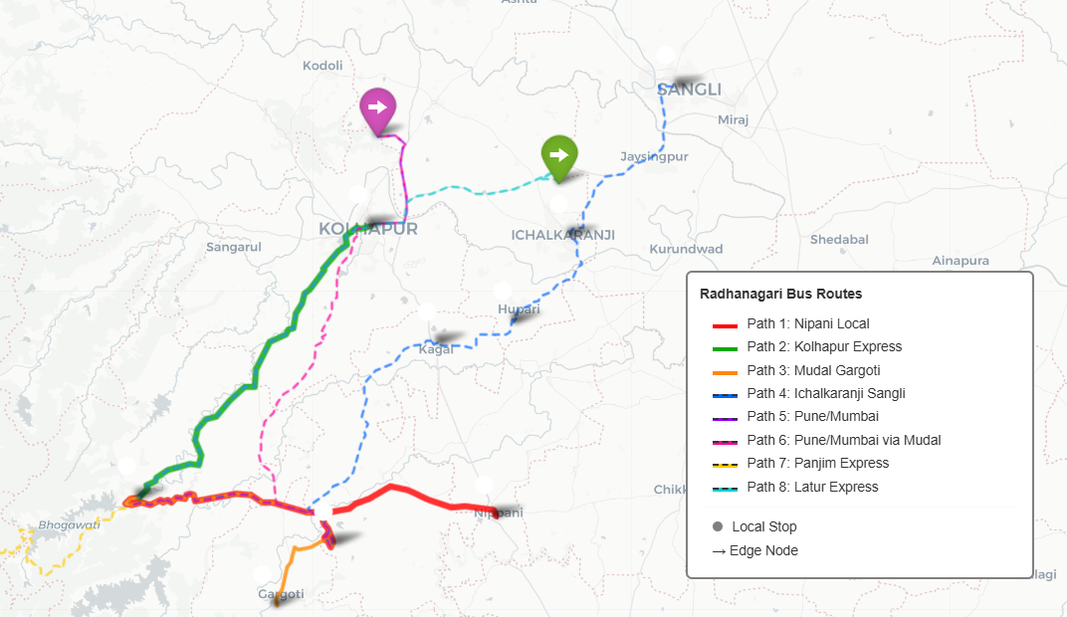
DEMO
Routes

Slide 7
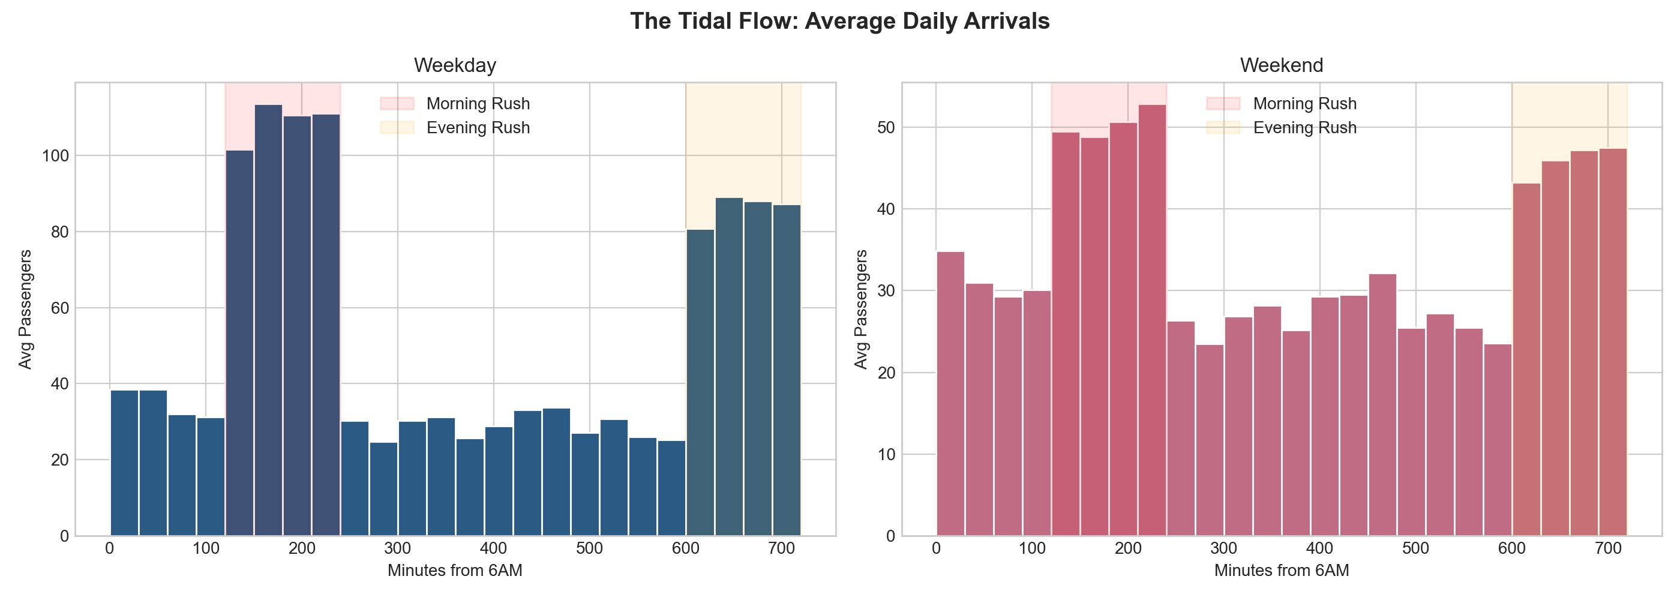
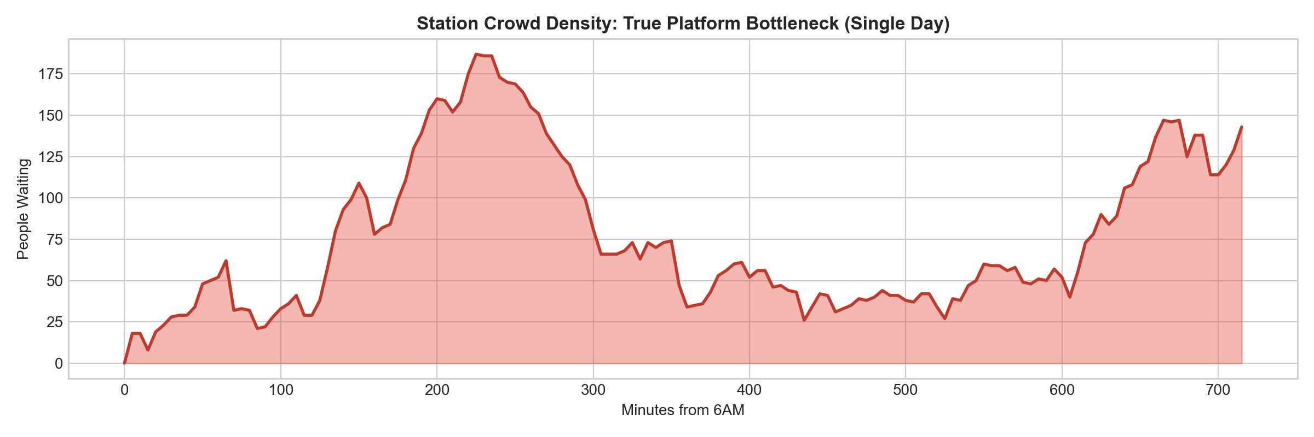
RESULTS — PART 1
The Time Space mismatch
2×
More passengers arrive in rush hour vs midday
185+
People trapped at peak morning backlog
760
Passengers stranded daily on average

Slide 8
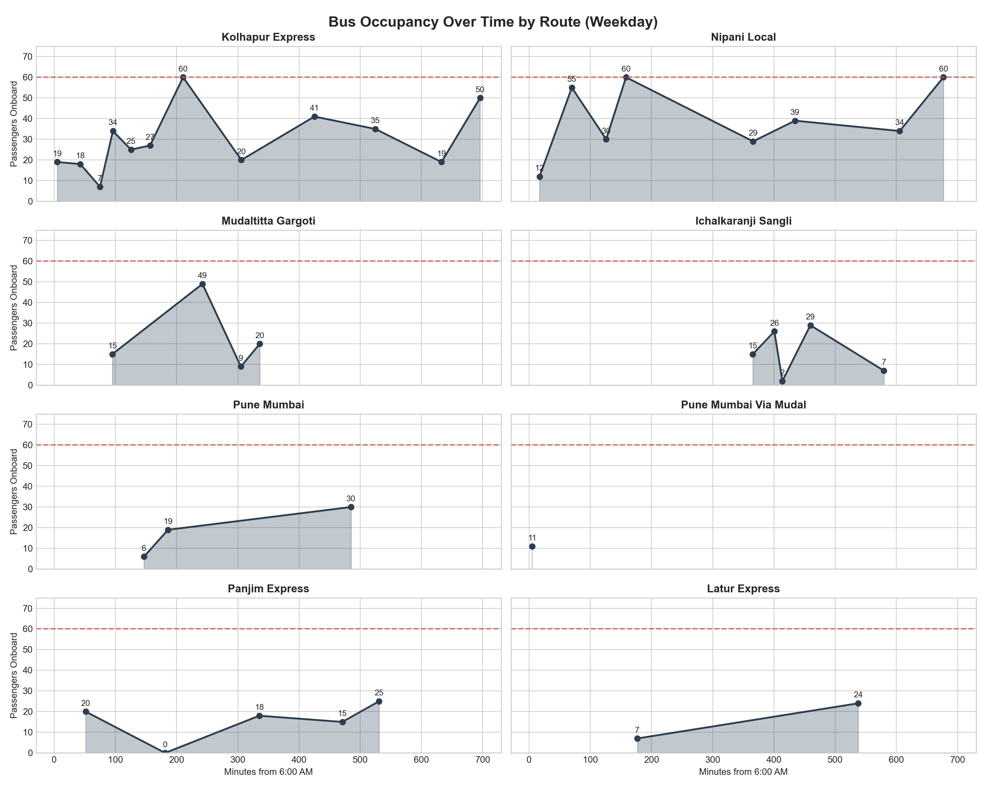
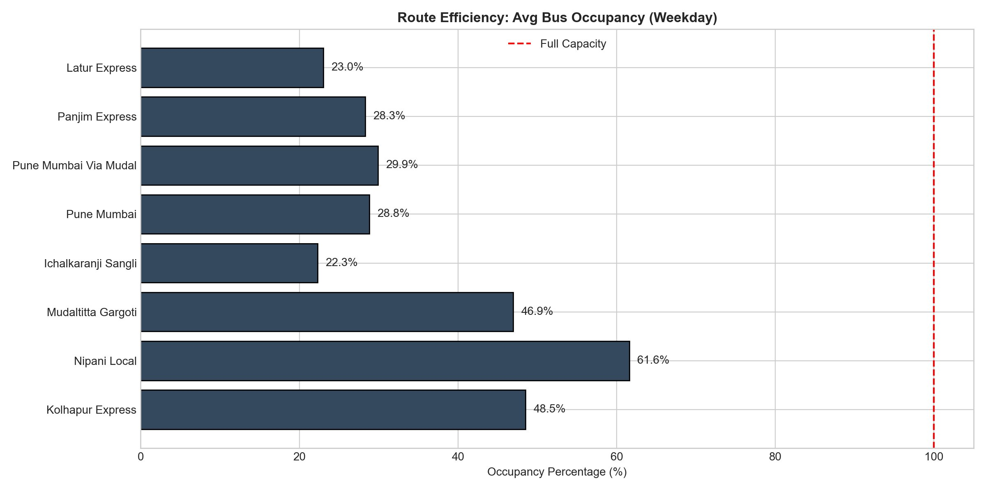
RESULTS — PART 2
Ghost buses & route collapse
🚌
⚠️
Ghost Buses
Route Collapse
Panjim Express departed at 8:45 AM with 0 passengers. Latur Express runs at 23% capacity.
Nipani Local & Kolhapur Express hit 60-passenger limit during both rush windows.
🔧
Schedule Gaps
Mudaltitta-Gargoti: zero evening departures. Ichalkaranji: zero morning departures.

Slide 9
CHALLENGES & TAKEAWAYS
What was hard. What we learned.
⚡ Challenges
💡 Takeaways
Modeling irrational human behavior (paranoia buffers, mob boarding) without making it too random
Averages lie. Spatiotemporal mismatch is the real enemy, not fleet shortage.
Route reallocation beats fleet expansion — move ghost bus drivers to rush-hour routes.
Getting the queue math right — distinguishing "in system" vs "actively waiting"
Fix schedule gaps first: Mudaltitta evening + Ichalkaranji morning can be solved in one memo.
Calibrating arrival rates from zero ground-truth data; had to use sociological reasoning
Simulation gives you a risk-free sandbox to test ideas before any bus moves.
Monte Carlo convergence took trial-and-error to find N=30 as the sweet spot
Simulation gives enough data for business owners around bus station to target customers with better planning.

Slide 10
The transit system doesn't need more buses.
It needs buses at the right place, at the right time.
Built with SimPy · Monte Carlo · Queueing Theory · Behavioral Modeling
Thank you
Into the Bus-Verse: Radhanagari ST Depot Digital Twin

