Slide 1
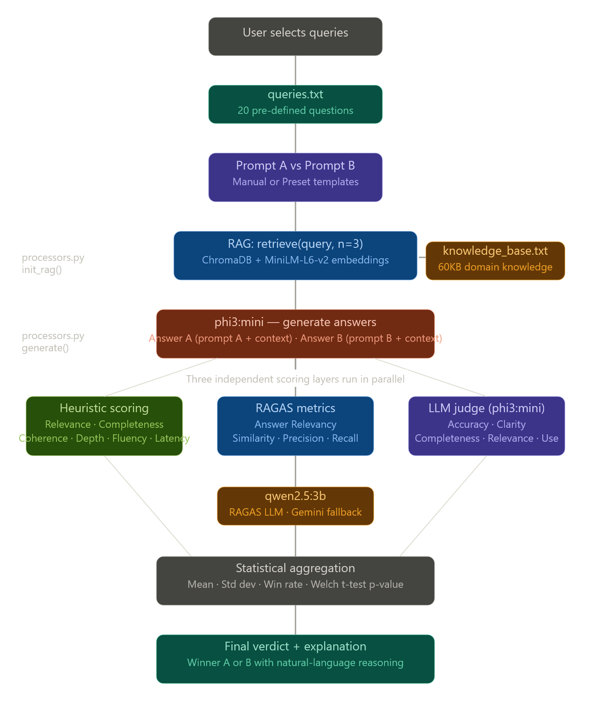
full flow per query

Slide 2
📁 Which File Does What
File | Role | Key functions
models.py | Config + data shapes | PROMPTS, MetricsResult, RAGASScores, SingleResult
processors.py | All computation | init_rag(), retrieve(), generate(), heuristic(), run_ragas(), llm_judge_all()
main.py | Web app + UI | All FastAPI routes, HTML rendering, chart data, final verdict
knowledge_base.txt | Knowledge source | 60KB of ML/AI domain text — chunked into RAG index
queries.txt | Test questions | 20 questions the user can select from

Slide 3
What Each Model Does
phi3:mini — the main workhorse
Does two jobs:
Answer generation — given a query + context, generates the actual response for Prompt A and Prompt B
LLM Judge — separately called again to score both answers on 5 criteria (Accuracy, Clarity, Completeness, Relevance, Usefulness), producing scores 1–5 per criterion
qwen2.5:3b — the RAGAS evaluator
Called only for RAGAS metric computation. It is a separate, lighter model used to evaluate answer quality using semantic methods. The reason a separate model is used: you don't want the same model that generated the answer to also judge it — that creates bias.
all-MiniLM-L6-v2 — the embedding model
Used by sentence-transformers to convert text into dense vectors. Used twice:
At startup to embed all knowledge base chunks into ChromaDB
At query time to embed the user's query for similarity search
Gemini (gemini-2.5-flash-lite) — the fallback
Only activates if qwen2.5:3b times out or fails during RAGAS scoring. Requires a Gemini_API_key in .env.

Slide 4
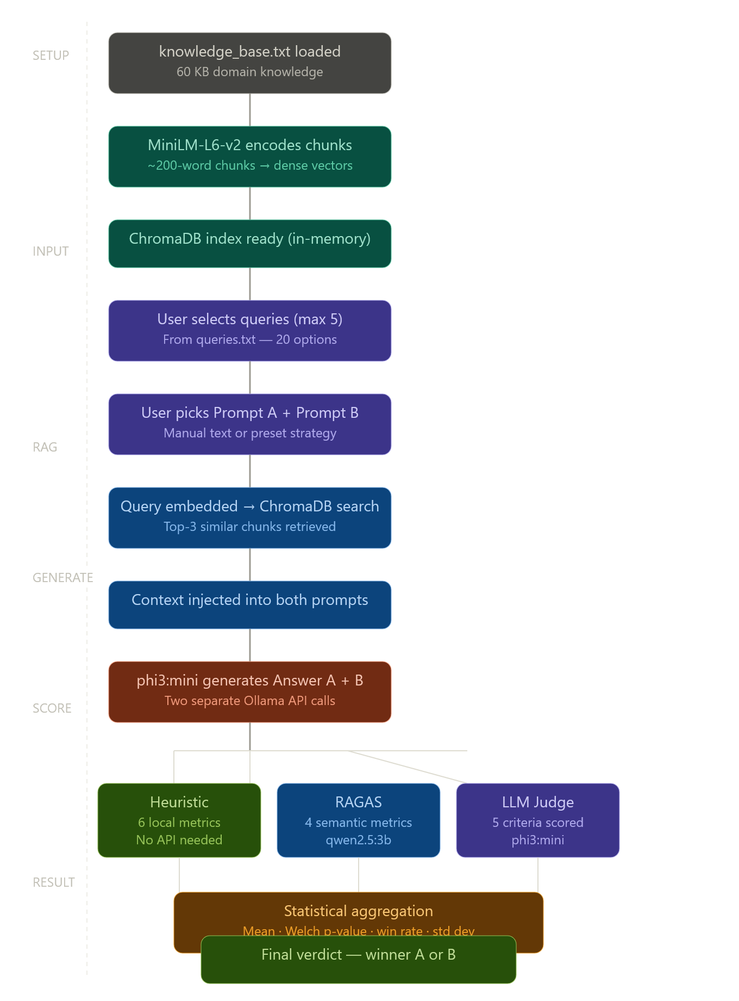
Pipeline workflow

Slide 5
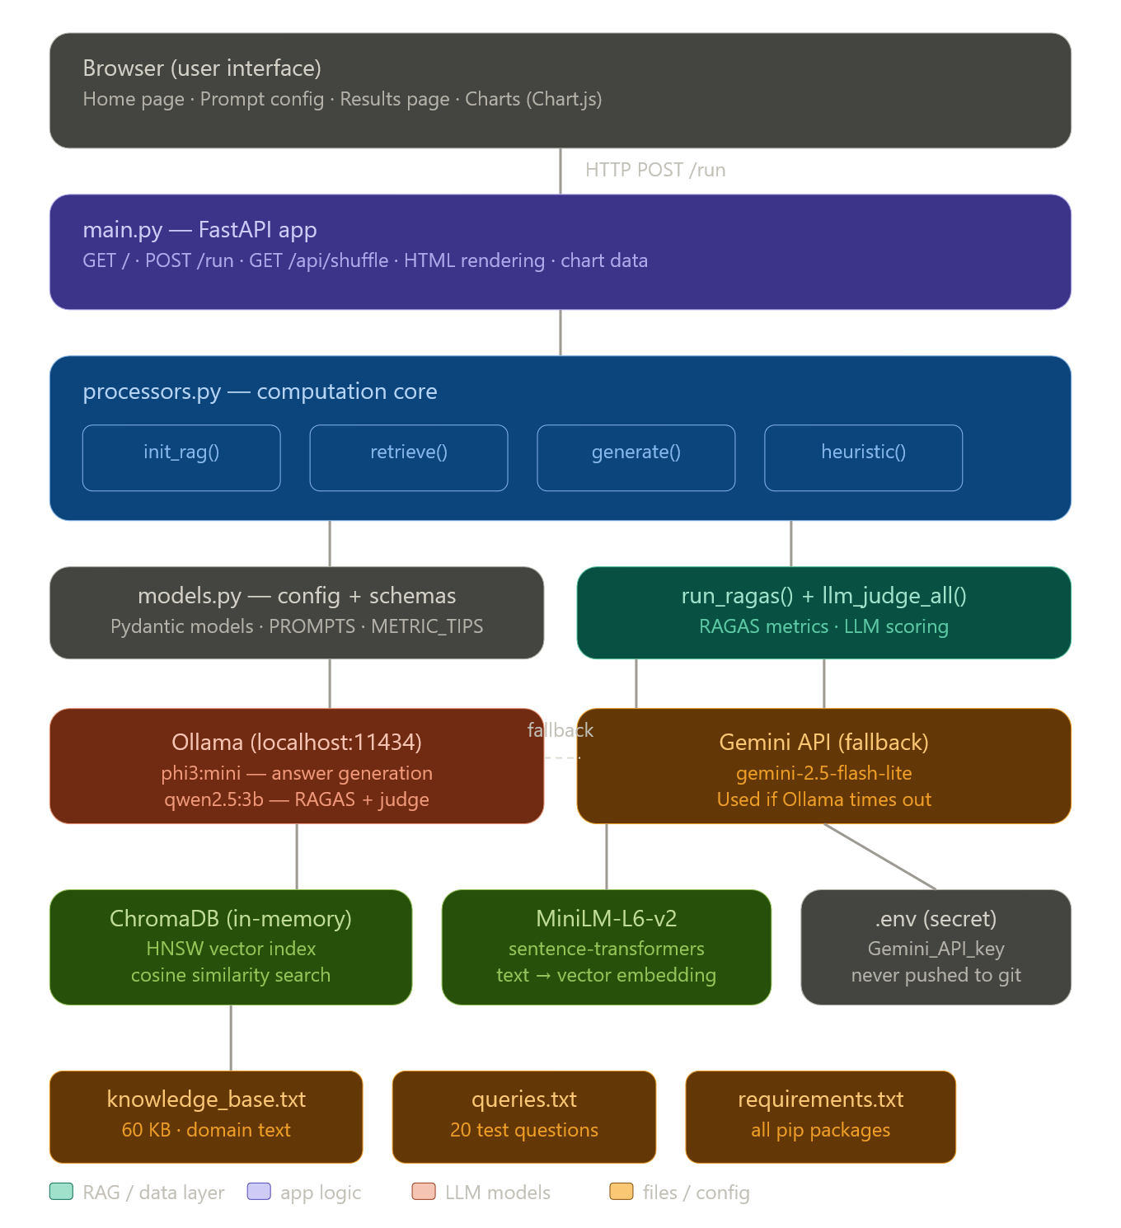
System Architecture

Slide 6
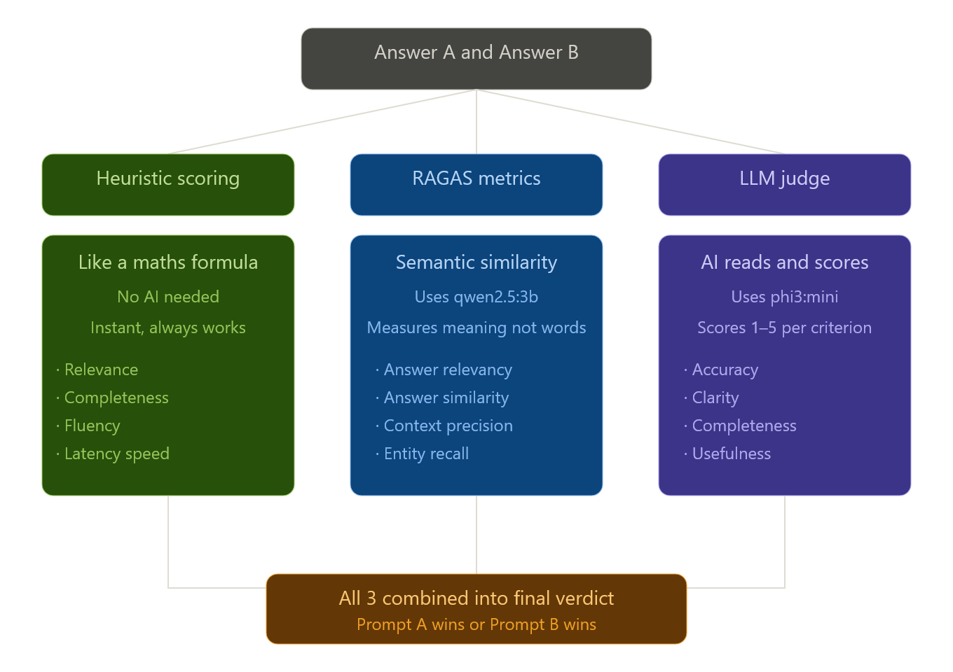
Scoring System

