Slide 1

Optimization of vehicle routing with inventory allocation problems in Cold Supply Chain Logistics
Name – Rupesh Garg
Roll Number – 19IM30019

Slide 2
Introduction
A Cold Supply Chain is a temperature-controlled supply chain comprising refrigerated production, storage and distribution facilities supported by equipment that can constantly maintain the required low-temperature range
CSCs needs high costs to maintain, for example, the report by UNICEF, as it spent more than 40 million USD in 2014 for only the CSC of vaccines (UNICEF, 2015)
Governments and Researchers from all the world have focused on food safety regulations in distribution and storing because of their significance in public health and disease prevention, especially, for products that can deteriorate due to high temperatures (Calanche et al., 2013; LeBlanc et al., 2015)

Slide 3
Why should Cold Supply Chains be handled differently than regular supply chains?
The high cost associated with CSC, as such chains consume additional cost for cooling
The Customers need fresh, refrigerated, and frozen products with maximum efficiency and minimum total cost
Perishable products have limited shelf lives with continuous and significant deterioration in the quality value over time in all stages of the supply chain (Blackburn & Scudder, 2009)
One of the most important considerations in guaranteeing safe food products of high organoleptic quality is the distribution management of food products including all types (Ji, Yang, & Zhou, 2015; Li, He, Zheng, Huang, & Fan, 2015)
To optimize the product cost for enhancing profit margins for commodity distribution companies as much as possible (Akkerman, Farahani, & Grunow, 2010)
To enable food to be supplied to an increasingly urbanized world and to meet the requirements with regard to high customer expectations

Slide 4
The Cooling costs for refrigeration and deep freezing
On an average, cold supply chains for refrigeration need 25 kwh energy to operate for 1 year for 1 square foot, i.e., 930 cm². We are considering the packet size of 1 unit of commodity to be 100 cm² = 100/930 ft² = 0.1075 ft²
Energy needed per hour will be (say C), C = (0.1075*25)/(365*24) = 0.00031 kwh
Average cost of 1 kwh energy for all business (which include CSCs) in USA = 0.128 $
Cost of cooling per hour per unit for refrigeration(in $) = 0.128*0.00031 = 0.00004 $/hr per unit (approx.)
The average energy consumption of deep freezer is 1.8608 kwh (savejoules.com) and of a refrigerator is 1 kwh, so cost of cooling per hour for deep freezing is 1.8 times the cost of cooling i.e., 0.00004*1.8 = $0.000072 which is approximately 0.00007 $/hr per unit.

Slide 5
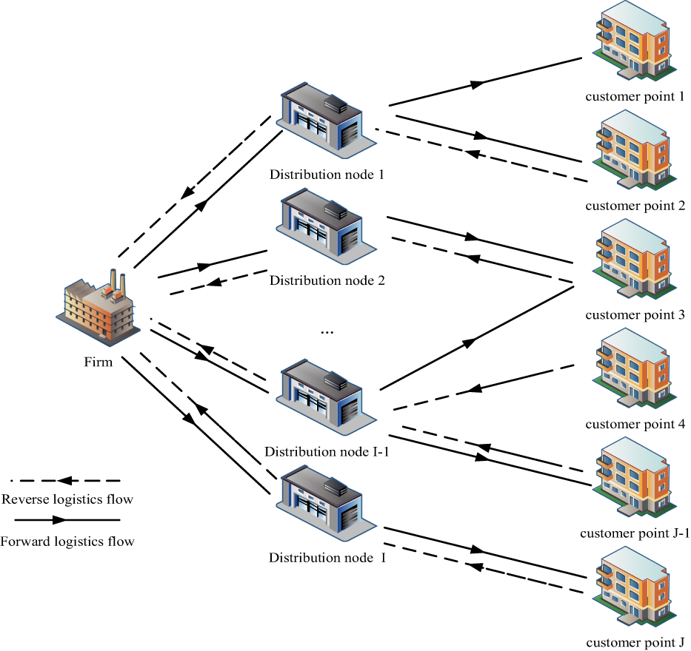
Cold Supply Chains

Slide 6
Problem Statement
We are given a cold-chain logistic system consisting of multiple distribution centers (supply nodes), refrigerated commodity and deep-frozen commodity, and multiple demand nodes and warehouses.
The objective function is to minimize the total cost which includes transportation costs, penalty cost for late deliveries, cooling costs per hour, penalty costs for unsatisfied demands at demand nodes and the holding costs of storing both commodity types that remain unsold.

Slide 7
Model Development
The distribution system of the problem statement can be described as follows :-
The “Knowns”:
sup: Set of supply nodes
dmnd: Set of demand nodes
s_r[dmnd]: The supply of refrigerated commodity at supply node i Є sup
d_r[dmnd]: The demand of refrigerated commodity at demand node j Є dmnd
s_df[dmnd]: The supply of deep-frozen commodity at supply node i Є sup
d_df[dmnd]: The demand of deep-frozen commodity at demand node j Є dmnd
transport_cost[sup][dmnd] : Transportation cost of 1 unit of commodity to travel from supply node i Є sup to demand node j Є N

Slide 8
holding_cost[j]: Unit holding cost of inventory stored at demand node j Є dmnd
time[i][j]: Time period required to travel from supply node i Є sup to demand node j Є dmnd
The “Variables”:
q_r[i][j]: Quantity of refrigerated commodity from supply i to demand node j in thousand kgs
q_df[i][j]: Quantity of deep-frozen commodity from supply i to demand node j in thousand kgs
inv_r[j]: Inventory of refrigerated commodities at demand node j in thousand kgs
inv_df[j]: Inventory of deep-frozen commodities at demand node j in thousand kgs
z[i][j]: Quality factor

Slide 9
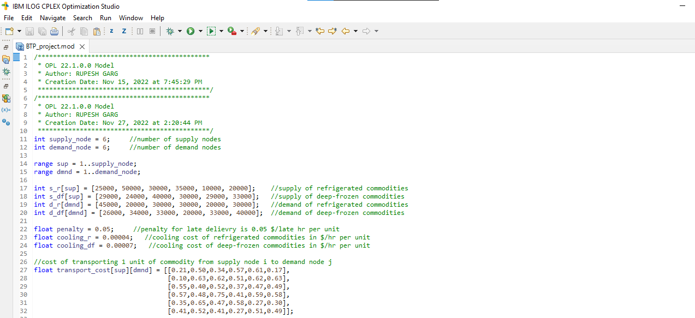
CPLEX Code Screenshot

Slide 10
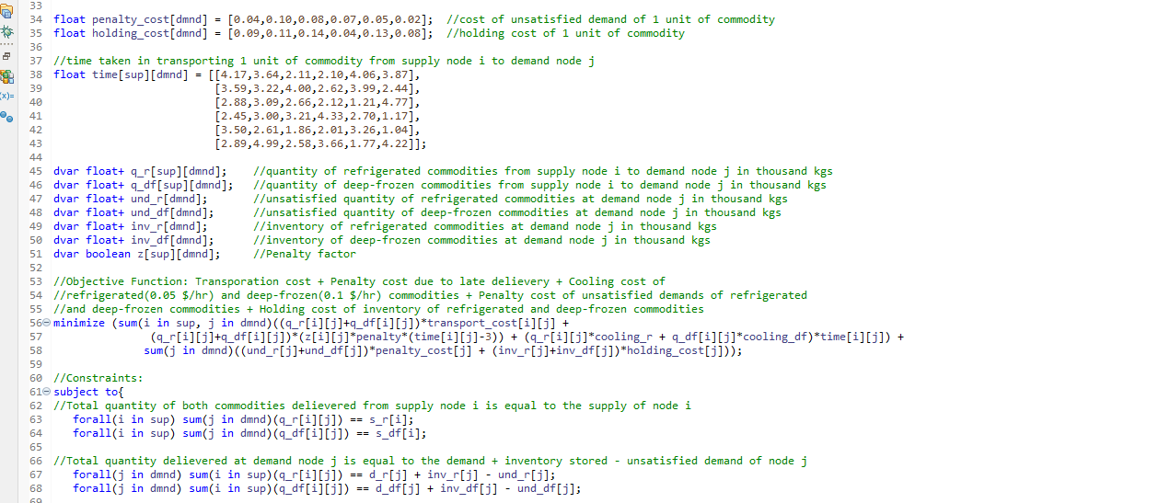

Slide 11
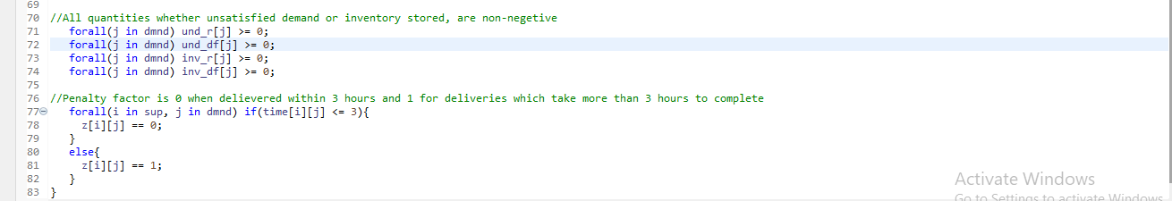
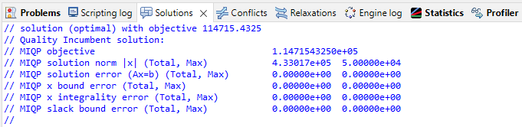
Results

Slide 12
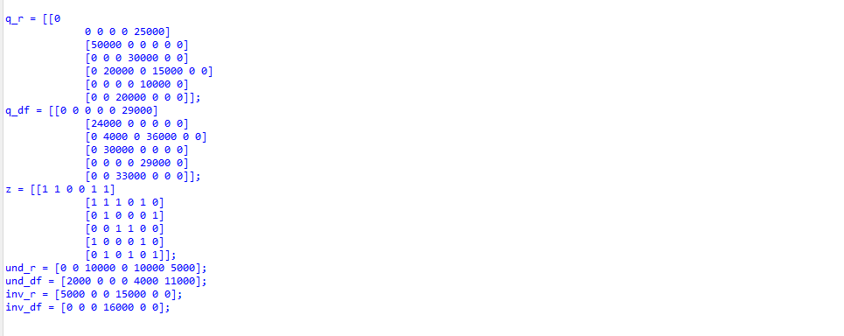
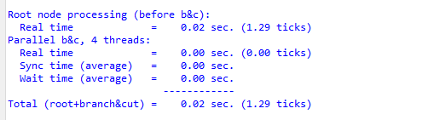
Total time taken in CPLEX

Slide 13
Conclusion
Our goal in this study is to coordinate CSC's logistics while minimizing transportation, penalties, and storage costs. To achieve this goal, a comprehensive optimization model is proposed for coordinating a set of supply and demand nodes. Refrigerated and frozen products are picked up from supply nodes and delivered to demand nodes. Since frozen and chilled products require different degrees of cooling, the cooling costs are also different. We proposed a mixed-integer model that considers detailed vehicle routes, considers inventory costs as storage costs and penalty costs for unmet demand, and solves the cold product distribution problem.
CPLEX offers the best solution with an average computation time of 1.29 ticks. Ultimately, many future research opportunities could be achieved. For example, uncertainties in some parameters can be included in the model, and stochastic or robust operational research techniques can be used to solve such modified models. Additionally, you can use multiple targets to provide a Pareto front for your users. This includes many solutions with different target values ​​related to transportation, penalties, or holding costs.

Slide 14
References and Related Literature
Akkkerman, R., Farahani, P., & Grunow, M. (2010). Quality, safety and sustainability in food distribution: a review of quantitative operations management approaches and challenges. Or Spectrum, 32(4), 863–904
Blackburn, J., & Scudder, G. (2009). Supply chain strategies for perishable products: The case of fresh produce. Production and Operations Management, 18(2), 129–137
Calanche, J., Samayoa, S., Alonso, V., Provincial, L., Roncalés, P., & Beltrán, J. (2013). Assessing the effectiveness of a cold chain for fresh fish salmon (salmo salar) and sardine (sardina pilchardus) in a food processing plant. Food Control, 33(1), 126–135
Cold Storage Case Study: Increasing Energy Efficiency (written on May 24, 2018. posted in news, solar energy, sustainability)
Ji, Y., Yang, H., & Zhou, Y. (2015). In vehicle routing problem with simultaneous delivery and pickup for cold-chain logistics. Proceedings of the international conference on modeling, simulation and applied mathematics, Phuket, Thailand (pp. 23–24).
SaveJoules.com
UNICEF (2015). Cold-chain: the last child, the last mile. http://www.unicef.org/supply/ index_68352.html

