Slide 1

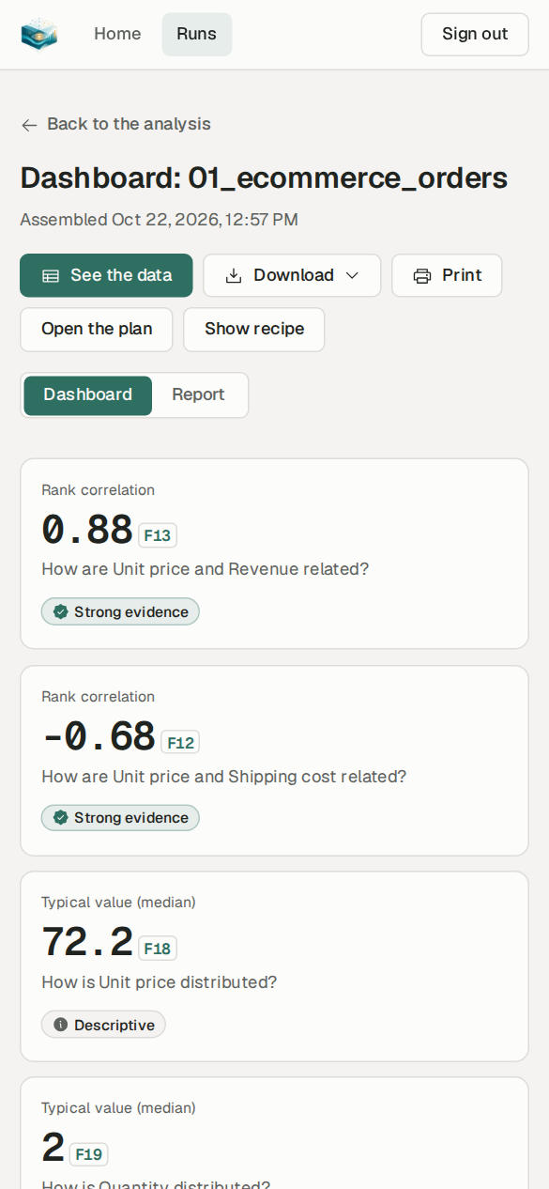
Every number shows its work
InsightfulCell
A verified, privacy-first platform that turns a spreadsheet into tested findings, checked charts and a plain-language report.
LIVE · app.ic.rgproject.me
CDU IT Code Fair 2026 · Rupesh Ghimire (product and engineering) · Sandesh Prasad Paudel (deployment)
Notes:
Open with the promise in the title. InsightfulCell is a web platform: you upload a table and get back a cleaned dataset, statistically tested findings, checked charts and maps, and a report in plain language. The phrase 'every number shows its work' is literal: every figure in the product links to a stored, unchangeable fact you can inspect. It is live today on AWS at app.ic.rgproject.me. Introduce the team: Rupesh built the product end to end; Sandesh took it from local to the hosted AWS deployment.

Slide 2


Spreadsheet owners face a trust gap
General AI assistants
BI and statistics tools
✓ Fluent, fast, no expertise needed
✓ Accurate and reproducible
✗ Numbers can be invented, with no way to check
✗ Data cleaning happens invisibly
✗ Raw rows are sent to a third-party model
✗ Need an analyst to prepare the data
✗ You must already know which questions to ask
✗ Weeks of set-up before the first answer
Our research question Can analysing your own data be as easy as asking an assistant, and as trustworthy as the work of a careful analyst?
Notes:
Frame the problem. People who own a spreadsheet want answers, not a statistics course. Today they choose between two imperfect options. General-purpose AI assistants are fluent but their numbers can be made up, their cleaning is invisible, and sending customer rows to a model is unacceptable for sensitive data. Traditional BI and statistics tools are accurate but need a skilled analyst. Our project started from one question, which is also our academic research question: can analysis be as easy as an assistant and as trustworthy as a careful analyst?

Slide 3



Our answer: a strict division of labour
Code computes
The model only plans and writes
Everything is checked
Every statistic, test, chart value and map value is calculated by deterministic code (DuckDB, SciPy).
A language model may suggest questions and phrase sentences. It never writes a number: it writes slots the engine fills.
Plans are validated, charts recomputed and every sentence verified against its facts before anyone sees it.
Tenets, in priority order: when two goals conflict, the higher one wins
1 Correctness over fluency
›
2 Traceability
›
3 Privacy: rows never reach a model
›
4 Simple to operate
Notes:
This is the core design idea. Code computes; the language model only plans and writes; everything is checked. When two goals conflict we follow a fixed priority: correctness beats fluency, then traceability, then privacy, then simplicity of operation. So a plain, exact sentence always wins over a smooth, wrong one. These tenets are enforced in code and in tests, not just written down.

Slide 4
Live demo
1
Sign in and upload a spreadsheet
2
Watch the analysis run live
3
Review the cleaning (manual mode)
4
Read the report; open a fact
We now switch to the deployed site, app.ic.rgproject.me. The next slides show the same journey, captured on the live site on 22 October 2026.
5
Dashboard, maps and a drill-down
6
See the data, download the report
Notes:
SHARE SCREEN NOW. Demo script, about 5 minutes: 1) Sign in to app.ic.rgproject.me and upload sample_data/4_analysis/01_ecommerce_orders.csv. 2) Click 'Analyse newest version' in Automatic mode and let the steps stream live. 3) Upload sample_data/3_complex/field_service_jobs.csv, choose Manual, and show the review page: each change with rows affected and before/after values. 4) Open the report: click a source chip such as F13 to show the test, interval, q-value and content hash. 5) Open the dashboard, the Australia map, then 'Show the numbers and explore a region' to start a drill-down. 6) Open 'See the data' and the Download menu. If the network fails, the following slides are the backup.

Slide 5
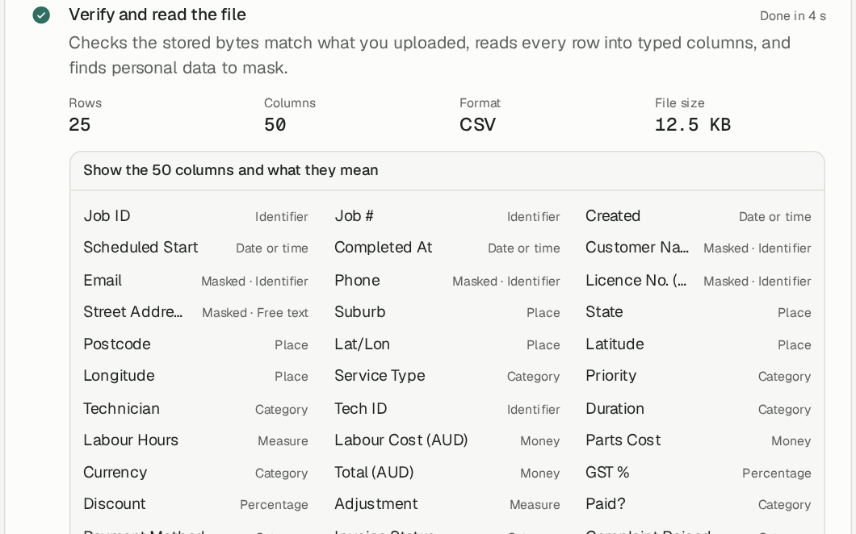
Upload once; every column is understood
Five formats, CSV, TSV, Excel, Parquet and JSON, up to 250 MB
Straight to storage: the browser hashes the file (SHA-256) and uploads it in parallel parts to S3
Duplicates caught: the same bytes are stored once, and you are told
Meaning, not just type: amount, category, date, place, identifier…
Personal data found first: names, emails, phones and licence numbers are masked before anything else happens
live · field_service_jobs.csv · 5 columns masked
Notes:
The screenshot is the messy field-service file on the live site: 25 rows, 50 columns. Notice the columns marked 'Masked': customer name, email, phone, licence number and street address were detected as personal data before any analysis. Uploads never pass through our API: the browser computes the SHA-256 in a Web Worker and sends parts directly to S3 through presigned URLs, so the API stays small and fast. If you upload the same bytes again, nothing new is stored.

Slide 6
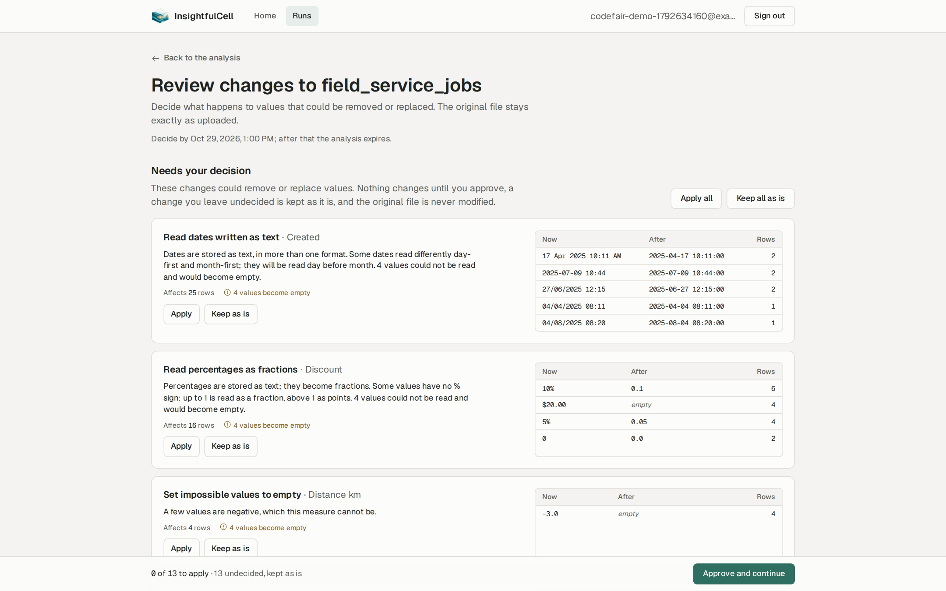
You stay in control of every change to your data
Automatic
Default. Suggested cleaning is applied and the run goes straight to the report.
Manual
The run stops at a review gate. Apply or keep each change, or ask for a different plan in your own words.
Each change shows the rows it affects, before and after
Changes that can lose data are flagged
The uploaded file is never modified
A Python recipe rebuilds the cleaned table
Notes:
Data preparation is where silent errors usually creep in, so the person stays in charge. Automatic mode is the default for speed. Manual mode stops at a review gate: here 13 changes could remove or replace values, for example reading dates written as text, where 4 values could not be read. Each card shows exactly how many rows change and the before/after values. Nothing is applied until you approve, the original upload is never modified, and a downloadable Python recipe reproduces the cleaning outside the app.

Slide 7
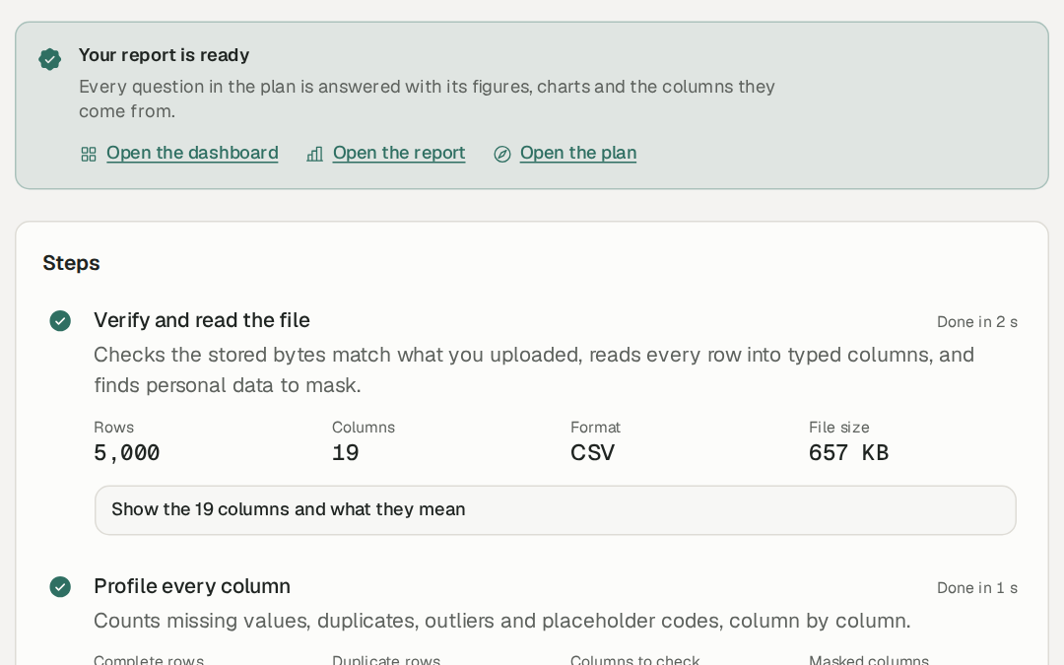
Twelve checkpointed steps, streamed live
14 s
upload to report, 5,000 rows × 19 columns, on a 1 GB server
1,444
chart and map values recomputed; 0 withheld
12
pipeline stages, each checkpointed for retry
Progress arrives over Server-Sent Events with replay and a polling fallback; a run can be cancelled or retried from its last checkpoint.
live run 01a16153 · 22 Oct 2026
Notes:
Every analysis is a run of twelve stages. Each stage is checkpointed by a hash of its inputs, configuration and code version, so a retry resumes where it stopped and an identical re-run reuses earlier work. On the live AWS server, a t3.micro with 1 GB of memory, the 5,000-row e-commerce file went from upload to finished report in 14 seconds, and 1,444 chart and map values were recomputed from the data with none withheld.

Slide 8
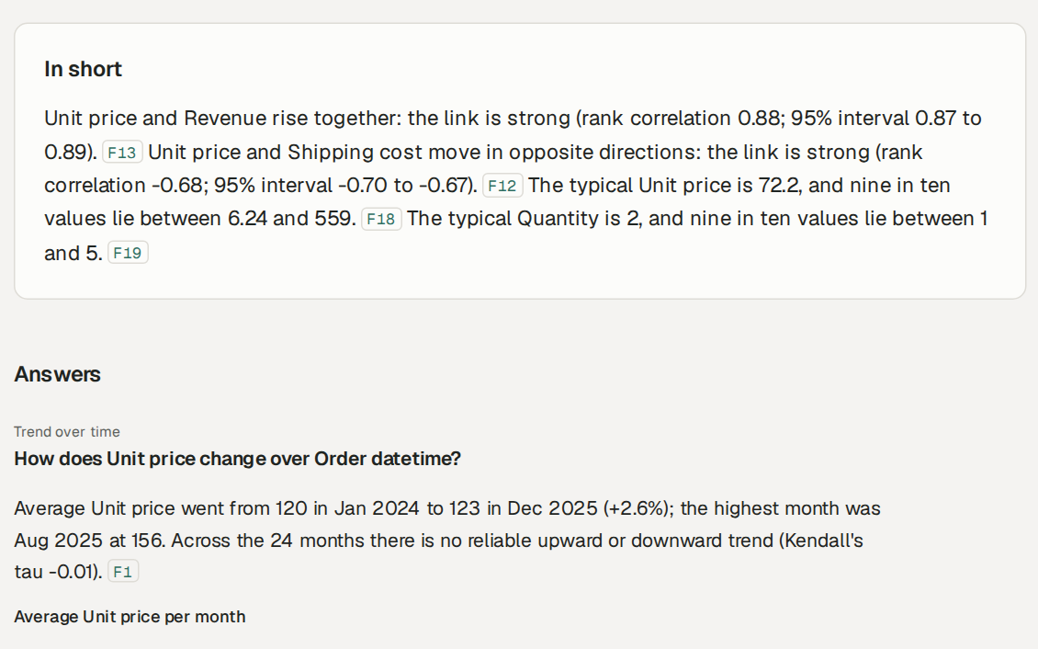
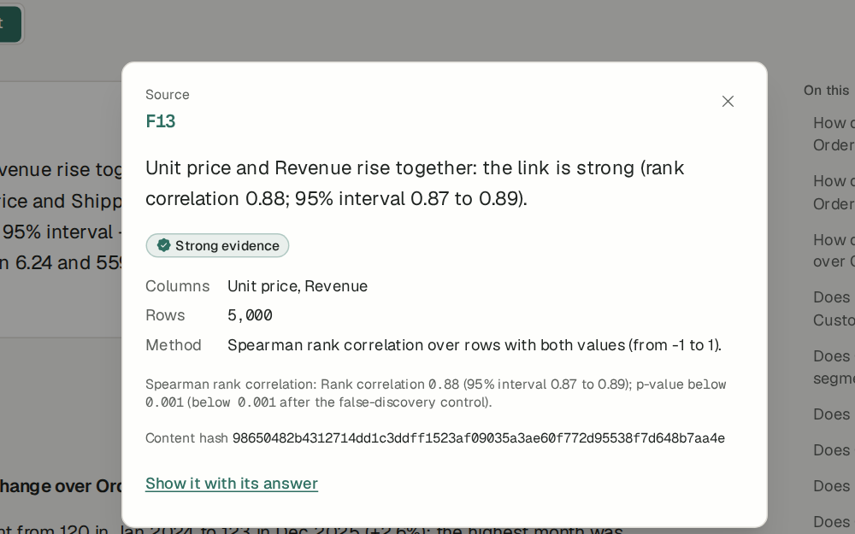
Every sentence cites its facts
Click any chip (F13) to open its fact
A fact is immutable: test, interval, p and q values, rows used, method and a content hash
Notes:
This is the heart of the trust story. The report's 'In short' section and every answer cite facts like F13. Clicking a chip opens the fact inspector: the statement, an evidence badge (Strong evidence), the columns and 5,000 rows used, the method (Spearman rank correlation), the 95% interval, the p-value before and after false-discovery control, and a content hash. Facts are append-only in the database; updates and deletes are rejected by triggers.

Slide 9
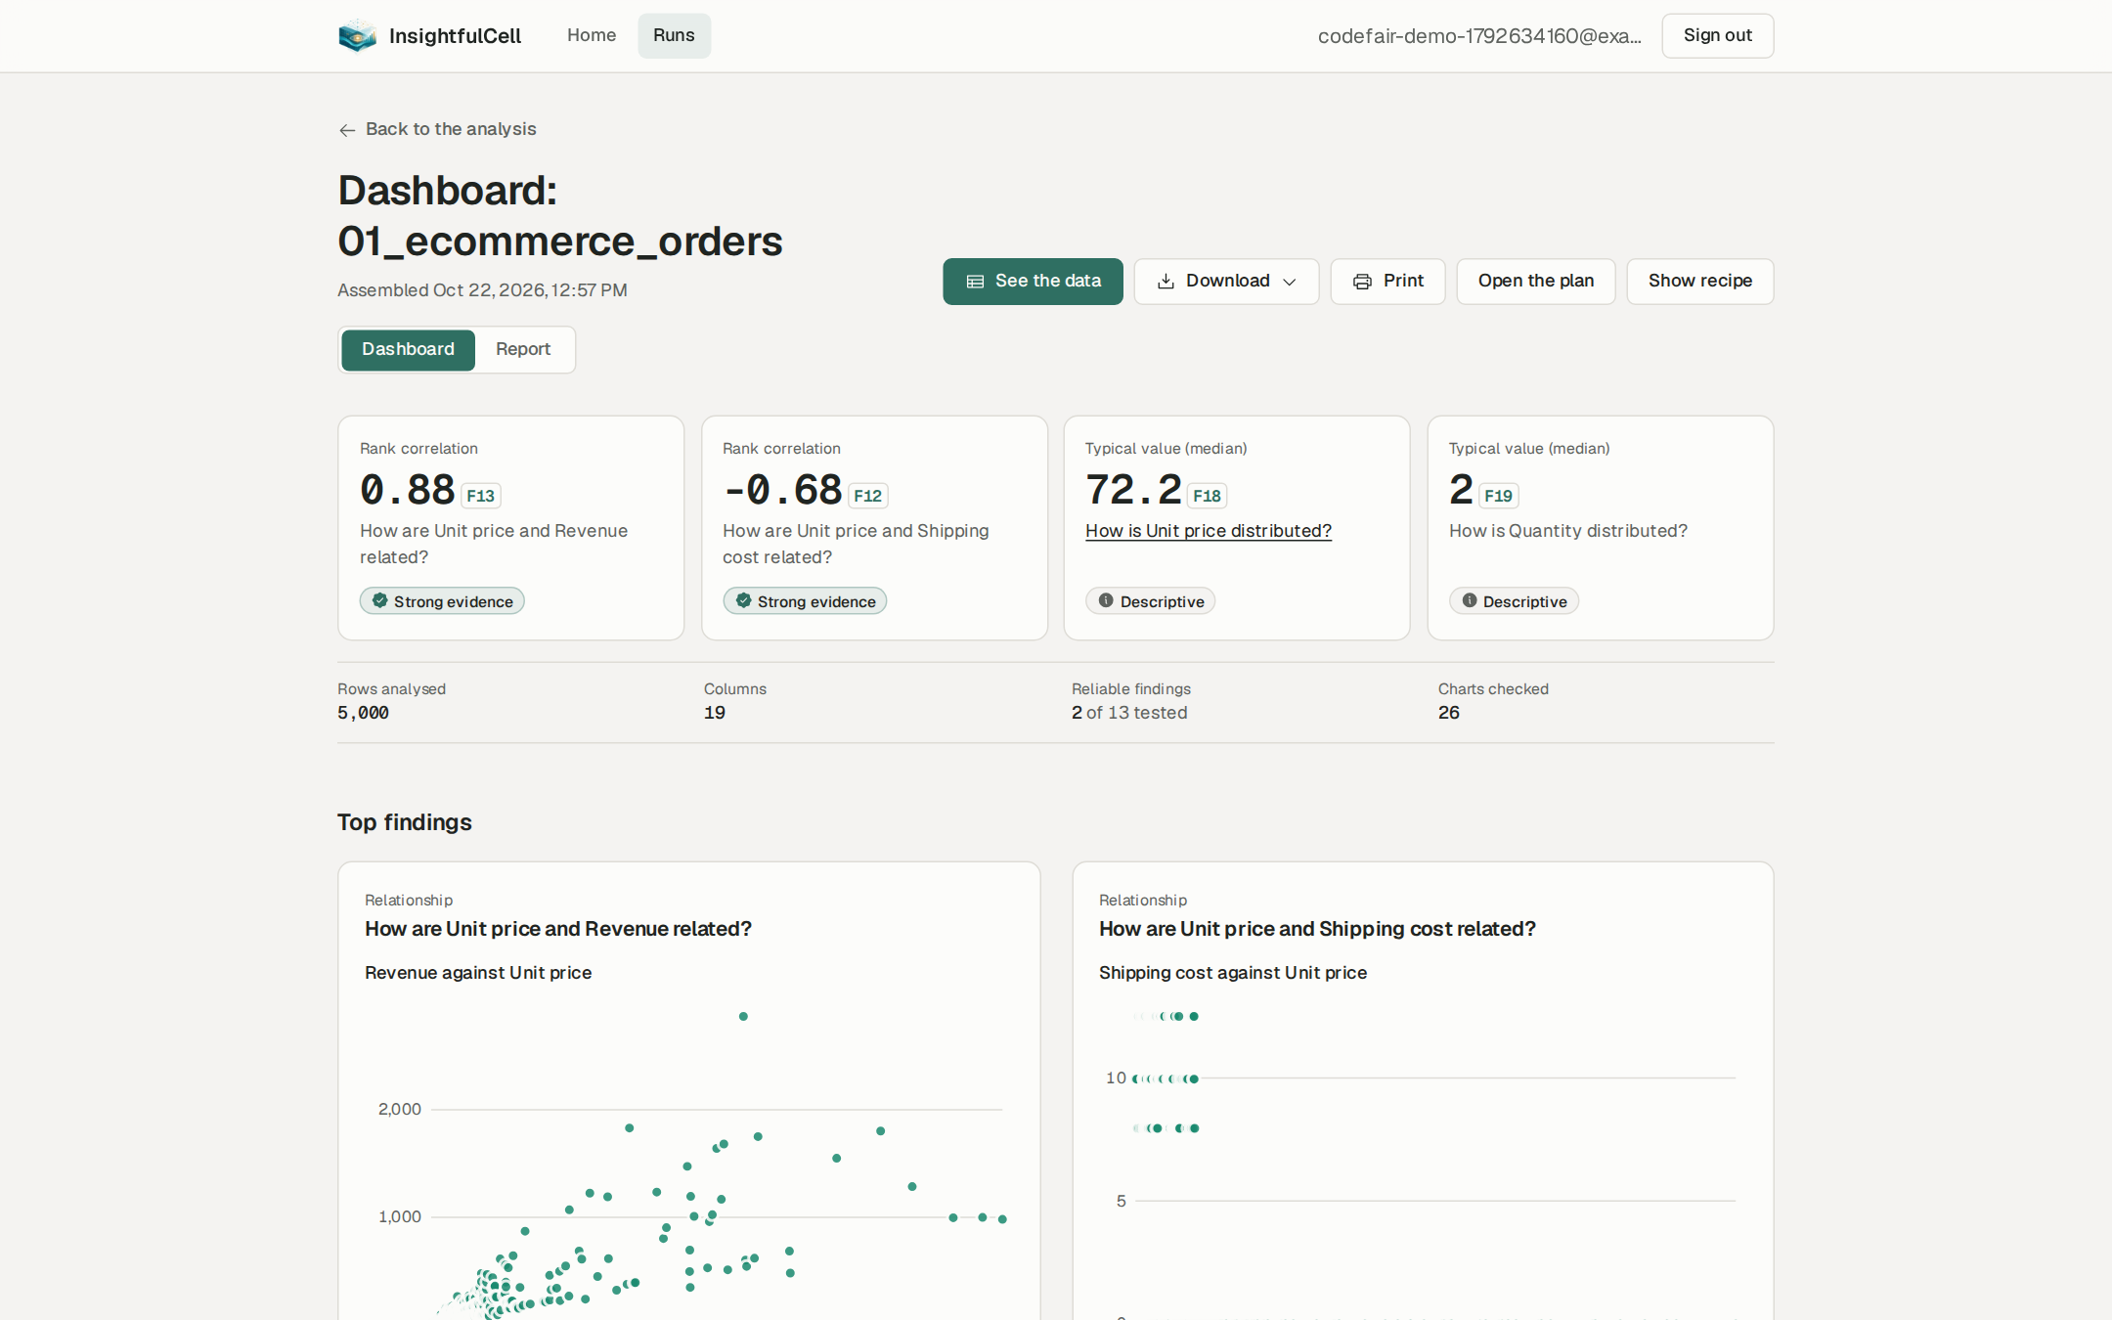
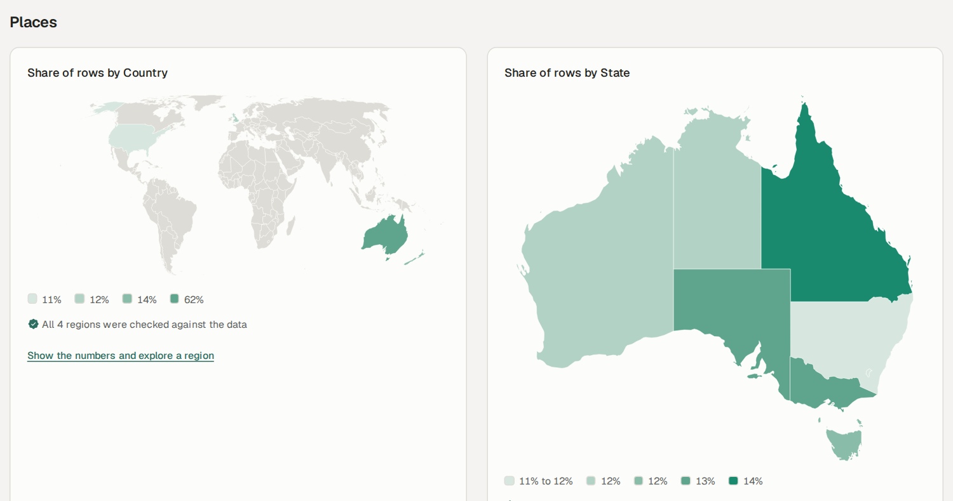
Dashboards and maps you can check
Places resolved offline to countries and Australian states (100% matched here)
Headline tiles carry an evidence badge and a fact chip
Every point is a claim recomputed by its own query; a chart that disagrees is withheld
Notes:
The dashboard puts the strongest findings first, each with an evidence badge: Strong evidence, Supported, Not reliable or Descriptive. Charts are not drawn from model output: every value is recomputed from the data by its own query, and a chart with any mismatch is withheld rather than shown wrong. Place columns are resolved offline against a packaged, digest-pinned reference set, so no data leaves the server for geocoding.

Slide 10
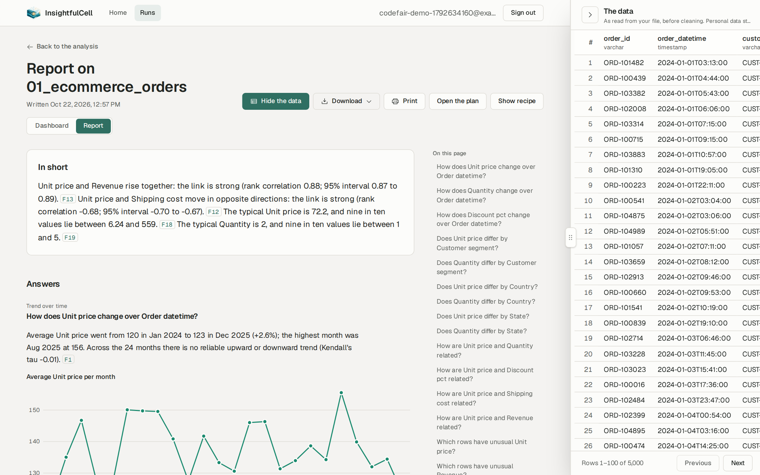

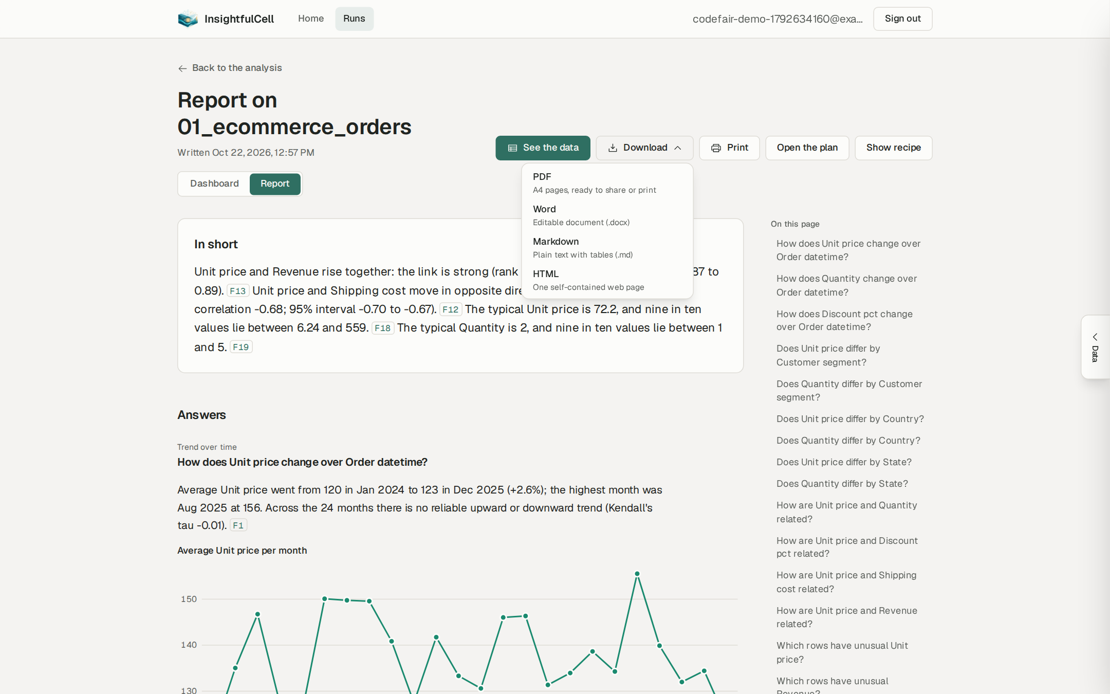
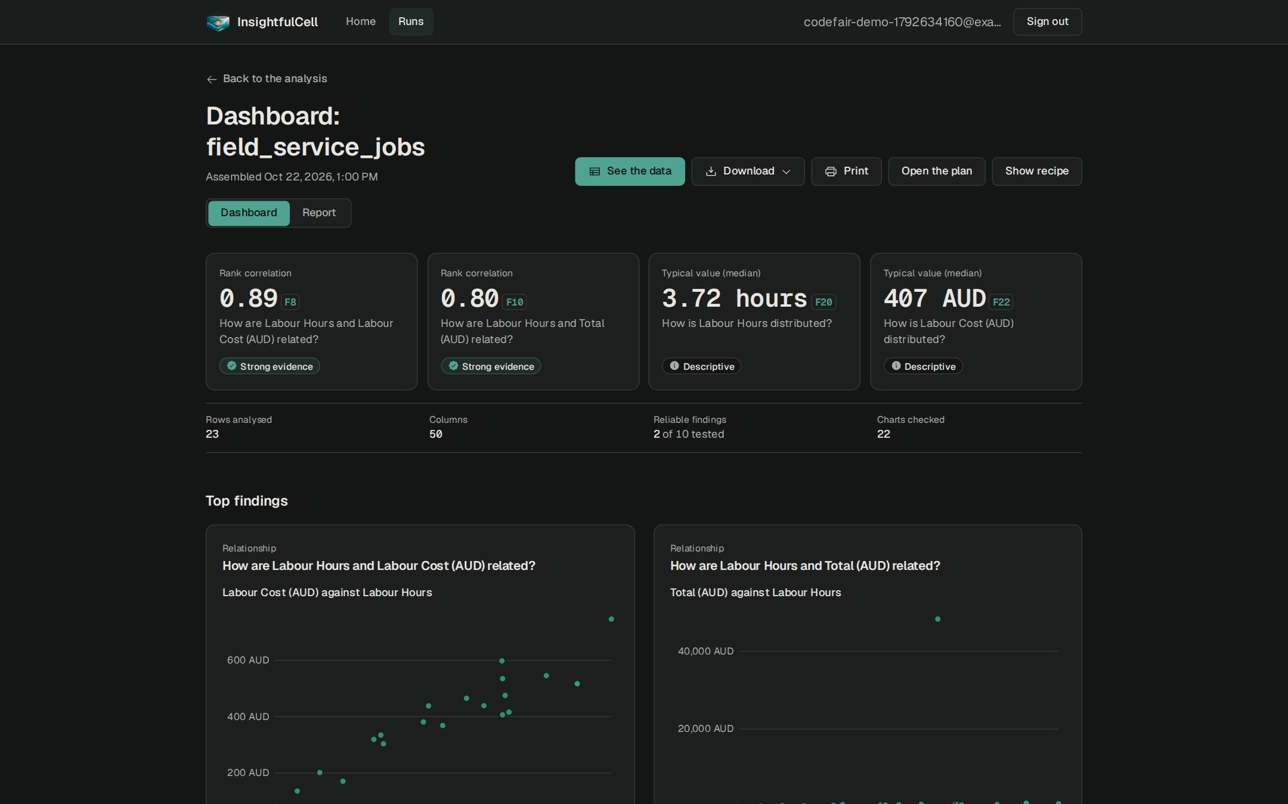
Dig deeper, then share
See the data: the original rows beside the report, personal columns hidden
Drill-down: explore one region as a separate, exploratory analysis
Download as PDF, Word, Markdown or a self-contained HTML file
Accessible by design: keyboard, screen readers, dark scheme, mobile
Notes:
Four ways to go further. 'See the data' opens a resizable panel with the rows as read from the file, one page at a time, with personal-data columns never read. A drill-down explores one group, for example Queensland, as a sub-run that reuses the approved plan and is clearly labelled exploratory, because the group was chosen after seeing results. The report downloads as PDF, Word, Markdown or HTML with no scripts. And the interface is accessible: every component has automated axe tests, with dark scheme and phone layouts.

Slide 11
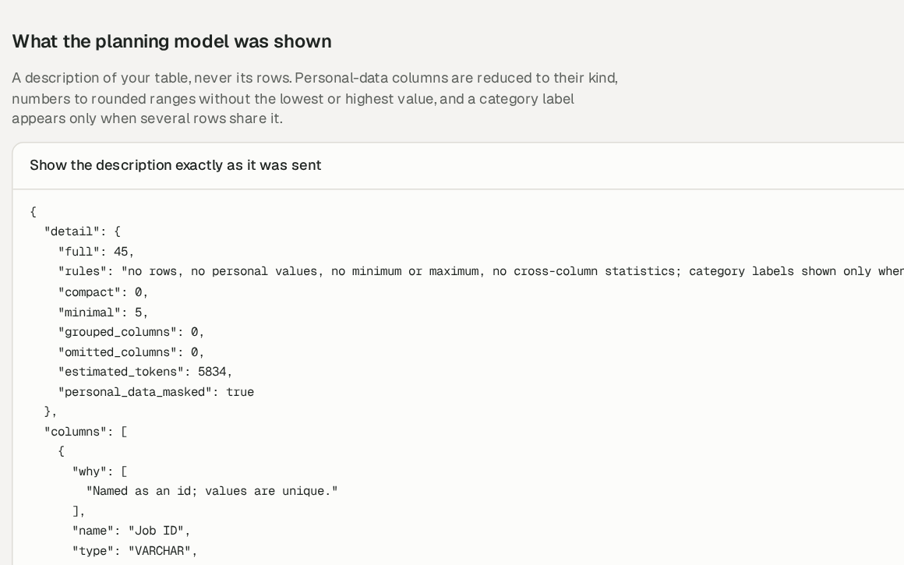
See exactly what a model is shown
No rows, ever. A model sees only a masked description of the table
No personal values, no exact minimum or maximum, no cross-column statistics
A gateway blocks any payload that still contains personal data
AI is optional. Without a model, rules plan the analysis and templates write the sentences
The live site runs with no model configured: the whole product works on deterministic code alone, at zero AI cost.
Notes:
Privacy is tenet three. The recipe page shows, word for word, the description a planning model would be sent: flagged 'personal_data_masked: true', with no rows, no personal values and rounded ranges only. A single gateway is the only code allowed to call a model; it blocks any payload containing personal data, enforces budgets and a hard spend cap, and records every call without prompt text. Importantly, the model is optional: the deployed site currently has none configured, and everything you saw was planned by our rules engine and written from templates.

Slide 12
How it works
Architecture, the analysis pipeline, and the checks that make every number traceable.
Notes:
Now the engineering behind it: architecture, pipeline, statistics, security and deployment.

Slide 13
A modular monolith: three processes, two stores
Web app
Next.js · Better Auth · BFF proxy
15-min EdDSA token
API
FastAPI · tokens verified offline
session cookie
Browser
React, Web Worker
PostgreSQL 18
data · job queue · events · auth
presigned PUT
Object storage
Amazon S3 · bronze / silver / gold
Worker
same image · 12 stages
Language model
optional · masked only
The API never sees file bytes or passwords; the browser never holds an API token
PostgreSQL is also the queue and event bus: one system to secure and back up
Notes:
The system is a modular monolith shipped as three processes. The browser talks to the Next.js web app, which handles sign-in with Better Auth and proxies API calls as a backend-for-frontend, minting a 15-minute EdDSA token on the server so the browser never holds it. File bytes go straight to S3 through presigned URLs. The API and the worker are the same Python package; the worker does all heavy work and the only model calls. PostgreSQL holds business data, the job queue, the event log and the auth tables: one fewer system to run. Layering is enforced by six import-linter contracts in CI.

Slide 14
The pipeline: understand, review, then prove
PHASE A · understand and plan
review gate
ingest
profile
understand
clean_plan
automatic: pass through
manual: wait for approval
PHASE B · clean, test, explain
clean_apply
geo
features
mine
sensitivity
rank
visualize
report
understand
A rules planner (or a model, validated item by item) decides which questions to ask
features
A derived measure is kept only if it beats 19 random shuffles
mine
Nine miners test the questions; false discoveries controlled at 5% across the run
sensitivity
The top ten findings are re-tested on lossless-only data
visualize · report
Charts recomputed; sentences narrated from facts and verified
Notes:
An analysis runs as two jobs on the queue, split at the review gate. Phase A ingests and re-hashes the bytes, profiles every column, plans which questions to ask, and proposes typed cleaning operations. Phase B applies the approved cleaning, resolves places, keeps derived features only if they carry signal, mines the questions with nine statistical miners, re-tests the strongest findings without lossy cleaning, ranks them, recomputes every chart value and finally writes and verifies the report.

Slide 15
Numbers come from facts, never from the model
1
2
3
4
Fact stored
Slots, not numbers
Engine fills
Verifier checks
→
→
→
The engine stores each finding: numbers, test, interval, p and q, provenance, content hash. Append-only.
A model (or a template) writes the sentence with numeric slots such as {F3.1}.
Numbers are copied from the fact, never from model text.
Citations, stray numbers, direction, strength words versus effect size, causal language.
Model writes Unit price and Revenue rise together: the link is strong (rank correlation {F13.r}).
Reader sees Unit price and Revenue rise together: the link is strong (rank correlation 0.88; 95% interval 0.87 to 0.89). F13
A sentence that fails is rewritten once, then replaced by the fact’s own statement. The summary is written last, from verified findings only. Evaluation: all 31 planted errors in the corrupted-narrator suite are rejected.
Notes:
This mechanism is what makes hallucinated numbers structurally impossible. The engine stores each finding as a fact. The writer, model or template, can only refer to numbers through slots. The engine fills them from the fact. Then a verifier checks every sentence for missing citations, stray numbers, wrong direction, wording that overstates the effect size, causal language and missing conditions. A failing sentence gets one rewrite, then falls back to the fact's own plain statement. Our evaluation suite plants 31 deliberate errors in narration; all 31 are rejected while 11 clean sentences are kept.

Slide 16
Statistical rigour, by construction
5%
False-discovery rate, controlled across the whole run (Benjamini–Hochberg), not per test
19
Random shuffles a derived feature must beat before it is kept (signal gate)
10
Strongest findings re-tested on lossless-only data, so cleaning cannot create them
9
Miners: differences, relationships, trends, drivers, outliers and more; every test is logged
Each finding gets an honest tier: Strong evidence · Supported · Not reliable · Descriptive. Intervals are reported with every estimate, and causal wording is rejected by the verifier.
Notes:
For an academic audience: testing many hypotheses on one table inflates false positives. We control the false-discovery rate at 5% across the whole run with Benjamini–Hochberg, using every test in a persistent test log. Derived features must beat 19 random permutations, which is a 5% level permutation test. The ten strongest findings are re-tested on data with only lossless cleaning, to rule out findings created by our own cleaning. Findings are tiered honestly, and the verifier rejects causal language because correlational analysis cannot support it.

Slide 17






Security and privacy, enforced in the database
Tenant isolation
Short-lived identity
Personal data stays home
Forced row-level security on every tenant table; the organisation comes only from the verified token
15-minute EdDSA tokens with a pinned algorithm; the browser never receives one
Detected at ingest, masked in the model card, blocked by the gateway
Tamper evidence
Hostile files
Hard spend cap
Facts, tests, events and model calls are append-only, enforced by triggers; facts carry content hashes
Extension allow-list, magic bytes, size and shape limits, zip-bomb guard, parsing only in the worker
Each model call reserves its worst-case cost first; the total can never pass the cap
system test 18 Oct: 0 of 22 cross-tenant attacks succeeded
Notes:
Security is designed into the data layer, not bolted on. Every tenant query runs in a transaction that sets the organisation from the verified token, and every tenant table has forced row-level security, so even a bug in our service code cannot read another organisation's rows. In our 18 October system test, all 22 cross-tenant attacks failed. Tokens are short-lived and never reach page scripts. Results are tamper-evident. Uploads are treated as hostile. And because this runs as a public demo, a hard spend cap reserves the worst-case cost of each model call before it is made.

Slide 18
Live in production on AWS
EC2 t3.micro · Docker Compose
One command to release: ./deploy.sh pulls the images, migrates and waits for health
Roll back by deploying an earlier commit’s images
No storage keys anywhere: S3 access comes from the instance role
Cost: free-tier instance; about US$3.6 a month for the IP address outside it
Only change needed: upload links signed for the bucket’s regional S3 host
web
Next.js
Browser
HTTPS
Caddy
auto-HTTPS
api
FastAPI
postgres
private
worker
1 run at a time
GitHub Actions → ghcr.io
images per commit
S3 uploads
instance role
S3 backups
nightly dump
deploy/aws · live since 22 Oct 2026
Notes:
The product is deployed, not just a local demo. One free-tier EC2 instance runs PostgreSQL, the API, the worker and the web app under Docker Compose. A shared Caddy proxy provides automatic HTTPS. GitHub Actions builds the images on every push, because a 1 GB server cannot build the web app; the server only pulls them, and rolling back is deploying an earlier commit's images. Uploads go straight to a private S3 bucket using the instance role, so there are no keys in config files, and the database is dumped to a backups bucket every night. The only code change needed for AWS was signing upload links for the bucket's regional host. Credit to Sandesh for the deployment.

Slide 19
Engineering quality you can measure
719
93%
422
6
backend tests (unit + integration on real PostgreSQL and S3)
backend line coverage (full gate, 21 Oct 2026)
frontend tests, each component with an axe accessibility check
architecture contracts enforced by import-linter in CI
Style and lint
ruff, prettier, eslint (jsx-a11y)
Types
mypy strict, TypeScript strict
Database
every migration up, down and up again
Contract
OpenAPI → TypeScript drift check
Browser journeys
Playwright, against a real worker
Supply chain
pip-audit, pnpm audit, secret scan
Notes:
Quality is measured, not claimed. 719 backend tests including integration tests on a real PostgreSQL with row-level security and real S3; 93% line coverage on the last full gate on 21 October; 422 frontend tests, each component with an automated accessibility check; and six architecture contracts so the analysis engine can never import web or database code. The same script runs locally and in CI. Plus two evaluation suites: planted statistical effects that must be found, and planted narration errors that must be rejected.

Slide 20
Business prospect
Who it serves, how it competes, how it could earn, and what is still open.
Notes:
Now the business side: market, positioning, a proposed model, and an honest view of limitations.

Slide 21




Positioned where trust matters more than flair
 | InsightfulCell | AI assistant | BI / statistics tool
Every number traceable to a test | ✓ | ✗ | Partly
Raw rows stay private | ✓ | ✗ | ✓
No analyst needed | ✓ | ✓ | ✗
False discoveries controlled | ✓ | ✗ | Manual
Reproducible recipe | ✓ | ✗ | Partly
Plain-language report | ✓ | ✓ | ✗
Who it is for
Small and medium businesses
sales, operations and service data, no analyst on staff
NGOs and public sector
sensitive records that cannot go to an AI vendor
Students and researchers
auditable statistics and a reproducible recipe
Consultants
fast first analysis with evidence for the client
Notes:
Our positioning is trust. Compared with general AI assistants, we keep raw data private and make every number traceable. Compared with BI and statistics tools, we remove the need for an analyst while keeping statistical control and reproducibility. The segments where this matters most: small and medium businesses without an analyst, NGOs and the public sector holding sensitive records, students and researchers who need auditable statistics, and consultants who need evidence they can hand to a client. This comparison is our qualitative assessment, not a measured benchmark.

Slide 22
A proposed model: AI cost stays optional
Community
Pro
Team / private
Free
Per seat
Per organisation
Rules planner and template narration
All checks, charts, maps, exports
No AI cost to serve
Model-planned questions and narration
Per-person hard spend cap
Priority processing
Organisation workspaces and roles
Self-hosted on the customer’s cloud
Audit log and SSO (roadmap)
≈ US$0.26
$0
1 host
target model cost per run (baseline design)
model cost per run in rules-only mode, as on the live site today
runs the whole stack; scales by instance size first
PROPOSED · pricing not yet validated
Notes:
This is a proposed model for discussion, not validated pricing. Because the product works fully without a language model, the free tier can be served at near-zero marginal cost. Pro adds model planning and narration, protected by the per-person spend cap we already built. A team or private tier serves organisations that must keep data in their own cloud; our AWS deployment kit is the starting point. Our baseline design targets about 26 US cents of model cost per run, and rules-only runs cost nothing in model fees.

Slide 23
Honest limitations, and what we learned
Automatic cleaning can still change data silently
in a few cases (0–100 percentage columns, decimal commas, close-sounding names). Use Manual review for sensitive work until fixed.
What we learned
Data preparation, not statistics, is where trust is won or lost
A product that works without AI is cheaper, faster and easier to trust
Enforcing rules in the database and in CI beats relying on convention
Testing on a real deployment finds what local tests miss (the S3 regional host)
Asking questions in plain language is not built yet
Phase 7: tiered Q&A with closed tools, quotas and an answer cache.
Production is one small server
no staging, monitoring, alerts or point-in-time recovery yet; one analysis at a time.
Accounts are basic
one workspace per person, email not verified, no invitations in the UI.
Notes:
In the academic spirit, we state our limitations. Our own system test found that automatic cleaning heuristics can change data silently in some cases, such as percentage columns on a 0 to 100 scale, decimal commas and close-sounding category names; manual review avoids this until the heuristics are fixed. Natural-language Q&A is the next phase. Production is a single small server without monitoring. Our lessons: trust is won or lost in data preparation; building AI as optional made the product cheaper and more robust; and a real deployment surfaced a bug local tests could not, the S3 regional host.

Slide 24
Roadmap
Done
22 Oct 2026
Next
Next
11 Dec 2026
12 Mar 2027
9 Apr 2027
Phases 0–6
Live on AWS
Phase 7 · Q&A
Phase 8 · Operations
Release 1 alpha
Release 2 beta
General availability
Sign-in, uploads, queue, pipeline, narration, report, dashboard, exports
One host, HTTPS, S3, nightly backups, CI-built images
Ask questions of your data with closed, verified tools
Staging, monitoring, audit log, rate limits, retention
First real users
Teams, roles, shared reports, semantic search
Service levels and cost controls
Release dates are the baseline plan in the project’s system map; Phases 7 and 8 are not started.
Notes:
Where we are and where we are going. Phases 0 to 6 are built and tested, and on 22 October the product went live on AWS. Next come natural-language questions over the data, Phase 7, and production operations, Phase 8. The planned milestones are a Release 1 alpha on 11 December 2026, a beta in March 2027 and general availability in April 2027. These dates come from the baseline plan.

Slide 25
Thank you. Questions?
InsightfulCell
Why it matters
Every number traces to an immutable, hashed fact
Raw rows never reach a language model
False discoveries controlled across the whole run
Works fully without AI; live on AWS today
Code computes, the model only writes, and every number shows its work.
TRY IT · app.ic.rgproject.me
Rupesh Ghimire, project owner and lead developer · Sandesh Prasad Paudel, deployment
Notes:
Close with the recap: every number traces to an immutable, hashed fact; raw rows never reach a language model; false discoveries are controlled across the whole run; and the product works fully without AI and is live on AWS today. Invite the audience to try app.ic.rgproject.me and take questions.

