Slide 1

CAR RESERVATION SYSTEM (C.R.S)
Alex, Chongwei, Rupesh

Slide 2
Team C.A.R
Alex Aguilar (AWS
Chongwei Ma
Rupesh Ghimire(AWS Pricing) -I like playing outdoor games and I was a ping pong champion during my freshman year in college.

Slide 3
Project BackGroung
Clients can see the details of the car in the inventory before they make a reservation.
Clients can book reservations with our highly experienced reservation specialist through the C.R.S system.
Clients can update and cancel their reservations.
Clients can see their invoices after they are done making reservations.

Slide 4
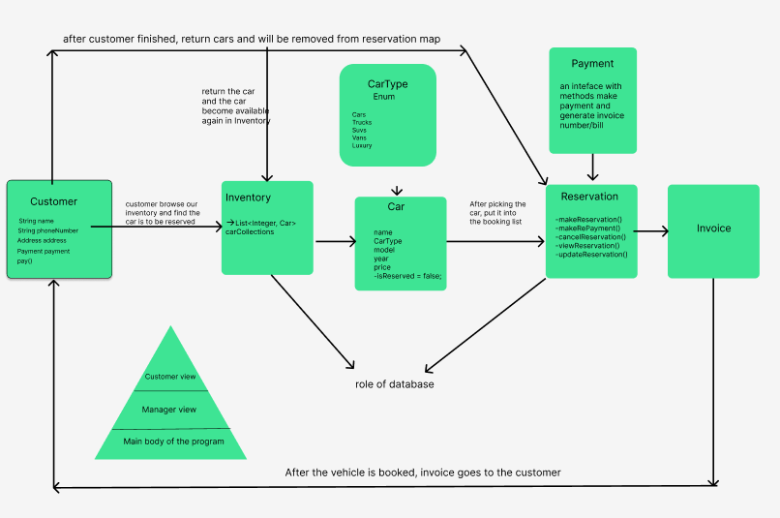
Flow Diagram

Slide 5
Demo

Slide 6
Values, Benefits and ImpaCt
Flexible in booking and canceling the reservations
Able to add balance if user doesn’t have sufficient balance to reserve
Able to view the inventory while making reservations

Slide 7
Future Plans
Able to Logged in as an admin
Payment (Credit Card/Loan)
Graphical User Interface(GUI)
Database

Slide 8
Technologies USED
Java
IntelliJ
GitHub
Figma
Trello Board

Slide 9
Key LESSONS
TeamWork (mob/pair programming)
Unit Tests
Git Commands (commit, push, pull, merge, rebase, squashing)
Building new repositories from the ground up
Debugging
Clean code and proper coding practices

Slide 10

Questions?

Slide 11
Thank You!

