Slide 1

CAR RESERVATION SYSTEM (C.R.S)
Alex, Chongwei, Rupesh

Slide 2
Team C.A.R
Alex Aguilar -Location: Pearl City, HI -OJT Team: Engineering Planning & Analytics -When I was in the Air Force, I could benchpress 450lbs and deadlift and squat 500lbs.
Chongwei Ma -Location: Seattle, WA -OJT Team: Documentation Develop Operations -I like pistol shooting and I was really thinking open a gun shop one day before joining AWS
Rupesh Ghimire -Location: Cameron, NC -OJT Team: AWS Pricing -I like playing outdoor games and I was a ping pong champion during my freshman year in college

Slide 3
Project BackGroung
Clients can see the details of the car in the inventory before they make a reservation.
Clients can book reservations with our highly experienced reservation specialist through the C.R.S system.
Clients can update and cancel their reservations.
Clients can see their invoices after they are done making reservations.

Slide 4
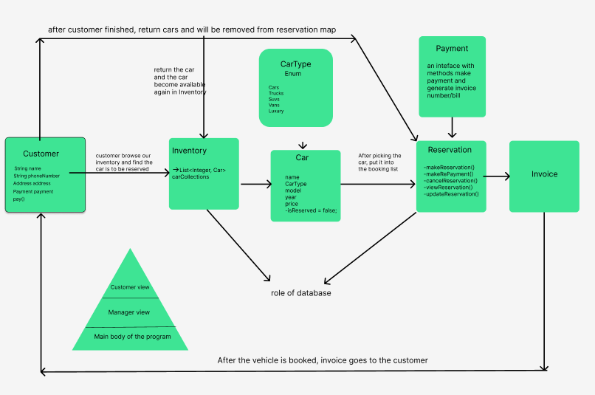
Flow Diagram

Slide 5
C.R.S Demo

Slide 6
Values, Benefits and ImpaCt
Flexible and easy to book, update and cancel the reservations
User friendly booking system
Multiple users booking functionality

Slide 7
Future Plans
Able to Logged in as an admin
Payment (Credit Card/Loan)
Graphical User Interface(GUI)
Database

Slide 8
Technologies USED
Java
IntelliJ
GitHub
Figma
Trello Board

Slide 9
Key LESSONS
Teamwork (mob/pair programming)
Unit Tests
Git Commands (commit, push, pull, merge, rebase, squashing)
Building new repositories from the scratch
Debugging
Clean code and proper coding practices

Slide 10

Questions?

Slide 11
Thank You!

