Slide 1
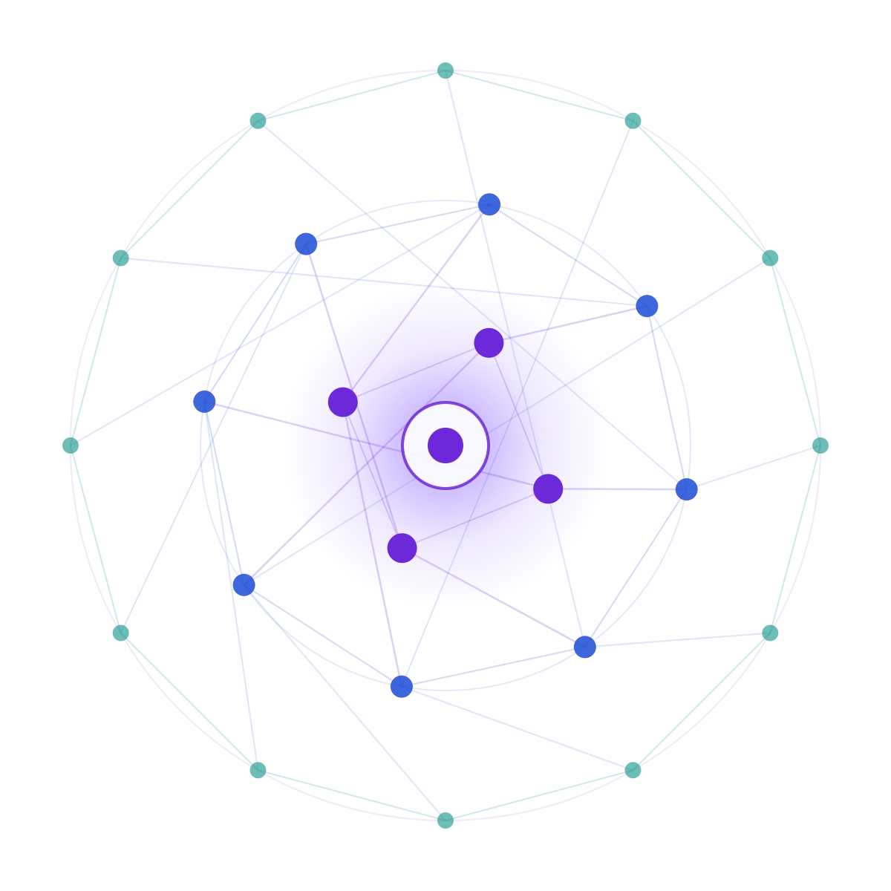
Generative AI Hackathon
SAMSUNG PRISM
Theme ID 05
Project INTERLOCK — Reality, without guesswork.
Team name 404NotFound
College Vellore Institute of Technology, Vellore
Member 1 Rohan Chaudhary · rohan.chaudhary2024@vitstudent.ac.in
Member 2 Amrit Kumar · amrit.kumar2024@vitstudent.ac.in
Member 3 Rupesh Tripathi · rupesh.tripathi2024@vitstudent.ac.in
Member 4 Abhinav Anand . abhinav.anand2024b@vitstudent.ac.in
Submission github.com/rupeshhh007/404-samsung
2026 – 27

Slide 2
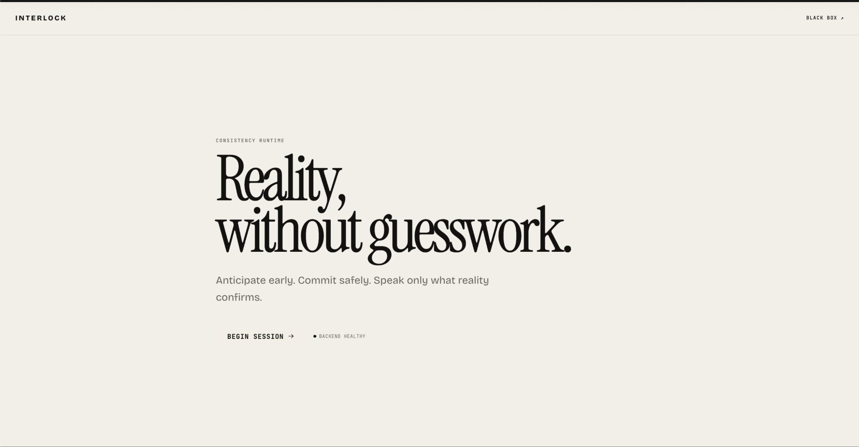
Theme 05 — Voice-native, interruption-safe agents
PROBLEM / THEME
WHAT CHANGES WHEN PEOPLE INTERRUPT AN AGENT?
Voice is fluid.
External effects are not.
A correction can arrive before, during, or after a tool commits. INTERLOCK tracks what the user wants and what the external world actually did — without conflating either with fluent speech.
ANTICIPATE • ADAPT • VERIFY
Product landing view · INTERLOCK Console
Theme ID 05 • Samsung PRISM Generative AI Hackathon, 3rd Edition
02 / 12

Slide 3
Existing Solutions & Gaps
WHY CURRENT ASSISTANTS CAN FAIL
01
Fast reply, weak proof
02
Corrections create races
03
Speech ≠ tool control
An acknowledgement or tool timeout can be mistaken for a completed action; certainty outruns evidence.
An old booking may commit after the user changes their mind. The late effect must not disappear.
Stopping TTS must not automatically undo a provider operation. Barge-in and task cancellation differ.
CORE RESEARCH / ENGINEERING GAP
No single consistency boundary across evolving intent, provider effects, verified claims and interruptible speech.
03 / 12

Slide 4
Our Solution & Architecture Diagram
SINGLE-AUTHORITY EXECUTION MODEL
DATA FLOW · BROWSER MICROPHONE AND CONSOLE
BROWSER
LIVEKIT
TRANSPORT
BACKEND
EXECUTION
›
›
›
›
Mic / Console
STT / TTS / VAD
Authenticated WS
Journal + reducer
SAFEPOINT + tools
CONSOLE
TRUTHLOCK
PROVIDER FACTS
Backend projection
‹
Claim-based speech
‹
Evidence + world effects
ONE backend Application owns intent, operations, effects, claims, TRUTHLOCK and ProjectionHub. LiveKit is audio transport only.
Provider in Samsung extension: deterministic, simulated samsung-demo-v1 · Consequential work passes authorization + SAFEPOINT.
04 / 12

Slide 5
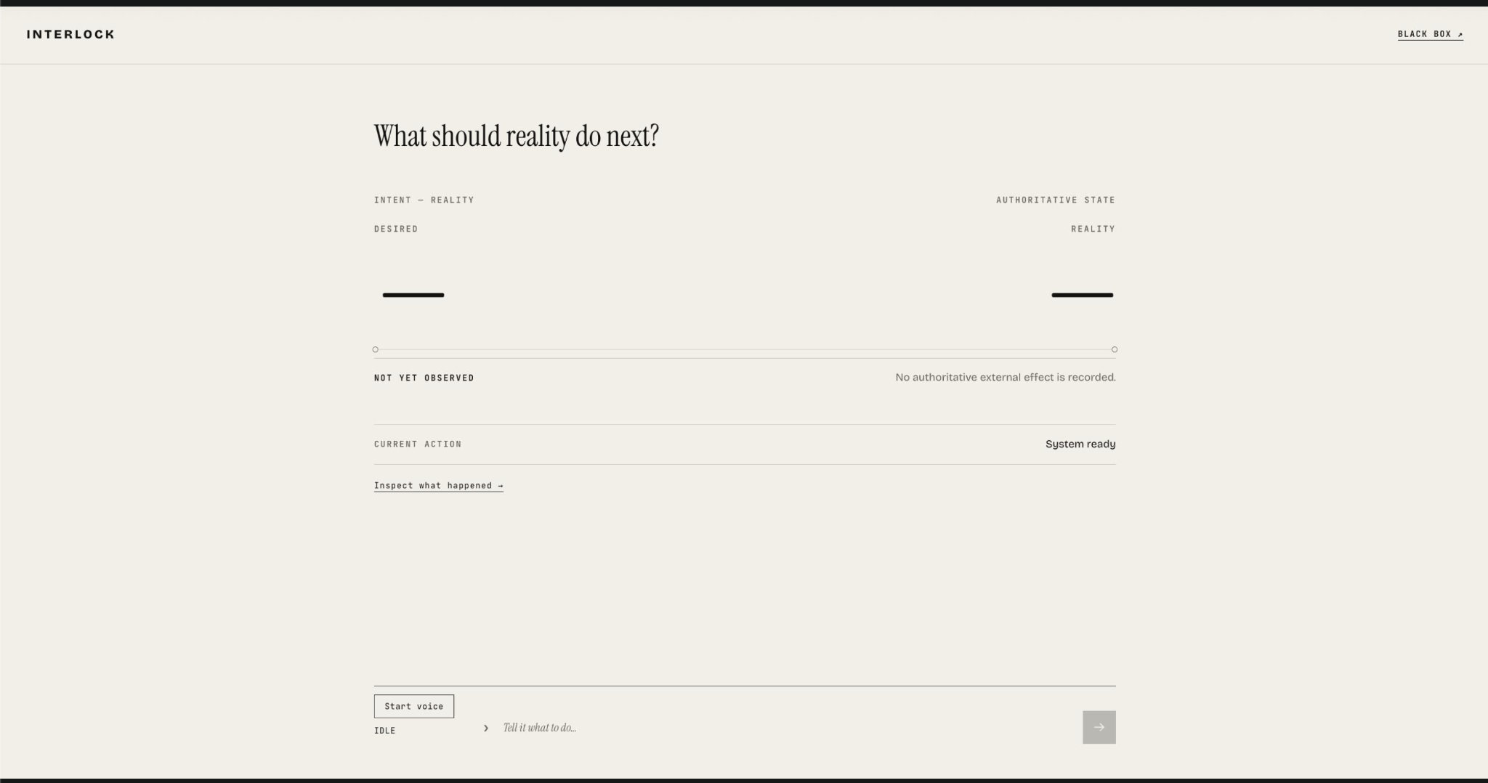
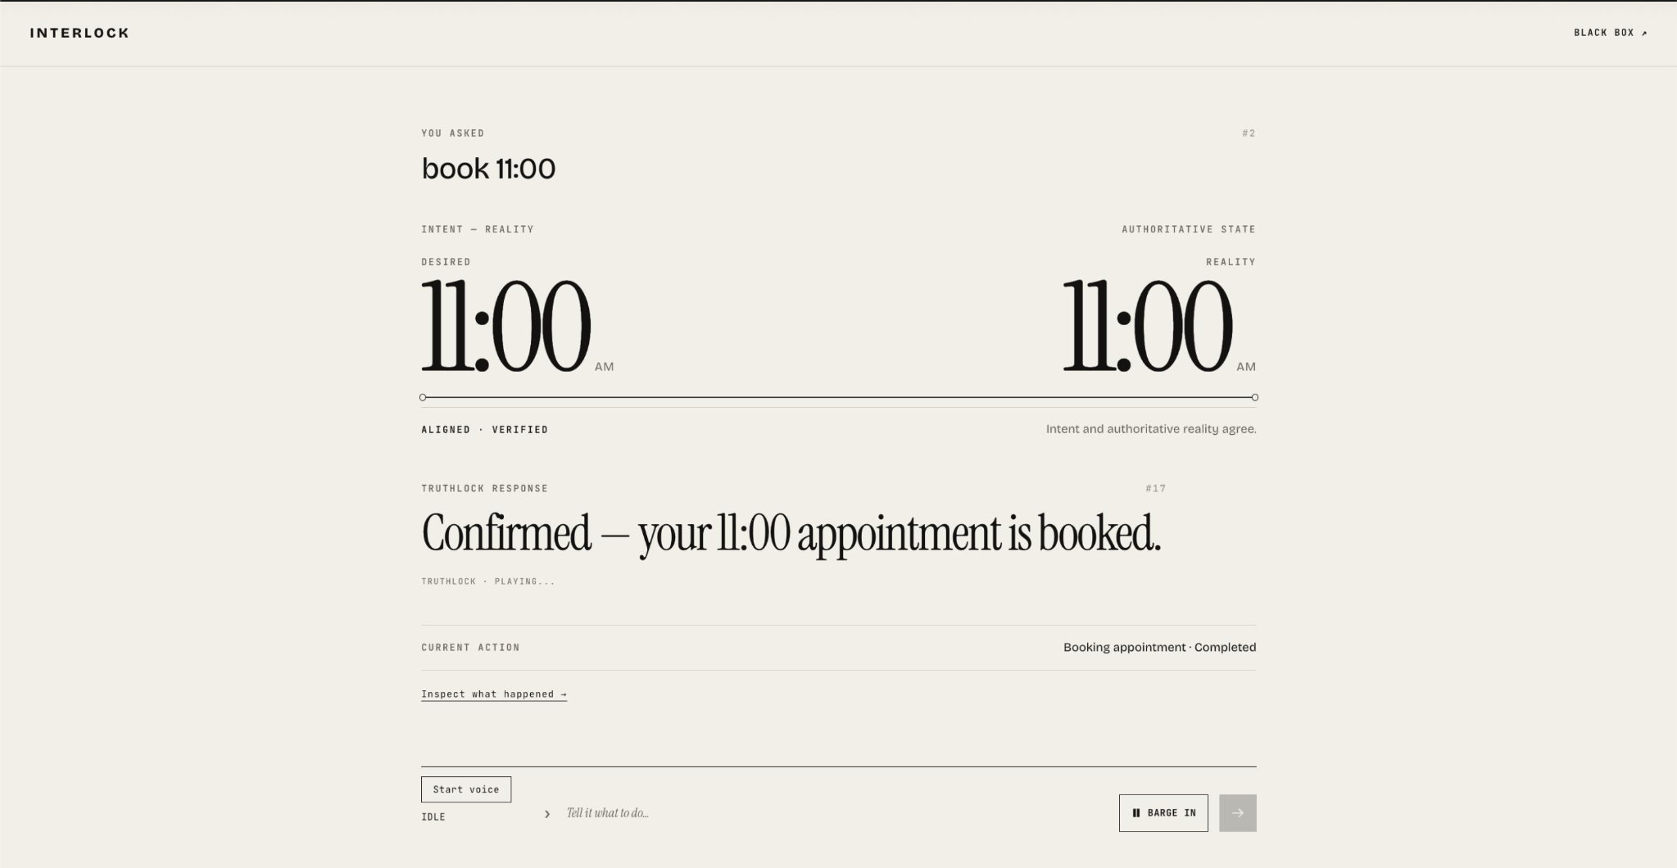
Demo & Product Walkthrough
PRODUCT EVIDENCE · SIMULATED BOOKING
01 START FROM A TRUTHFUL BLANK STATE
02 OBSERVE AN 11:00 CONFIRMED BOOKING
No provider effects yet · no invented confirmation
Desired 11:00 = world 11:00 · truth-gated response
INPUT → INTENT → SAFEPOINT / TOOL → AUTHORITATIVE EFFECT → CLAIM → APPROVED OUTPUT
Captured Console screens; Samsung service booking is simulated, not a real Samsung API transaction.
05 / 12

Slide 6
Tools & Tech Stack
IMPLEMENTATION / TESTED DEPENDENCY BOUNDARIES
Frontend
API & runtime
Audio transport
React · TypeScript · Vite
Tailwind CSS · LiveKit browser SDK
Python 3.11 · FastAPI
Session journal · pure reducer · WebSocket
LiveKit Agents 1.8.4
Deepgram Nova-3 · Cartesia Sonic-3 · Silero VAD
Execution safety
Truth & audit
Validation
ToolRegistry · SAFEPOINT
Idempotency · deterministic fake provider
Immutable evidence · EffectInterpreter
ClaimGraph · TRUTHLOCK · Black Box
pytest · Vitest · trace/scenario tests
Reproducible FDB-v3 runner scaffold
Credentialed LiveKit audio and official FDB-v3 metrics require a separate measured run; no score is claimed here.
06 / 12

Slide 7
Impact & Use Cases
ONE USER REQUEST · THREE POSSIBLE REALITIES
NORMAL
EARLY CHANGE
LATE CHANGE
“Book eleven.”
“Actually make it twelve.”
“Actually make it twelve.”
Intent 11 = World 11
A supported confirmation may be spoken.
11 safely cancelled before effect.
Only 12 may commit.
11 already committed; desired 12.
Surface OPEN divergence — no false 12 claim.
WHERE THIS MATTERS
Service appointments • Order changes • Repair workflows • Other consequential voice actions
07 / 12

Slide 8
Innovation, Results & Limitations
WHAT IS DIFFERENTIATED · WHAT IS EVIDENCED
DIFFERENTIATORS
RESULTS / EVIDENCE
Intent ≠ observed world
Visible demo capture: one booking operation, one authoritative effect and one claim, with a 28-event causal record.
Both are first-class projections.
Speech ≠ effect
Claims pass TRUTHLOCK and playout proof.
LIMITATIONS (DISCLOSED)
Samsung tools use a simulated provider. Credentialed browser STT/TTS smoke and official benchmark scoring are not presented as completed results.
Replayable causality
Journal sequence + correlated events explain why.
No benchmark accuracy, pass-rate or latency numbers are asserted without measured run artifacts.
08 / 12

Slide 9
What’s Next
FROM REPRODUCIBLE EXTENSION TO MEASURED VOICE DEPLOYMENT
01
Credentialed room-to-audio smoke
Record normal, early/late correction, barge-in, partial safety and room isolation in a real browser.
02
Official FDB-v3 measurement
Run the pinned evaluator with the official dataset; publish raw artifacts, provenance and measured outcomes.
03
Production-grade provider bridge
Replace Samsung-shaped fake provider with authorized integrations without changing domain truth invariants.
04
Capability-gated reconciliation
Extend divergence from transparent detection to explicitly authorized, verified repair when supported.
Next-step items are planned work, not a claim of shipped production capability.
09 / 12

Slide 10
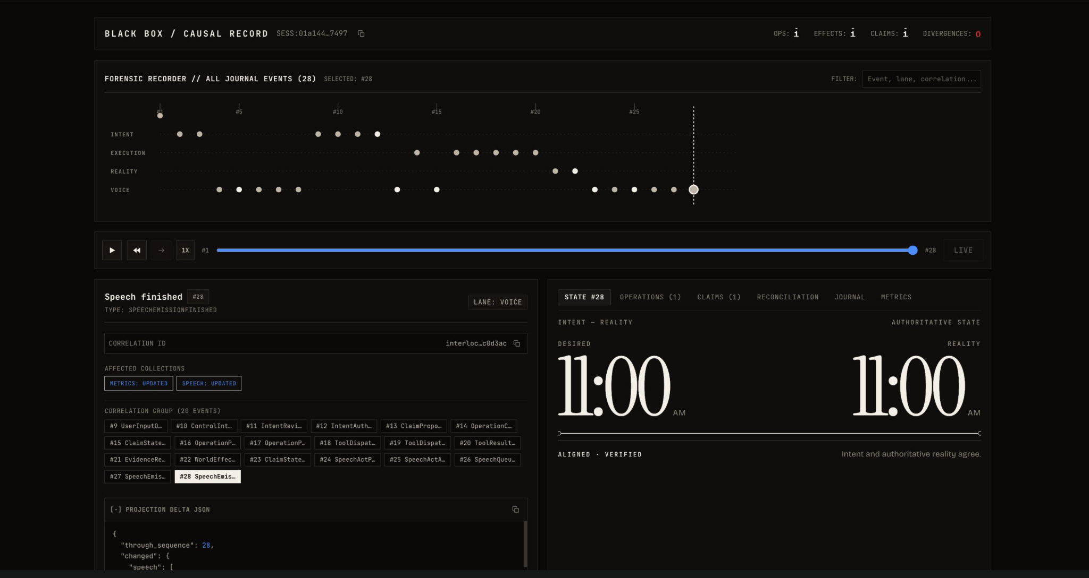
Brownie Points — Black Box Audit
INSPECTABLE CAUSALITY · NOT A CHAT-ONLY DEMO
Forensic timeline: INTENT · EXECUTION · REALITY · VOICE, with event-level sequence and correlated projection diffs.
Illustrative captured state: 28 journal events; OPS 1 · EFFECTS 1 · CLAIMS 1 · DIVERGENCES 0.
10 / 12

Slide 11
Checklist — Public GitHub Submission
EVALUATOR HANDOFF / STATUS
Working prototype code
YES — code hosted in public 404-samsung repository.
Reproducible setup instructions
YES — backend/frontend + voice worker commands in README.
Demo video (max 5 min)
PENDING — link not provided; add after recording.
Presentation file (PPT / PDF)
PREPARED — deck and PDF generated for repository upload.
REPOSITORY
github.com/rupeshhh007/404-samsung
Voice demo uses a simulated Samsung provider. Actual browser-audio success and benchmark scores require recorded evidence.
11 / 12

Slide 12
TEAM 404NOTFOUND · THEME 05
Thank you
INTERLOCK
Anticipate early. Commit safely.
Speak only what reality confirms.
Organised by the Language AI Team and the PRISM Team, Samsung R&D Institute India
github.com/rupeshhh007/404-samsung

