Slide 1
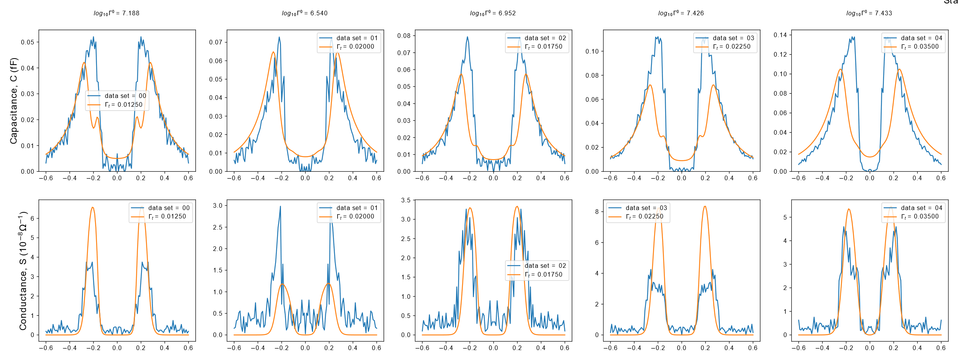
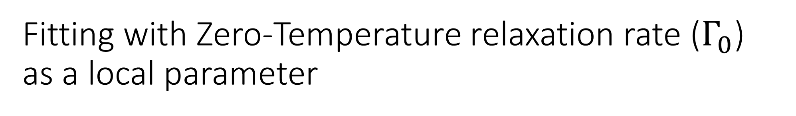
Fitting with Zero-Temperature relaxation rate ($Γ_{0}$)
as a local parameter

Slide 2
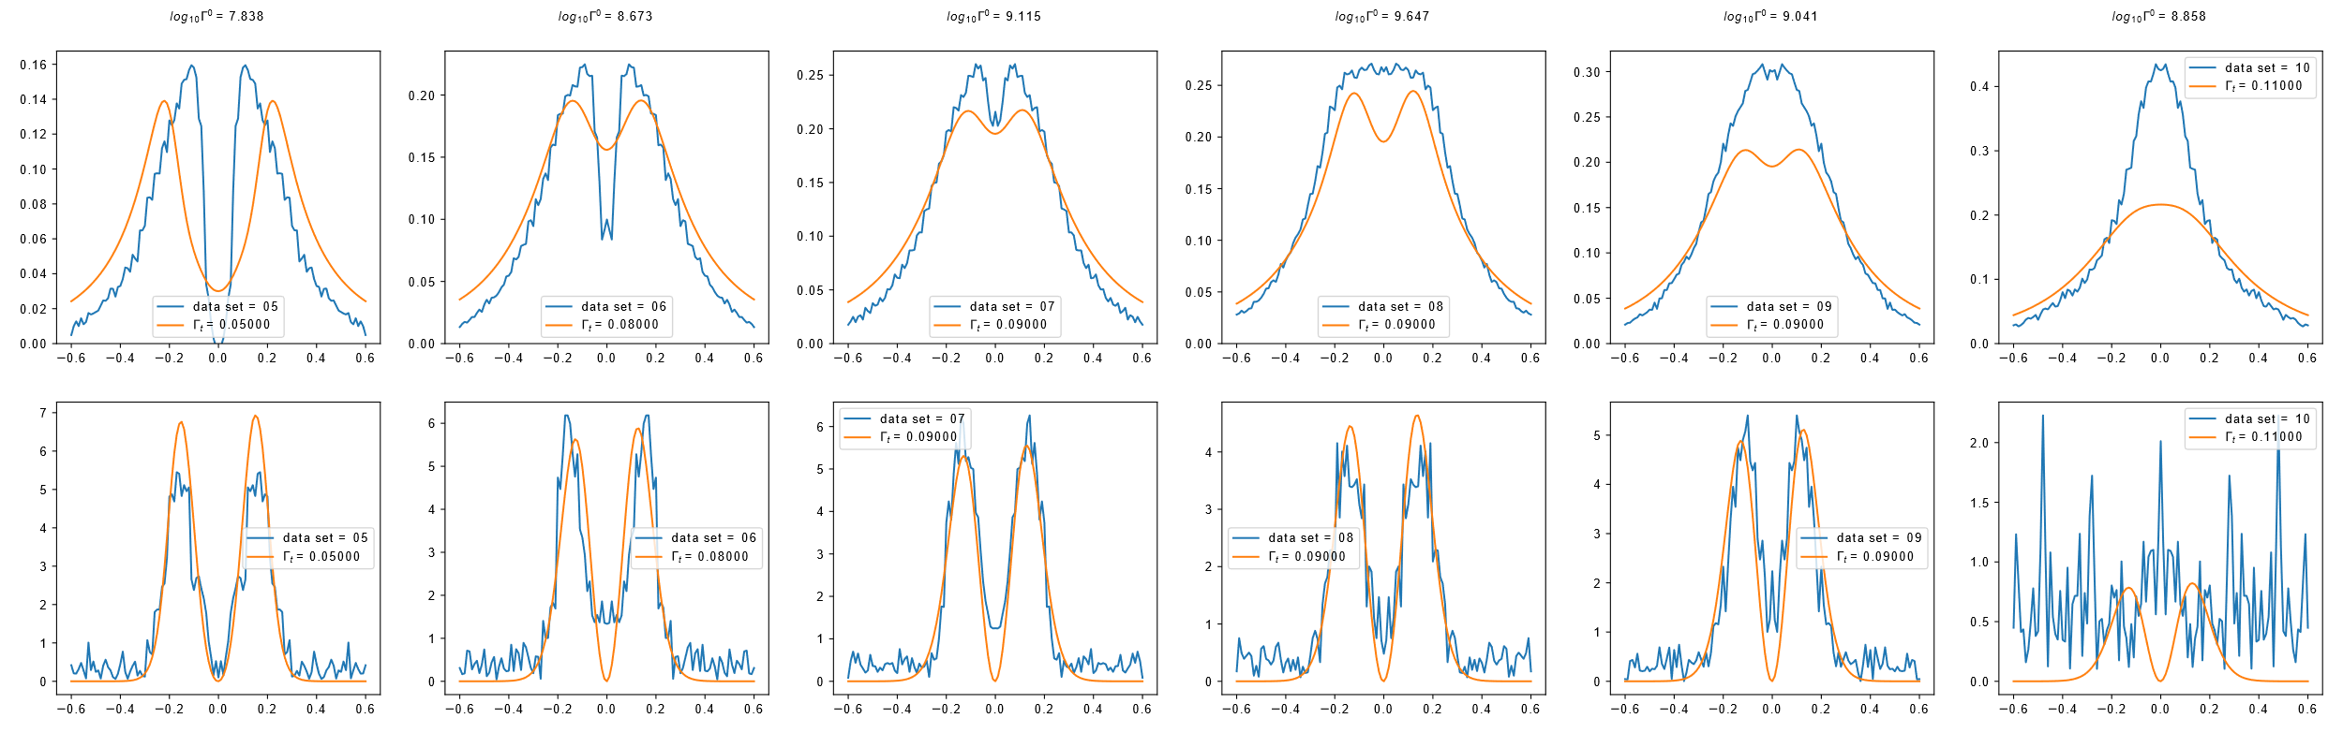
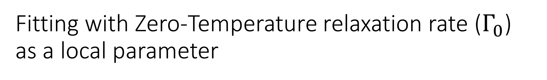
Fitting with Zero-Temperature relaxation rate ($Γ_{0}$)
as a local parameter
In the previous fit results I had accidentally missed out dataset_opening_00 and dataset_opening_10. Apologies.

Slide 3
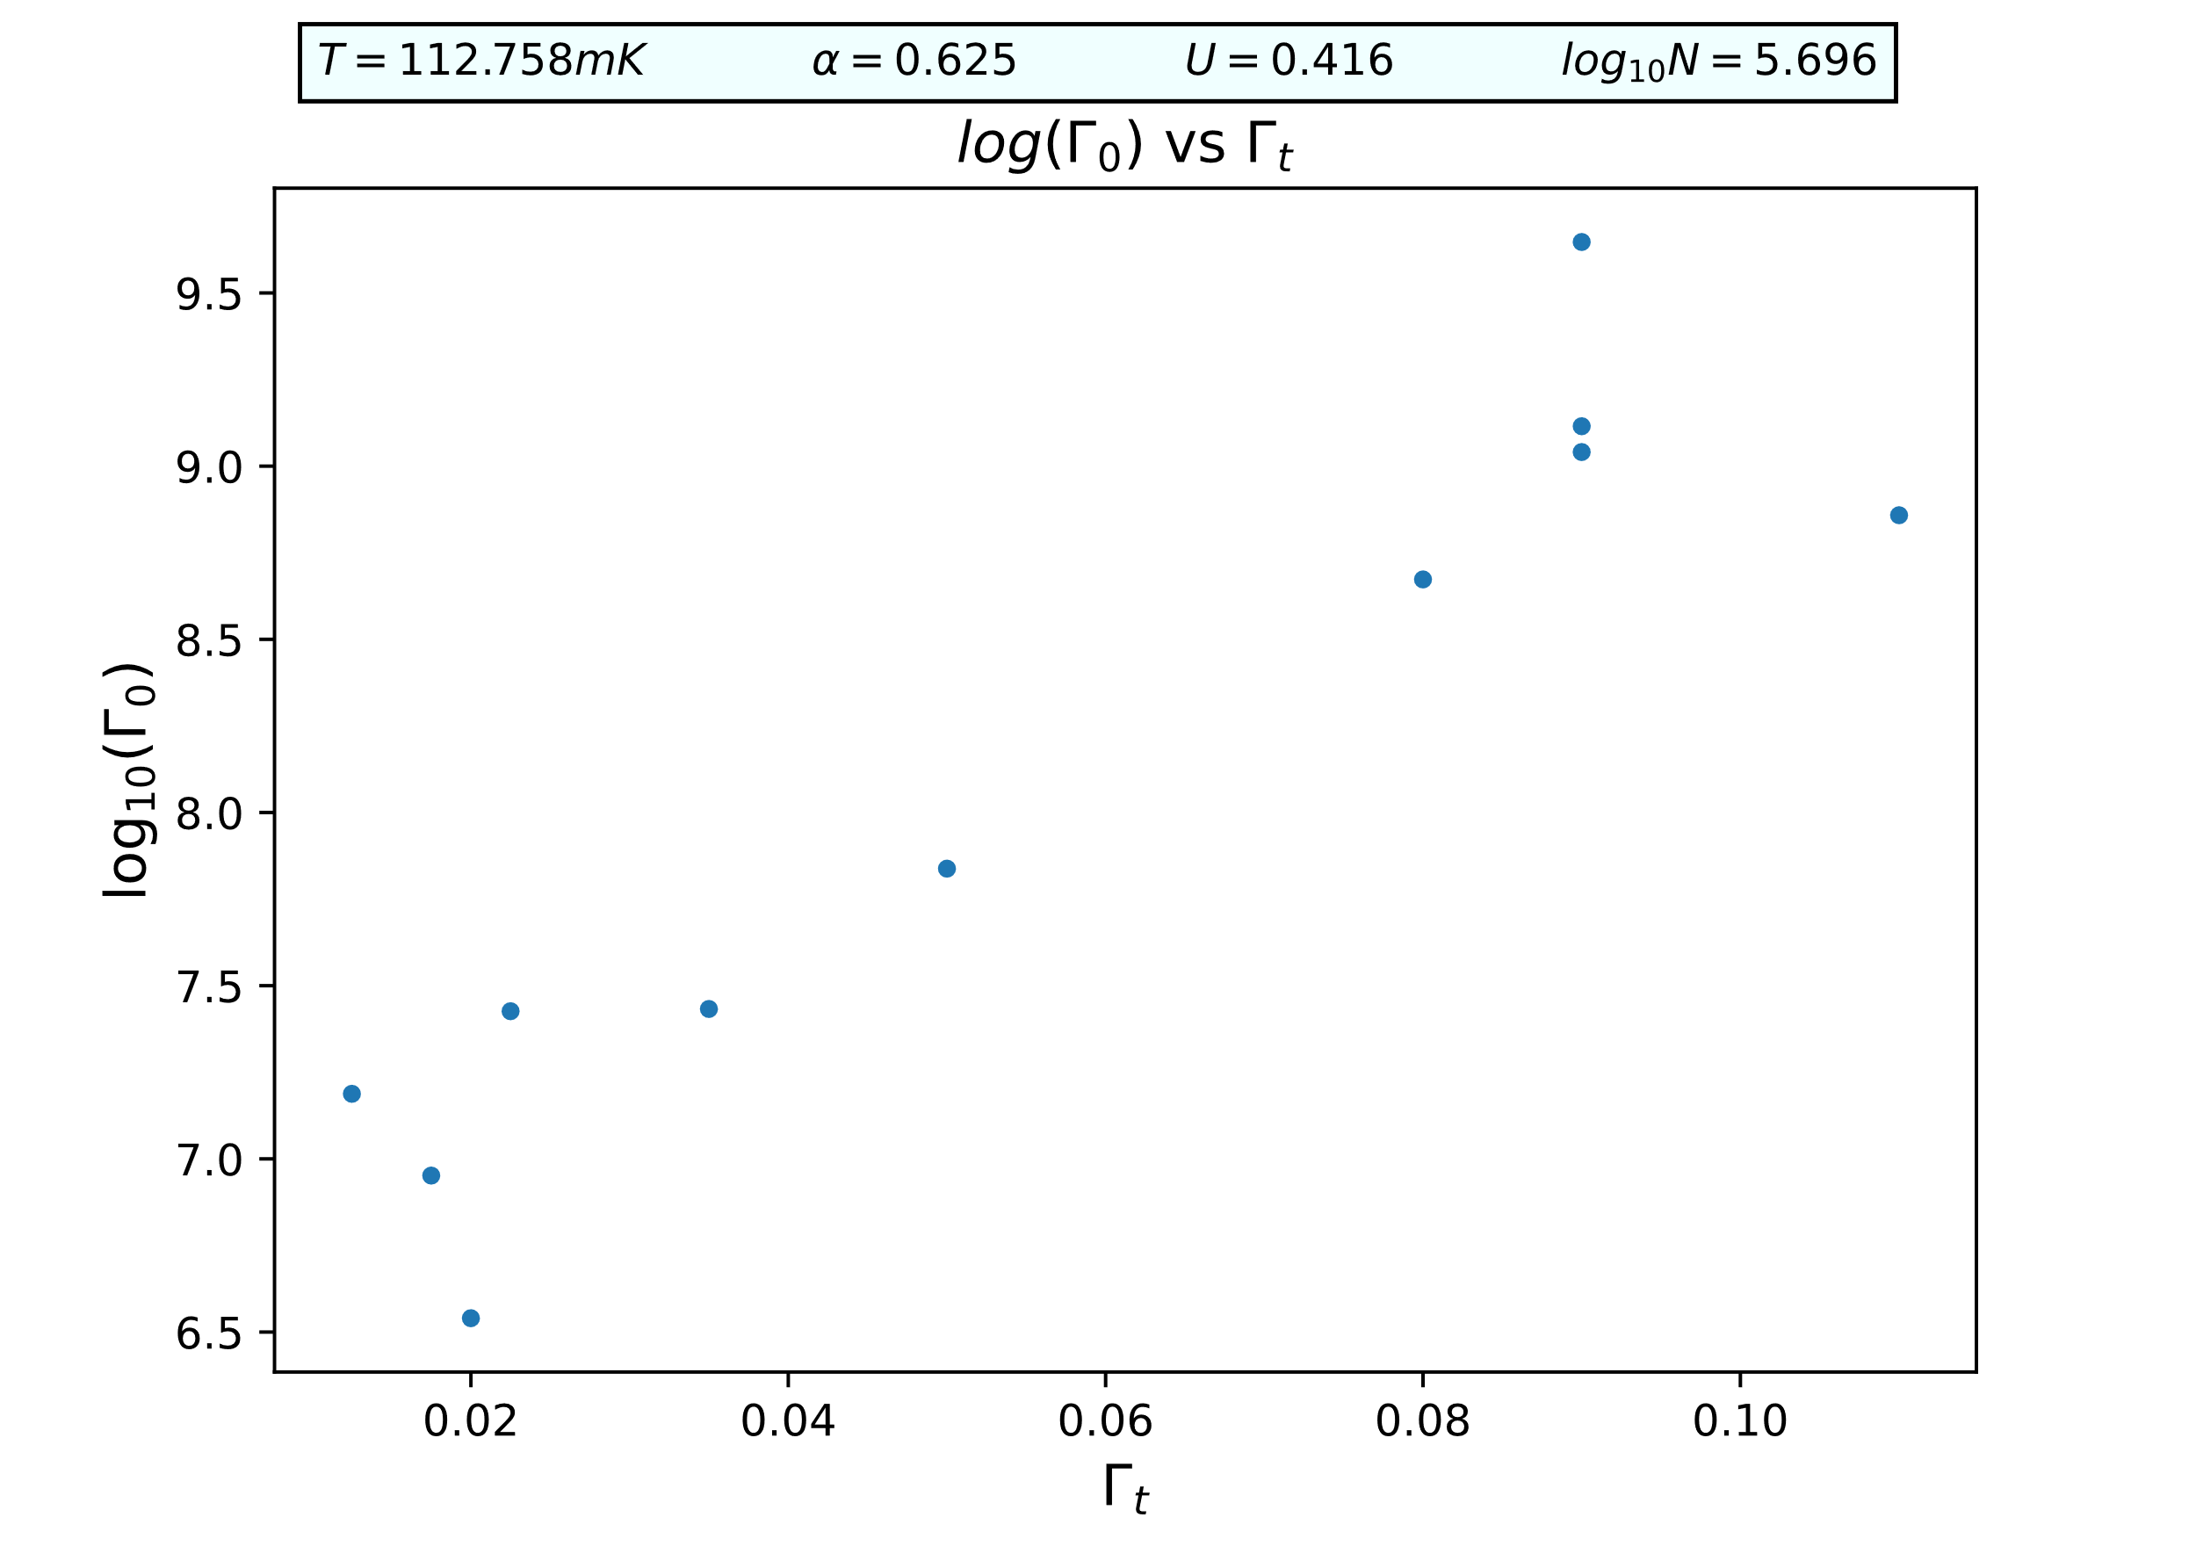
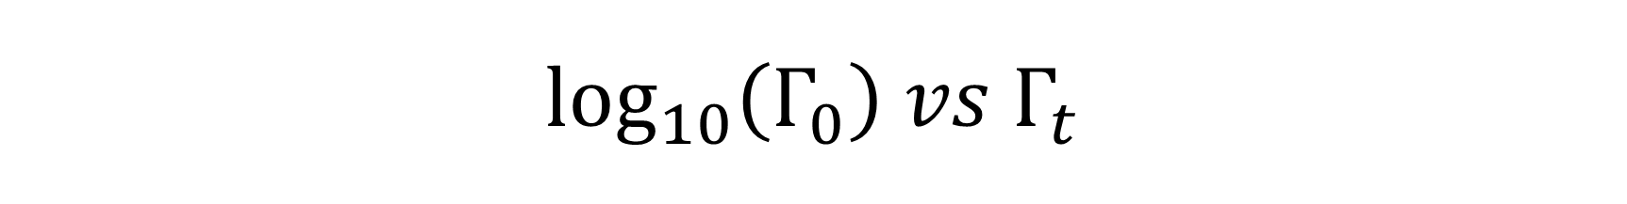
$$\log_{10}\left(Γ_{0}\right) vs Γ_{t}$$

Slide 4
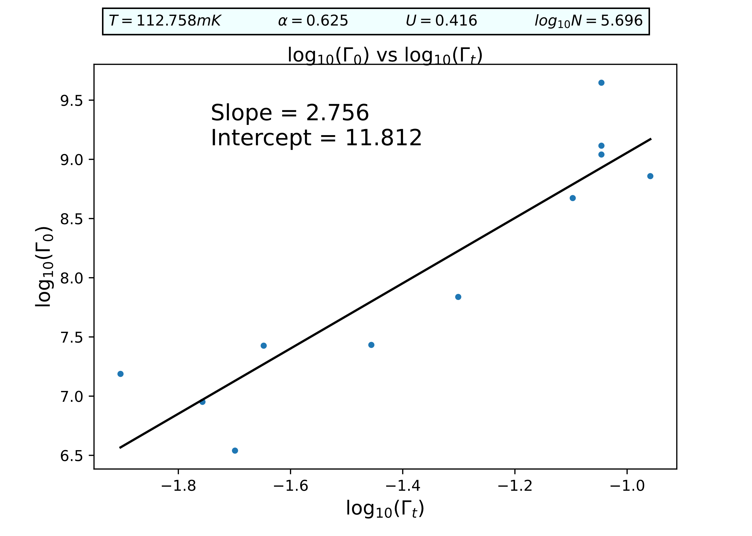
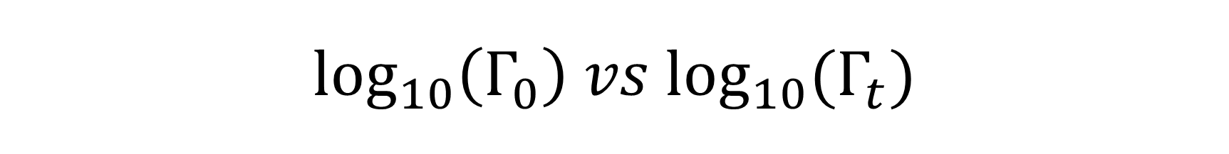
$$\log_{10}\left(Γ_{0}\right) vs {\log_{10}(Γ}_{t})$$
The fit is not an exact power-law, but there is a trend

