Slide 1
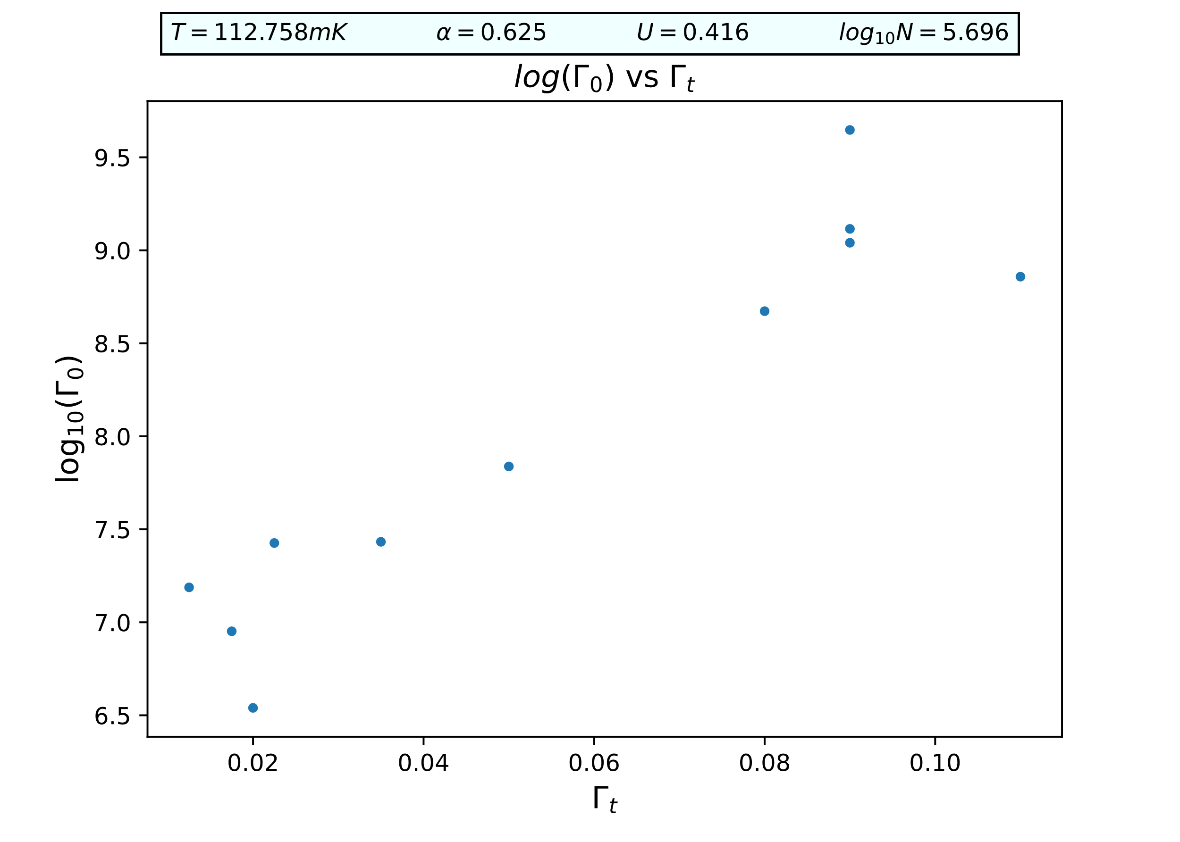
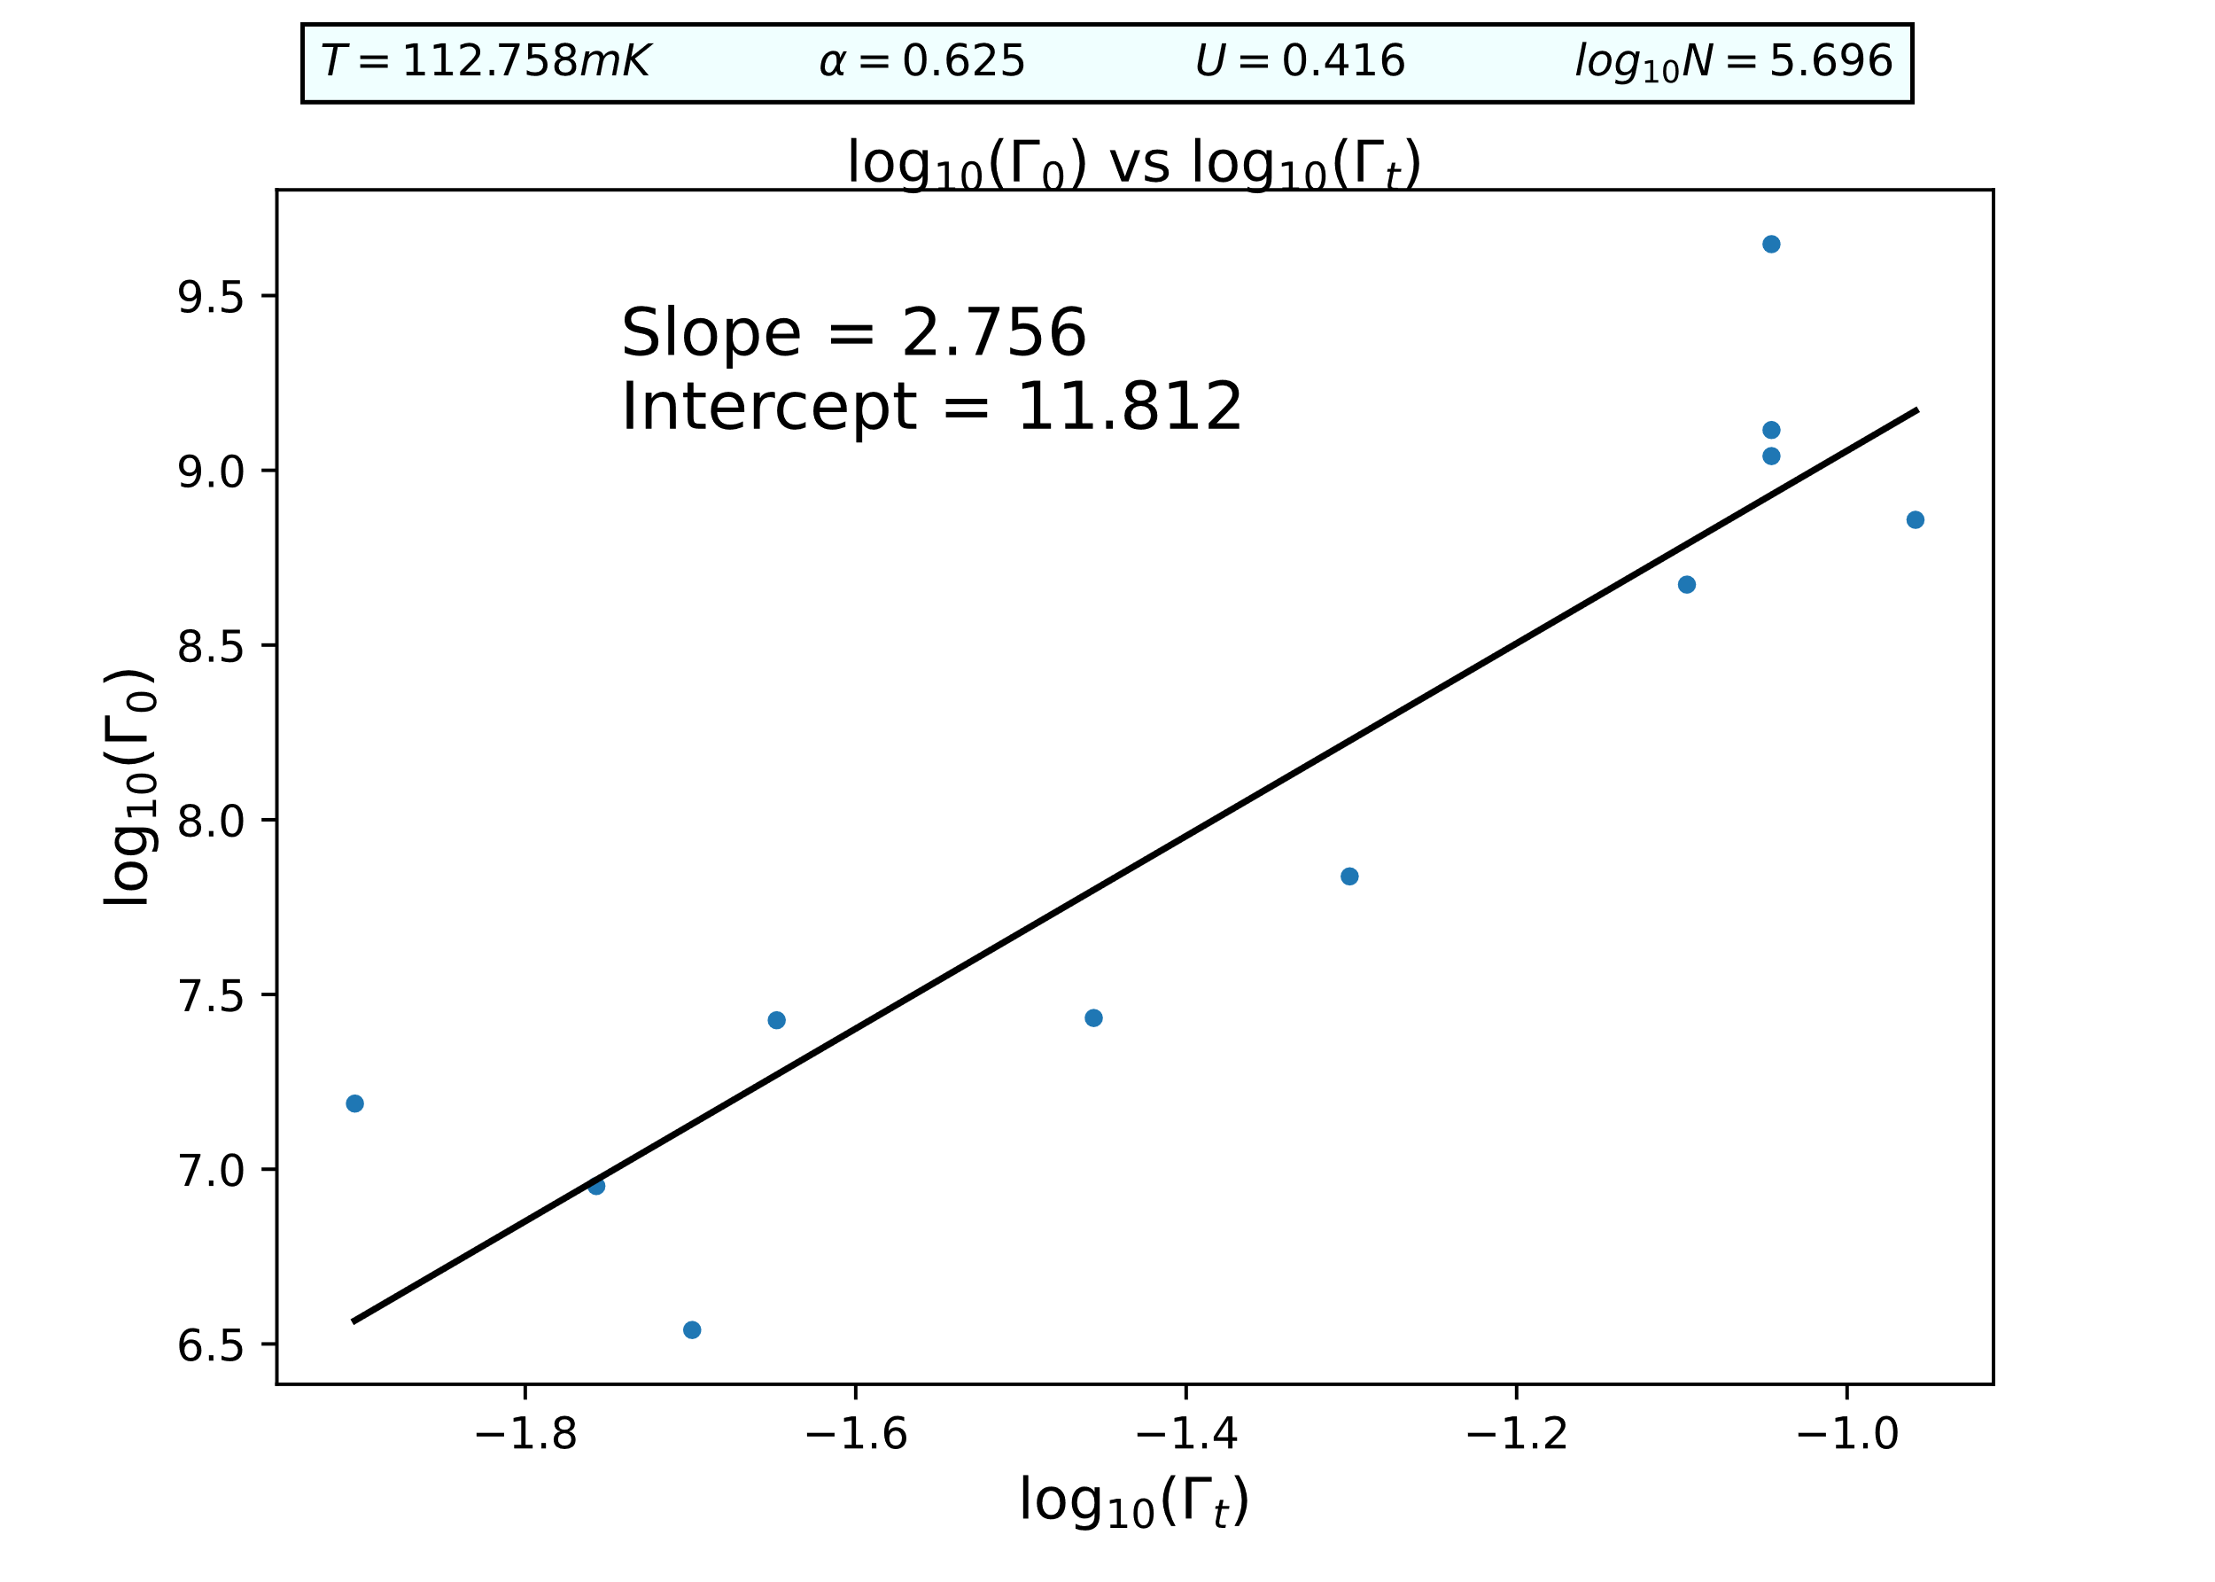
C:G = 1:1

Slide 2
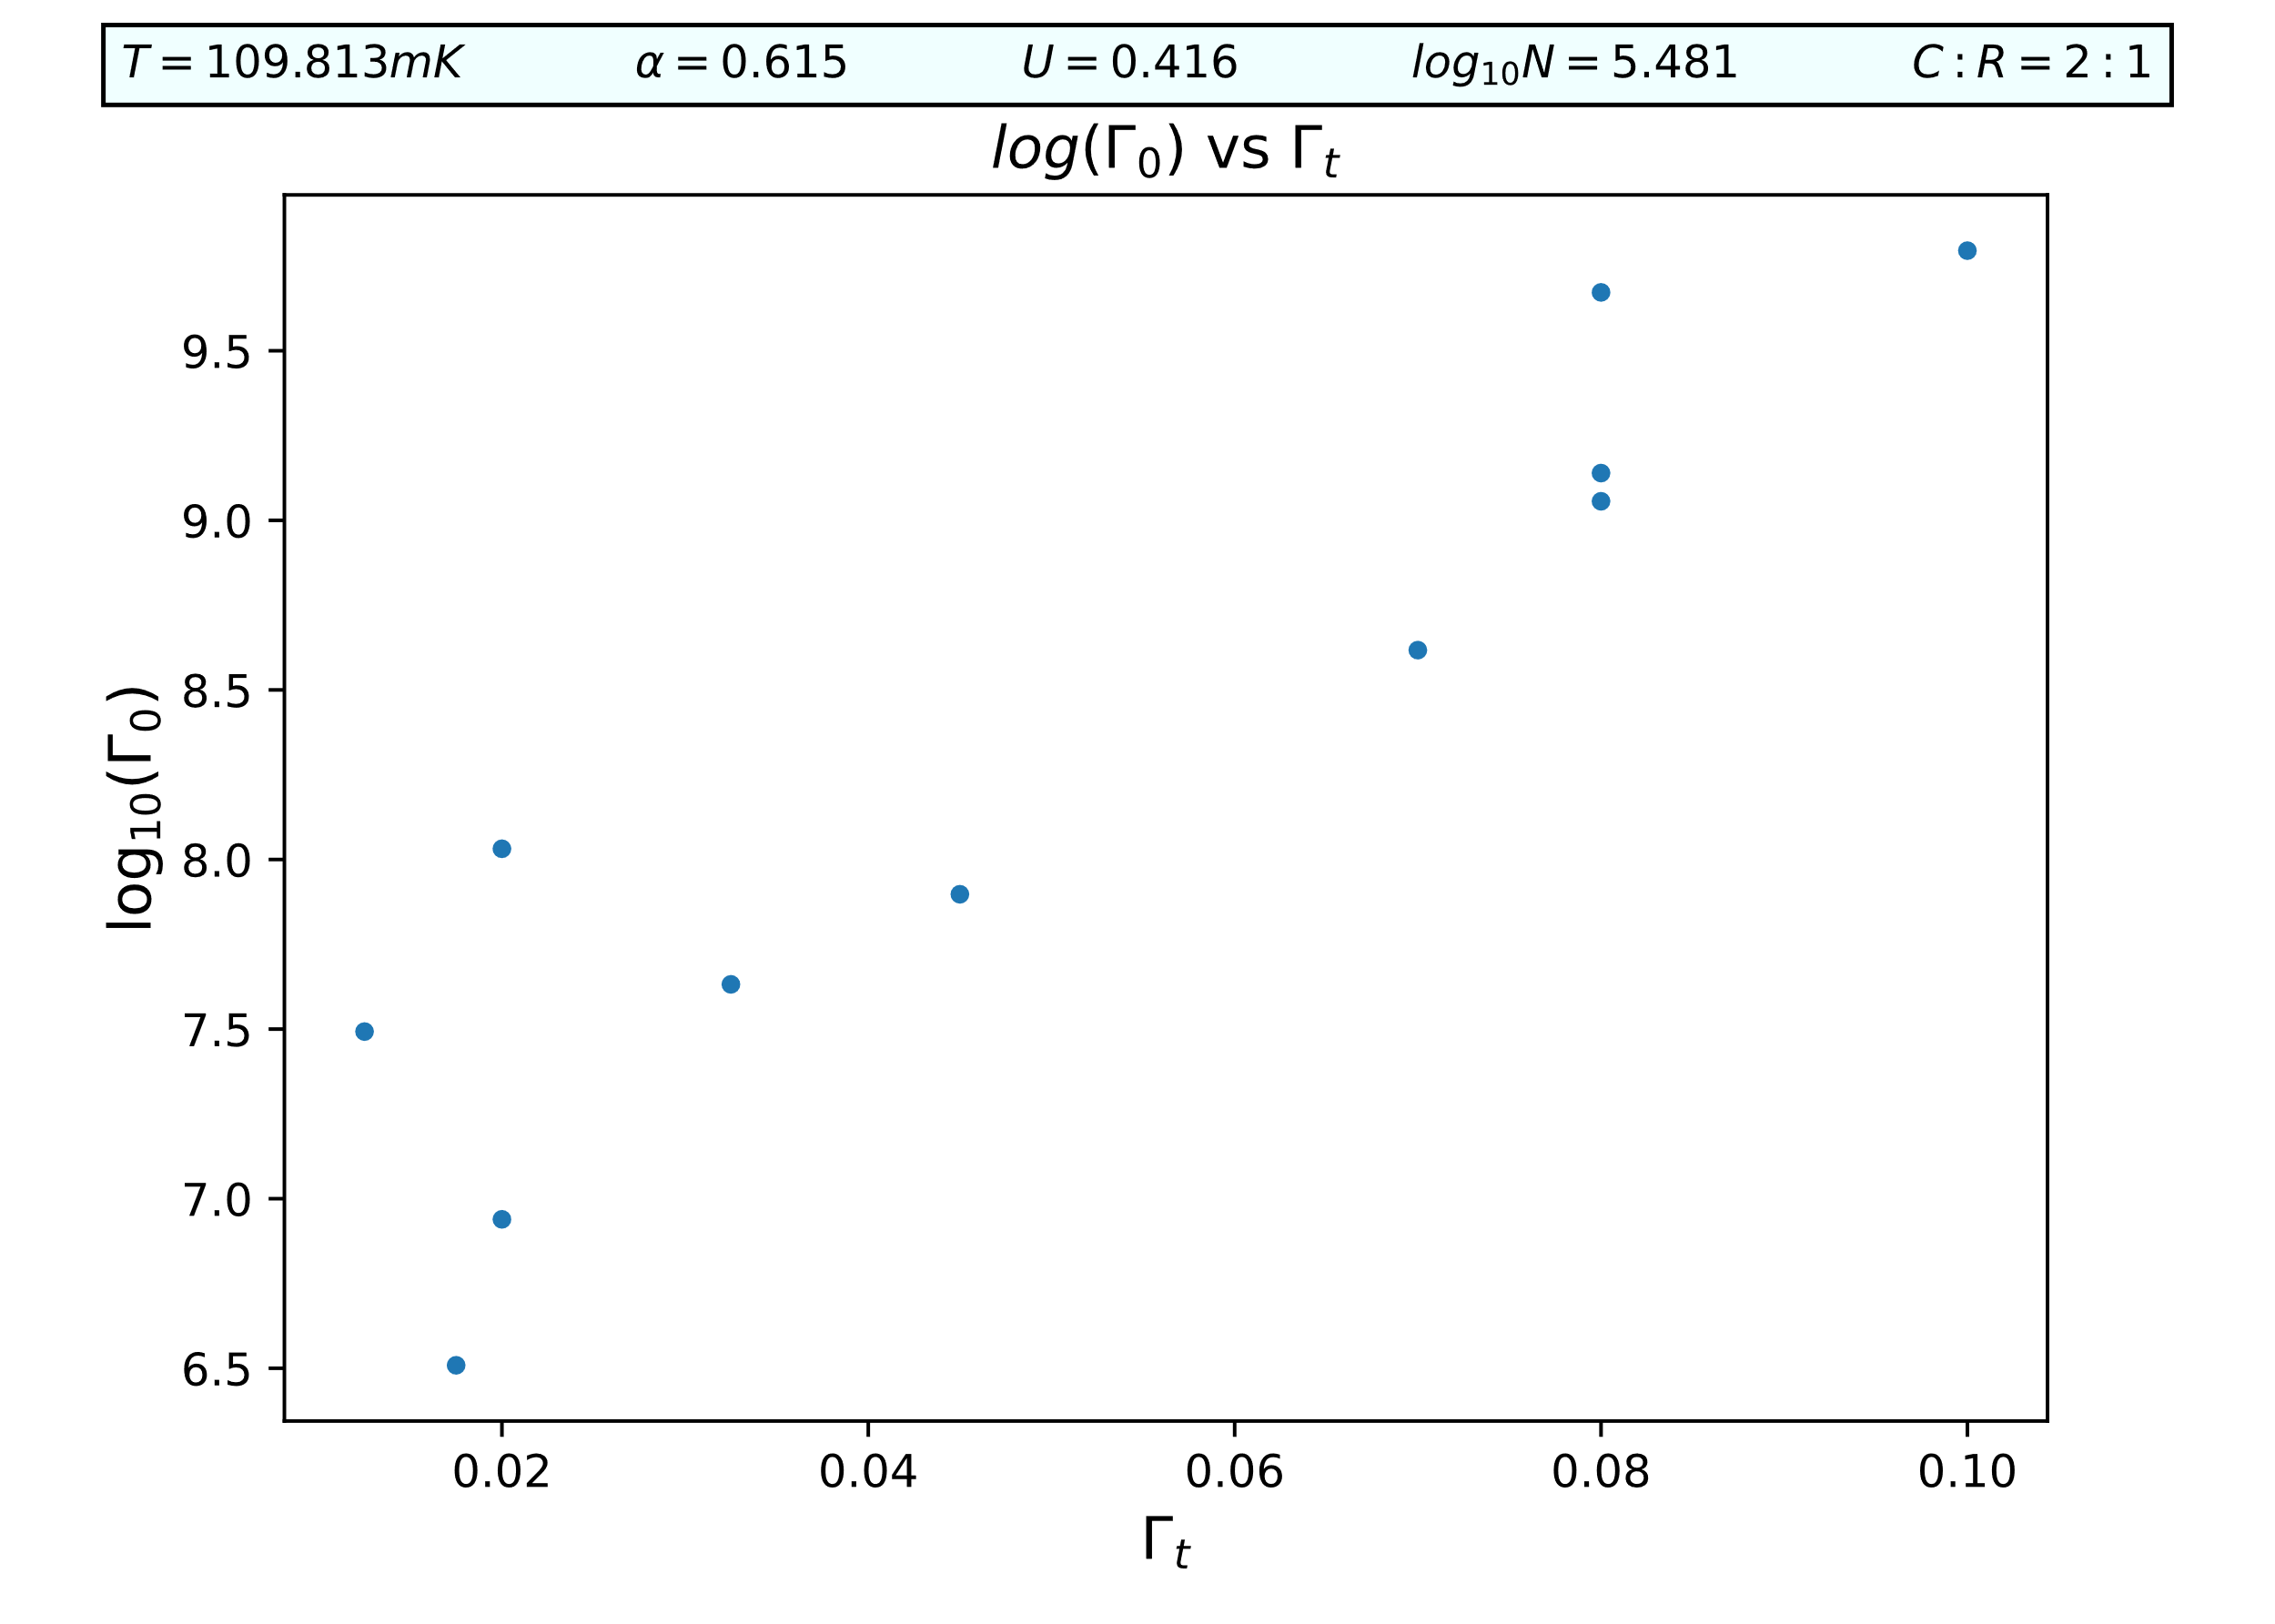
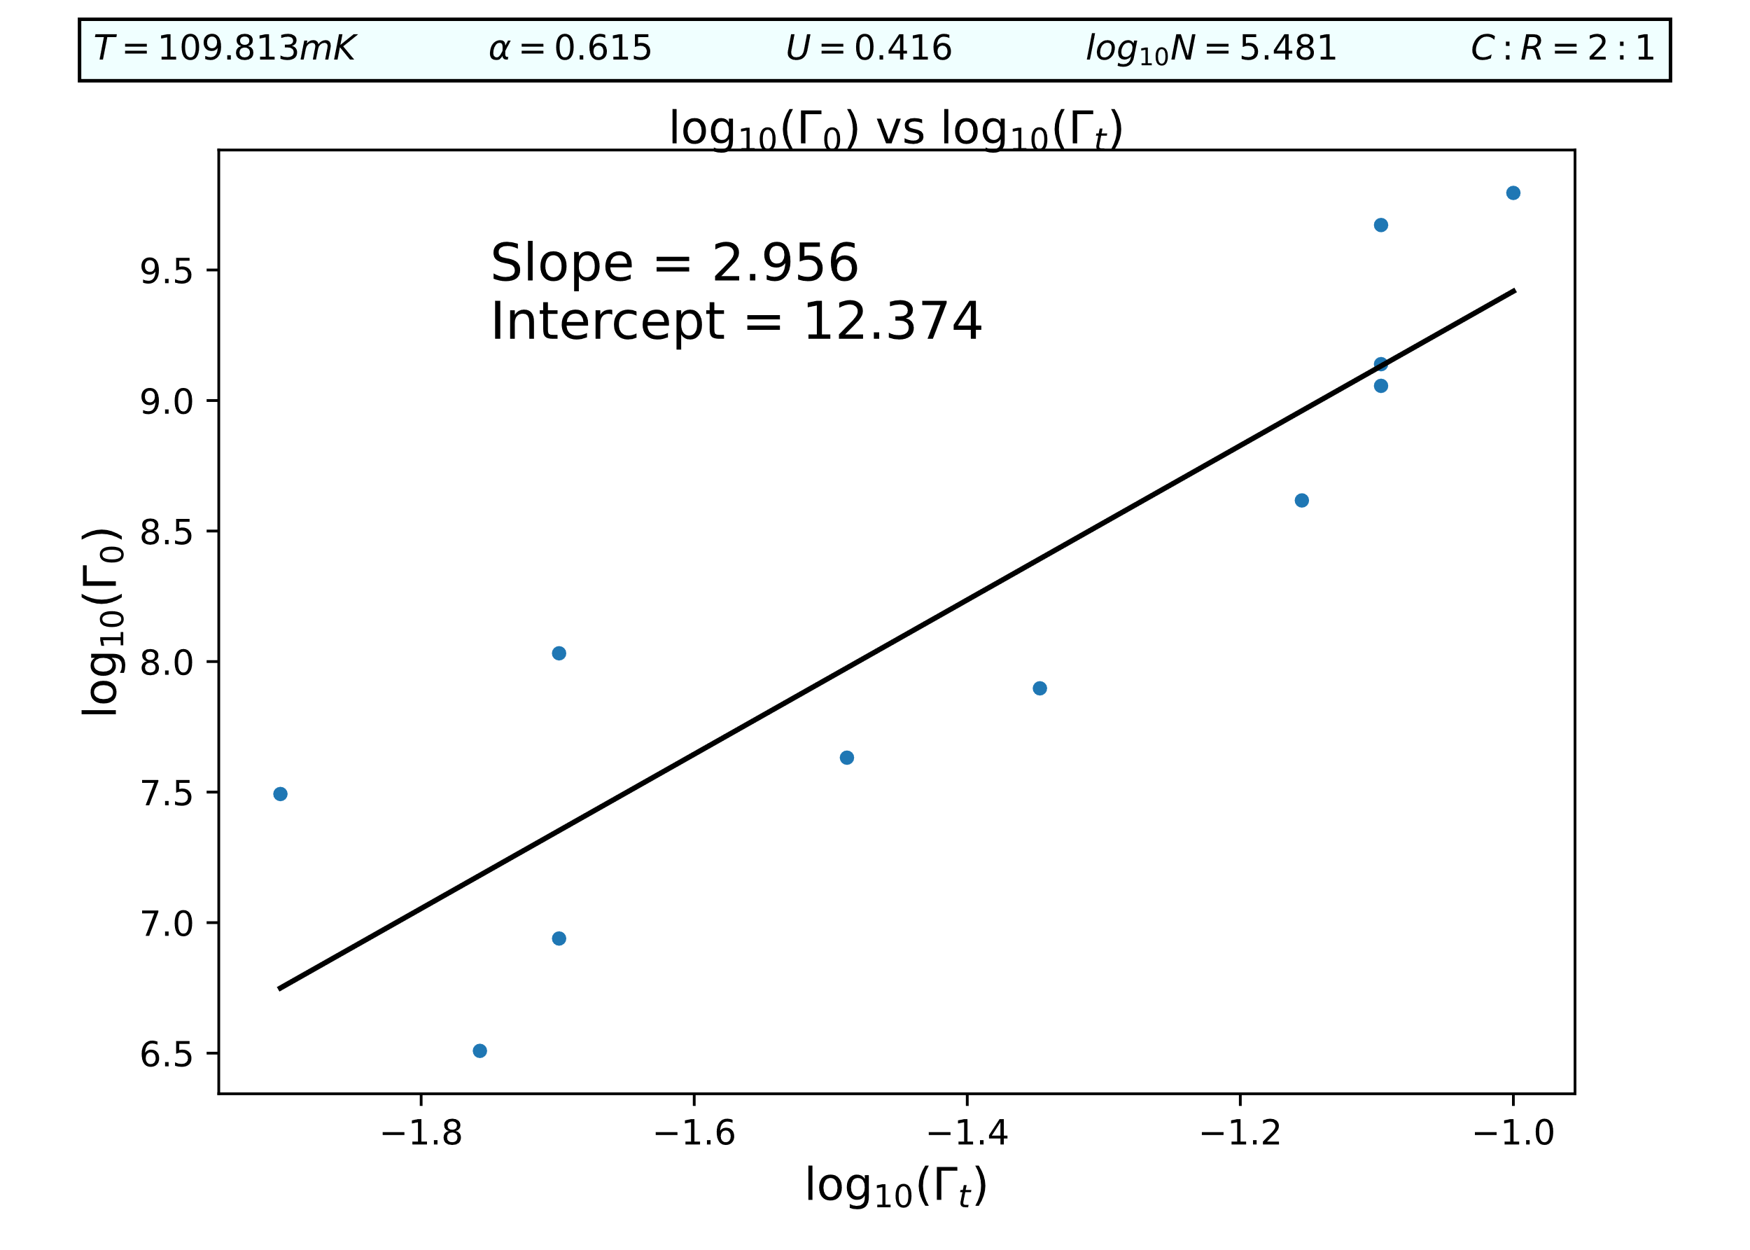
C:G = 2:1

Slide 3
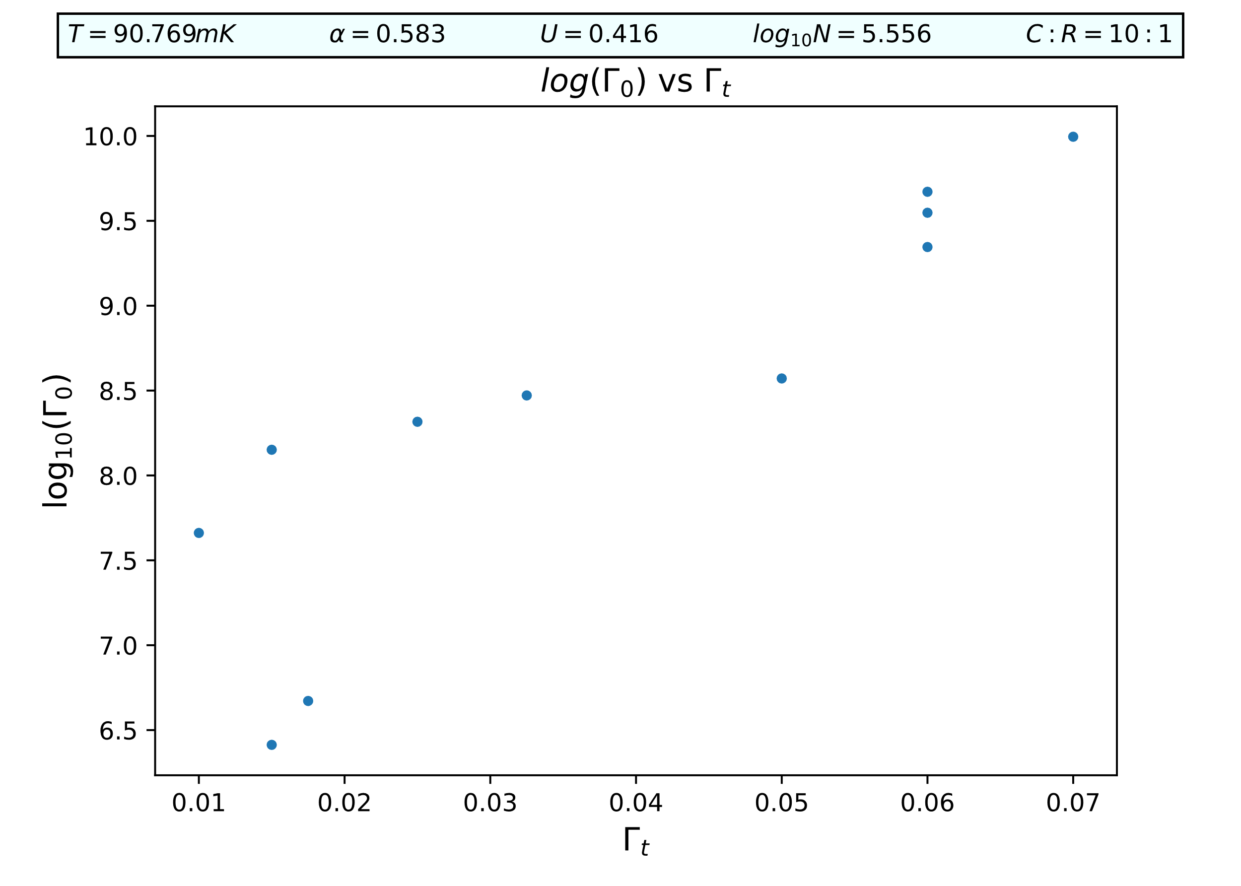
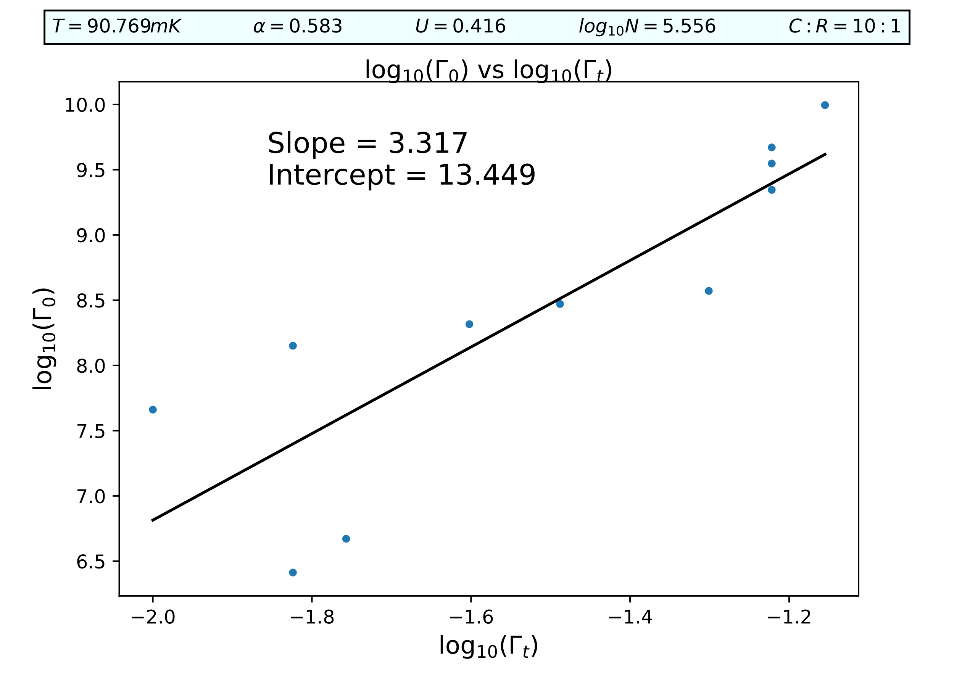
C:G = 10:1

Slide 4
Capacitance

Slide 5



1:1
2:1
10:1

Slide 6



1:1
2:1
10:1

Slide 7
Conductance

Slide 8



1:1
2:1
10:1

Slide 9



1:1
2:1
10:1

Slide 10
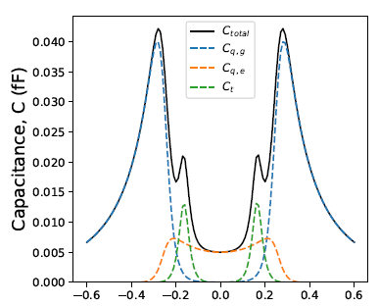
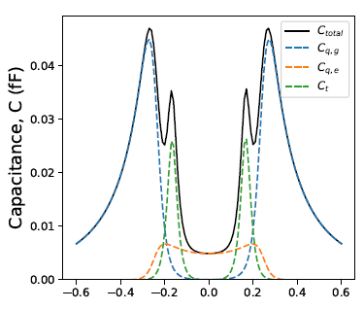
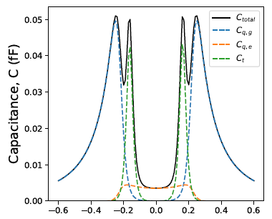
Tunneling Capacitance contribution
1:1
2:1
10:1
Tunneling Contribution increases when Capacitance contribution increases! This is also captured by the increasing intercept value in slide 1,2,3.

