Slide 1
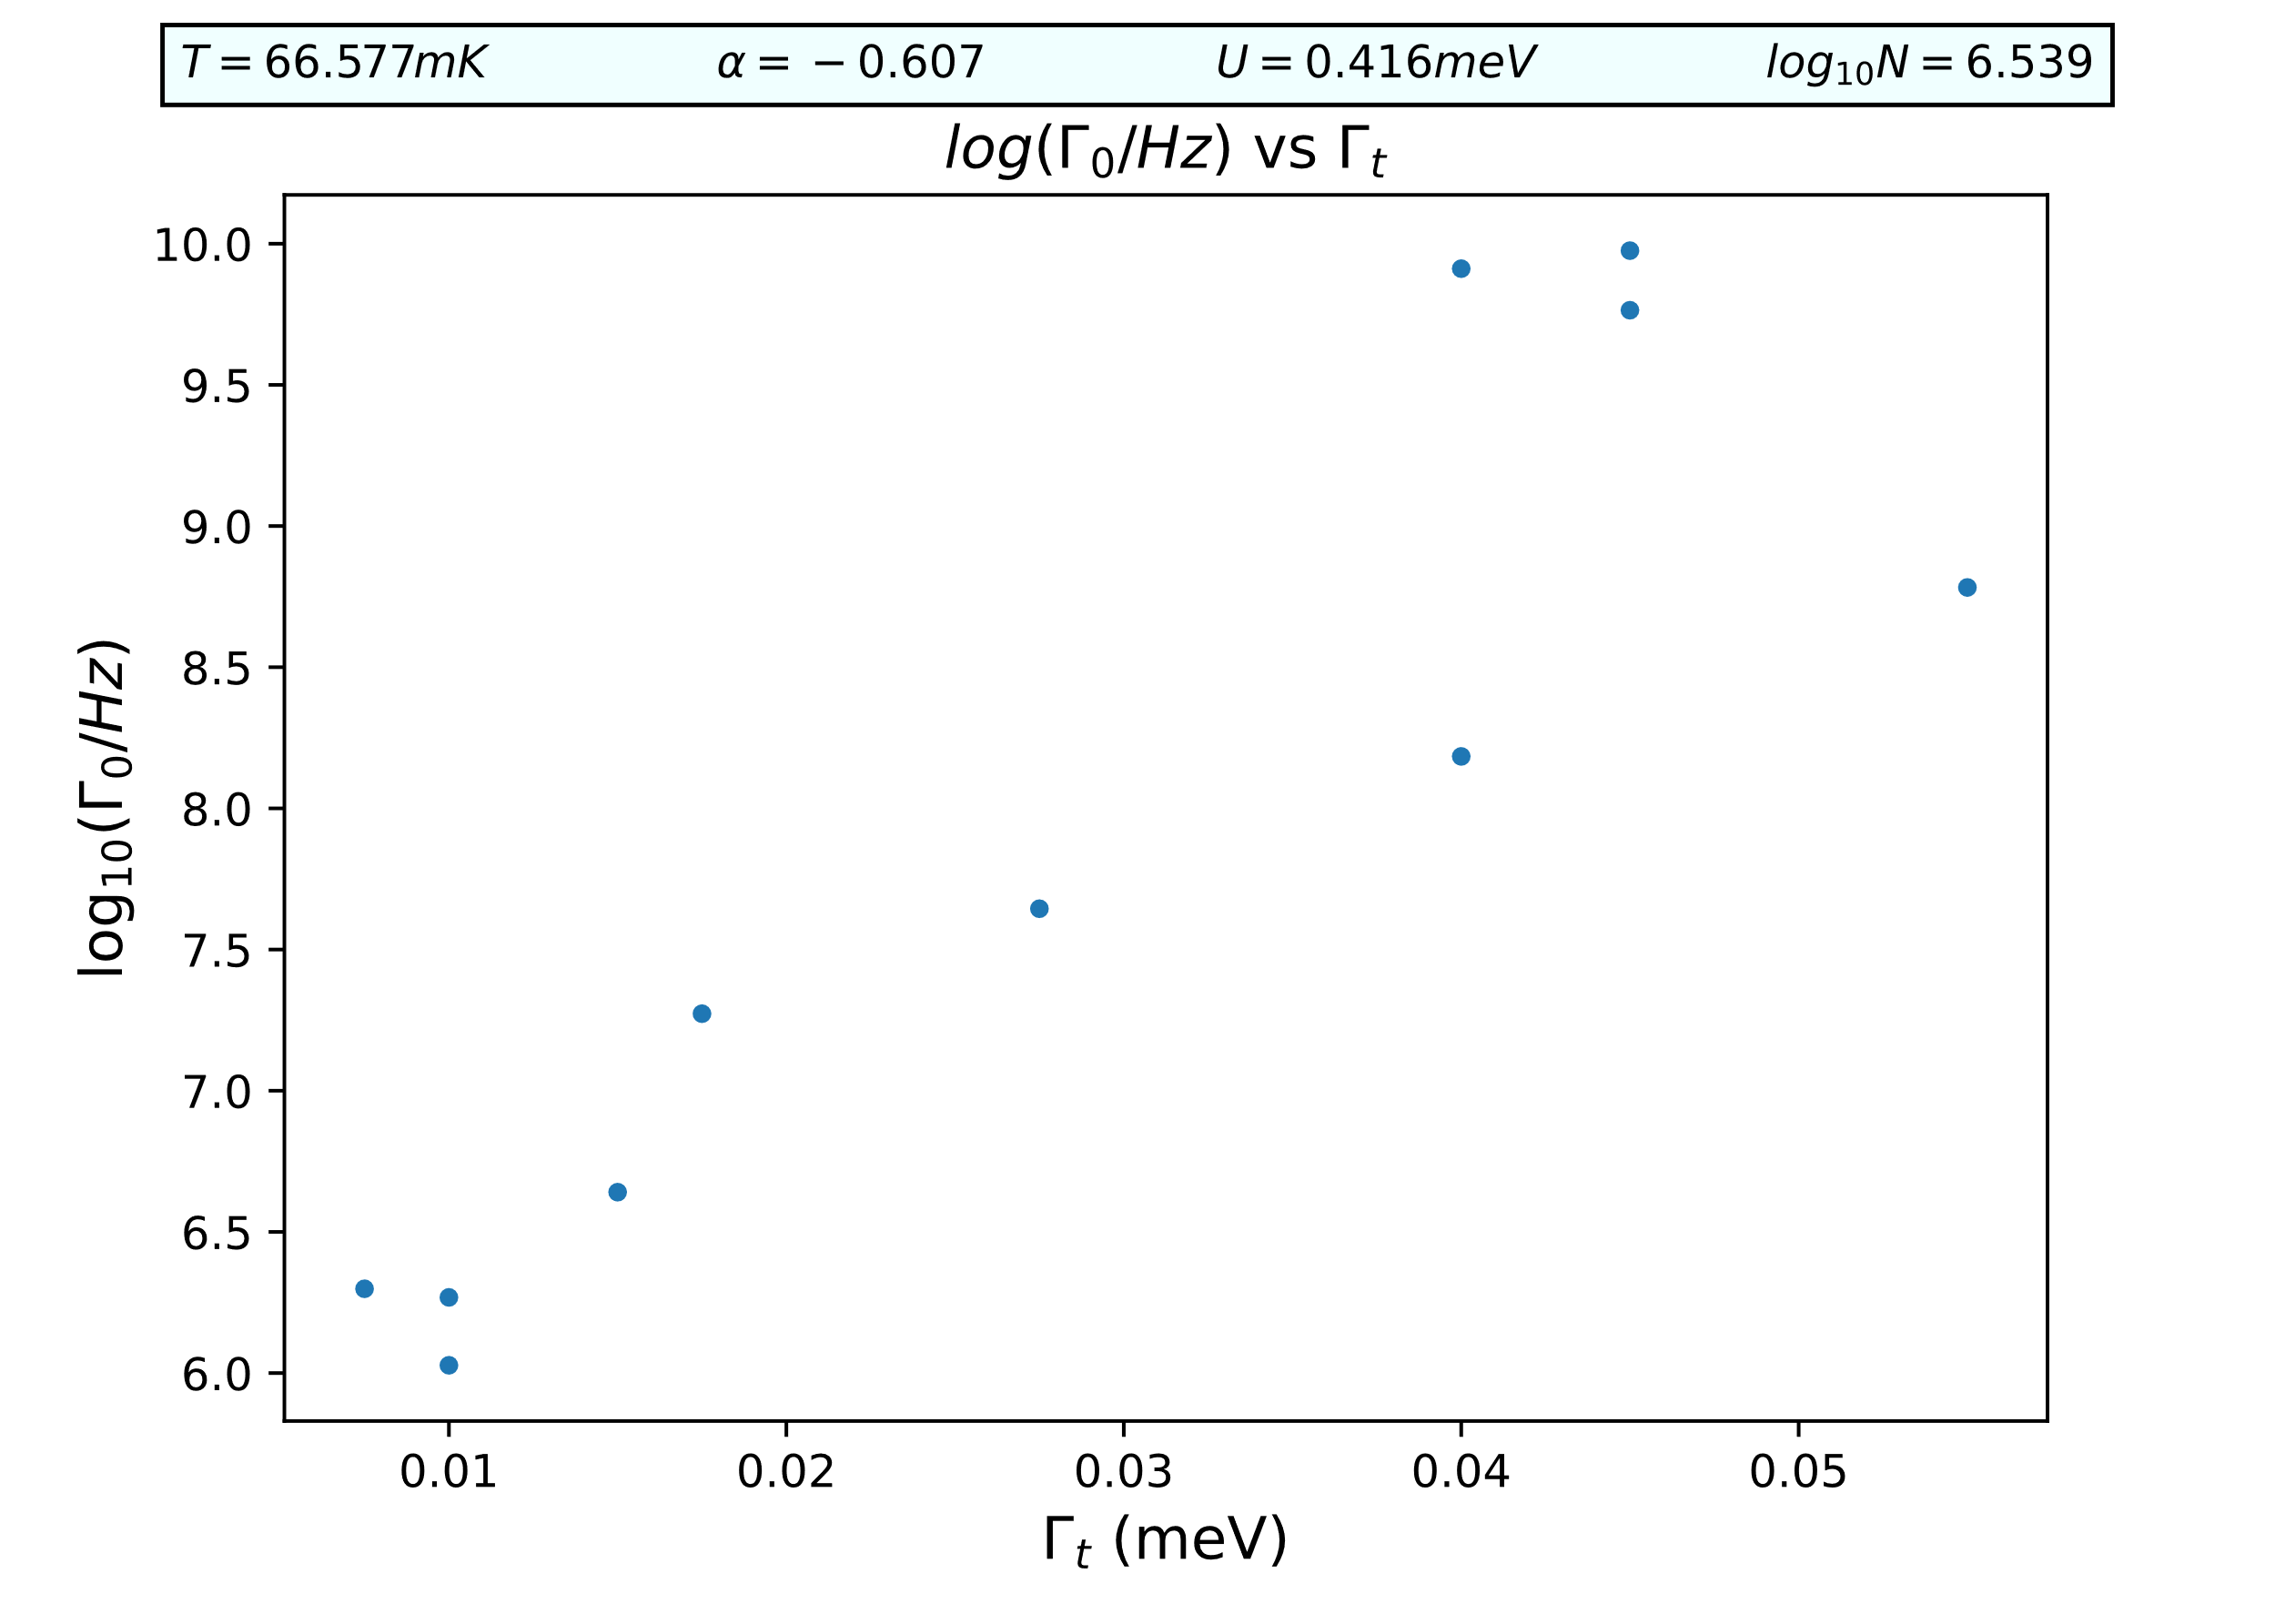
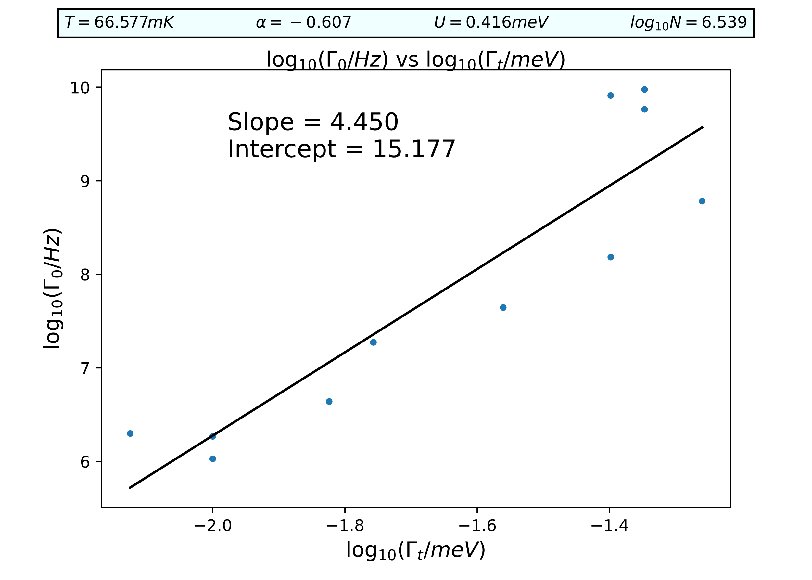
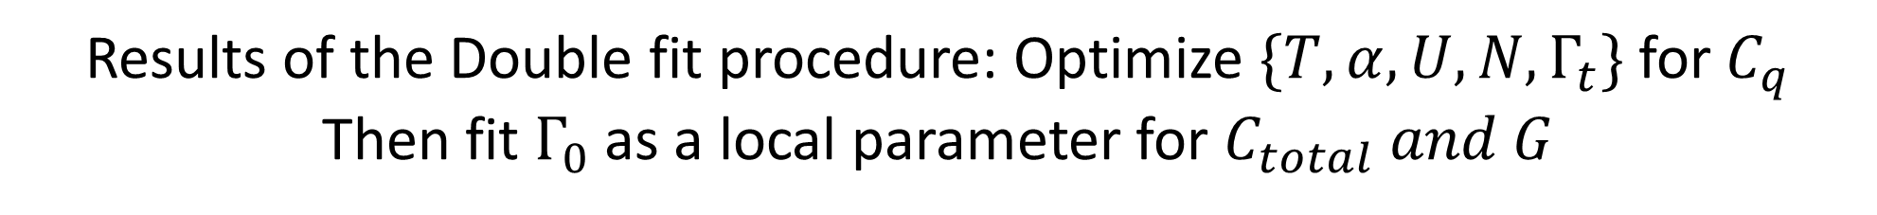
Results of the Double fit procedure: Optimize $\{T, α,U,N,Γ_{t}\}$ for $C_{q}$
Then fit $Γ_{0}$ as a local parameter for $C_{total} and G$

Slide 2
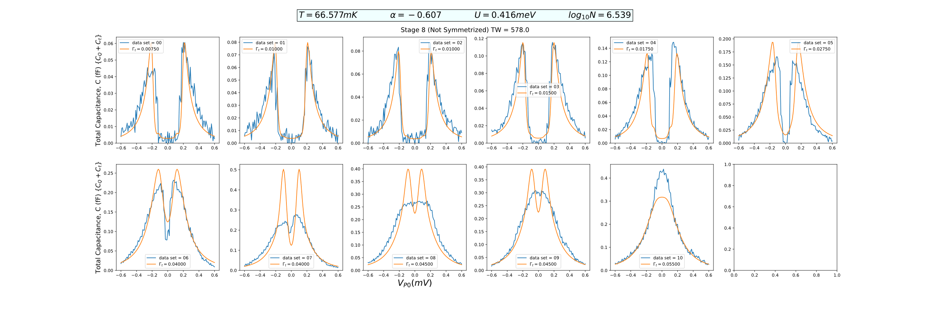

Slide 3
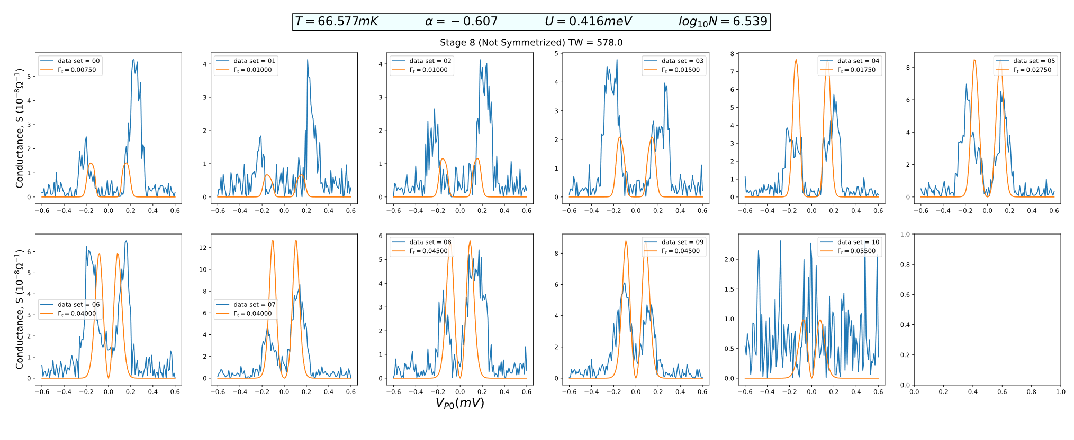

Slide 4
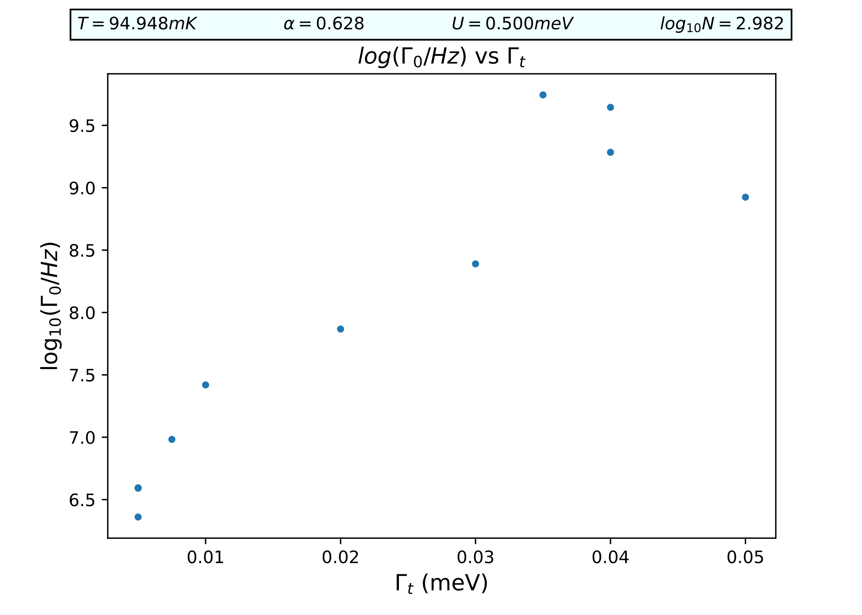
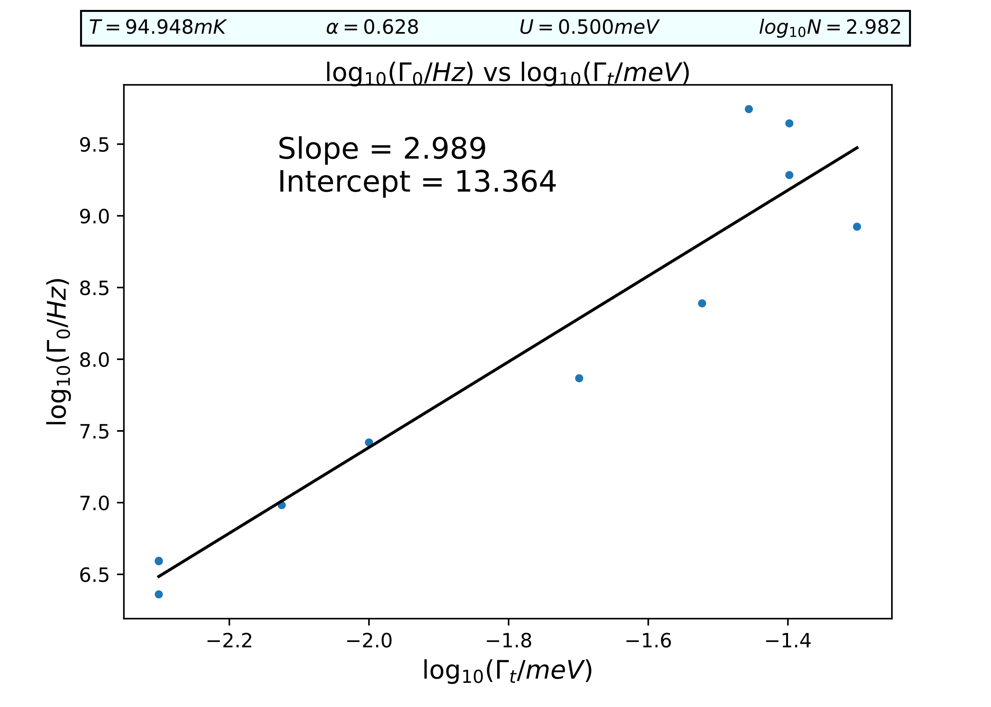
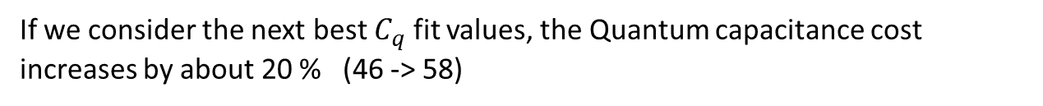
Results of the Double fit procedure: Optimize $\{T, α,U,N,Γ_{t}\}$ for $C_{q}$
Then fit $Γ_{0}$ as a local parameter for $C_{total} and G$
If we consider the next best $C_{q}$ fit values, the Quantum capacitance cost increases by about 20 % (46 -> 58)

Slide 5
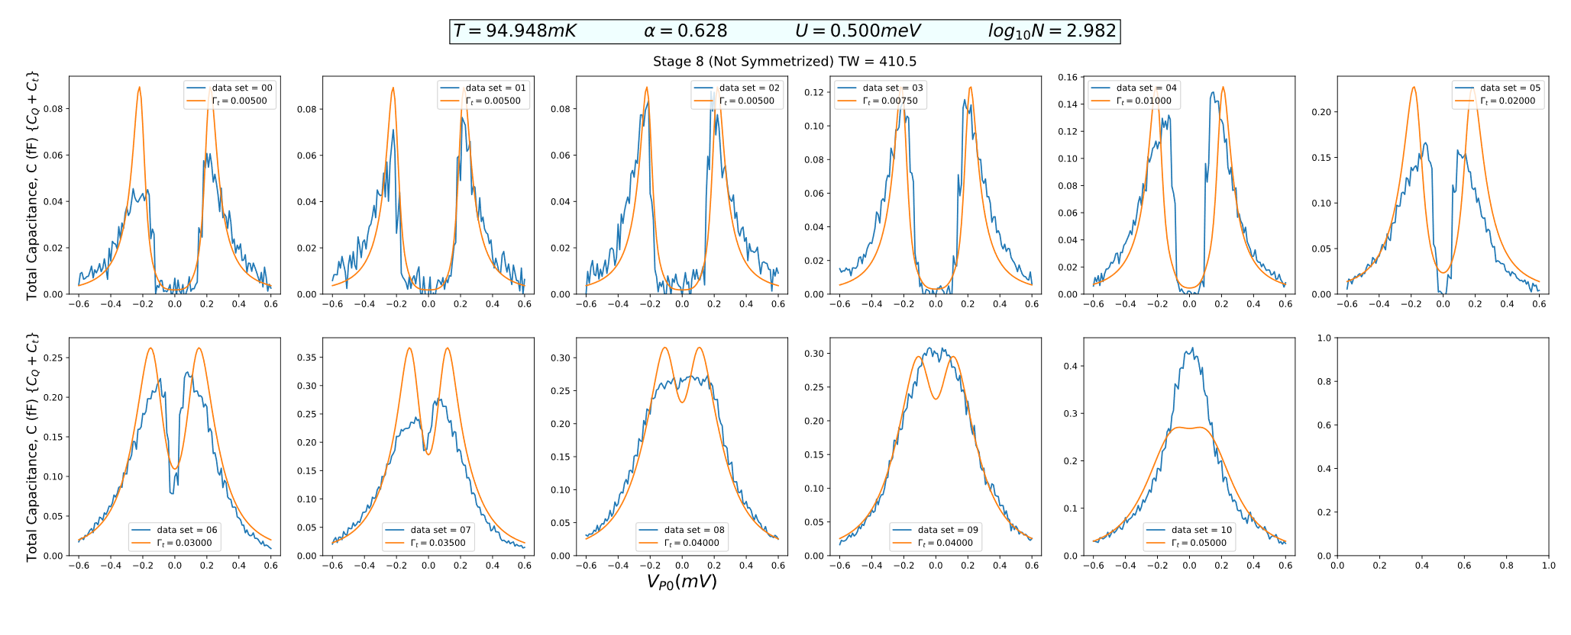
The Capacitance fits don’t change much

Slide 6
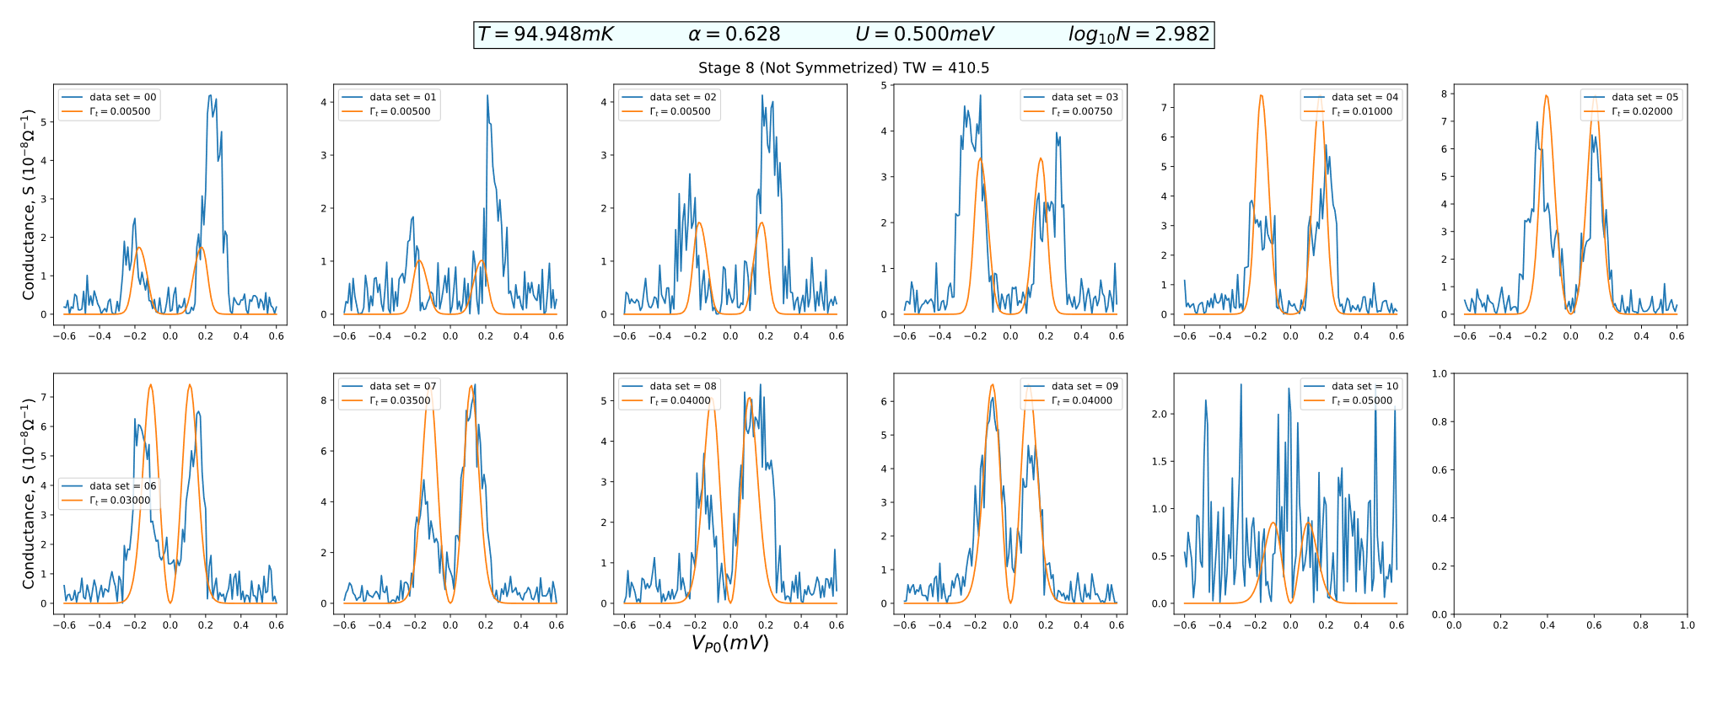
But the conductance fits are quite better, and a reduction in the overall cost (578 -> 410)
But the N value is lower than expected

