Slide 1


Lanczos Algorithm for Qiskit Dynamics
Mentor – Mirko Amico, IBM
Mentee – R K Rupesh, University of Hyderabad
$$\left|ψ\left(t\right)\right\rangle =e^{−iHt} \left|ψ\left(0\right)\right\rangle$$

Slide 2

Why Lanczos
Local Hamiltonians describing qubit systems are sparse
$$H=\left(\begin{matrix}0 & 0 & α & β \\ 0 & d_{0} & 0 & 0 \\ α^{∗} & 0 & 0 & 0 \\ β^{∗} & 0 & 0 & d_{1}\end{matrix}\right)$$
Calculating time evolution requires exponentiating the Hamiltonian
$$\left|ψ\left(t\right)\right\rangle =e^{−iHt}\left|ψ_{0}\right\rangle$$
This can be done by diagonalizing $H$
$$e^{−iHt}=S^{†}e^{−iDt}S$$

Slide 3

Why Lanczos
Time evolution requires only sparse matrix – vector multiplication
$$\left|ψ\left(t\right)\right\rangle =e^{−iHt}\left|ψ_{0}\right\rangle$$
$$=\sum_{n}{{\frac{\left(−it\right)}{n!}}^{n}H^{n}}\left|ψ_{0}\right\rangle$$
$$=\sum_{n}{{\frac{\left(−it\right)}{n!}}^{n}|u_{n}⟩}$$
$\left|u_{0}\right\rangle =\left|ψ\right\rangle \left|u_{1}\right\rangle =H\left|u_{0}\right\rangle \left|u_{2}\right\rangle =H\left|u_{1}\right\rangle . . . .$

Slide 4

Why Lanczos (Krylov Subspace)
$K_{r}=\{|ψ⟩, A\left|ψ\right\rangle ,{ A}^{2}\left|ψ\right\rangle ,{ A}^{3}\left|ψ\right\rangle …A^{k−1}|ψ⟩\}$ Is the krylov subspace for a given matrix $A$ and vector $\left|ψ\right\rangle$ of order $k$
One can construct a basis $\{|φ_{i}⟩\}$ for this subspace using Gram-Schmidt
$$\left|{\tilde{φ }}_{k−1}\right\rangle =\left|u_{k−1}\right\rangle −\sum_{i}{\left\langle φ_{i} | u_{k−1}\right\rangle |φ_{i}⟩}$$
$$|φ_{k−1}⟩=\frac{\left|{\tilde{φ }}_{k−1}\right\rangle }{⟨{\tilde{φ }}_{k−1}\left|{\tilde{φ }}_{k−1}\right\rangle }$$

Slide 5
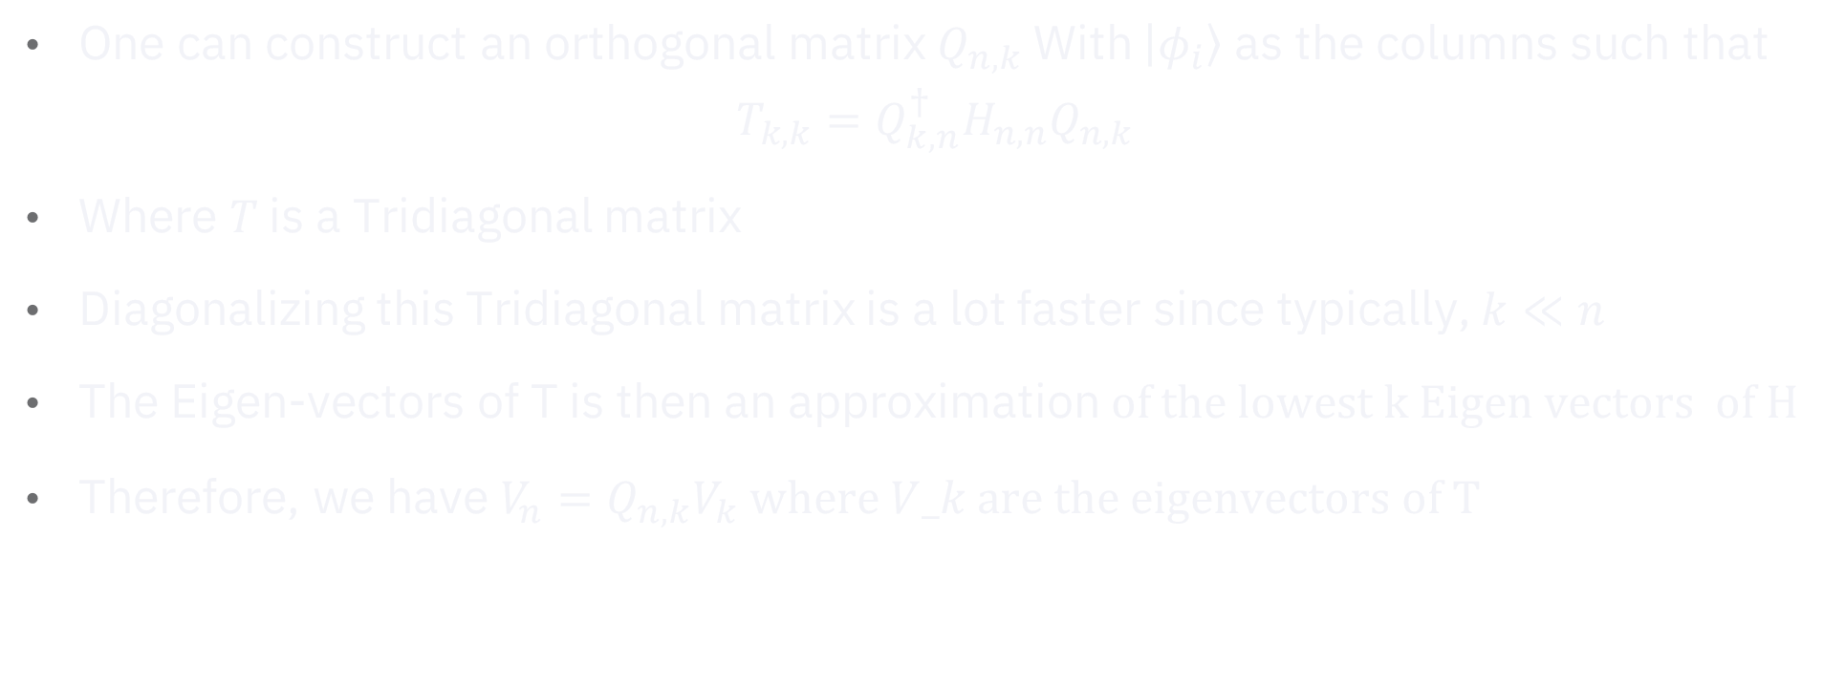
Why Lanczos (Krylov Subspace)
One can construct an orthogonal matrix $Q_{n,k}$ With $\left|φ_{i}\right\rangle$ as the columns such that
$$T_{k,k}=Q_{k,n}^{†}H_{n,n}Q_{n,k}$$
Where $T$ is a Tridiagonal matrix
Diagonalizing this Tridiagonal matrix is a lot faster since typically, $k≪n$
The Eigen-vectors of T is then an approximation of the lowest k Eigen vectors of H
Therefore, we have $V_{n}=Q_{n,k}V_{k}$ where $V_k$ are the eigenvectors of T

Slide 6
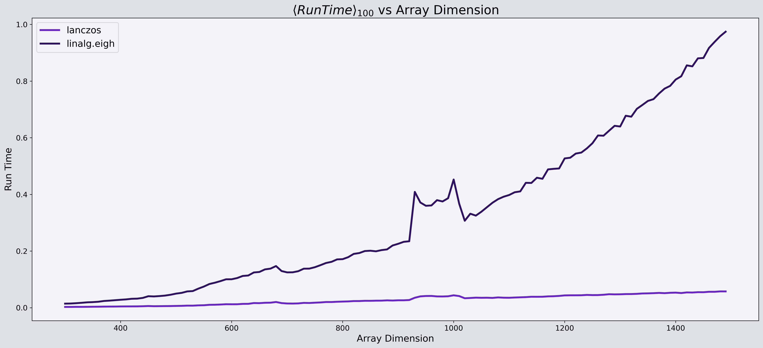
Lanczos vs NumPy
(ground state calculation)

Slide 7
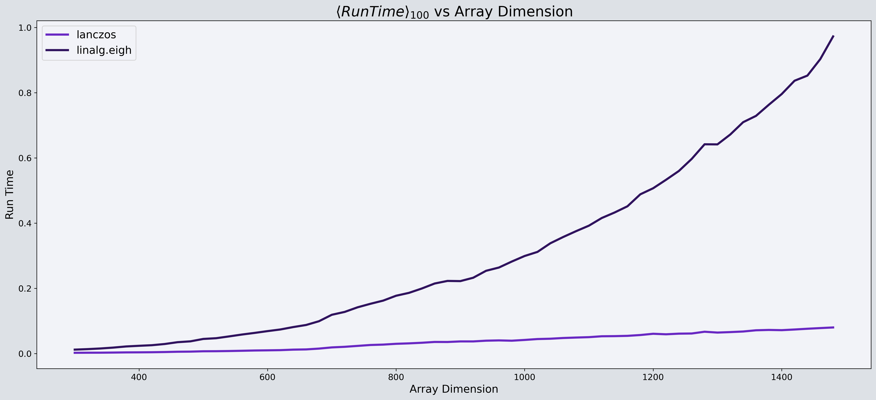
Lanczos vs NumPy
(ground state calculation)

Slide 8
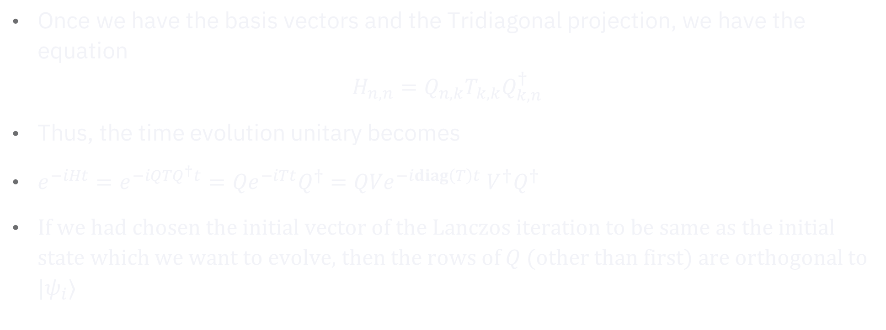
Lanczos Time-evolution
Once we have the basis vectors and the Tridiagonal projection, we have the equation
$$H_{n,n}=Q_{n,k}T_{k,k}Q_{k,n}^{†}$$
Thus, the time evolution unitary becomes
$e^{−iHt}=e^{−iQTQ^{†}t}={Qe}^{−iTt}Q^{†}={QVe}^{−idiag\left(T\right)t} V^{†}Q^{†}$
If we had chosen the initial vector of the Lanczos iteration to be same as the initial state which we want to evolve, then the rows of $Q$ (other than first) are orthogonal to $|ψ_{i}⟩$

Slide 9
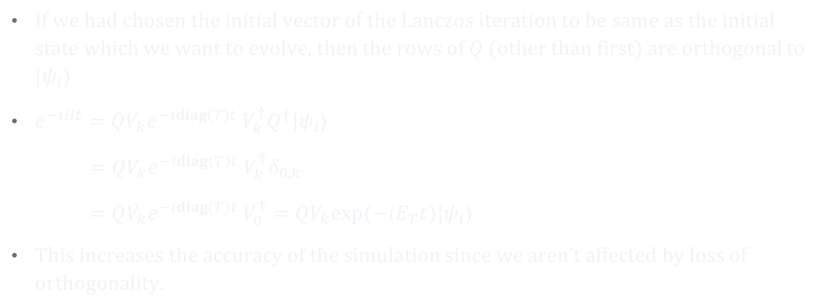
Lanczos Time-evolution
If we had chosen the initial vector of the Lanczos iteration to be same as the initial state which we want to evolve, then the rows of $Q$ (other than first) are orthogonal to $|ψ_{i}⟩$
$e^{−iHt}={QV_{k}e}^{−idiag\left(T\right)t} V_{k}^{†}Q^{†}|ψ_{i}⟩$
$={QV_{k}e}^{−idiag\left(T\right)t} V_{k}^{†}δ_{0,k}$
$={QV_{k}e}^{−idiag\left(T\right)t} V_{0}^{†}=QV_{k}exp⁡(−iE_{T}t)|ψ_{i}⟩$
This increases the accuracy of the simulation since we aren’t affected by loss of orthogonality.

Slide 10
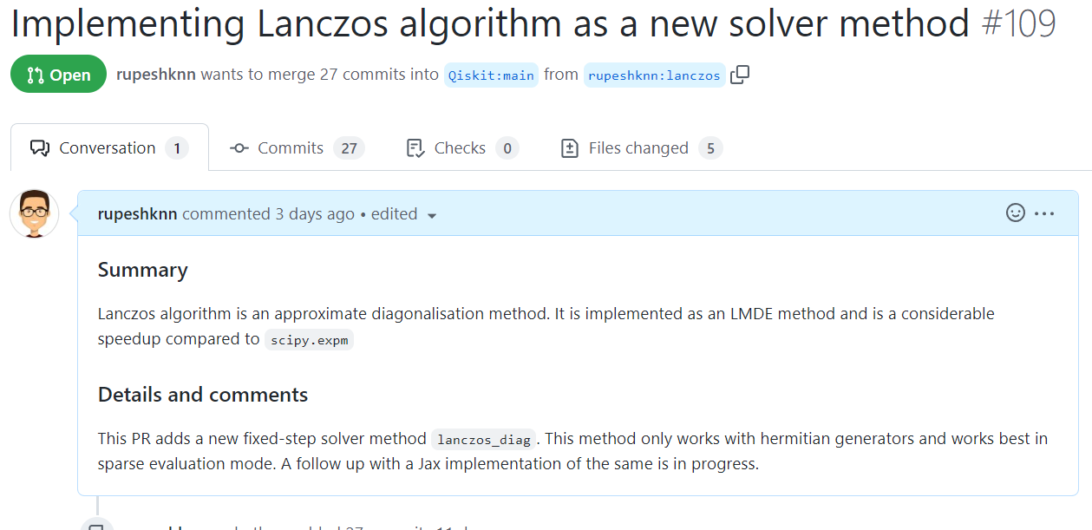
The PR

Slide 11
Thank You
R K Rupesh
MSc Physics, University of Hyderabad
Gachibowli, India
GitHub: github.com/rupeshknn/lanczos-QD
11

