Slide 1


Slide 2

Major Project-II (01CE0807), Semester 8
Review 3 (31/01/2026)
BankSEC: Blockchain-enabled Intelligent Scheme for Secure Smart Banking Environment
Team ID: 8PRO_095
Team Member 1: Rupesh Kumar (92201703182) (8EC-3)
Team Member 2: Darshan Thakkar(92310103059) (8TC-1)
Guided By
Internal Guide Name: Dr. Sushil Kumar Singh
Department of Computer Engineering, Faculty of Engineering & Technology

Slide 3
Outline
Introduction
Abstract
Objective
Motivation
Literature Review
Flowchart
Gantt chart
Tools and technologies
Challenges
Methodology / Algorithm Description
Future implementation
Conclusion
References

Slide 4
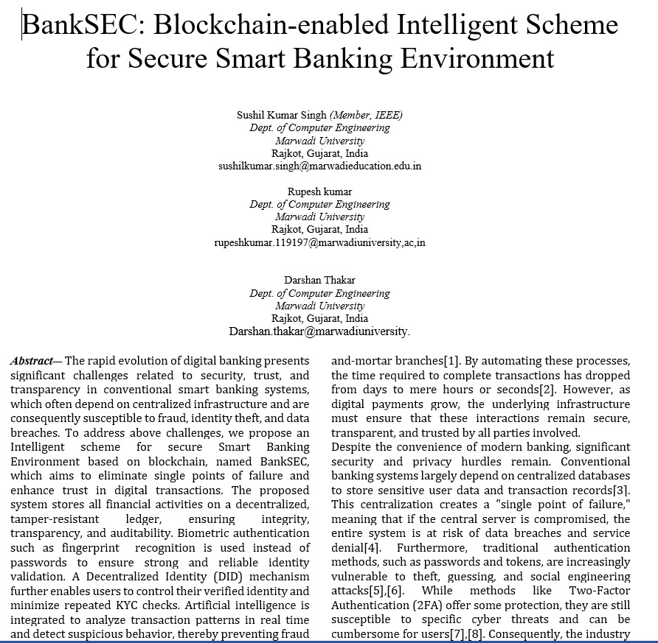
Review 1 : suggestion
Need to start Research Paper(Prof. Jigar dave)

Slide 5
Introduction
Digital banking is growing rapidly but faces major issues like security risks, data breaches, and identity theft.
Traditional systems rely on centralized servers, which are vulnerable to attacks.
The proposed system introduces a Blockchain-Based smart-Banking Platform for safer and transparent banking.
Combines Blockchain, Biometrics, and Artificial Intelligence (AI) for enhanced security and trust.
Biometric authentication (fingerprint/face) replaces passwords for easy and secure access.
Decentralized Identity (DID) gives users full control over their verified digital identity.
Smart contracts automate banking services like loans and transactions.
Aims to make e-banking secure, transparent, and user-friendly.

Slide 6
Abstract
The rapid evolution of digital banking presents significant challenges related to security, trust, and transparency in conventional smart banking systems, which often depend on centralized infrastructure and are consequently susceptible to fraud, identity theft, and data breaches.
To address above challenges, we propose an Intelligent scheme for secure Smart Banking Environment based on blockchain, named BankSEC, which aims to eliminate single points of failure and enhance trust in digital transactions. The proposed system stores all financial activities on a decentralized, tamper-resistant ledger, ensuring integrity, transparency, and auditability.
Biometric authentication such as fingerprint recognition is used instead of passwords to ensure strong and reliable identity validation.
A Decentralized Identity (DID) mechanism further enables users to control their verified identity and minimize repeated KYC checks. Artificial intelligence is integrated to analyze transaction patterns in real time and detect suspicious behavior, thereby preventing fraud before it occurs.

Slide 7
Objective
To overcome the security and privacy issues in traditional e-banking systems.
To reduce fraud and data breaches by using blockchain’s decentralized structure.
To replace passwords with biometric authentication for safer and easier access.
To enhance user trust and transparency in digital financial transactions.
To give users control over their digital identity through Decentralized Identity (DID).
To automate core banking operations like loans and transactions using smart contracts.
To build a modern, secure, and user-centric banking system for the digital era.

Slide 8
Motivation
Rapid growth of digital banking increases need for strong security.
Rising cases of fraud, hacking, and data theft reduce customer trust.
Centralized systems are more vulnerable to cyberattacks.
Users face repeated KYC checks and complex login processes.
Need for a secure, transparent, and easy-to-use banking platform.
Blockchain ensures data safety and transparency.
Biometrics provide quick and reliable user authentication.
Aim to build trust and confidence in digital banking systems.

Slide 9
Literature Review
Paper | Method | Technology | Addressed Issue | Limitation
Tsai et al.[1] | Mutual authentication scheme using digital signatures and logic postulates. | Blockchain, Smart Contracts. | Online banking spoofing, tampering, and mutual trust gaps. | Limited scalability regarding traffic flow; lacks cross-chain interoperability[2].
Salem et al.[3] | Identity management using deep learning for feature extraction. | Private Blockchain, Smart Contracts, FaceNet. | Privacy risks of centralized storage and data breaches. | Implemented as a proof-of-concept; limited testing on diverse real-world datasets[4].
Song et al.[5] | BFTEM: Trust mechanism recording parameters during block transmission. | Blockchain, Edge Computing. | Malicious user behavior and inaccuracies in trust evaluation. | High storage complexity for hash operations; relies on edge server availability[6].
Lee and Jeong[7] | BDAS: Protocol that splits and fragments biometric templates. | Blockchain, Distributed Storage. | Biometric data theft and single points of failure in storage. | Focuses on storage security rather than real-time behavioral analysis; reassembly adds latency[8],[9].
Ahmed[10] | Quantitative cost analysis using the Random Forest Method. | Blockchain Adoption Analysis, Machine Learning. | Quantifying the reduction of banking processing and fraud costs. | Restricted sample size (UAE banks); difficulty accessing raw transaction data[11].
BankSEC (Proposed) | Intelligent security scheme combining DID, biometrics, and real-time analysis. | Blockchain, Biometrics, AI, Smart Contracts. | Eliminates single points of failure, enhances user control (DID), and provides real-time fraud prevention.

Slide 10
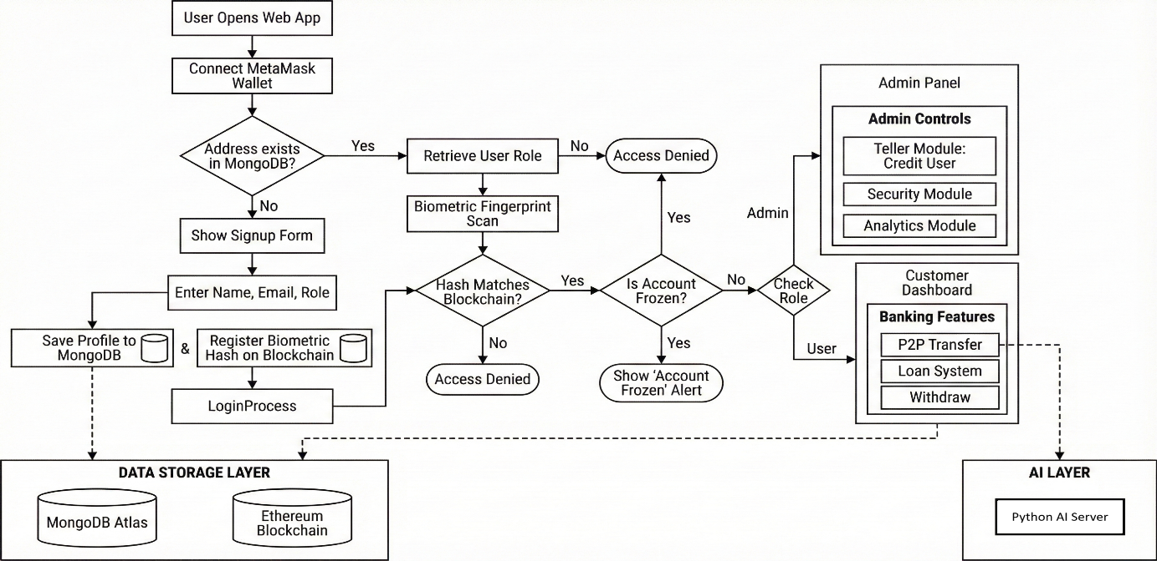
Operational Flowchart of the BankSEC System

Slide 11
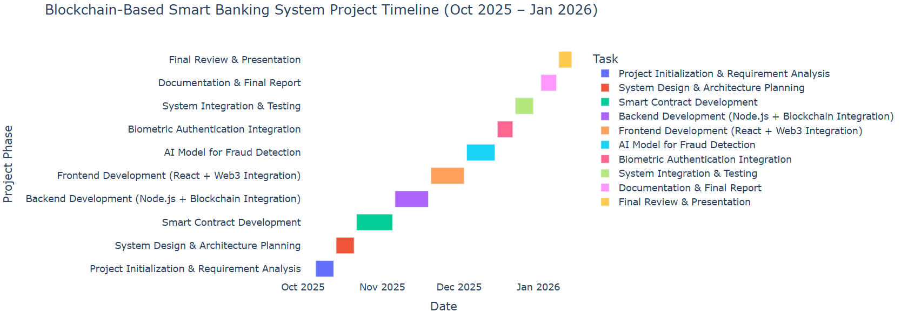
Project Scheduling Gantt Chart

Slide 12
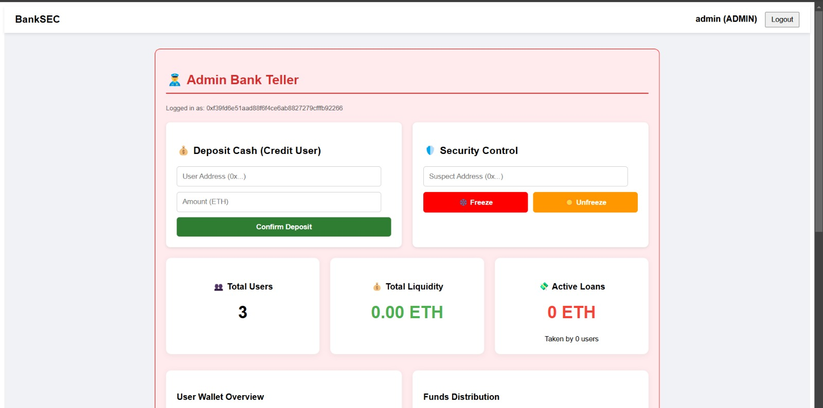
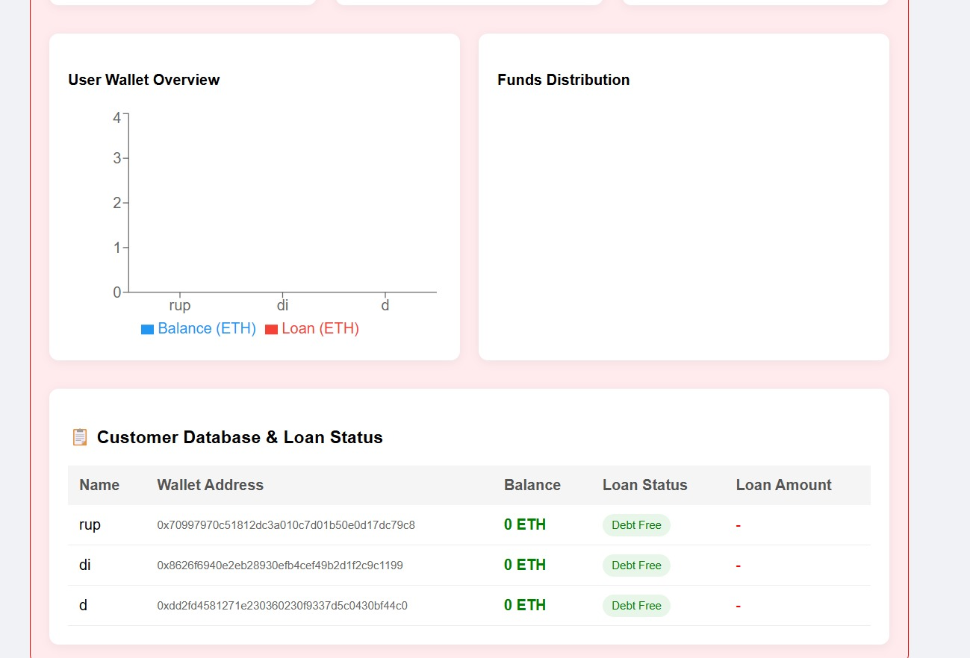
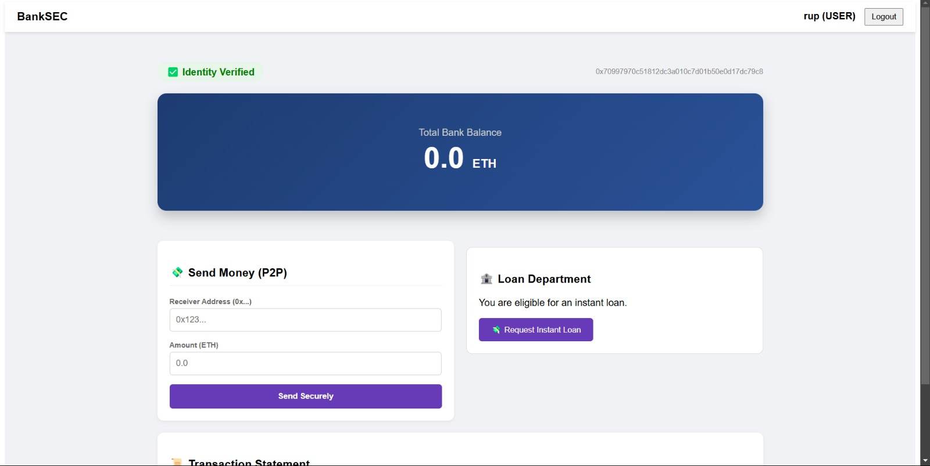
Screenshot

Slide 13
Tools & Technologies
Frontend : React.js
Backend : Node.js + Express
Blockchain Platform : Ethereum
Smart Contracts : Solidity
Web3 Integration : Web3.js/Ether.js
Database : MongoDB (for Off-chain metadata)
AI/ML Models : Python for Fraud Detection
Biometric Authentication : Fingerprint/FaceID Integration via Web APIs

Slide 14
Challenges
Ensuring high security while keeping the system user-friendly.
Integrating blockchain, biometrics, and AI seamlessly into one platform.
Managing scalability and transaction speed on the blockchain network.
Handling data privacy while using decentralized storage.
Ensuring compatibility with existing banking infrastructure.
Maintaining low operational costs despite advanced technologies.
Building trust and awareness among users and financial institutions.
Keeping up with regulatory and compliance requirements in banking and blockchain.

Slide 15
Methodogy / Algorithm Description
The proposed BankSEC system follows a hybrid methodology that integrates Blockchain technology, Artificial Intelligence, and centralized databases to ensure secure, transparent, and intelligent smart banking operations. The system workflow is divided into multiple sequential phases to guarantee data integrity, fraud prevention, and efficient transaction processing.
.
Step 1: User login and authentication Step 2: Generate transaction request Step 3: Verify user credentials and digital signature Step 4: Analyze transaction using AI fraud detection model Step 5: Validate transaction via smart contract Step 6: Create and broadcast block Step 7: Achieve consensus among nodes Step 8: Store transaction hash on blockchain Step 9: Update database and notify user

Slide 16
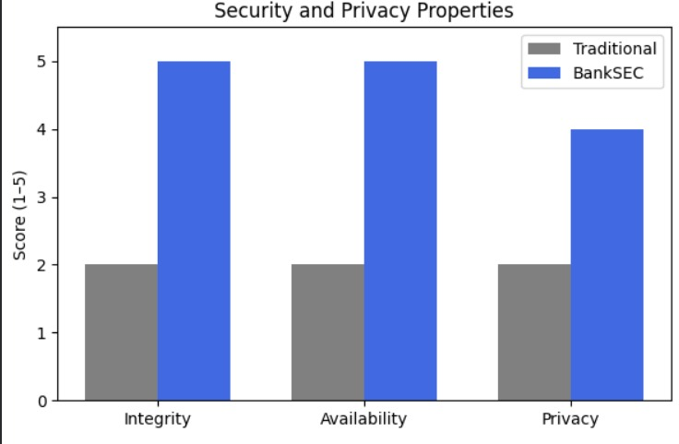
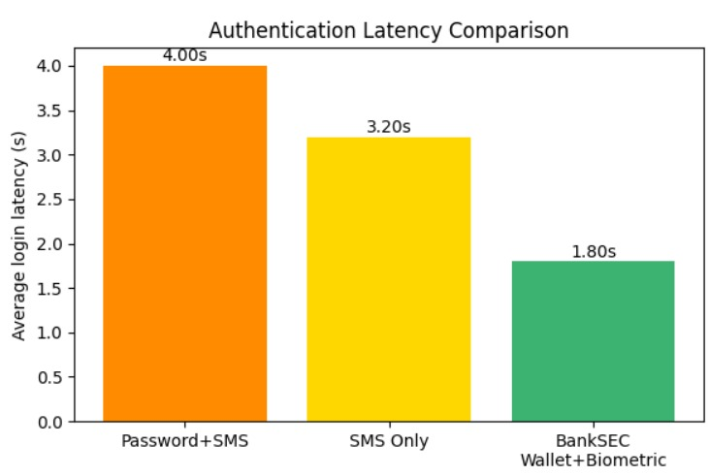
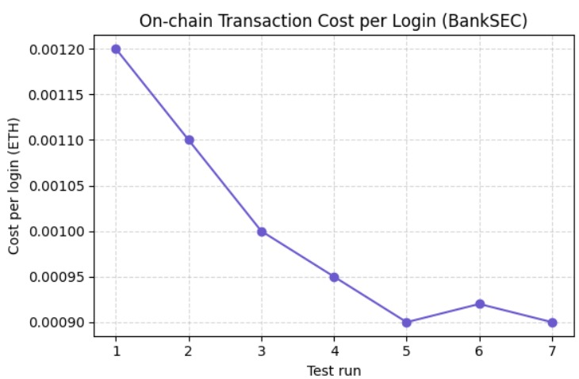
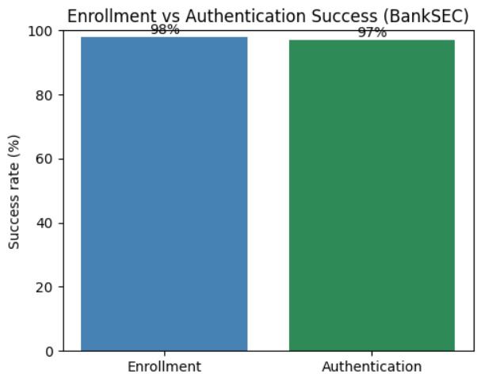
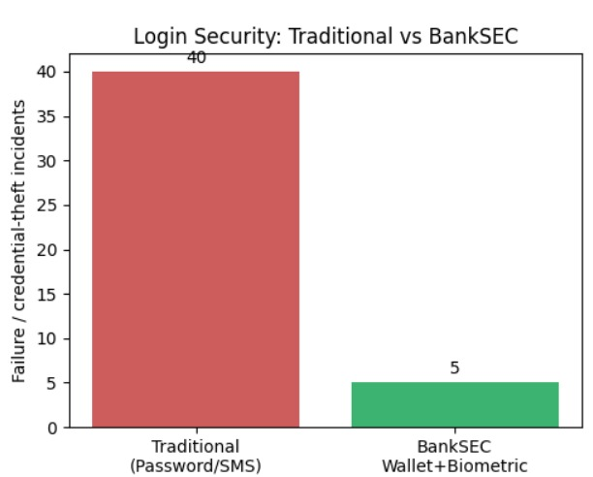
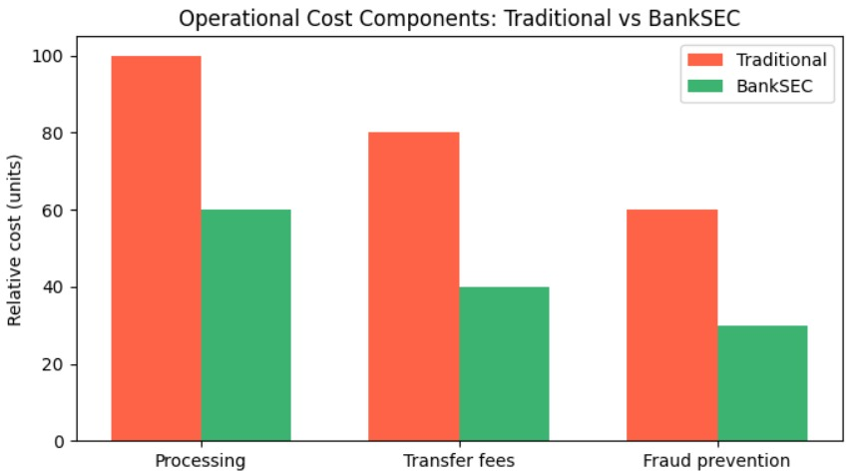
Result Section

Slide 17
Conclusion
The project introduces a secure and transparent banking system using blockchain, biometrics, and AI.
Blockchain technology ensures data integrity and prevents tampering or fraud.
Biometric authentication provides simple and reliable user access without passwords.
Decentralized Identity (DID) gives users control over their verified digital identities.
Smart contracts automate core banking functions for efficiency and trust.
Overall, the system enhances security, transparency, and user confidence in digital banking.
It represents a modern step toward a safer and more reliable financial ecosystem.

Slide 18
References
Karadag, B., Zaim, A. H., & Akbulut, A. (2024). Blockchain in Finance: A Systematic Literature Review. Pressacademia Journal of Business, Economics and Finance, 13(1), 15–28. DOI: 10.17261/Pressacademia.2024.1945
Islam, I., Munim, K. M., Oishwee, S. J., & Rahman, M. M. (2020). A Critical Review of Concepts, Benefits, and Pitfalls of Blockchain Technology Using Concept Map. IEEE Access, 8, 68319–68343. DOI: 10.1109/ACCESS.2020.2985647
Wu, H., Zhang, L., & Chen, Z. (2024). Blockchain for Finance: A Survey. IET Research Journal on Blockchain and Distributed Ledger Technologies, 5(2), 44–63. arXiv:2402.17219v1
Mohammed, M. A., De-Pablos-Heredero, C., & Montes Botella, J. L. (2024). A Systematic Literature Review on the Revolutionary Impact of Blockchain in Modern Business. Applied Sciences, 14(5), 3211–3232. DOI: 10.3390/app14053211
Sunny, F. A., Rahman, M. S., & Hossain, M. M. (2022). A Systematic Review of Blockchain Applications. IEEE Access, 10, 75129–75158. DOI: 10.1109/ACCESS.2022.3186247
Ali, O., Ally, M., Clutterbuck, D., & Dwivedi, Y. K. (2020). Annexure – Thematic Analysis on Blockchain Literature. In Solojano Annexure Dataset (pp. 1–20). Document ID: solojano,+annexure.pdf

Slide 19


