Slide 1
The TTM™ Strategy
Step-by-step simplified overview of the TTM™ Strategy, based on Price Action & Market Structure

Slide 2
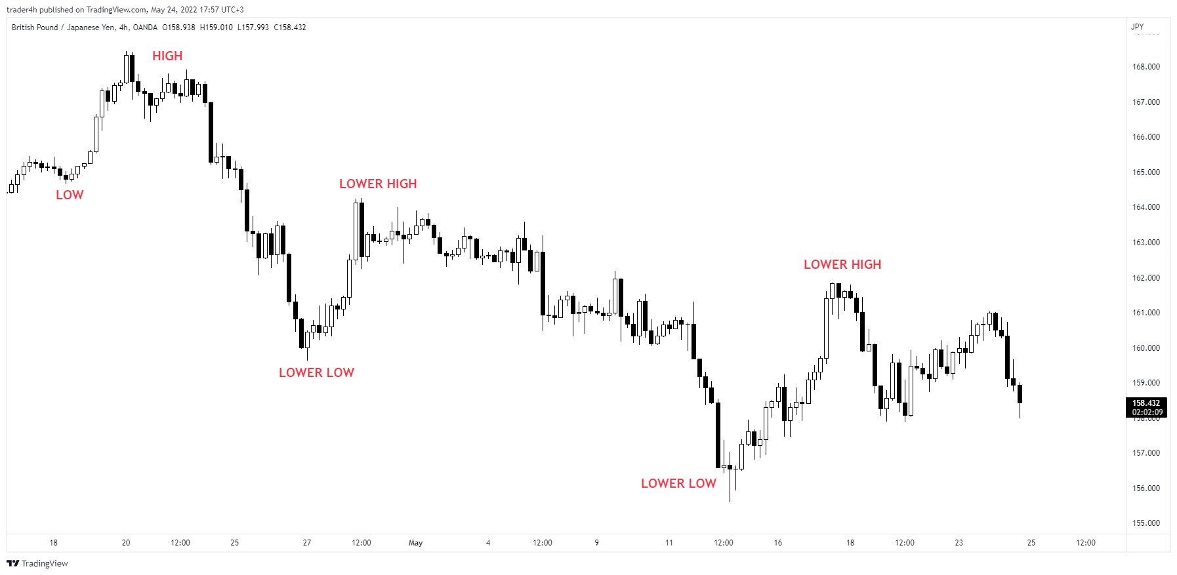
Step 1 – Identifying the 4H trend

Slide 3
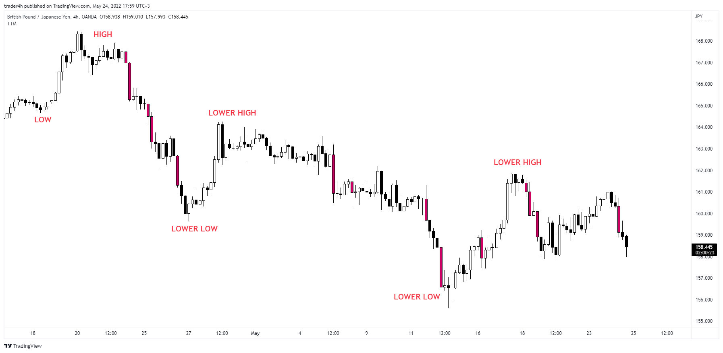
Step 2 – Identifying supply candles

Slide 4
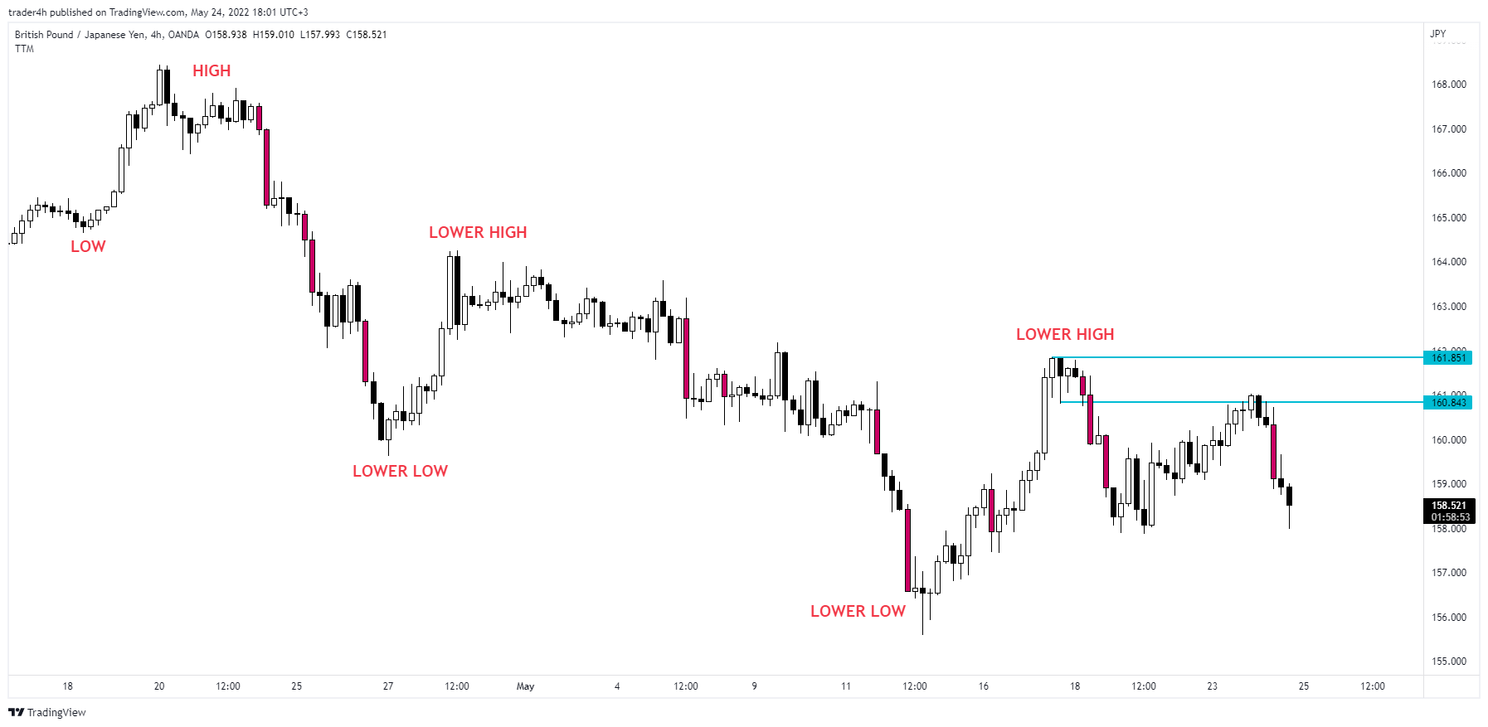
Step 3 – Marking the supply zone

Slide 5

Step 4 – Retest of UT (untested) zone

Slide 6
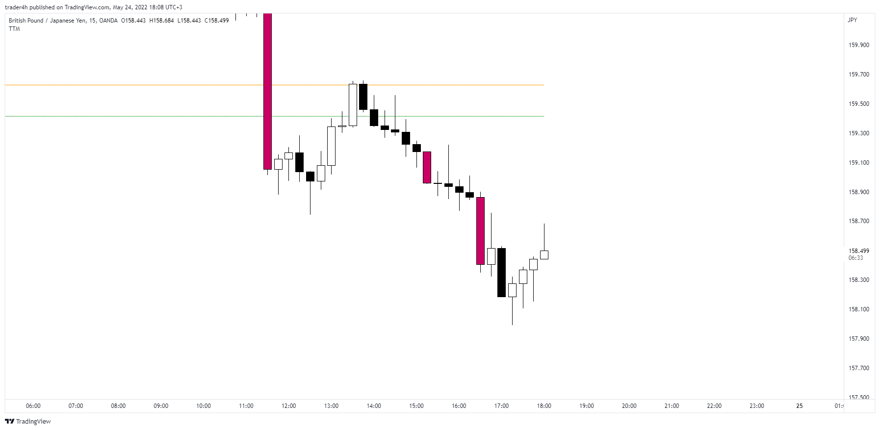
Step 5 – S/R bounce on the 15-min chart

Slide 7
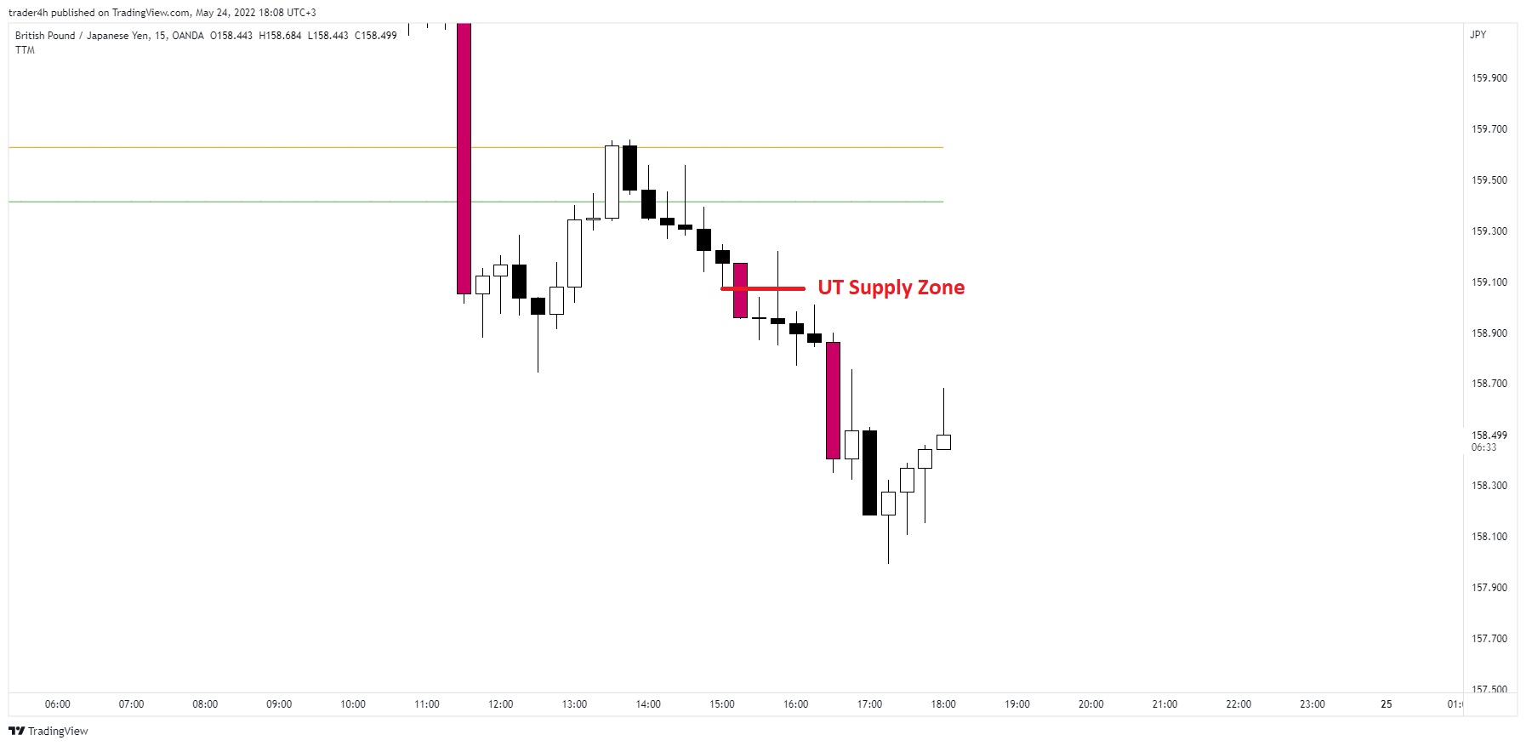
Step 5 – UTSZ bounce on the 15-min chart

Slide 8
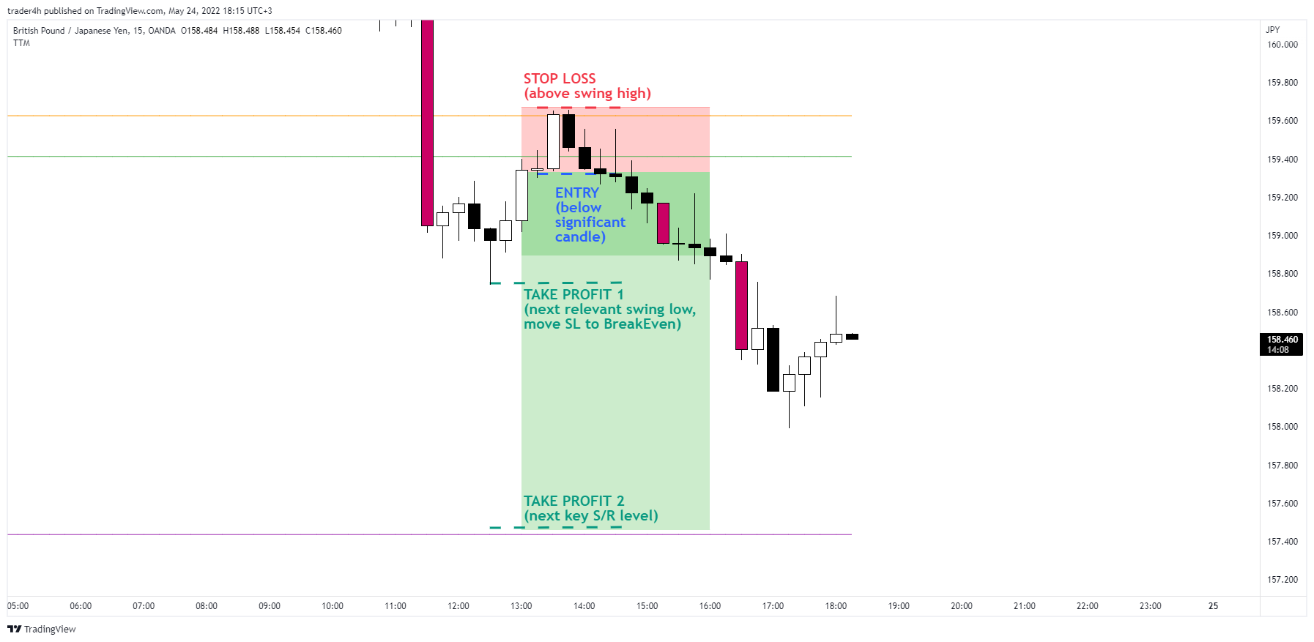
Step 6 – Trade execution

Slide 9
Thank you!
NOTE! The information in this document is NOT financial, trading or investment advice.

