Slide 1
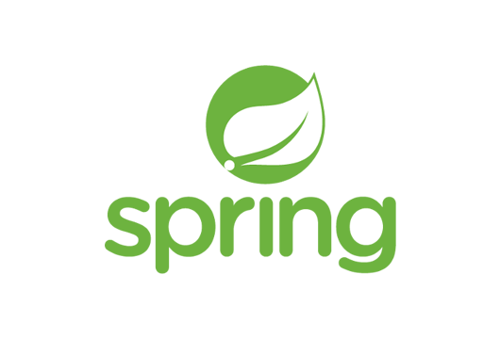
Service Discovery & Feign Client
By Rupesh Patil
(16th Nov 2022)

Slide 2
Agenda
Distributed Systems?
What is Service Discovery and Why do we need it?
Client-side service discovery V/S Server-side service discovery
What is Spring Cloud Eureka?
Implementing a Eureka Server and a Client
Demo - Inter-Microservice Communication via Eureka
Feign Client
Q & A

Slide 3
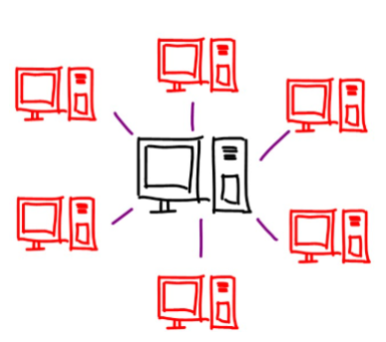
Distributed Systems
A system, which involves multiple components talking to each other in SOME WAY while performing their own activities
Components communicate via rest API or messaging (Like RabbitMQ or Kafka)
Component can have one or more of its instances (Load Balancing)
Every component exposes a contract, with which clients communicate with them

Slide 4
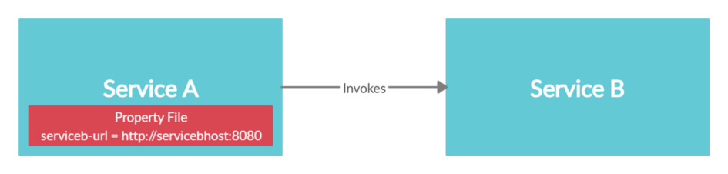
What is Service Discovery?
-Service discovery is the process of one service dynamically discovering the network location (IP address and port) of another service to communicate with it.
-Example Scenario of 2 services:
-However above approach is nearly impossible in cloud based microservice architecture, due to increase in number of services, dynamic network locations.

Slide 5
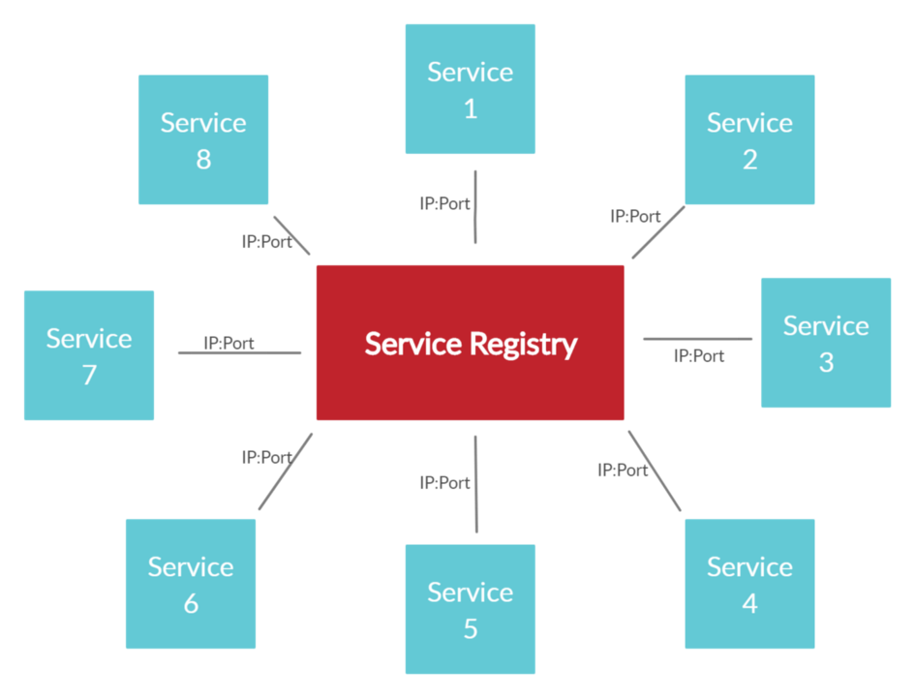
What is Service Discovery? Conti …
- Need a more sophisticated mechanism for microservices to dynamically discover the network locations of other microservices for communication.
- Service discovery mechanism uses a central registry to maintain the network locations of all the microservices.
- If for some reason the IP address and the port number of a particular microservice changes, new values will be immediately re-registered in the registry.

Slide 6
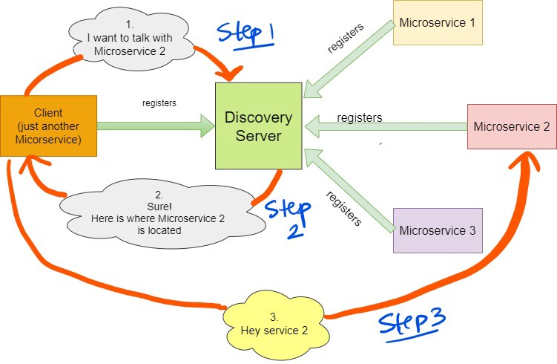
Client-Side Service Discovery
This is Client-side service discovery because all the work of discovery is done by the client i.e., connect the discovery-server and get the information of the service to contact.
Spring cloud uses is client-side server discovery — Netflix Eureka
Challenge: Client needs to handle load balancing may be using Feign or Robin

Slide 7
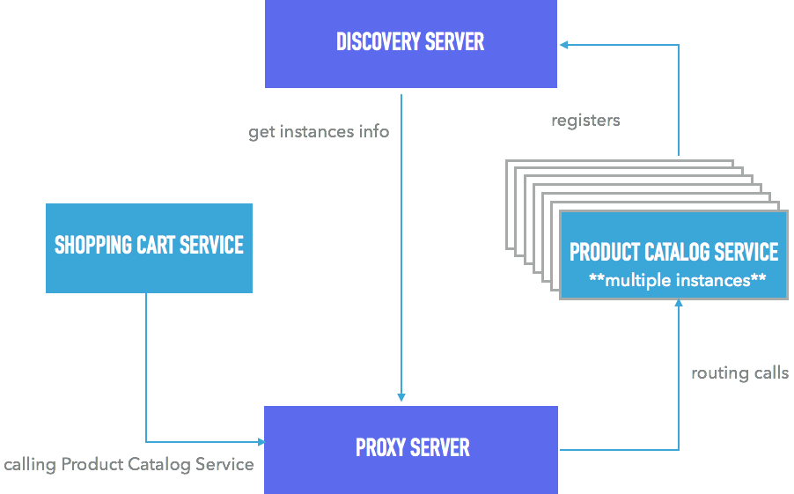
Server-Side Service Discovery
We have a dedicated proxy server that takes care load balancing.
The Proxy Server is responsible for two things
To route the requests
To do load-balancing
- Challenge: The proxy server needs to be highly available as this is the single-entry point for all the microservices

Slide 8
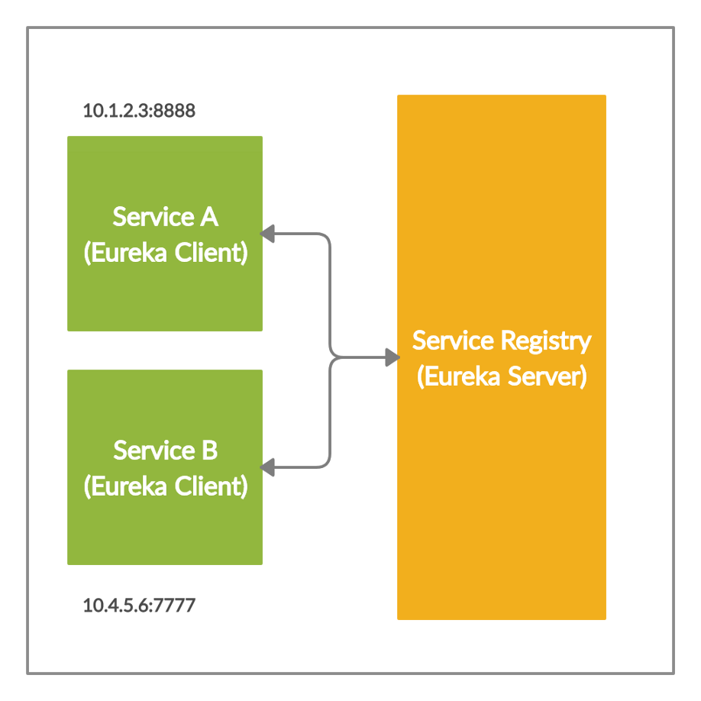
Eureka Server and Clients
Service Discovery has two components.
Eureka Server is REST based service which is primarily used for acquiring information about services.
The Services that register in Eureka Server to obtain information about each other are called Eureka Clients.

Slide 9
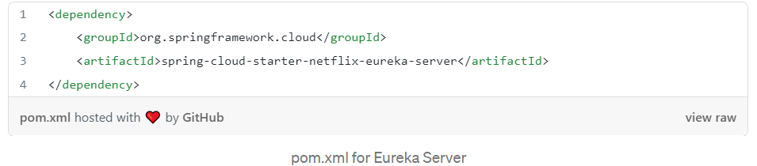
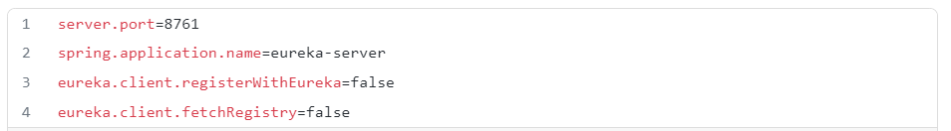
Implementing a Eureka Server
Setup Eureka Server — Act as discovery server and service registry.
To make the spring-boot app a discovery server, we need to add @EnableEurekaServer annotation in the main class.
We need to also tell the eureka server that it should not register itself with itself (line 3 and 4 does that).
Start the application and hit http://localhost:8761/

Slide 10

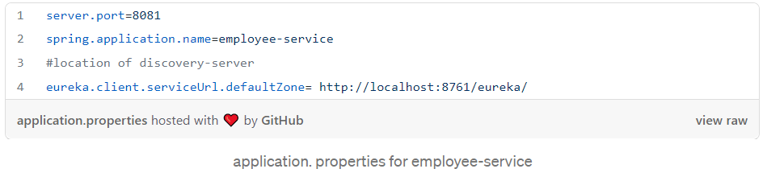
Implementing a Eureka Client
Create a spring boot app with below dependencies.
Add @EnableEurekaClient annotation in main class to make the spring-boot app a discovery client and it will register itself with Eureka Server
We need to give the information to the client regarding the discovery server so that it can register itself.

Slide 11
Demo - Inter Microservice Communication via Eureka
Run the Eureka Server and access at http://localhost:8761/
Run the Product Service
Run the Order Service and check if services are registered with Eureka Server
Call the Order Service API’s
- /order-service-host/order
- /product-service-host/product
- /order-service-host/order/product (with hard-coded URL)
- /order-service-host/order/product-new **(with Service Discovery)
Run one more instance of the Product service on different port and call the API again.
Load Balancing will happen because we have added @LoadBalanced annotation.
We can use Feign or Ribbon Client as well

Slide 12
Feign Client
Feign client is used to make declarative REST calls to other microservices
it basically uses interfaces and has fallback Capability.
Dependency: group org.springframework.cloud and artifact id spring-cloud-starter-openfeign
@EnableFeignClients - To include Feign
@FeignClient annotation accepts String value is an arbitrary client name, which is used to create a Ribbon load balancer.
You can also specify a URL using the URL attribute (absolute value or just a hostname)
If your application is a Eureka client then it will resolve the service in the Eureka service registry
If you don’t want to use Eureka, you can simply configure a list of servers in your external configuration
More Details: https://cloud.spring.io/spring-cloud-netflix/multi/multi_spring-cloud-feign.html
Demo

Slide 13
Q & A
Thank you !!

