Slide 1
BIG DATA ANALYTICS — CA3 ACTIVITY 2
Bengaluru Urban Mobility & Transit Analytics
Multi-modal (Bike · Auto · Cab) demand, congestion, fare and ETA analytics with MapReduce and machine learning
247,951
4
2
10
Trips analysed
MapReduce jobs
ML models
City hubs
Team Members: [Your Name], [Teammate Name] | MCA AIML — III Semester | [Date]
Notes:
Bengaluru multi-modal mobility analytics: synthetic trip data for 10 hubs and 3 vehicle types, processed with 4 Hadoop-Streaming-style MapReduce jobs and 2 Random Forest models, served through a role-based Flask dashboard.

Slide 2
WHY THIS PROJECT
The real-world problem
Bengaluru riders choose between bike taxis, autos and cabs on roads that slow to a crawl at peak. Riders, drivers and city planners each need different answers from the same trip data.
1
When and where is demand highest?
2
Which ride should I take?
3
Where are the choke points?
By hour, hub and vehicle type.
ETA and fare for bike vs auto vs cab.
Slowest peak-hour corridors.
4
How do peaks and rain change trips?
5
Where should drivers wait?
6
Can ML predict ETA and demand?
Speed, delay and surge.
Fare earned per minute, by hour and corridor.
Regression for ETA, classification for surge.
Notes:
Three audiences: users (which ride), drivers (where and when to work), admins/planners (congestion and system health).

Slide 3
STAGE 0
Dataset: synthetic Bengaluru trips
No open trip-level dataset exists for Bengaluru bike / auto / cab rides, so trips are generated from documented city rules (seed 42, fully reproducible).
10 hubs with real coordinates, from Koramangala and Whitefield to Kempegowda Airport and Majestic.
Traffic peaks 08:30–11:30 (1.5–2.2×) and 17:30–21:30 (1.6–2.4×); free-flow at night; rain adds 15%.
Rate cards: Bike ₹20 + ₹8/km, Auto ₹30 + ₹15/km, Cab ₹60 + ₹18–22/km, plus delay charge, night surcharge and surge.
1 Jan – 30 Jun 2025 (181 days, 25 rainy). About 1.5% dirty rows were injected on purpose for the cleaning stage.
250,750
247,951
Raw rows
After cleaning
11
30
Raw columns
Columns after
feature engineering
Notes:
Be upfront: the data is synthetic. The generator is pipeline/00_generate_bengaluru_data.py and every rule lives in pipeline/mobility_model.py, which the backend also uses, so fares are consistent everywhere.

Slide 4
HOW IT ALL FITS TOGETHER
End-to-end pipeline
0
1
2
3
4
5
6
→
→
→
→
→
→
Generate
synthetic trips
Clean &
engineer
MapReduce
4 jobs
Train
2 models
Precompute
role data
Flask
JSON API
Role-based
dashboard
pipeline/run_all.py runs steps 0–4 in about 10 seconds. backend/app.py serves /api/dashboard?role=, /api/predict/trip and /api/predict/demand.
Notes:
Steps 0 to 4 are offline batch stages that write CSV, joblib and JSON files. The Flask app only loads those artifacts, so the dashboard starts instantly.

Slide 5
STAGE 1
Data cleaning & feature engineering
Cleaning step | Rows
Duplicate rows removed | 750
Missing pickup zone removed | 600
Zero / negative distance removed | 600
Duration ≠ timestamps removed | 600
Outliers > 99.9th pct (185 min) removed | 249
Missing fares imputed from rate card | 600
Vehicle names normalised (case / spaces) | 600
Engineered features
hour, day_of_week, is_weekend, month
is_peak_hour, is_night, time_period
traffic_factor, traffic_level
free_flow_min, delay_min, avg_speed_kmph
corridor (pickup → drop-off)
distance_category, fare_per_km, fare_per_min
Notes:
Net result: 247,951 clean rows with 30 columns, plus a 12-column TSV that is the MapReduce input contract (pipeline/schema.py).

Slide 6
STAGE 2 — HADOOP-STREAMING COMPATIBLE
MapReduce implementation
Job 1 · Modal demand by hour
Job 2 · Duration & fare by zone
Map (hour | vehicle) → 1
Map (zone | vehicle) → minutes, fare
Reduce sum → 72 rows
Reduce count, averages, total → 30 rows
Job 3 · Congestion corridors
Job 4 · Demand dataset
Map peak, inter-zone only: (pickup | drop) → km, min, delay
Map (date | hour | day | zone | rain) → 1
Reduce speed, delay share, status → 90 rows
Reduce count → 38,158 rows → feeds Model B
Each job is a real mapper.py / reducer.py pair run as Map → Shuffle/Sort → Reduce subprocesses, the contract Hadoop Streaming uses. 247,951 records through all 4 jobs in 1.5 s locally.
Notes:
The same files run unchanged with: hadoop jar hadoop-streaming.jar -mapper mapper.py -reducer reducer.py. Job 3 only maps peak-hour, inter-zone trips (64,762 records).

Slide 7
STAGE 3 — ANALYTICS
Demand peaks at 09:00 and 19:00
Busiest hour 19:00, about 20,000 trips over the period.
48% of trips fall in the two peak windows.
Mode share is balanced: bike 33%, auto 35%, cab 32%.
Weekdays carry 76% of trips; Wednesday is busiest.
Notes:
Source: outputs/mapreduce/job1_modal_demand_by_hour.csv. Demand is lowest 02:00-04:00.

Slide 8
STAGE 3 — CONGESTION
Choke points: two corridor clusters
Slowest peak-hour corridors (MapReduce Job 3)
Corridor | km/h | Delay
Koramangala → HSR Layout | 13.1 | 10 min
Electronic City → HSR Layout | 13.1 | 23 min
Majestic → MG Road | 13.2 | 10 min
HSR Layout → Koramangala | 13.2 | 10 min
MG Road → Majestic | 13.3 | 10 min
Koramangala → Jayanagar | 13.4 | 9 min
Of 90 corridors: 21 Critical (< 13.75 km/h), 46 Severe (< 15), 23 Moderate. Peak traffic factor reaches 2.6× at 19:00 on weekdays.
Notes:
Two clusters: Koramangala / HSR Layout / Electronic City (the Silk Board junction area) and Majestic <-> MG Road in the old city centre. Delay = average minutes above free-flow time.

Slide 9
STAGE 3 — MODES
Bike vs auto vs cab
Bike
Auto
Cab
₹78
₹172
₹408
average fare
average fare
average fare
33% / 12%
35% / 28%
32% / 61%
of trips / of revenue
of trips / of revenue
of trips / of revenue
23 → 16.8
19.5 → 12.8
23.3 → 13.1
km/h, off-peak → peak
km/h, off-peak → peak
km/h, off-peak → peak
+47%
+29%
+31%
minutes per km in rain
minutes per km in rain
minutes per km in rain
Notes:
Bikes hold speed best in peak traffic but lose the most in rain. Cabs are 32% of trips but about 61% of fare value.

Slide 10
WHAT THE DATA SHOWS
Key findings
19:00
Koramangala
17.4 km/h
Peak demand hour
Busiest pickup hub
Average trip speed
₹5.36 Cr
1.39×
0.85
Total fare value, 6 months
Average surge multiplier
Distance ↔ duration correlation
Drivers earn less per trip-minute in peak jams (auto ₹6.5/min by day vs ₹11.8/min at night): delay charges don't keep pace with time lost.
At night an auto costs as much as a cab for trips of 8 km or more (₹184 vs ₹180 at 23:00), because of the 1.5× auto night meter.
Notes:
Night fare comparison is from the rate card for an identical 8 km trip; by day the same auto trip is ₹131 vs ₹167 by cab.

Slide 11
STAGE 4
Machine learning models
MODEL A — REGRESSION
MODEL B — CLASSIFICATION
Trip duration (ETA)
Zone demand level → surge
Random Forest regressor · 80 trees, depth 12
Random Forest classifier · Low / Medium / High
Features: vehicle, distance, hour, day, traffic factor, rain
Learns actual ÷ formula ETA, so long trips still scale by vehicle
Fare is then computed from the ETA via the rate card
Trained on 38,158 MapReduce Job 4 cells
Features: hour, day, weekend, peak, zone, rain
Tertile labels: Low ≤ 4, Medium ≤ 8, High > 8 trips / hour
2.995 min
0.957
68.0%
0.687
Mean absolute error
R² score
Accuracy (random = 33%)
Weighted F1
Notes:
Per-vehicle MAE: bike 1.875, auto 2.767, cab 4.383 min. Honest caveat: the physics formula alone scores MAE 2.99 min, because the synthetic data was generated from it. Feature importance: distance 42%, traffic factor 34%, hour 10%.

Slide 12
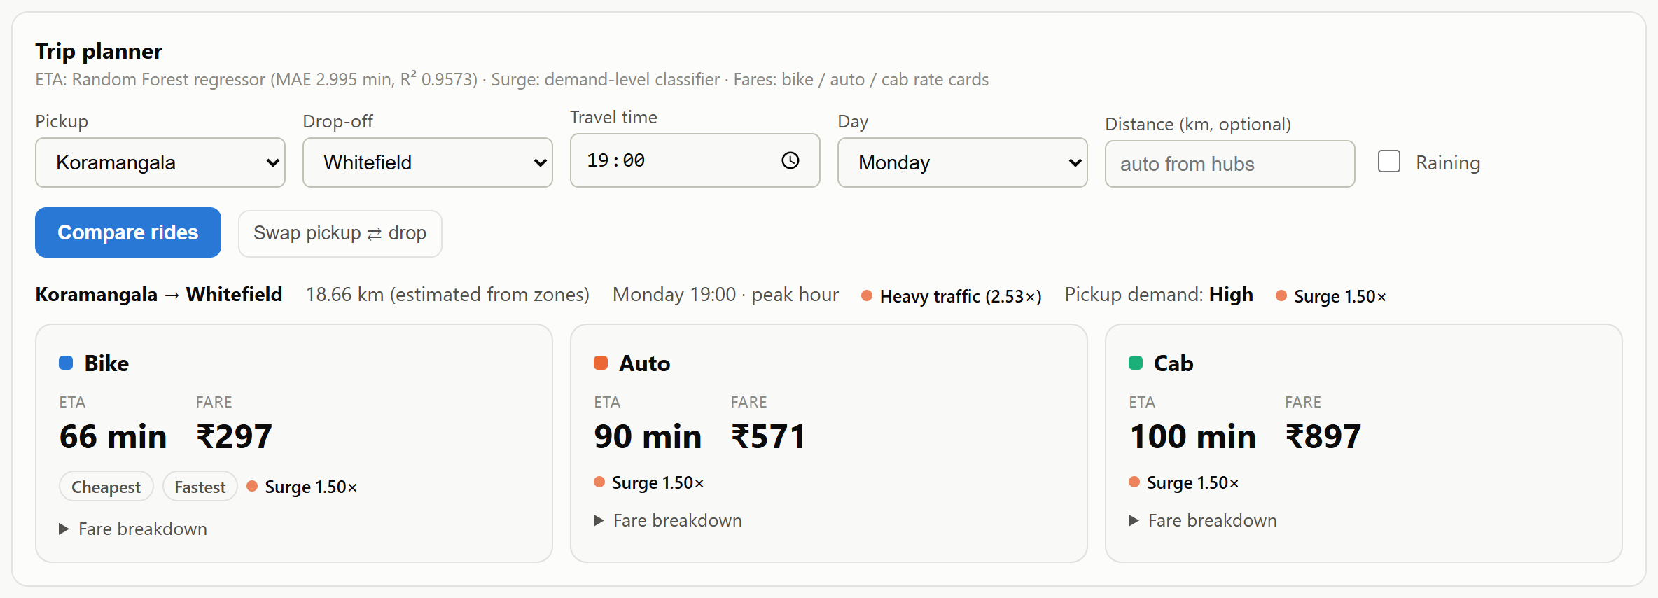
THE DASHBOARD — USER VIEW
Trip planner: compare all three rides
Koramangala → Whitefield, Monday 19:00: bike 66 min / ₹297, auto 90 min / ₹571, cab 100 min / ₹897. ETA from Model A, surge from Model B, fares from the rate card.
Notes:
Live demo: python backend\app.py then open http://127.0.0.1:5000. Each card has an expandable fare breakdown (base, distance, delay, night, surge).

Slide 13
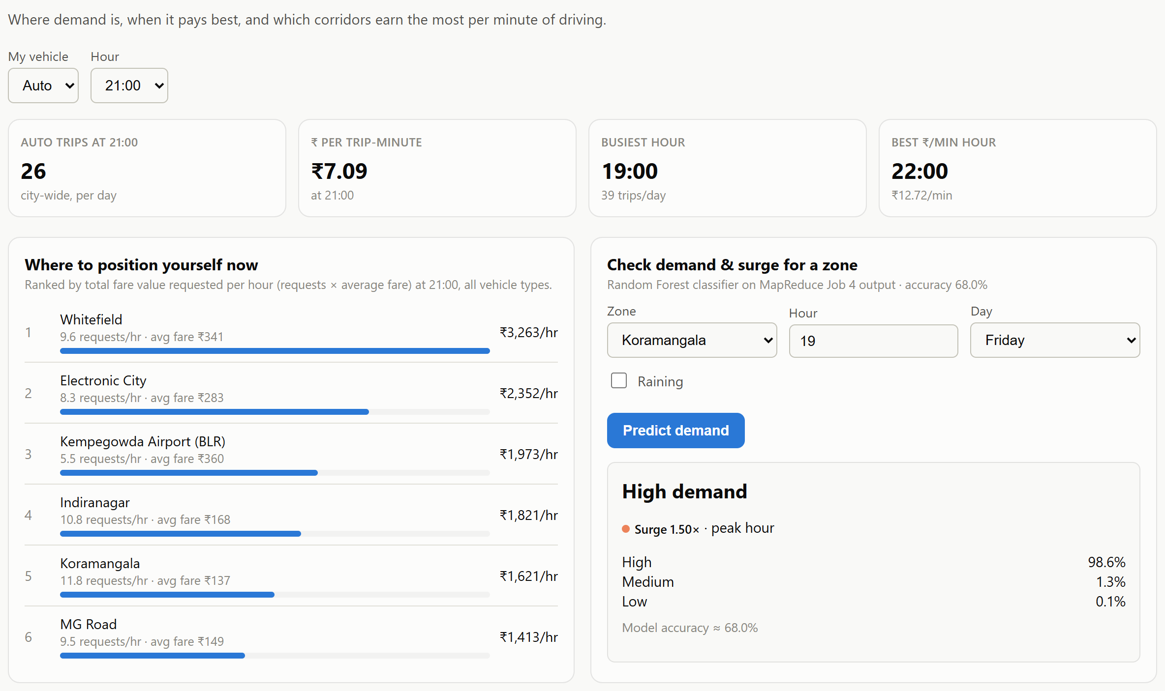
THE DASHBOARD — DRIVER VIEW
Where to wait, and when it pays
Hubs ranked by fare value requested per hour at the chosen time.
Demand & surge check calls Model B live (Koramangala, 19:00 → High, 1.5× surge).
Also: zone × hour heatmap, earning-window chart, best-earning corridors.
Notes:
Driver KPIs: trips at the selected hour, fare per trip-minute, busiest hour and the best fare-per-minute hour for the chosen vehicle.

Slide 14
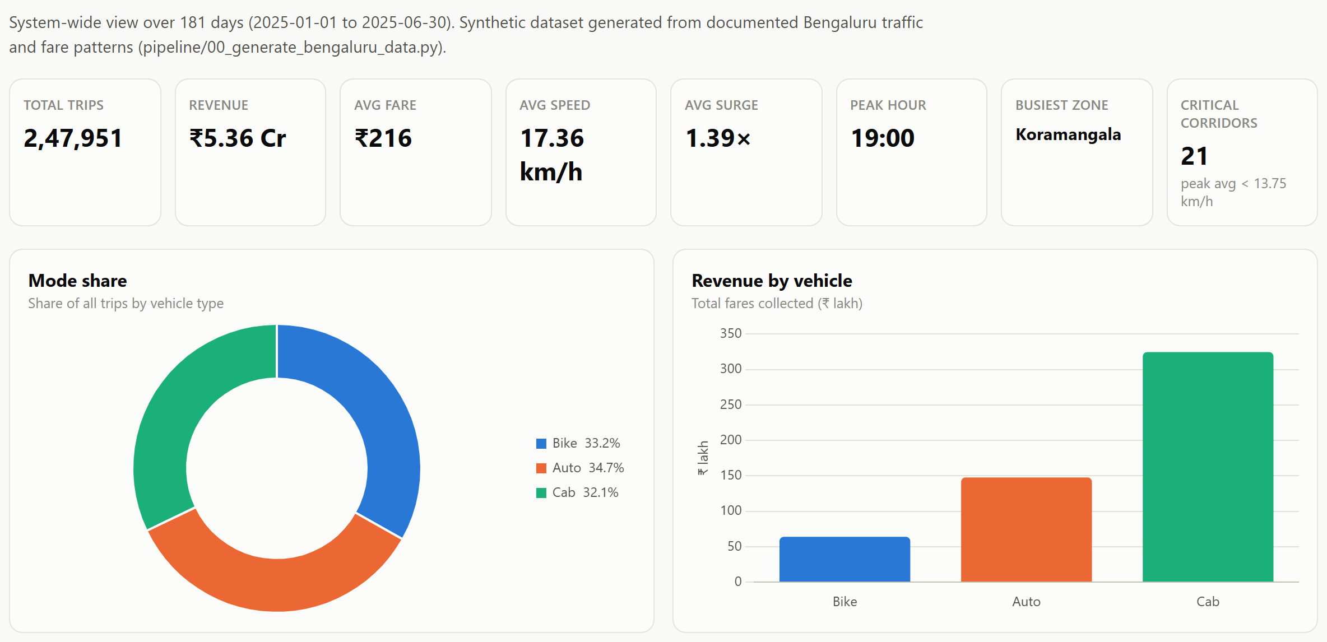
THE DASHBOARD — ADMIN VIEW
System-wide view of all MapReduce outputs
KPIs for the full 181 days: trips, revenue, speed, surge, critical corridors.
Charts for all four MapReduce jobs, congestion, speed, rain impact and a day × hour heatmap.
ML card shows both models' metrics next to the formula-only baseline.
Notes:
The Admin view is where the MapReduce tables (Jobs 1-4) are shown raw, for the MapReduce rubric criterion.

Slide 15
SO WHAT?
Insights & recommendations
1
Put supply where the peaks are
Shift drivers to 09:00–10:00 and 18:00–20:00; Job 1 shows these hours carry the most trips.
2
Fix two corridor clusters first
Koramangala / HSR / Electronic City (Silk Board area) and Majestic ↔ MG Road are the slowest, at 13.1–13.3 km/h.
3
Recommend by context
Bikes for short peak trips (16.8 km/h vs 13.1 for cabs); cabs in rain (bikes +47% min/km).
4
Review peak-hour driver pay
₹/trip-minute is lowest in jams; a higher delay rate would keep drivers on the road.
5
Revisit the night auto surcharge
At 1.5× an auto costs as much as a cab for 8 km+ trips after 22:00.
Notes:
Each recommendation maps to a chart in the dashboard: Job 1 (supply), Job 3 (corridors), rain impact (modes), earning window (driver pay), fare comparison (night auto).

Slide 16
BEING HONEST
Limitations & next steps
Synthetic data
ML ≈ formula
Trips are generated from documented rules, not collected. Real operator or city data would validate the patterns.
On this data the formula alone scores MAE 2.99 min, matching the model. Real data would show what ML adds.
Hadoop simulated
Demand model at 68%
Jobs run locally with the Hadoop Streaming contract; the same mapper/reducer files can run on a real cluster.
Weather forecasts, events and holidays would sharpen the Low / Medium / High split.
Notes:
Expect viva questions on these four points; the answers are on this slide.

Slide 17
Thank you
A complete Big Data pipeline — generation, cleaning, MapReduce, analytics and machine learning — processing 247,951 Bengaluru trips end-to-end in about 10 seconds.
4
20+
2
3
MapReduce jobs
Charts & tables
ML models
Role views
Questions?

