Slide 1
Python for Data Science
Data science life cycle & why python is needed?
Python Installation
Basic program
Data structure & Data types
Condition & looping based programs
Prepared By:
Rupesh S
Data Analyst

Slide 2
Introduction to Data science:-
What is data science?
Data science is an interdisciplinary field that uses scientific methods, processes, algorithms and systems to extract knowledge and insights from noisy, structured and unstructured data, and apply knowlegde and actionable insights from data across a broad range of application domains.

Slide 3
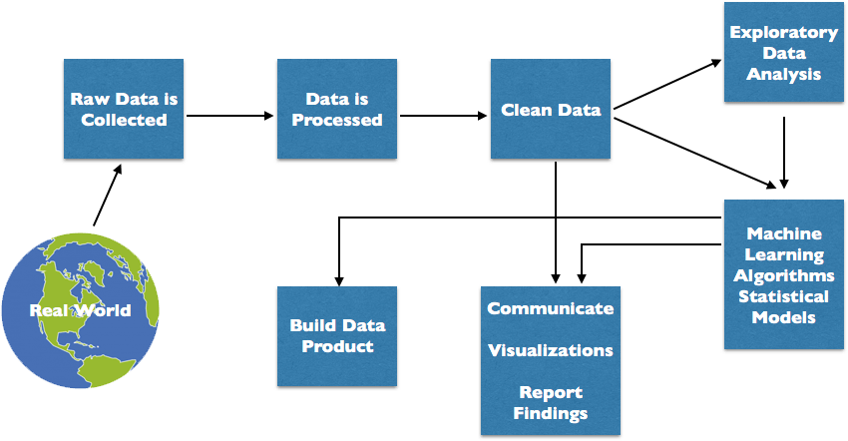
Flow Chart for DS:-

Slide 4
Life cycle of Analytics:-
Understand Business problem
Business problem to analytical problem
Data exploration & preparation
Model building & validation
Visualization / Model Application & Business insights
Communication of insights to user

Slide 5
Why python is needed for DS?
Python provide great functionality to deal with mathematics, statistics and scientific function.
It provides great libraries to deals with data science application
It uses the elegant syntax, hence the programs are easier to read.
Python packages can read & process the huge amount of data.

Slide 6
Python installation:-
Based on your system OS download the anaconda installer.
https://www.anaconda.com/products/individual#Downloads

Slide 7
Basic Program:
How to assign a value to variable
How to check data types
Conversion of data
Statements
Data structure – List, tuple, set, dictionary
Input & output formatting
Operators – Arithmetic & comparsion
Conditions – if ,elif & else
Looping – for & while looping
Break, continue & pass

Slide 8
Python for Data Science
Define the functions
Error handling techniques
File handling techniques
What is Data & Types of analytics
Prepared By:
Rupesh S
Data Analyst

Slide 9
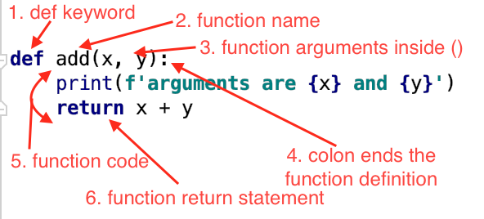
Python function:-
A function is a block of code which only runs when it is called.
You can pass data, known as parameters, into a function.
A function can return data as a result.

Slide 10
Error handling in python:-
Basically, Python will normally stop and generate an error message in order to avoid those error message error handling will play here.
The “try” block lets you test a block of code for errors.
The “except” block lets you handle the error.
The “finally” block lets you execute code, regardless of the result of the try- and except blocks.

Slide 11
File handling techniques:-
File handling is an important part of any web application.
Python has several functions for creating, reading, updating, and deleting files.
The key function for working with files in Python is the open() function.
The open() function takes two parameters; filename, and mode.
There are four different methods (modes) for opening a file:
"r" - Read - Default value. Opens a file for reading, error if the file does not exist
"a" - Append - Opens a file for appending, creates the file if it does not exist
"w" - Write - Opens a file for writing, creates the file if it does not exist
"x" - Create - Creates the specified file, returns an error if the file exists

Slide 12
Basics of analytics:-
What is Data?
Collection of raw facts
Types of Data:
1) Qualitative --> Categorical
Nominal -Nominal variables have two or more categories without having any kind of natural orde
Ordinal - The ordinal scale is a type of measurement scale that deals with ordered variables.
2) Quantitative --> Numerical
Interval - has values of equal intervals that mean something.
Ratio - exactly the same as the interval scale except that the zero on the scale means: does not exis

Slide 13
What is analytics?
Analytics is a field of computer science that uses math, statistics, and machine learning to find meaningful patterns in data. Analytics – or data analytics – involves sifting through massive data sets to discover, interpret, and share new insights and knowledge.
Types of Analytics:
Descriptive - what happened?
Diagnostic – why did it happen?
Predictive and, - what will happen next?
Prescriptive – what action should we take?

Slide 14
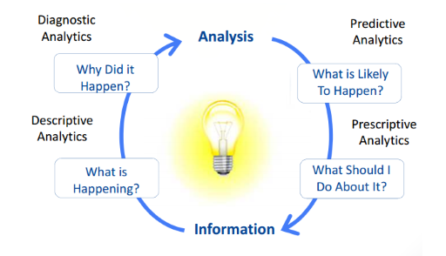
Flow chart for analytics:

Slide 15
Descriptive Analytics:-
Descriptive analytics answers the question “What happened?”. This simple form of analytics uses basic math, such as averages and percent changes, to show what has already happened in a business. Descriptive analytics, also called traditional business intelligence (BI), is the first step in the analytics process, creating a jumping-off point for further investigation.
Predictive Analytics:-
Predictive analytics answers the question “What is likely to happen in the future?”. This branch of advanced analytics uses findings from descriptive and diagnostic analytics – along with sophisticated predictive modeling, machine learning, and deep learning techniques – to predict what will happen next.

Slide 16
Prescriptive Analytics:
Prescriptive analytics answers the question “What action should we take?”. This state-of-the-art type of analytics builds on findings from descriptive, diagnostic, and predictive analytics and uses highly advanced tools and techniques to assess the consequences of possible decisions and determine the best course of action in a scenario.

Slide 17
Python for Data Science
Business Statistics
Analytics with Pandas
Analytics with Numpy
Visualising the Data
Data aggregation
Prepared By:
Rupesh S
Data Analyst

Slide 18
Statistics:-
Descriptive Statistics:
Collection of procedure & tools which are used to “quantitatively” describe or summarize collection of data.
Inferential statistics:
Using descriptive statistics to make inference / conclusions
Measure of central tendency:
Mean- just average the given numbers
Median – middle number in the series
Mode- frequently occured

Slide 19
Measure of Data Dispersion:
Range – diff btw max value – min value
Variance - is a way to measure how far a set of numbers is spread out
Standard deviation – measures the spread of the data about the mean value.
Correlation – statistics tool which helps study relationships between 2 or more variables is called correlation
Types of correlation: [-1 to 1]
Positive correlation- if both variables vary in same direction
Negative correlation – if both variables vary in opposite direction
No correlation – no correlation between 2 variables

Slide 20
Analytics with pandas:-
Pandas is an open-source library that is built on top of NumPy library. It is a Python package that offers various data structures and operations for manipulating numerical data and time series. It is mainly popular for importing and analyzing data much easier. Pandas is fast and it has high-performance & productivity for users.
We can analyze data in pandas with:
Series - Series is one dimensional(1-D) array defined in pandas that can be used to store any data type.
DataFrames- DataFrames is two-dimensional(2-D) data structure defined in pandas which consists of rows and columns.

Slide 21
Analytics with Numpy:-
Numpy is a general-purpose array-processing package. It provides a high-performance multidimensional array object, and tools for working with these arrays. It is the fundamental package for scientific computing with Python.

Slide 22
Visualising the Data :-
Matplotlib is easy to use and an amazing visualizing library in Python. It is built on NumPy arrays and designed to work with the broader SciPy stack and consists of several plots like line, bar, scatter, histogram, etc
Seaborn library:
Seaborn is an open-source Python library built on top of matplotlib. It is used for data visualization and exploratory data analysis. Seaborn works easily with dataframes and the Pandas library. The graphs created can also be customized easily.

Slide 23
Data aggregation & descriptive statistics:-
Data aggregation is the process where data is collected and presented in a summarized format for statistical analysis and to effectively achieve business objectives.
Example: - Count, sum, max, min, average
Descriptive statistics summarizes or describes the characteristics of a data set.
Example: mean, median, mode,std, var, range, count

Slide 24
LOAN DATASET:-
Problem Statement
About Company
Dream Housing Finance company deals in all home loans. They have presence across all urban, semi urban and rural areas. Customer first apply for home loan after that company validates the customer eligibility for loan.
Problem
Company wants to automate the loan eligibility process (real time) based on customer detail provided while filling online application form. These details are Gender, Marital Status, Education, Number of Dependents, Income, Loan Amount, Credit History and others. To automate this process, they have given a problem to identify the customers segments, those are eligible for loan amount so that they can specifically target these customers. Here they have provided a partial data set.

Slide 25
Python for Data Science
SQL with Python
Data preprocessing using python
Machine learning model
Prepared By:
Rupesh S
Data Analyst

Slide 26
SQL with Python:-
PyMYSQL is an interface for connecting to a MySQL database server from Python
This package contains a pure-Python MySQL client library.
The proper way to get an instance of this class is to call connect() method. This method establishes a connection to the MySQL database and accepts several arguments:
Parameters :
host – Host where the database server is located
user – Username to log in as
password – Password to use.
database – Database to use, None to not use a particular one.
port – MySQL port to use, default is usually OK. (default: 3306)

Slide 27
Data preprocessing using python:-
Descriptive statistics – (Summarize the collection of data)
Replacing the missing values - ( Mean, Median or Mode)
Outlier detection – (figuring the outlier values in columns)
Categorical data handling – (label & Ordinal encoding)
Feature selection – (selecting right features for ML)
Feature elimination - ( droping the meaningless features)
Feature scaling -( transforming the features)

Slide 28
Machine Learning Model:-
Why ML?
Because machine can drive your car for you
Because machine can now detect 50 eye diseases
Because machine can unlock your phone with your face
What is ML?
Machine learning is the science of making computers learn and act live humans by feeding data and information without being explicitly programmed.

Slide 29
Life cycle of Machine Learning:-
Define Objective
Collect Data
Prepare Data
Select Algorithm
Train Model
Test Model
Predict
Deployment

Slide 30
Types of ML:-
Supervised learning
Supervised learning is a method used to enable machines to classify / predict objects, problems or situations based on labeled data fed to the machine
Unsupervised learning
Non- labeled data, No feedback, find hidden structure in data
Reinforcement learning
Is a important type of machine learning where an agent learns how to behave in an environment by performing actions and seeing the results.

Slide 31
Supervised learning method:-
Regression
Linear
Decision tree
Random forest
Support vector machine
Classification
Logistics
Decision tree
Randon forest
Support vector machine
KNN
Naive bayes

Slide 32

Classification Problem:-
Logistics Regression:
Logistics Regression is a Machine Learning classification algorithm that is used to predict the probability of a categorical dependent variable. In logistic regression, the dependent variable is a binary variable that contains data coded as 1 (yes, success, etc.) or 0 (no, failure, etc.)

Slide 33
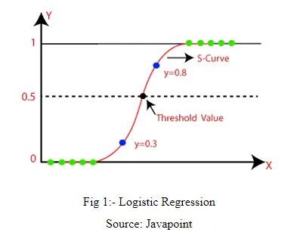
Main Aim of Logistic Regression Formula.
The Logistic Regression formula aims to limit or constrain the Linear and/or Sigmoid output between a value of 0 and 1. The main reason is for interpretability purposes, i.e., we can read the value as a simple Probability; Meaning that if the value is greater than 0.5 class one would be predicted, otherwise, class 0 is predicted

Slide 34
Confusion matrix:-
A confusion matrix is a summary of prediction results on a classification problem. The number of correct and incorrect predictions are summarized with count values and broken down by each class. This is the key to the confusion matrix.
correctly = TP + TN / Total
Wrongly = FP + FN / Total

Slide 35
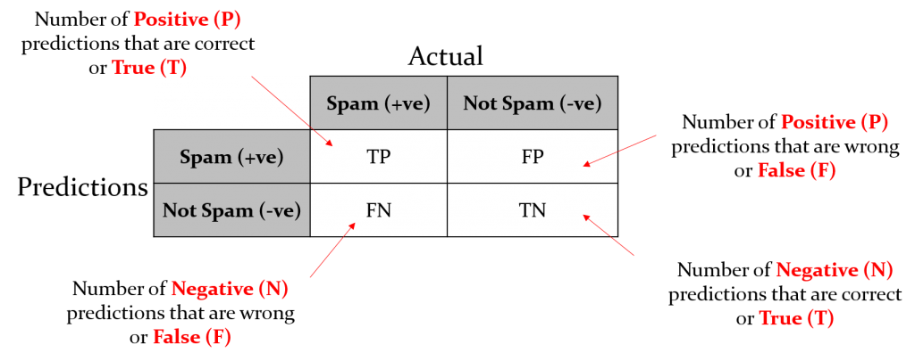
Confusion Matric Chart:-

Slide 36
Source for Data Science:-
Articles / Blogs:-
Www.analyticsvidhya.com
Www.machinelearningmastery.com
Www.towardsdatascience.com
Www.greeksforgreeks.com
Www.stackoverflow.com
Video Platforms:-
Www.Datacamp.com
Www.udemy.com
Www.coursera.com

Slide 37
THANK YOU!

