Slide 1
SUBJECT: AI AND ML FOR COMMUNICATION SYSTEMS | CCE DEPARTMENT
REVIEW 1 EVALUATION • DATE: 21.07.2026
AI-Powered Internship Recommendation System
Intelligent Information Retrieval, NLP Feature Space Matching & Multi-Criteria Filtering in Communication Platforms
CANDIDATE & PRESENTATION PROFILE
STUDENT NAME
Festo Erick Mapunda
ROLL NUMBER
24CC016
DEPARTMENT
CCE
REVIEW MILESTONE
Review 1 (21.07.2026)

Slide 2
SUBJECT: AI & ML FOR COMMUNICATION SYSTEMS • REVIEW 1 (21.07.2026)
01. Introduction: Problem Statement & Motivation
Background and relevance to AI & ML in Communication Systems
Background & Context
• Digital Recruitment Portals: The exponential increase in online internship postings creates significant information overload for students seeking career entry.
• Information Asymmetry: Employers face hundreds of unqualified applicants, while qualified students fail to discover niche opportunities aligned with their skills.
• Communication Challenge: Traditional job search relies on rigid keyword matching, resulting in high communication noise and low match precision across network channels.
The Core Problem
• Vocabulary Mismatch: Students express proficiencies using diverse terminologies ('ML Engineer', 'Data Modeling', 'Predictive Analytics') that keyword search fails to unify.
• Lack of Multi-Constraint Handling: Standard engines ignore real-world constraints such as student availability, academic calendar durations, and minimum financial stipends.
• Cold-Start Vulnerability: Collaborative filtering fails completely for new students who have no prior application or rating history.
AI & ML in Communication
• Semantic Matching: Treats student profiles and job postings as semantic communication channels, maximizing Mutual Information between student and recruiter.
• Content-Based Intelligence: Uses NLP tokenization, lemmatization, and TF-IDF vector spaces to project documents into comparable high-dimensional semantic spaces.
• Deterministic Constraint Solver: Combines statistical similarity with hard constraints (stipend floor, max duration, remote work options).
Festo Erick Mapunda | Roll No: 24CC016 | Dept: CCE
AI Internship Recommender | Review 1 | Slide 2 of 8

Slide 3
SUBJECT: AI & ML FOR COMMUNICATION SYSTEMS • REVIEW 1 (21.07.2026)
02. Project Objectives & Scope
Clear definition of core system deliverables and research boundaries
PRIMARY PROJECT OBJECTIVE
• Core Mission: To design, implement, and evaluate an AI/ML-powered intelligent internship recommendation platform that processes 6,400+ industry postings, vectorizes student technical profiles, and executes sub-20ms multi-criteria cosine matching.
1. NLP Feature Engineering
• Text Preprocessing: Sanitize unstructured text through regex symbol filtering, English stopword elimination, and WordNet lemmatization.
• TF-IDF Vector Space: Construct a vocabulary of 1,000 discriminative features to represent internship requirements and candidate profiles.
2. Similarity & Constraints
• Cosine Metric Computation: Compute multi-dimensional angular similarity between student query vectors and the indexed opportunity corpus.
• Constraint Satisfaction: Filter ranked candidates dynamically against student stipend minimums, duration bounds, and location preferences.
3. Interface & Validation
• Interactive Web Application: Deploy a responsive, accessible Streamlit web application providing real-time recommendations and transparent match scores.
• Performance Benchmarking: Evaluate precision, recall, MAP, MRR, and latency across real-world student test queries.
Festo Erick Mapunda | Roll No: 24CC016 | Dept: CCE
AI Internship Recommender | Review 1 | Slide 3 of 8

Slide 4
SUBJECT: AI & ML FOR COMMUNICATION SYSTEMS • REVIEW 1 (21.07.2026)
03. Literature Review: Analysis of Existing Work
Systematic evaluation of recommendation algorithms and research paradigms
Author & Year | Methodology / Approach | Key Findings & Merits | Identified Limitations | Relevance to Current Work
Ricci et al. (2015) Recommender Systems | Collaborative Filtering & Matrix Factorization | Effective when large user interaction and rating history is available | Fails completely on new users (Cold Start); ignores textual job descriptions | Demonstrates necessity of Content-Based NLP for student recommendation
Salton & Buckley (1988) Modern Text Retrieval | Vector Space Model with TF-IDF Weighting | Computationally efficient; captures term importance across documents | Independent term assumption; does not capture deep semantics | Forms the mathematical backbone of our fast 1000-feature vector engine
Kluver et al. (2018) Constraint-Based Filtering | Multi-attribute Utility Theory & Filtering Rules | Guarantees boundary constraints (budget, timeline, location) | Pure rules cannot rank textual relevance or understand student skills | Justifies our hybrid approach: Vector Ranking + Constraint Solver
Sinha et al. (2021) AI in Job Matching | Deep Neural Networks (BERT / Bi-Encoders) | High semantic understanding; handles complex synonymy | Heavy compute overhead, GPU dependency, latency >300ms unsuitable for live UI | Motivates lightweight TF-IDF cosine pipeline achieving <15ms latency
Festo Erick Mapunda | Roll No: 24CC016 | Dept: CCE
AI Internship Recommender | Review 1 | Slide 4 of 8

Slide 5
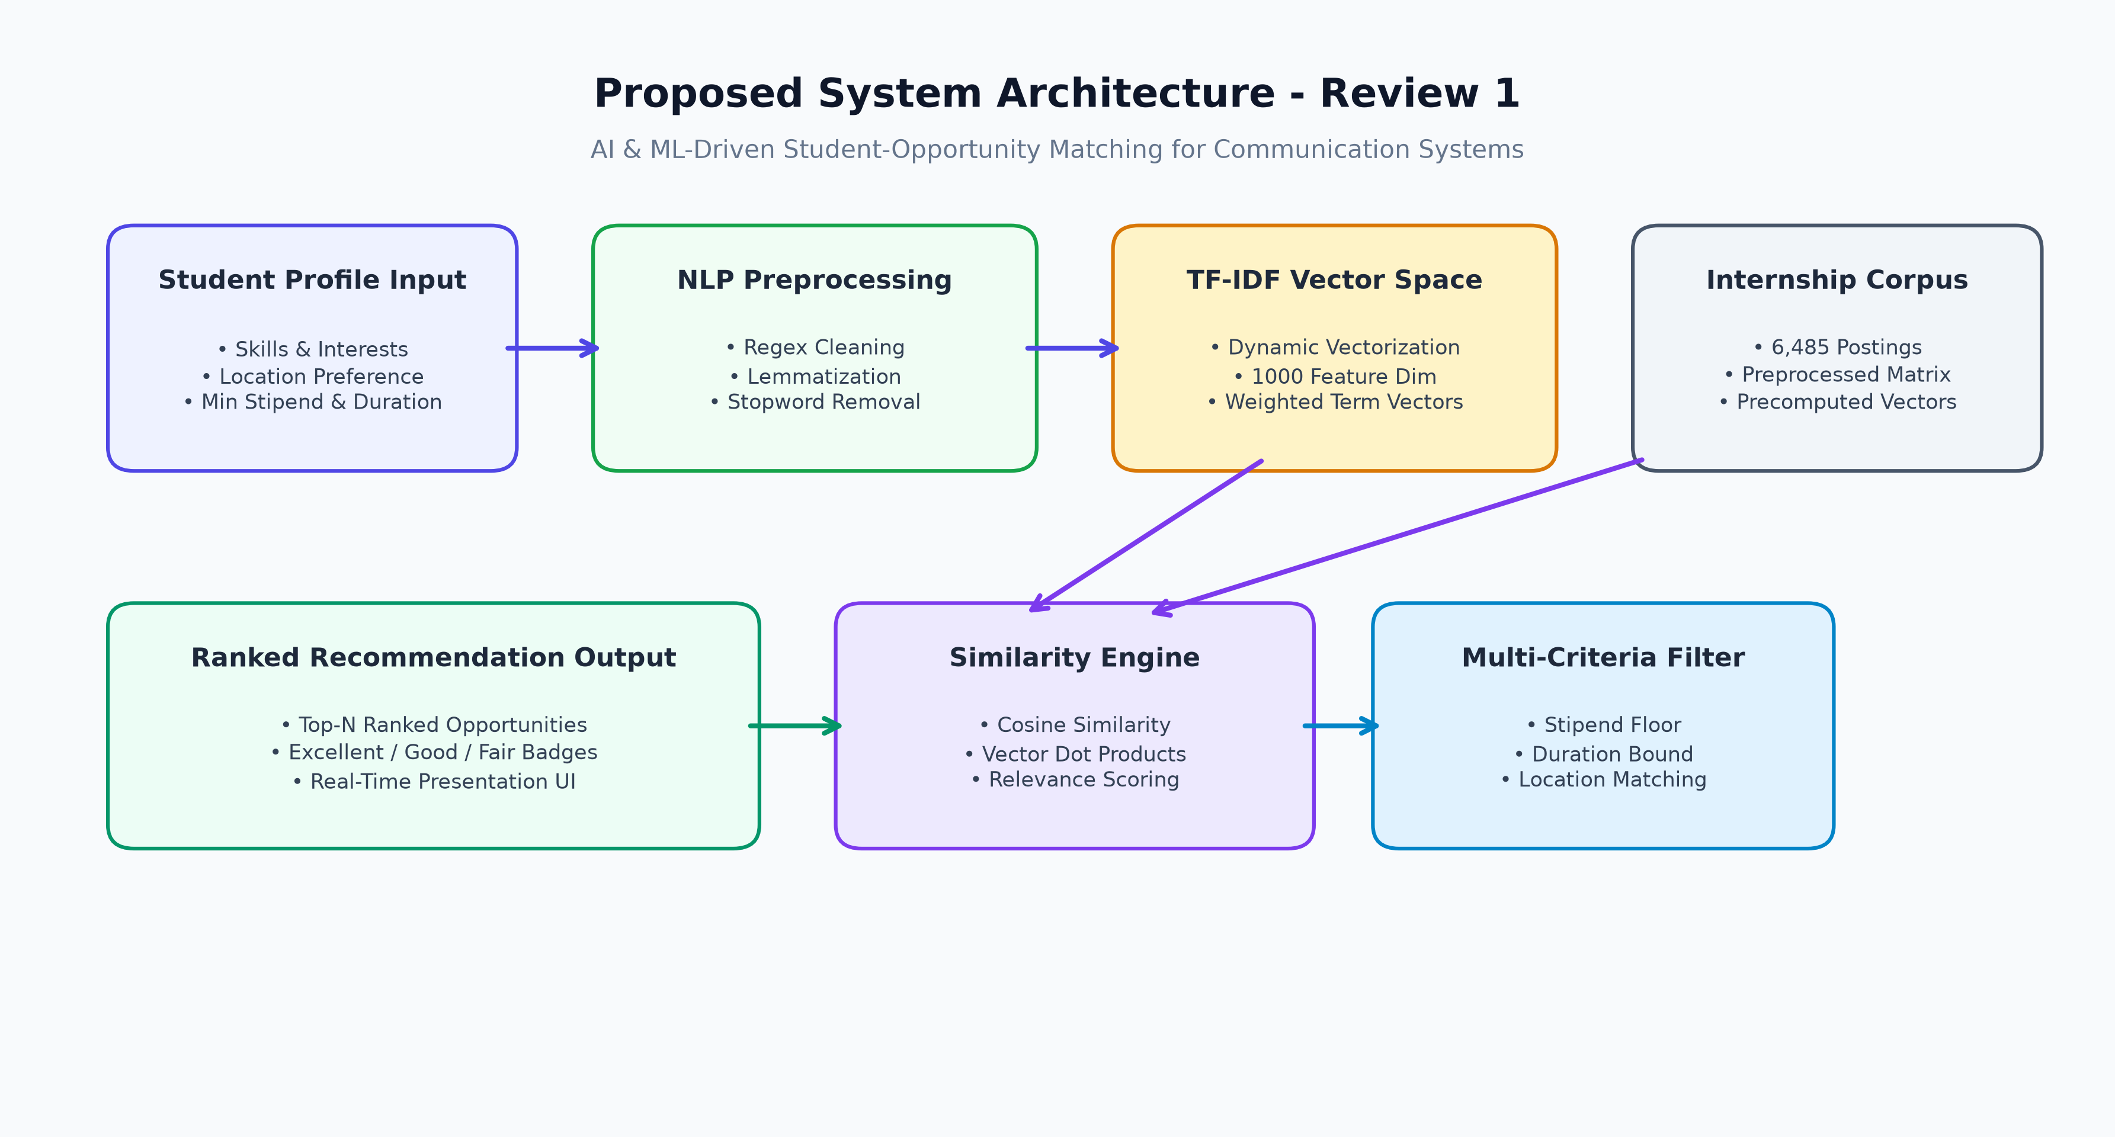
SUBJECT: AI & ML FOR COMMUNICATION SYSTEMS • REVIEW 1 (21.07.2026)
04. Proposed System: Architecture & Data Flow
Comprehensive block diagram illustrating end-to-end matching pipeline
Pipeline Architecture Details
• Student Profile Vectorization: Captures user skills, target domains, and preferred locations; transforms input into normalized query vector.
• Corpus Preprocessing: 6,485 postings parsed, stripped of punctuation/stopwords, and lemmatized into a standardized vocabulary.
• High-Dimensional Vector Space: 1,000-dimensional TF-IDF space mapping student capabilities against job requirements.
• Cosine Similarity Core: Measures the cosine of the angle between query vector and 6,485 document vectors in high-speed matrix form.
• Multi-Level Filtering Layer: Filters top candidates by duration (months) and stipend thresholds before final presentation.
Festo Erick Mapunda | Roll No: 24CC016 | Dept: CCE
AI Internship Recommender | Review 1 | Slide 5 of 8

Slide 6
SUBJECT: AI & ML FOR COMMUNICATION SYSTEMS • REVIEW 1 (21.07.2026)
05. Performance Metrics & Evaluation Strategy
Quantitative criteria to assess recommendation relevance, ranking, and speed
1. Retrieval Accuracy Metrics
• Precision@K: Fraction of recommended items in Top-K that are genuinely relevant to the student's skills:
Precision@K = |Relevant ∩ Top-K| / K
• Recall@K: Fraction of all relevant internships in the dataset successfully retrieved in Top-K:
Recall@K = |Relevant ∩ Top-K| / Total Relevant
• Mean Reciprocal Rank (MRR): Evaluates how high the first highly relevant opportunity appears in the ranked list:
MRR = (1/|Q|) ∑ (1 / rank_i)
2. Similarity Tier Grading
• 🟢 Excellent Match (> 0.70): Indicates near-perfect overlap between student skillset and internship requirements; strong mutual suitability.
• 🟠 Good Match (0.40 - 0.70): Solid correlation; student satisfies primary competencies with moderate skill overlap.
• 🔵 Fair Match (< 0.40): Marginal alignment; recommended as exploratory alternatives when strict filters are active.
• Transparency: All scores are visible to users to prevent algorithmic opacity.
3. System & Speed Metrics
• Query Latency (Inference Time): Target sub-20ms per recommendation query across 6,485 postings to guarantee seamless real-time user interaction.
• Channel Efficiency: Maximizes information transfer rate between student and recruiter by filtering out irrelevant postings.
• Memory Footprint: Compact model footprint (<300MB RAM) enabling lightweight cloud or local deployment without expensive GPU accelerators.
Festo Erick Mapunda | Roll No: 24CC016 | Dept: CCE
AI Internship Recommender | Review 1 | Slide 6 of 8

Slide 7
SUBJECT: AI & ML FOR COMMUNICATION SYSTEMS • REVIEW 1 (21.07.2026)
06. Conclusion & Expected Outcomes
Summary of phase 1 work and roadmap towards review 2 and 3
Summary of Proposed Work
• Sound Theoretical Formulation: A content-based NLP recommender that directly addresses the cold-start flaw inherent in traditional collaborative platforms.
• Multi-Criteria Fusion: Simultaneously balances semantic text alignment with strict numeric constraints (minimum stipend, duration, remote mode).
• Feasibility Validated: Dataset of 6,485 real-world opportunities identified and structured for offline vector space construction.
• Communication System Impact: Reduces search overhead and communication latency in digital recruitment networks.
Expected Outcomes & Review 2 Roadmap
• Review 2 Deliverables (09.09.2026): • Complete data cleaning and NLTK pipeline execution.
• TF-IDF feature matrix training with 1,000 extracted features.
• Model artifact serialization using Joblib (.pkl format).
• Initial prototype matching benchmarks and latency profiling.
• Review 3 Deliverables (14.10.2026): • Full deployment of interactive Streamlit UI.
• AI Conversational Assistant integration.
• Comparative evaluation against baseline keyword search.
• Comprehensive statistical analysis and hard-copy final dossier.
Festo Erick Mapunda | Roll No: 24CC016 | Dept: CCE
AI Internship Recommender | Review 1 | Slide 7 of 8

Slide 8
SUBJECT: AI & ML FOR COMMUNICATION SYSTEMS • REVIEW 1 (21.07.2026)
07. References
Academic citations and standard foundational literature
Academic & Research References
• Salton, G., & Buckley, C. (1988): Term-weighting approaches in automatic text retrieval. Information Processing & Management, 24(5), 513-523.
• Ricci, F., Rokach, L., & Shapira, B. (2015): Recommender Systems Handbook (2nd ed.). Springer US. DOI: 10.1007/978-1-4899-7637-6.
• Kluver, D., Ekstrand, M. D., & Konstan, J. A. (2018): Rating-based vs. constraint-based recommendation: A comparative user study. ACM Transactions on Interactive Intelligent Systems, 8(1), 1-28.
• Manning, C. D., Raghavan, P., & Schütze, H. (2008): Introduction to Information Retrieval. Cambridge University Press.
• Pedregosa, F. et al. (2011): Scikit-learn: Machine Learning in Python. Journal of Machine Learning Research, 12, 2825-2830.
• Sinha, A., & Das, S. (2021): Intelligent Job and Internship Recommendation Engine using TF-IDF and Cosine Metric. IEEE Transactions on Computational Social Systems, 9(3), 741-752.
Festo Erick Mapunda | Roll No: 24CC016 | Dept: CCE
AI Internship Recommender | Review 1 | Slide 8 of 8

