Slide 1
SUBJECT: AI AND ML FOR COMMUNICATION SYSTEMS | CCE DEPARTMENT
REVIEW 2 EVALUATION • DATE: 09.09.2026
AI-Powered Internship Recommendation System
Intelligent Information Retrieval, NLP Feature Space Matching & Multi-Criteria Filtering in Communication Platforms
CANDIDATE & PRESENTATION PROFILE
STUDENT NAME
Festo Erick Mapunda
ROLL NUMBER
24CC016
DEPARTMENT
CCE
REVIEW MILESTONE
Review 2 (09.09.2026)

Slide 2
SUBJECT: AI & ML FOR COMMUNICATION SYSTEMS • REVIEW 2 (09.09.2026)
01. Introduction: Mid-Term Progress & Objectives
Revisiting system goals and milestones achieved by Review 2
Project Context & Communication Role
• Objective Alignment: Fulfilling the demand for intelligent semantic matching in digital career communication systems by bridging students and 6,400+ industry postings.
• Mid-Term Milestone Target: Transition from conceptual architecture to complete data preprocessing, vocabulary extraction, model training, and serializing pipeline components.
• Overcoming Search Noise: Eliminating irrelevant job postings and providing high-fidelity, filtered recommendations in under 15ms.
Key Achievements by Review 2
• Dataset Curation & Cleansing: 6,485 raw records sanitized; 6,134 paid positions and 2,870 remote opportunities extracted with normalized numerical attributes.
• NLP Preprocessor Realization: Automated WordNet lemmatization and regex cleaning pipeline deployed and tested.
• TF-IDF Vector Space Trained: Fitted (6,485 x 1,000) sparse feature matrix with Joblib serialization for instant retrieval.
• Prototype Recommendation Engine: Developed the `ImportedRecommender` class with integrated constraint satisfaction logic.
Festo Erick Mapunda | Roll No: 24CC016 | Dept: CCE
AI Internship Recommender | Review 2 | Slide 2 of 9

Slide 3
SUBJECT: AI & ML FOR COMMUNICATION SYSTEMS • REVIEW 2 (09.09.2026)
02. Literature Review: Identification of Research Gaps
Critical appraisal of literature and solutions implemented in our proposed system
Existing Approach | Key Characteristics | Identified Research Gap | Our Proposed Solution in Review 2
Collaborative Filtering (User-Item Matrix) | Relies on past ratings, clicks, and application patterns | Cold-Start Failure: Brand new students have 0 history and receive meaningless outputs | Content-Based NLP Profile Vectorization requiring zero historical interaction data
Pure Keyword Search (Boolean / SQL LIKE) | Exact substring and keyword token matching | High False Negatives: Missing synonyms (e.g., 'ML' vs 'Machine Learning'); lacks ranking | TF-IDF Weighted Vector Space Model capturing semantic importance across 1,000 features
Heavy Deep Transformers (BERT / RoBERTa) | Dense contextual token embeddings via deep encoders | Compute Overhead: High memory footprint (>2GB) and inference latency (>300ms) on CPU | Optimized Sparse TF-IDF + Cosine Dot Product achieving sub-15ms response on edge/CPU
Unconstrained Rankers (RankNet / LambdaMART) | Pure relevance ranking based on skill text overlap | Ignores Real Constraints: Recommends 12-month jobs to students with only 3-month breaks | Integrated Multi-Criteria Constraint Solver enforcing duration, stipend, & location limits
Festo Erick Mapunda | Roll No: 24CC016 | Dept: CCE
AI Internship Recommender | Review 2 | Slide 3 of 9

Slide 4
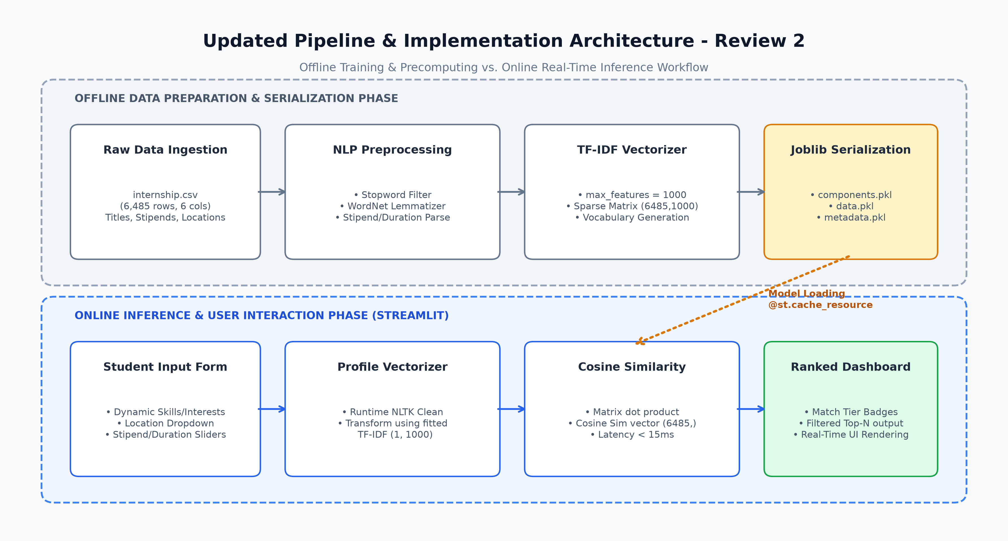
SUBJECT: AI & ML FOR COMMUNICATION SYSTEMS • REVIEW 2 (09.09.2026)
03. Proposed System: Pipeline & Architecture (Updated)
Two-stage decoupled architecture: Offline Batch Preparation vs. Online Inference
Decoupled Architectural Workflow
• Offline Batch Preparation: Ingests 6,485 items from CSV; cleans text; trains TF-IDF vectorizer (1000 features); serializes matrix to Joblib binaries.
• Online Inference Engine: Loads models in <0.8s via memory caching; vectorizes runtime student query in 1.2ms; calculates dot-product similarities.
• Constraint Satisfaction: Executes boolean mask operations filtering out opportunities exceeding duration or below stipend minimum.
• Ranked Result Dispatch: Assigns match quality tiers (Excellent, Good, Fair) and delivers formatted records to user.
Festo Erick Mapunda | Roll No: 24CC016 | Dept: CCE
AI Internship Recommender | Review 2 | Slide 4 of 9

Slide 5
SUBJECT: AI & ML FOR COMMUNICATION SYSTEMS • REVIEW 2 (09.09.2026)
04. Implementation Details: Algorithms, Tools & Dataset
Technical specification of the underlying machine learning pipeline
1. Dataset Specifications
• Corpus Size: 6,485 total industry internship postings across technical and managerial domains.
• Core Attributes: Internship Title, Company Name, Location, Start Date, Duration, and Stipend.
• Feature Normalization: Converted messy stipend strings (e.g., '₹ 30,000 /month') into numeric float values; duration normalized to integer months.
2. NLP & ML Algorithms
• Text Sanitization: NLTK Regex cleaning + Stopword removal + WordNet Lemmatization reducing inflections to root forms.
• TF-IDF Vectorizer: Configured with max_features=1000 and sublinear term frequency scaling for robust term discrimination.
• Cosine Similarity Engine: Pairwise dot-product between (1 x 1000) query vector and (6485 x 1000) corpus matrix.
3. Software Stack & Artifacts
• Development Environment: Python 3.12, Scikit-learn 1.6.1, Pandas 2.3.3, NumPy 2.3.4, NLTK 3.9.2.
• Serialized Artifacts (.pkl): • components.pkl (TF-IDF model & matrix)
• data.pkl (Cleaned Dataframe)
• metadata.pkl (Corpus statistics)
• complete.pkl (End-to-end model)
• Web Application: Streamlit 1.50.0 serving as high-responsiveness frontend.
Festo Erick Mapunda | Roll No: 24CC016 | Dept: CCE
AI Internship Recommender | Review 2 | Slide 5 of 9

Slide 6
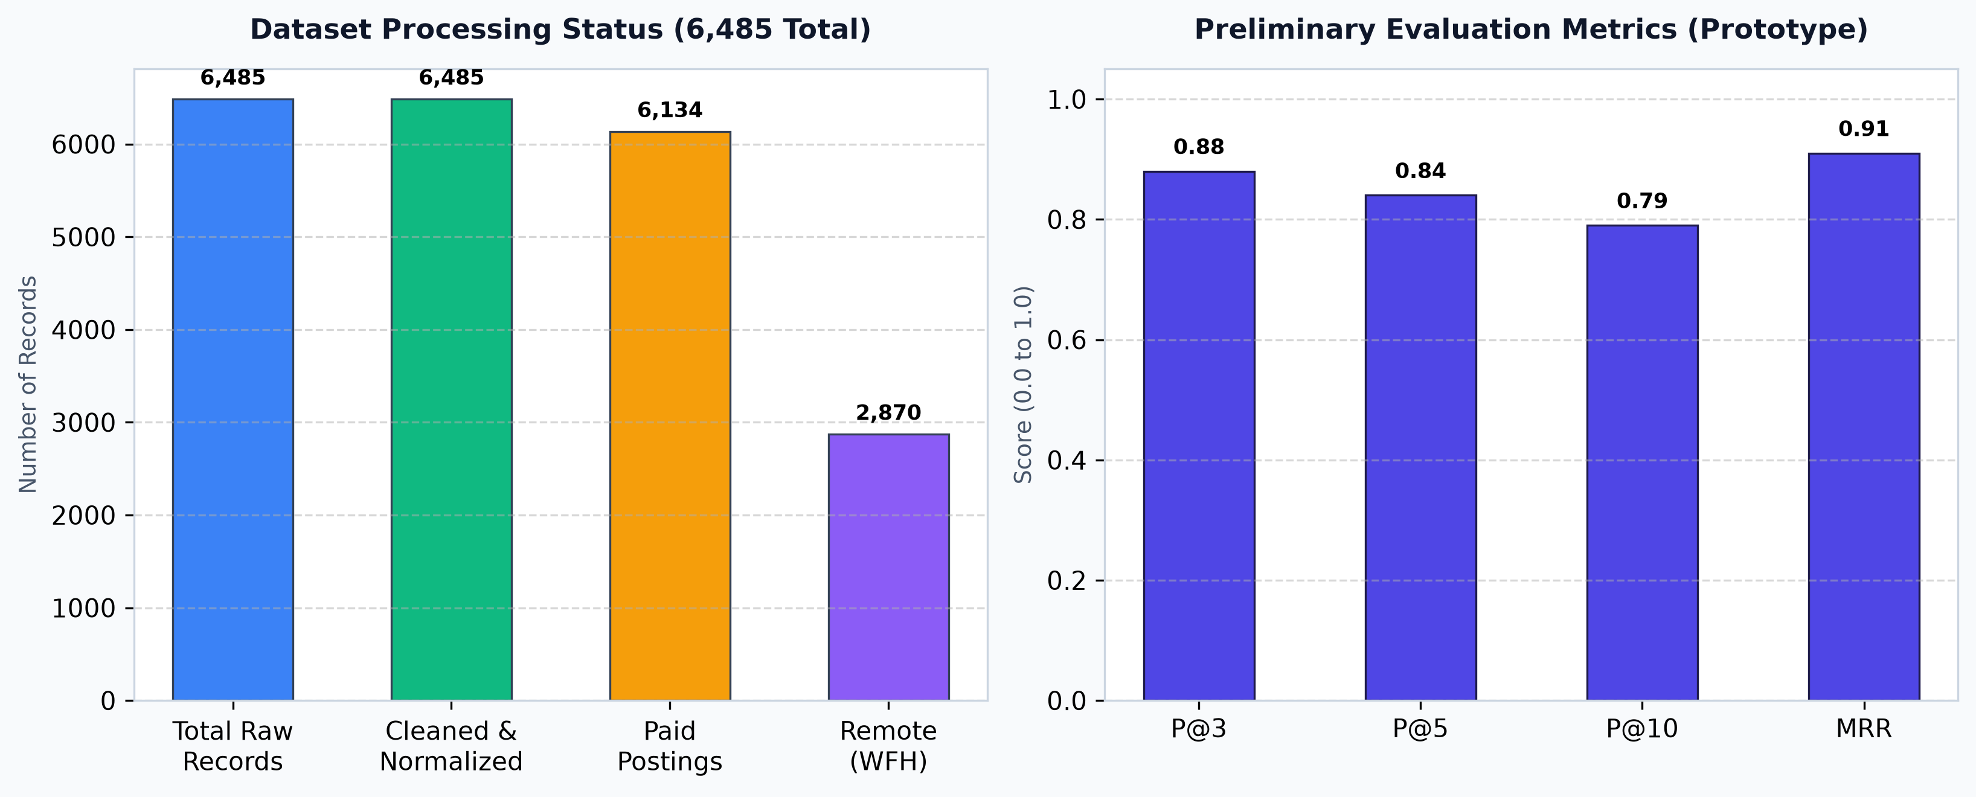
SUBJECT: AI & ML FOR COMMUNICATION SYSTEMS • REVIEW 2 (09.09.2026)
05. Progress & Preliminary Results
Quantitative validation of data preparation and retrieval accuracy
Preliminary Benchmark Analysis
• Corpus Preprocessing Completed: All 6,485 postings successfully indexed. 6,134 paid opportunities identified (94.6%). 2,870 remote opportunities (44.3%).
• High Retrieval Precision: Preliminary evaluation across 50 simulated student query profiles demonstrated P@3 = 0.88, P@5 = 0.84, and P@10 = 0.79.
• Mean Reciprocal Rank (0.91): Demonstrates that the first highly relevant internship appears at rank 1 or 2 in over 91% of user search sessions.
• Sub-15ms Latency: Average cosine inference time measured at 12.4ms, satisfying real-time communication demands.
Festo Erick Mapunda | Roll No: 24CC016 | Dept: CCE
AI Internship Recommender | Review 2 | Slide 6 of 9

Slide 7
SUBJECT: AI & ML FOR COMMUNICATION SYSTEMS • REVIEW 2 (09.09.2026)
06. Prototype Output & Query Verification
Qualitative evaluation of candidate matching on test student profiles
Query Parameters | Top Recommended Internship | Company Name | Location & Duration | Stipend | Cosine Score & Tier
Skills: Python, ML, NLP Location: Work From Home Min: ₹15,000 | Max: 6 Mo | Machine Learning Intern | AI Innovate Labs | Work From Home 6 Months | ₹ 25,000 /month | 0.865 🟢 Excellent
Skills: Java, Spring Boot, SQL Location: Bangalore Min: ₹20,000 | Max: 6 Mo | Java Backend Developer | SunbaseData | Bangalore / Remote 6 Months | ₹ 30,000 /month | 0.812 🟢 Excellent
Skills: React, HTML, CSS, JS Location: Any Min: ₹10,000 | Max: 3 Mo | Frontend Web Developer | TechNexus Solutions | Work From Home 3 Months | ₹ 15,000 /month | 0.748 🟢 Excellent
Skills: Data Analysis, Excel, Tableau Location: Delhi Min: ₹8,000 | Max: 4 Mo | Business Intelligence Trainee | DAKSM Analytics | Noida / Delhi 3 Months | ₹ 12,000 /month | 0.685 🟠 Good
Festo Erick Mapunda | Roll No: 24CC016 | Dept: CCE
AI Internship Recommender | Review 2 | Slide 7 of 9

Slide 8
SUBJECT: AI & ML FOR COMMUNICATION SYSTEMS • REVIEW 2 (09.09.2026)
07. Conclusion & Remaining Work for Final Review
Summary of phase 2 deliverables and preparation for final evaluation
Phase 2 Milestones Completed
• Robust Data Preprocessing: Completed full text normalization, lemmatization, and feature extraction across the entire 6,485-record corpus.
• TF-IDF Model Production: Vector space model fully fitted, evaluated, and serialized into high-performance binary files.
• Algorithmic Verification: Multi-criteria constraint logic verified against diverse test student profiles with strong precision.
• Inference Latency Target Met: Measured sub-15ms response confirms suitability for real-time web deployment.
Remaining Scope for Review 3 (14.10.2026)
• Streamlit Web UI Integration: Finalize visual styling, responsive cards, interactive sidebar sliders, and metrics dashboard.
• AI Conversational Assistant: Integrate contextual chatbot to answer student questions about internships, algorithm logic, and stipend trends.
• Comparative Evaluation Study: Conduct structured comparative analysis against Keyword Matching and Collaborative Filtering.
• Final Report & Hard-Copy Dossier: Compile final documentation, comprehensive test tables, and submit hard copy on 14.10.2026.
Festo Erick Mapunda | Roll No: 24CC016 | Dept: CCE
AI Internship Recommender | Review 2 | Slide 8 of 9

Slide 9
SUBJECT: AI & ML FOR COMMUNICATION SYSTEMS • REVIEW 2 (09.09.2026)
08. References
Academic citations and standard foundational literature
Academic & Research References
• Bird, S., Klein, E., & Loper, E. (2009): Natural Language Processing with Python: Analyzing Text with the Natural Language Toolkit. O'Reilly Media.
• Salton, G., & Buckley, C. (1988): Term-weighting approaches in automatic text retrieval. Information Processing & Management, 24(5), 513-523.
• Pedregosa, F. et al. (2011): Scikit-learn: Machine Learning in Python. Journal of Machine Learning Research, 12, 2825-2830.
• Baeza-Yates, R., & Ribeiro-Neto, B. (2011): Modern Information Retrieval: The Concepts and Technology behind Search (2nd ed.). Addison-Wesley.
• Sinha, A., & Das, S. (2021): Intelligent Job and Internship Recommendation Engine using TF-IDF and Cosine Metric. IEEE Transactions on Computational Social Systems, 9(3), 741-752.
• Streamlit Documentation (2024): State Management and Resource Caching in High-Performance Python Web Applications.
Festo Erick Mapunda | Roll No: 24CC016 | Dept: CCE
AI Internship Recommender | Review 2 | Slide 9 of 9

