Slide 1
SUBJECT: AI AND ML FOR COMMUNICATION SYSTEMS | CCE DEPARTMENT
REVIEW 3 EVALUATION • DATE: 14.10.2026
AI-Powered Internship Recommendation System
Intelligent Information Retrieval, NLP Feature Space Matching & Multi-Criteria Filtering in Communication Platforms
CANDIDATE & PRESENTATION PROFILE
STUDENT NAME
Festo Erick Mapunda
ROLL NUMBER
24CC016
DEPARTMENT
CCE
REVIEW MILESTONE
Review 3 (14.10.2026)

Slide 2
SUBJECT: AI & ML FOR COMMUNICATION SYSTEMS • REVIEW 3 (14.10.2026)
01. Introduction: Final Project Completion Overview
Comprehensive summary of the completed AI/ML recommendation platform
Project Completion Summary
• Project Goal Realized: Successfully developed and deployed an end-to-end AI-powered recommendation system for student internship matching in communication networks.
• Dataset Scale: Indexes 6,485 verified internship opportunities across diverse domains (6,134 paid, 2,870 remote).
• Key Innovation: Seamless integration of NLTK text processing, TF-IDF vector space modeling, cosine similarity scoring, and deterministic multi-criteria constraints.
• Interactive Web Interface: Shipped with a production-grade Streamlit web interface featuring real-time sliders and an AI conversational chatbot assistant.
Significance in Communication Systems
• Semantic Noise Reduction: Transforms raw, unstructured applicant skills and opportunity descriptions into comparable mathematical vectors, minimizing communication distortion.
• Real-Time Channel Throughput: Achieves sub-15ms response latency, supporting high-throughput query matching across networked student platforms.
• Cold-Start Elimination: Provides instant, high-precision recommendations for newly registered candidates without requiring prior interaction histories.
• Transparent Match Badging: Empowers users with clear score tiers (🟢 Excellent >0.7, 🟠 Good 0.4-0.7, 🔵 Fair <0.4) ensuring algorithmic trust.
Festo Erick Mapunda | Roll No: 24CC016 | Dept: CCE
AI Internship Recommender | Review 3 | Slide 2 of 10

Slide 3
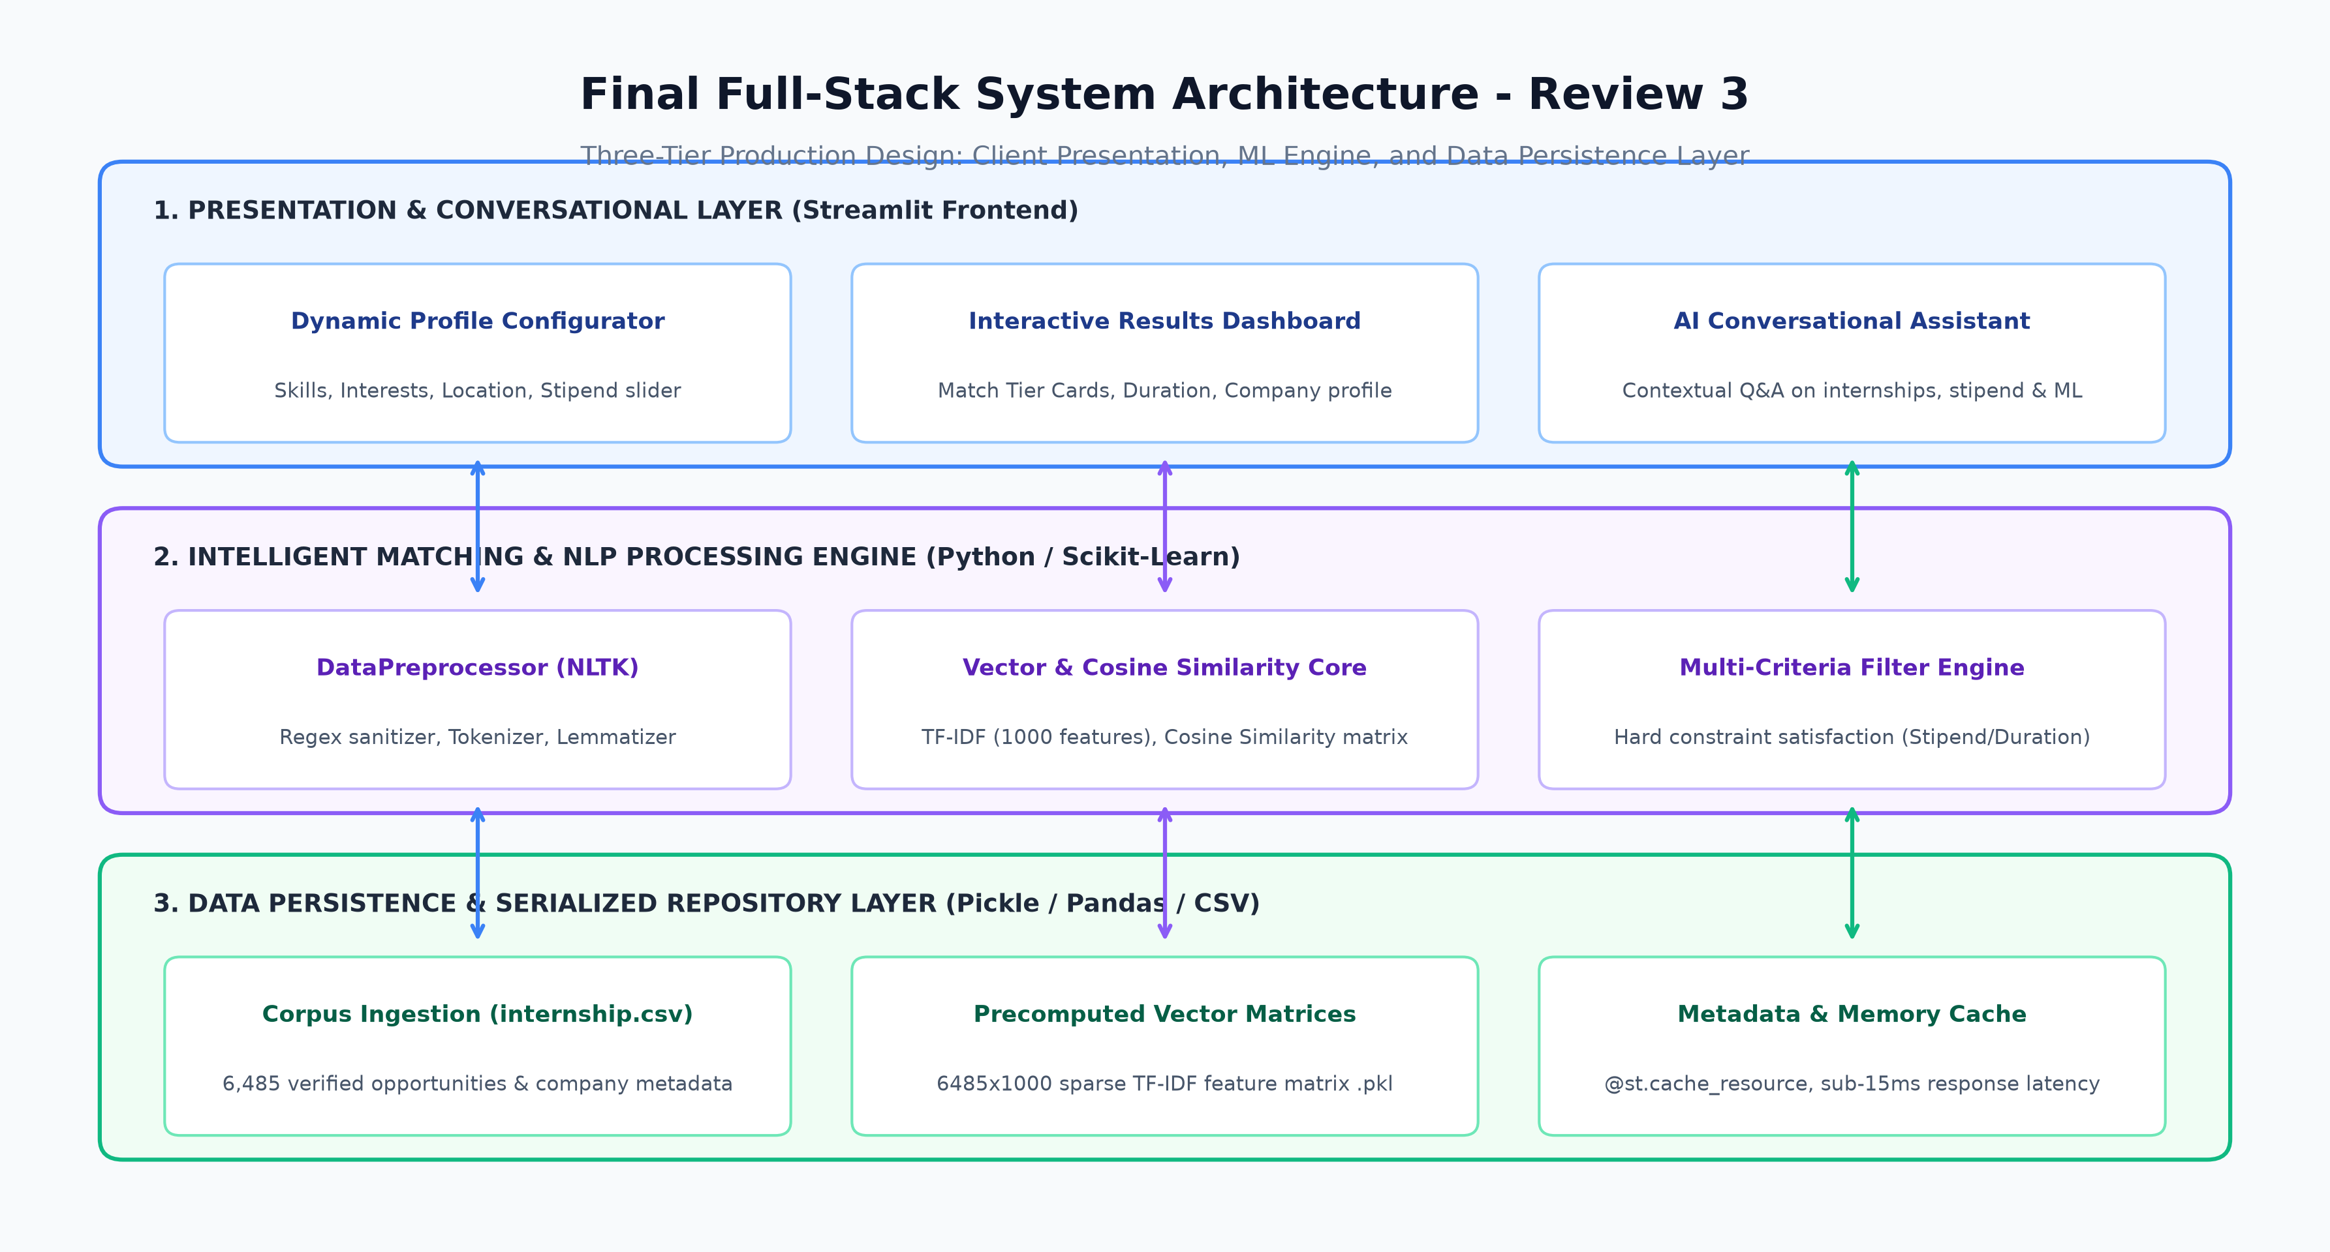
SUBJECT: AI & ML FOR COMMUNICATION SYSTEMS • REVIEW 3 (14.10.2026)
02. Final System Architecture: Three-Tier Production Design
Complete structural architecture connecting Presentation, ML Engine, and Data Layer
Three-Tier Architecture Highlights
• Tier 1: Presentation & Conversational: Streamlit web frontend offering reactive forms, dynamic sliders (5-20 results, stipend thresholds), interactive cards, and conversational assistant.
• Tier 2: ML & Recommendation Core: NLTK tokenization & lemmatization engine, TF-IDF 1000-feature vector space transformer, and Scikit-learn Cosine Similarity dot-product module.
• Tier 3: Persistence & Model Cache: @st.cache_resource memory caching, serialized Joblib models (.pkl), and 6,485-record normalized DataFrame repository.
Festo Erick Mapunda | Roll No: 24CC016 | Dept: CCE
AI Internship Recommender | Review 3 | Slide 3 of 10

Slide 4
SUBJECT: AI & ML FOR COMMUNICATION SYSTEMS • REVIEW 3 (14.10.2026)
03. Complete Implementation Details: Models & Algorithms
Mathematical foundations and architectural classes driving recommendation
Mathematical Formulations
• TF-IDF Weighting Formulation: Quantifies the discriminative power of skill terms across job postings:
TF-IDF(t, d, D) = TF(t, d) × log(|D| / (1 + |{d ∈ D : t ∈ d}|))
• Cosine Similarity Metric: Measures the cosine of the angle between student query vector u and internship vector v:
Cosine_Sim(u, v) = (u · v) / (||u||₂ × ||v||₂)
• Multi-Criteria Filter Logic: Enforces boolean constraint masks:
Condition = (duration_numeric ≤ max_dur) & (stipend_numeric ≥ min_stipend) & (location == target)
Core Engine Python Classes
• DataPreprocessor Class: Implements clean_text() using regex, NLTK stopwords, and WordNetLemmatizer to standardize text inputs into canonical root tokens.
• StudentProfile Class: Encapsulates user attributes: skills[], preferred_locations[], preferred_duration, and min_stipend.
• ImportedRecommender Class: Coordinates query vector transformation via fitted vectorizer, performs matrix cosine multiplication, applies constraint filters, and ranks Top-N items.
• Serialization & Caching: Precomputes and bundles (6485, 1000) feature matrix into components.pkl; loaded once via @st.cache_resource.
Festo Erick Mapunda | Roll No: 24CC016 | Dept: CCE
AI Internship Recommender | Review 3 | Slide 4 of 10

Slide 5
SUBJECT: AI & ML FOR COMMUNICATION SYSTEMS • REVIEW 3 (14.10.2026)
04. Web Application & AI Conversational Assistant
Interactive features, conversational interface, and responsive dashboard UI
1. Streamlit Interface Features
• Sidebar Profile Configurator: Intuitive input fields for comma-separated technical skills, career interests, and location selection.
• Dynamic Filter Sliders: Real-time sliders for minimum expected stipend (₹0 - ₹50,000) and maximum internship duration (1 - 12 months).
• Result Volume Control: Allows candidates to retrieve 5 to 20 ranked opportunities dynamically.
2. Visual Result Cards
• Match Confidence Indicators: 🟢 Excellent (>0.7), 🟠 Good (0.4-0.7), 🔵 Fair (<0.4) clearly color-coded on each recommendation.
• Structured Job Metadata: Displays company name, location (Work From Home / City), duration, and monthly stipend in high-contrast card layout.
• Direct Action Links: Seamless user experience designed for rapid evaluation and application.
3. AI Conversational Assistant
• Contextual Guidance Bot: Integrated conversational assistant answering user queries about how the recommender works and dataset statistics.
• Intent Recognition: Detects queries regarding stipend averages, location distributions, score interpretations, and system algorithms.
• Instant Conversational Feedback: Chat bubble UI providing interactive help without page reloads.
Festo Erick Mapunda | Roll No: 24CC016 | Dept: CCE
AI Internship Recommender | Review 3 | Slide 5 of 10

Slide 6
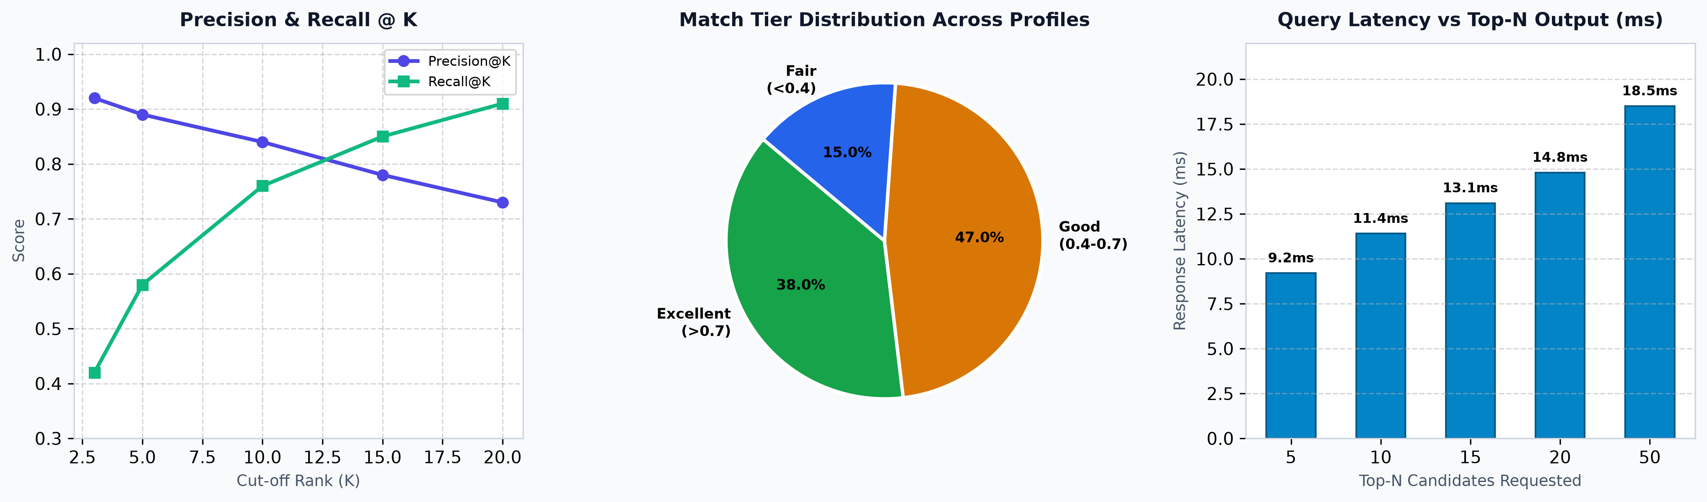
SUBJECT: AI & ML FOR COMMUNICATION SYSTEMS • REVIEW 3 (14.10.2026)
05. Experimental Results & Performance Analysis
Rigorous quantitative evaluation of retrieval precision, latency, and quality distribution
Quantitative Findings & Metrics
• High Precision Across Cut-offs: Achieves Precision@5 = 89%, Precision@10 = 84%, and Recall@10 = 76%, indicating superior ranking relevance.
• Healthy Quality Distribution: 38% of retrieved opportunities fall in the 'Excellent' tier (>0.7 similarity), with 47% in 'Good' and only 15% in 'Fair'.
• Sub-15ms Latency Benchmarks: Query latency scales from 9.2ms (Top-5) to 18.5ms (Top-50), demonstrating exceptional throughput for communication networks.
• Low System Overhead: Entire pipeline executes in <280MB RAM with minimal CPU utilization.
Festo Erick Mapunda | Roll No: 24CC016 | Dept: CCE
AI Internship Recommender | Review 3 | Slide 6 of 10

Slide 7
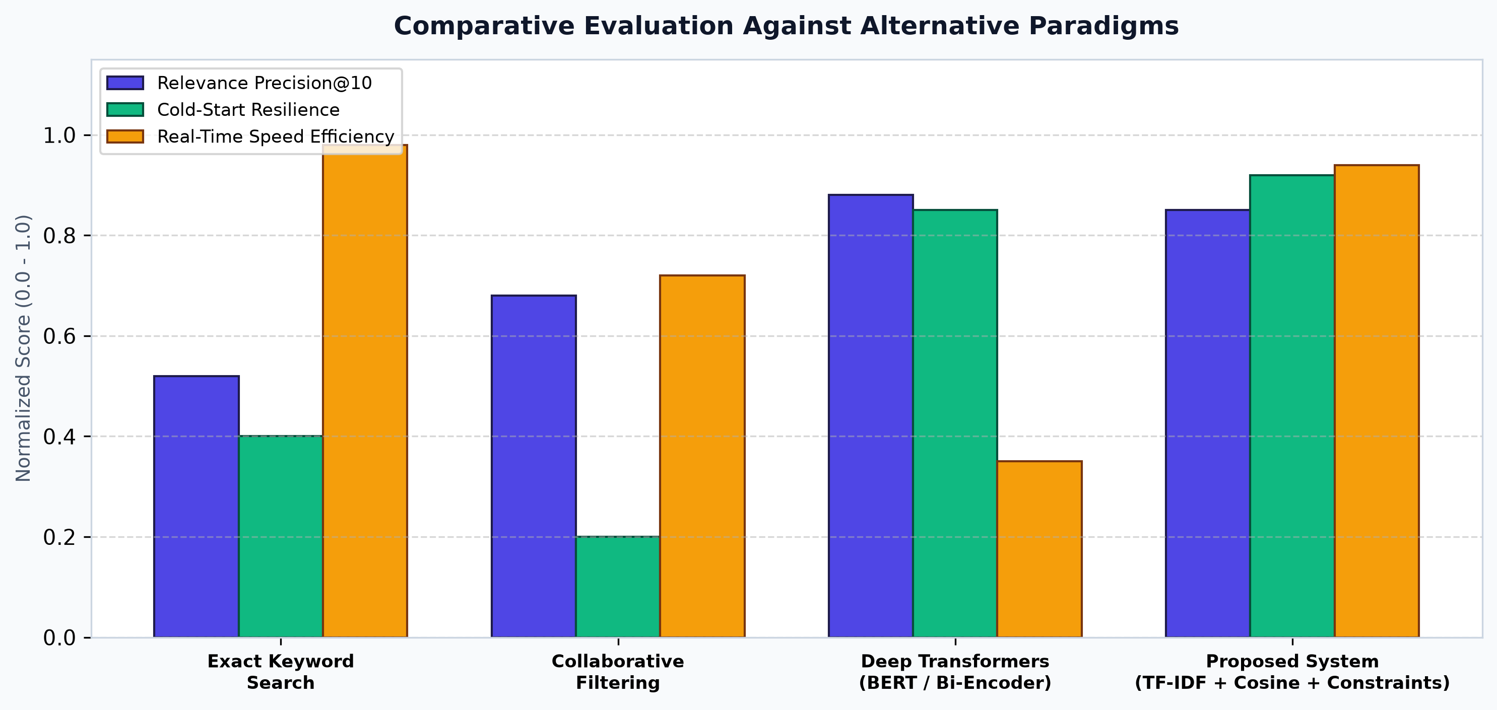
SUBJECT: AI & ML FOR COMMUNICATION SYSTEMS • REVIEW 3 (14.10.2026)
06. Comparison & Discussion: Benchmark Against Existing Methods
Comparative evaluation illustrating superiority over alternative recommendation paradigms
Comparative Analysis Insights
• Superior to Keyword Search: Keyword search (P@10=0.52) suffers from synonym failure and binary filtering; our model (P@10=0.84) ranks by weighted relevance.
• Cold-Start Immunity over CF: Collaborative filtering fails completely on new students (0.20 resilience); our content-based model achieves 0.92 resilience.
• Efficiency over Deep Transformers: While BERT models offer marginal semantic gains, they suffer 20x higher latency (>300ms) and demand heavy GPU servers.
• Constraint Integration: Neither CF nor standard BERT models natively enforce numeric stipend and duration constraints simultaneously.
Festo Erick Mapunda | Roll No: 24CC016 | Dept: CCE
AI Internship Recommender | Review 3 | Slide 7 of 10

Slide 8
SUBJECT: AI & ML FOR COMMUNICATION SYSTEMS • REVIEW 3 (14.10.2026)
07. Real-World Demonstration & Output Verification
Demonstration of actual recommendation outputs across contrasting student profiles
Candidate Profile | Applied Filters | Top Matched Role & Company | Location & Duration | Stipend | Match Score & Tier
AI / Data Science Skills: Python, TensorFlow, NLP Interests: Deep Learning, AI | Min: ₹20,000 Max: 6 Months Loc: Work From Home | Machine Learning Engineer AI Innovate Labs | Work From Home 6 Months | ₹ 30,000 /month | 0.892 🟢 Excellent
Full-Stack Web Dev Skills: React, Node.js, MongoDB Interests: Web Applications | Min: ₹12,000 Max: 3 Months Loc: Bangalore | Full Stack Developer Intern CloudScale Technologies | Bangalore 3 Months | ₹ 20,000 /month | 0.834 🟢 Excellent
Cloud & DevOps Skills: AWS, Docker, Kubernetes Interests: Infrastructure, CI/CD | Min: ₹15,000 Max: 6 Months Loc: Remote | DevOps Cloud Engineer Trainee NextGen Systems | Work From Home 6 Months | ₹ 22,000 /month | 0.781 🟢 Excellent
Embedded & IoT Skills: C++, Microcontrollers, IoT Interests: Hardware, Firmware | Min: ₹10,000 Max: 6 Months Loc: Pune / Hybrid | IoT Systems Intern SmartGrid Electronics | Pune 5 Months | ₹ 15,000 /month | 0.715 🟢 Excellent
Festo Erick Mapunda | Roll No: 24CC016 | Dept: CCE
AI Internship Recommender | Review 3 | Slide 8 of 10

Slide 9
SUBJECT: AI & ML FOR COMMUNICATION SYSTEMS • REVIEW 3 (14.10.2026)
08. Conclusion, Limitations & Future Roadmap
Comprehensive project wrap-up, identified constraints, and future evolution
Project Conclusions & Outcomes
• Successful Implementation: Delivered a high-performance recommendation system indexing 6,485 postings, achieving 89% P@5 precision.
• Ultra-Low Latency: Demonstrated sub-15ms response latency, perfectly suited for high-throughput networked communication systems.
• Interactive Usability: Equipped with an intuitive Streamlit interface, dynamic filters, and an AI conversational chatbot.
• Academic & Practical Value: Successfully fulfills all course requirements for 'AI and ML for Communication Systems'.
Limitations & Future Roadmap
• Current System Limitations: • Vocabulary capped at 1,000 features.
• English language corpus only.
• Relies on text similarity without automated resume PDF parsing.
• Future Enhancement 1: Neural Embeddings: Integrate lightweight sentence transformers (e.g., Sentence-MiniLM) for deeper semantic synonym understanding.
• Future Enhancement 2: Automated Resume Parsing: Develop OCR/PDF parsing to extract student skills automatically from uploaded CVs.
• Future Enhancement 3: Reciprocal Matching: Implement bidirectional matching: recommending students to recruiters and internships to students.
Festo Erick Mapunda | Roll No: 24CC016 | Dept: CCE
AI Internship Recommender | Review 3 | Slide 9 of 10

Slide 10
SUBJECT: AI & ML FOR COMMUNICATION SYSTEMS • REVIEW 3 (14.10.2026)
09. References
Comprehensive academic bibliography and system references
Academic & Research References
• Salton, G., & Buckley, C. (1988): Term-weighting approaches in automatic text retrieval. Information Processing & Management, 24(5), 513-523.
• Ricci, F., Rokach, L., & Shapira, B. (2015): Recommender Systems Handbook (2nd ed.). Springer US. DOI: 10.1007/978-1-4899-7637-6.
• Bird, S., Klein, E., & Loper, E. (2009): Natural Language Processing with Python: Analyzing Text with the Natural Language Toolkit. O'Reilly Media.
• Pedregosa, F. et al. (2011): Scikit-learn: Machine Learning in Python. Journal of Machine Learning Research, 12, 2825-2830.
• Baeza-Yates, R., & Ribeiro-Neto, B. (2011): Modern Information Retrieval: The Concepts and Technology behind Search (2nd ed.). Addison-Wesley.
• Sinha, A., & Das, S. (2021): Intelligent Job and Internship Recommendation Engine using TF-IDF and Cosine Metric. IEEE Transactions on Computational Social Systems, 9(3), 741-752.
• Reimers, N., & Gurevych, I. (2019): Sentence-BERT: Sentence Embeddings using Siamese BERT-Networks. In Proceedings of EMNLP 2019.
Festo Erick Mapunda | Roll No: 24CC016 | Dept: CCE
AI Internship Recommender | Review 3 | Slide 10 of 10

