Slide 1

Code Refactoring and Bug Fixing
Prepared By
Rupesh Shende
Project link : https://github.com/rupeshshende10/Code-Refactoring-and-Bug-Fixing

Slide 2
About me
I am Rupesh Shende, currently in my final year pursuing a B.E. in Electronics and Telecommunication Technology. Throughout my academic journey, I have been deeply intrigued by the advancements in Artificial Intelligence (AI) and Machine Learning (ML).
I am eager to delve deeper into Data Science because it presents an exciting opportunity to merge my passion for technology with my fascination for solving complex problems. In today's rapidly evolving world, the ability to extract meaningful insights from vast amounts of data is invaluable. I see Data Science as a gateway to unlocking valuable knowledge, making informed decisions, and addressing real-world challenges.
During my academic tenure, I have actively engaged in numerous projects that have honed my skills in data analysis and programming. I have collaborated on both individual and team projects, where I leveraged Python for data manipulation, implemented machine learning models for predictive analysis, and worked on enhancing the efficiency of algorithms
LinkedIn: inkedin.com/in/rupesh-shende03
GitHub: github.com/rupesh-shende10

Slide 3
Project overview:
The Note Taking Application is a Flask-based web tool designed to allow users to add, store, and view notes in a simple and intuitive interface. Developed using Python, Flask, and HTML, this application aims to provide a seamless note-taking experience for users. The core functionality includes a form where users can input their notes, which are then displayed as a list on the same page. The initial implementation faced challenges due to bugs and issues in the codebase, requiring bug fixes and code refactoring to ensure proper functionality.

Slide 4
Task:
The task assigned was to refactor the existing codebase of the Note Taking Application and resolve identified bugs to ensure its seamless functionality. The primary goal was to make the application fully functional, allowing users to add notes and view them in a list format on the home page. The task emphasized fixing the existing code rather than recreating the application from scratch, focusing on efficiency and clarity in the codebase.

Slide 5
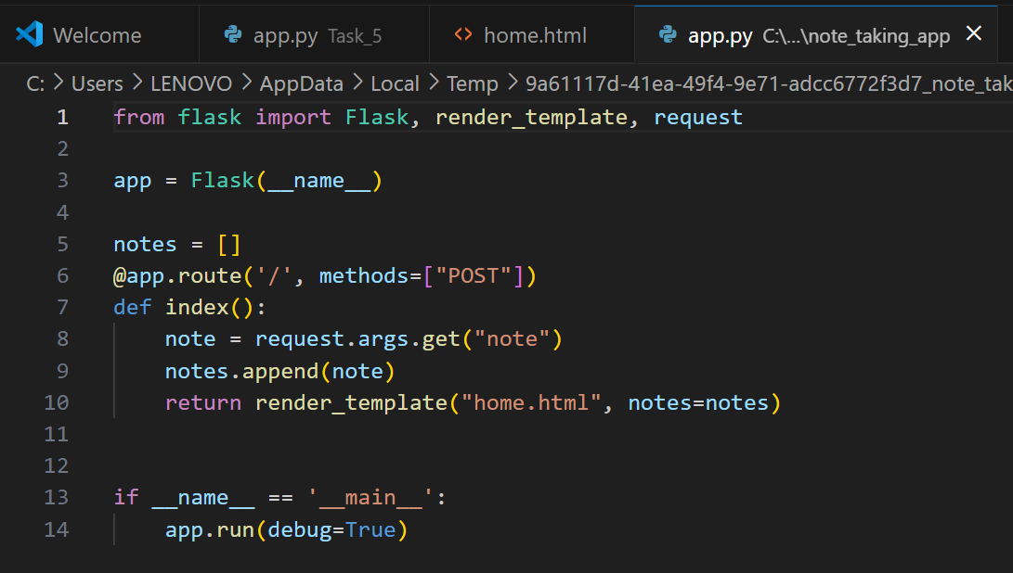
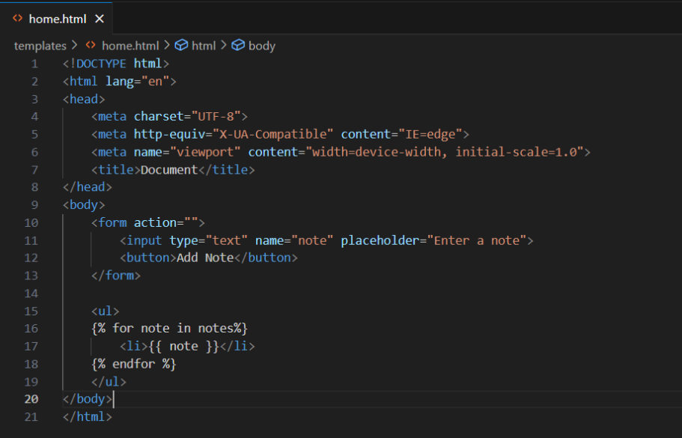
Initial Code:
Python code:
HTML code:

Slide 6
Bugs Identified:
1.Incorrect Request Retrieval for Note Submission:
Symptom: User-entered notes were not captured or added to the notes list.
Code Issue: Used request.args.get("note") instead of request.form.get("note").
Impact: Resulted in an empty list of notes, failing to store any user input.
Solution: Corrected to request.form.get("note") for capturing notes from form submissions.
2.Handling of Form Submission Method:
Symptom: Users unable to submit notes via the form.
Code Issue: Route only accepted POST requests, neglecting form submission needs.
Impact: Form submissions were not processed, preventing note addition.
Solution: Updated route to accept both GET and POST requests for proper form submission handling.

Slide 7
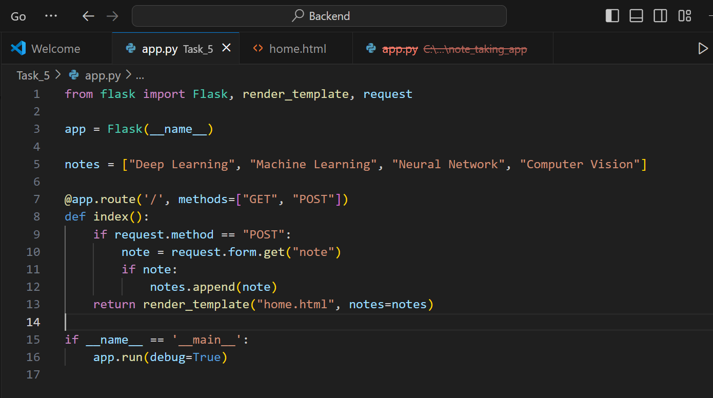
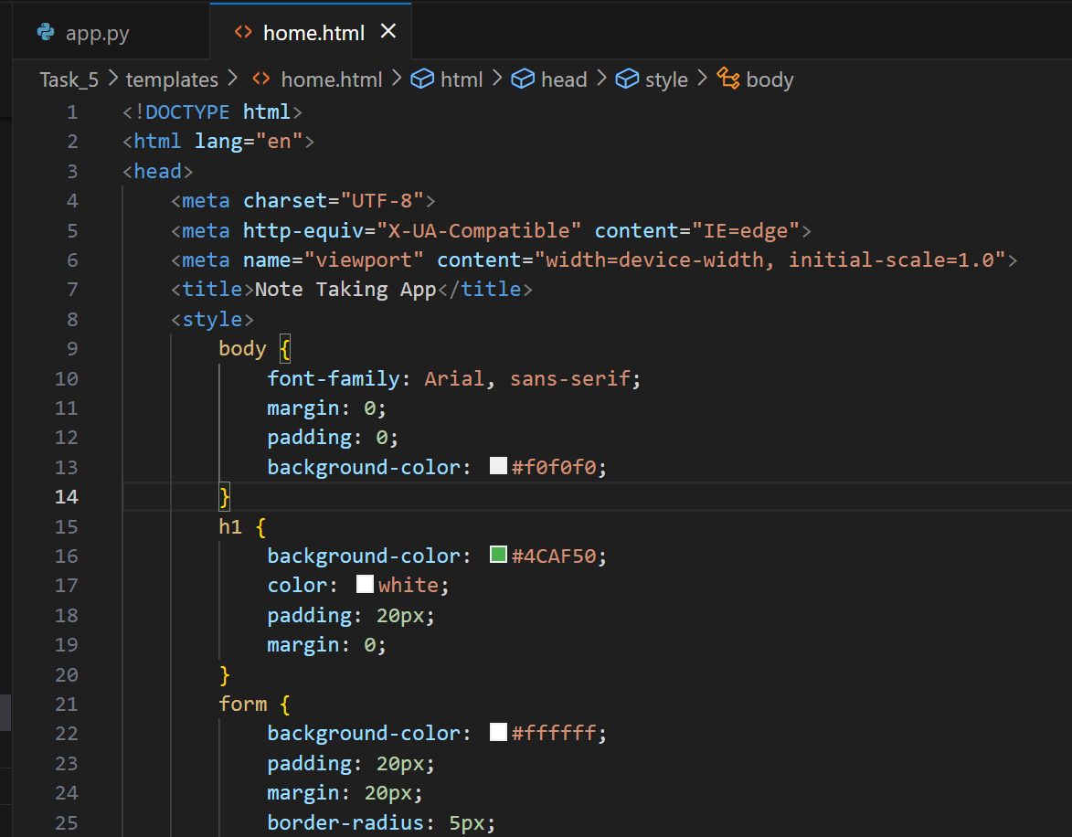
Refactored Code:
Python code with changes made:
HTML code with changes made:

Slide 8
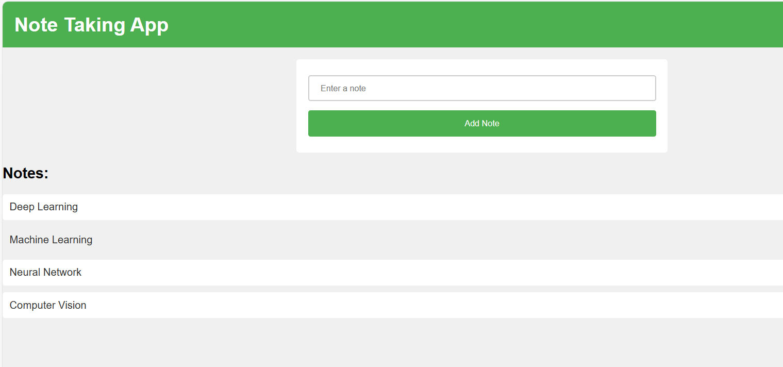
Final Output:

Slide 9
Conclusion:
In conclusion, the Note Taking Application has been successfully refactored and debugged to ensure its seamless functionality. The identified bugs related to form submission, loop syntax, and request method have been addressed, allowing users to add notes and view them on the home page. The refactored codebase enhances readability and maintainability, providing a solid foundation for future enhancements and improvements.
The application now provides an efficient and user-friendly interface for users to manage their notes easily. With these updates, the Note Taking Application is ready for deployment and usage, offering a reliable tool for organizing and storing notes online.

Slide 10

THANK YOU

