Slide 1
KNOWLEDGE EXTRACTION IN AGRICULTURE USING MACHINE LEARNING ALGORITHMS
Rukmangadan D
MTECH/13305

Slide 2
Introduction
Machine Learning algorithms are being widely used nowadays in all fields of science wherever huge amount of data is generated and agriculture is also not an exception for this.
Farmers in many parts of India are largely dependent on timely rainfall for harvest and subsequent profits.
Gradual onset of global warming and climate changes over the last century has slowly-yet steadily put this wisdom out of use. When age old systems fail, there is a need to look into the future.
One of the fastest growing areas under the discipline of “artificial intelligence” is machine learning.

Slide 3
Introduction
Machine learning can be used to draw conclusions from various sets of raw data.
Modern agriculture has the potential to discover even more ways to conserve water, use nutrients and energy more efficiently, and adapt to climate change.
With the advent of technology, numerous advancements have taken place so that now we are in a place where we can measure field soil moisture using Remote Sensing satellites.

Slide 4
Our Goal
The main goal in this study is to extract some information from the dataset showing variation between relative soil moisture obtained from the satellite data and field soil moisture obtained from ‘Berambadi’ Region.
The field soil moisture data is obtained from 112 sites, from each site manually. These are the sites where the surface soil moisture data is available for year 2016 and 2017.

Slide 5
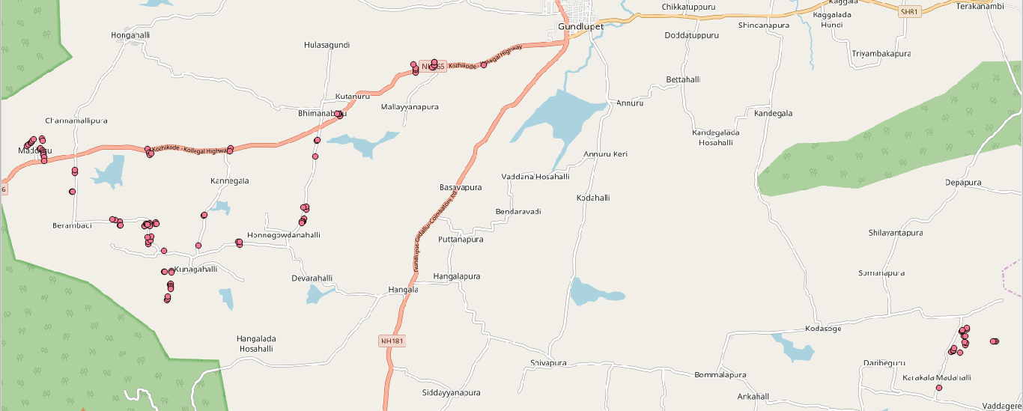
Our Goal
Out of the 112 sites, 92 sites fall on the Berambadi region of Gundlupet Taluk and 20 sites fall in Vaddagare region of Koratagere Taluk.

Slide 6
Field Soil Moisture vs Relative Soil Moisture
‘Relative Soil Moisture’ (RSM) refers to the soil moisture data obtained through satellite which is provided by VATI project of ‘Aapah innovations’. ‘Field Soil Moisture’ (FSM) refers to soil moisture measured from the site manually.
We know that Relative soil moisture is a function of Field Soil Moisture (FSM) and saturation capacity of the soil. Hence, at a particular site, the relative soil moisture should give a proper correlation with field soil moisture.

Slide 7
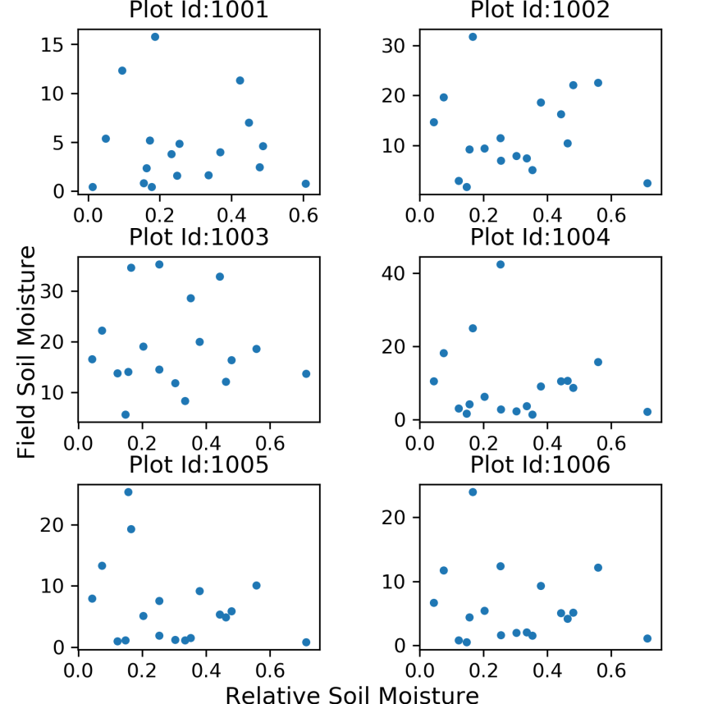
Field Soil Moisture vs Relative Soil Moisture
When we try to make scatter plots of ‘relative soil moisture’ vs ‘field soil moisture’, it does not show a good correlation. And, this leads to further thought why such variation.
Plot showing Field Soil Moisture vs Relative Soil Moisture (for 6 sites)

Slide 8
Literature Review
Though we can rely on moisture data given by satellite to a certain extent, we cannot rely on it completely as it is affected by many factors and it may not give the actual soil moisture.
H. McNairna,*, C. Duguayb, B. Briscoc, T.J. Pultza examined the effect of soil and crop residue characteristics on polarimetric radar response. This study reveals that radar parameters are most sensitive to volume and multiple scattering perform best at characterizing these surface conditions. The scattering mechanisms associated with standing senesced vegetation are varied.
Jun Wen, Zhongbo Su examined that the radar backscattering coefficient is mainly determined by surface soil moisture, vegetation and land surface roughness under a given configuration of the satellite sensor.

Slide 9
Literature Review
B.J. Choudury, T.J. Schmugge, R.W. Newton and A.Chang studied the effect of surface roughness on the brightness temperature of a moist terrain through the modification of Fresnel reflection coefficient and using the radiative transfer equation.
J.R. Wang, P.E. O'Neill, T.J. Jackson, E.T. Engman conducted experiment on remote sensing of soil moisture content was conducted over bare fields with microwave radiometers at the frequencies of 1.4 GHz, 5 GHz, and 10.7 GHz. Three bare fields with different surface roughnesses and soil textures were prepared for the experiment. The experimental results show that the effect of surface roughness is to increase the soils' brightness temperature and to reduce the slope of regression between brightness temperature and moisture content.

Slide 10
Literature Review
Thus, it is seen that the relative soil moisture determined by the satellites cannot be blindly correlated with the field soil moisture measured manually even though the saturation capacity of the soil is known.
The main factors that lie in between the correlation of relative soil moisture and field soil moisture are the type of crop, crop coverage or crop growth basically how much the crop has covered the field at a given instance and also the soil class based on texture and type of soil to which it belongs.

Slide 11
Our Problem
Each site is given a Plot ID for analysis purpose.
Plot_ID | Correlation | Plot_ID | Correlation | Plot_ID | Correlation | Plot_ID | Correlation
1001 | -0.066 | 1029 | -0.099 | 1057 | -0.092 | 1085 | 0.850
1002 | -0.004 | 1030 | -0.468 | 1058 | -0.016 | 1086 | 0.881
1003 | -0.030 | 1031 | -0.088 | 1059 | 0.135 | 1087 | 0.816
1004 | -0.127 | 1032 | 0.009 | 1060 | 0.101 | 1088 | 0.936
1005 | -0.308 | 1033 | 0.010 | 1061 | -0.057 | 1089 | 0.223
1006 | -0.169 | 1034 | -0.032 | 1062 | -0.007 | 1090 | 0.300
1007 | 0.038 | 1035 | -0.071 | 1063 | 0.176 | 1091 | 0.342
1008 | 0.059 | 1036 | -0.075 | 1064 | 0.082 | 1092 | 0.194
1009 | -0.016 | 1037 | -0.084 | 1065 | 0.197 | 1093 | 0.438
1010 | 0.016 | 1038 | -0.036 | 1066 | 0.088 | 1094 | 0.190
1011 | 0.088 | 1039 | 0.014 | 1067 | 0.238 | 1095 | 0.232
1012 | 0.082 | 1040 | -0.058 | 1068 | 0.110 | 1096 | 0.092
1013 | 0.456 | 1041 | -0.023 | 1069 | 0.030 | 1097 | 0.987
1014 | 0.103 | 1042 | -0.178 | 1070 |  | 1098 | 0.973
1015 | -0.142 | 1043 | -0.104 | 1071 |  | 1099 | 0.262
1016 | 0.145 | 1044 | -0.042 | 1072 |  | 1100 | 0.479
1017 | -0.174 | 1045 | -0.058 | 1073 |  | 1101 | 0.465
1018 | -0.131 | 1046 | -0.156 | 1074 |  | 1102
1019 | -0.089 | 1047 | -0.115 | 1075 |  | 1103 | -0.138
1020 | -0.063 | 1048 | 0.028 | 1076 |  | 1104 | -0.040
1021 | -0.182 | 1049 | 0.090 | 1077 |  | 1105 | -0.190
1022 | -0.209 | 1050 | 0.043 | 1078 |  | 1106 | -0.282
1023 | -0.239 | 1051 | 0.144 | 1079 |  | 1107 | -0.093
1024 | -0.058 | 1052 | 0.083 | 1080 |  | 1108 | -0.355
1025 | -0.357 | 1053 | 0.072 | 1081 |  | 1109 | -0.700
1026 | -0.009 | 1054 | 0.109 | 1082 | 0.217 | 1110 | 0.068
1027 | -0.023 | 1055 | 0.131 | 1083 | -0.338 | 1111 | 0.007
1028 | -0.172 | 1056 | -0.217 | 1084 | 0.860 | 1112 | 0.096
Table showing correlation between ‘relative soil moisture’ and ‘field soil moisture’ for each site

Slide 12
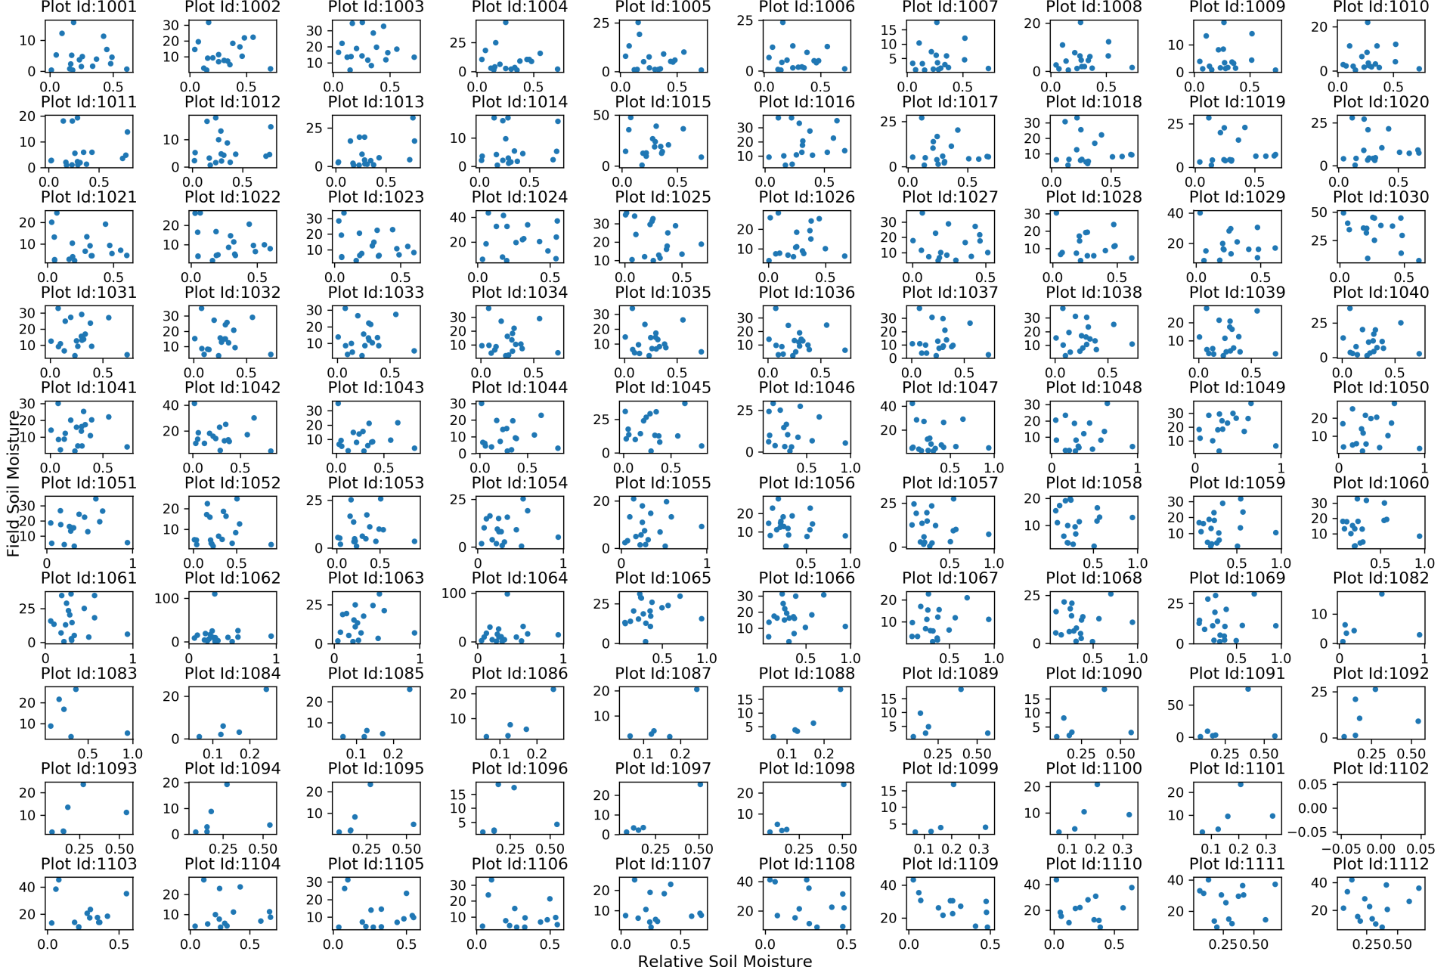
Field Soil Moisture vs Relative Soil Moisture Scatter Plot (for all 112 sites)

Slide 13
Our Problem
From the correlation table, it is seen that most of the sites have very poor correlation, mostly having R² values of less 0.1. Thus, to bring a good result, just comparing between these two is not sufficient, but it is required to bring other parameters which cause this problem.
It is seen in the literature review that relative soil moisture measured using satellite gets affected by various factors such as the type of crop, crop coverage or crop growth basically how much the crop has covered the field at a given instance and also to the soil class based on texture and type of soil to which it belongs.

Slide 14
Our Problem
Now, to understand how this relative soil moisture works along with parameters mainly crop type and soil class, machine learning algorithms are used.
Before moving on to analysis, the data for analysis has to defined and organized in a manner to feed into machine learning algorithms.
The compiled data used in these algorithms are derived from different sources and has been compiled into an excel sheet.

Slide 15
Software Utilized
The software utilized for extracting and organizing data are
(i) Quantum GIS, commonly called as QGIS – an open source software, extended its capability with “PyQGIS”.
(ii) Geospatial Data Abstraction Library, in short “GDAL”, for making pixel level calculations on the satellite data obtained.
(iii) The programming language used is Python

Slide 16
Data Feeds used for ML Algorithms
Crop Type:
The type of crop that is grown in farmer’s field is available along with date. Frequency of data available is approximately twice a month for year 2016 and 2017.
Total number of types of crop available from all 112 sites is 51.
 | Less coverage | Medium coverage | Dense coverage
Short | 1 | 2 | 3
Medium | 4 | 5 | 6
Tall | 7 | 8 | 9

Slide 17
Data Feeds used for ML Algorithms
Maximum relative soil moisture:
As saturation capacity is a property of soil at a site, maximum relative soil moisture can be defined as one property of site where at a site, the value of relative soil moisture in any time does not exceed the maximum relative soil moisture.

Slide 18
Data Feeds used for ML Algorithms
Soil Class:
The soil classes are available as vector file, ie., dbase file. Hence, the easiest approach that is followed is to get the soil class of all sites based on nearest neighbor algorithm. To feed into machine learning algorithms, the soil types are mapped to integer types accordingly.
Soil_Type | Int_Type
Clay | 1
Gravelly_Sandy_Clay | 2
Gravelly_Sandy_Clay_Loam | 3
Sandy_Clay | 4
Sandy_Clay_Loam | 5

Slide 19
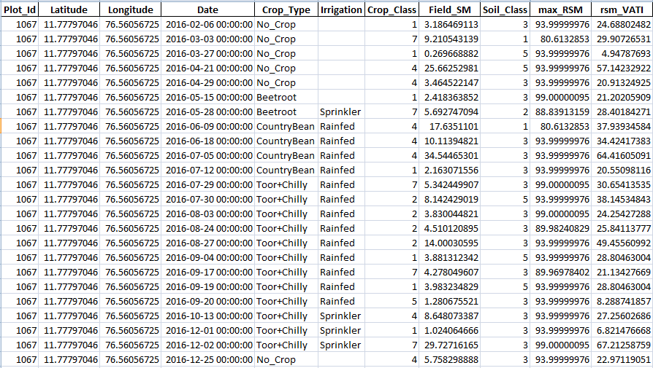
Snap of ML Excel Feed

Slide 20
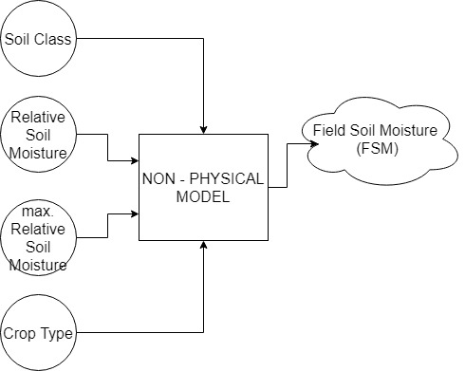
Methodology
In this study, a non physical model is used to analyze this problem.
The dataset to be fed to this model consists of around 5200 data points.

Slide 21
Methodology
This model has four inputs which are soil class, relative soil moisture, maximum relative soil moisture and crop type. And the output of the model is Field Soil Moisture.
To train this model, bagging regressor, artificial neural networks and tensorflow custom machine learning regressor are used and discussed.

Slide 22
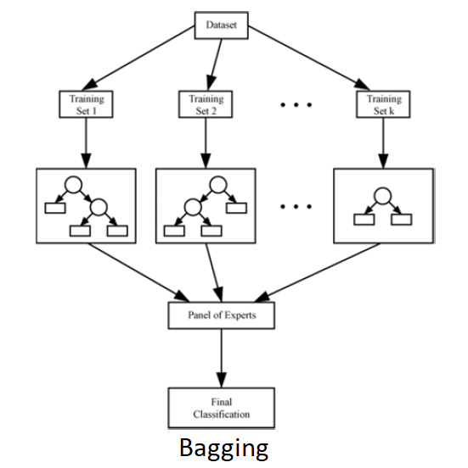
Bagging Regressor
BAGGING is coined from ‘Bootstrap AGGregatING’. Bagging regressor is an ensemble meta-estimator that fits base regressors each on random subsets of the original dataset and then aggregate their individual predictions (either by voting or by averaging) to form a final prediction. Such a meta-estimator can typically be used as a way to reduce the variance of a black-box estimator by introducing randomization into its construction procedure and then making an ensemble out of it.

Slide 23
Bagging Regressor
Given a set D of d tuples, at each iteration i, a training set D_{i} of d tuples is sampled with replacement from D. A classifier model M_{i} is learned for each training set D_{i}. Regression can be applied to the prediction of continuous values by taking the average value of each prediction for a given test tuple.

Slide 24
Artificial Neural Networks
A neural network is a set of connected input/output units (neurons) where each connection has a weight associated with it. During the learning phase, the network learns by adjusting the weights that enable it to predict the correct class label of the input samples.
Neural networks are built out of a densely interconnected set of simple units (neurons).

Slide 25
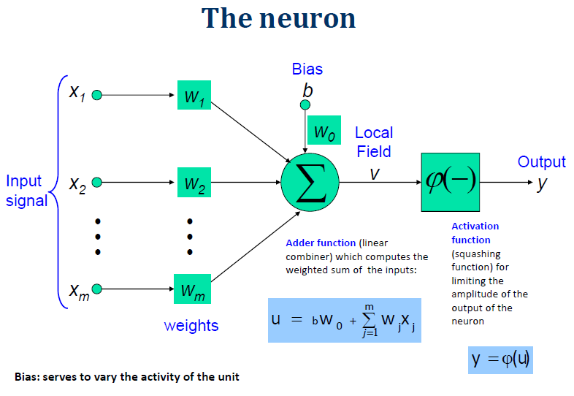
Artificial Neural Networks
Each neuron takes a number of real‐valued inputs.
Produces a single real‐valued output.
Inputs to a neuron may be the outputs of other neurons.
A neuron’s output may be used as input to many other neurons.
Artificial Neural Networks can also be used to learn complex pseudo random number generator.

Slide 26
Tensorflow Machine Learning Custom Regressor
Tensorflow has a custom regressor module wherein one can input the regressor functions along with variables and the corresponding training dataset for the model to train itself. Also, it has option of controlling flow of data for training based on conditions. The cost function for this model will be simple RMSE (Root Mean Square Error) between the predicted and actual values. The optimizer used for reducing RMSD (Root Mean Square Deviation) is Gradient Descent Optimizer.

Slide 27
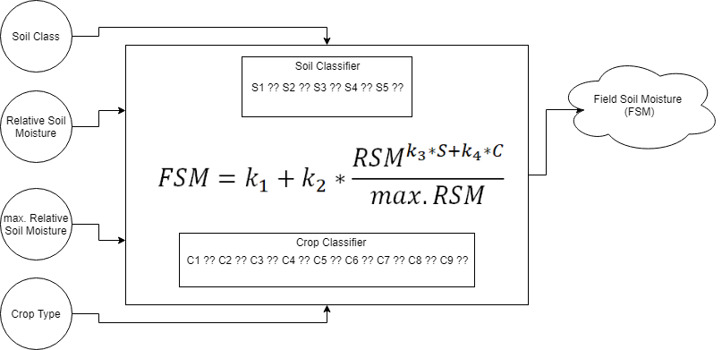
Tensorflow Machine Learning Custom Regressor
Regression
ML
Model
Since the dataset comprises of five soil classes and nine crop classes, 13 tensorflow variables will be kept for each class of S & C, ie., S1, S2, S3, S4, S5 for soil classes and C1, C2, …,C9 for crop classes.

Slide 28

Tensorflow ML Custom Regressor
The Field Soil Moisture (FSM) can be computed using
where
k₁, k₂, k₃, k₄ → constants of regression model
S → coefficient corresponding to type of soil
C → coefficient corresponding to type of crop
RSM → Relative Soil Moisture obtained from the satellite data
max.RSM → maximum RSM for the field point

Slide 29
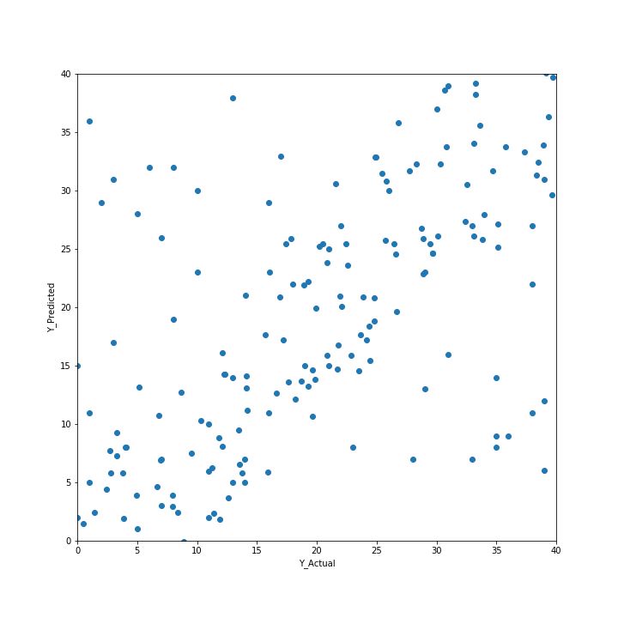
Results and Discussions
Bagging Regressor:
Bagging Regressor gives an average correlation of 0.65. Bagging regressor can also give average results if the dataset has a complex structure. To test if the dataset has a complex structure, Artificial Neural Networks (ANNs) are used.
It is far better than a single classifier derived from total dataset.
For noisy data, it works average only.
Scatter Plot of Bagging Regressor

Slide 30
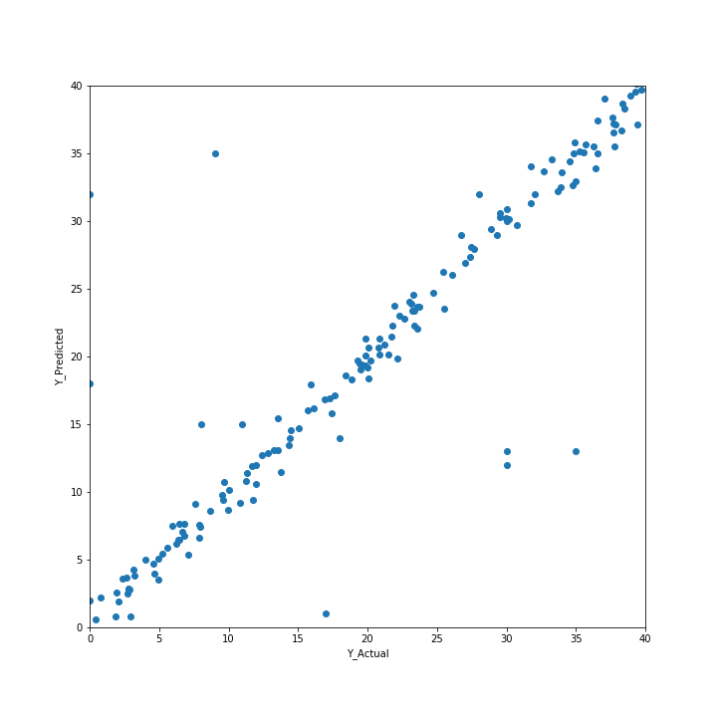
Results and Discussions
Artificial Neural networks:
Artificial Neural Networks gives correlation of around 0.92. The results are of high accuracy. This means that a complex structure is found in the dataset.
Prediction accuracy is generally high.
robust, works when training examples contain errors or noisy data
parameters are best determined empirically and longer training time
difficult to understand the learned function (weights)
not easy to incorporate domain knowledge
Scatter Plot of ANNs

Slide 31
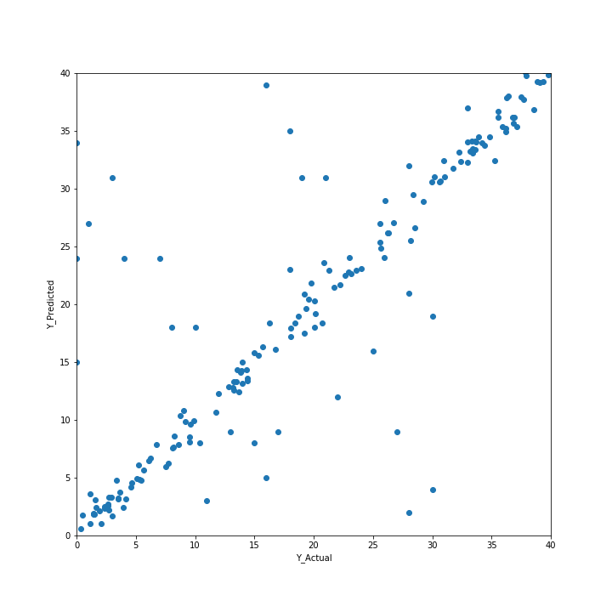
Results and Discussions
Regression ML Model:
Artificial Neural Networks has shown that there is a complex structure. Hence, the custom regressor model is tried and regression ML model gives correlation of around 0.86.
Scatter Plot of Regression ML Model

Slide 32
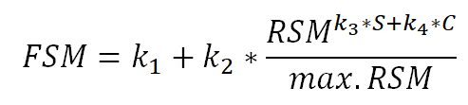
Results and Discussions
Regression ML Model:
For the custom regression model,
The values of coefficients are found to be
Constants of regression model:
Constant | Value
k1 | 0.539
k2 | 0.876
k3 | 0.32
k4 | 0.84

Slide 33
Results and Discussions
Coefficients of Soil Class:
Soil Class | Coefficient | Value
1 | s1 | -0.22715
2 | s2 | -0.27834
3 | s3 | -0.32364
4 | s4 | -0.46348
5 | s5 | -0.39676
Coefficients of Crop Class:
Crop Class | Coefficient | Value
1 | c1 | 2.065574
2 | c2 | 2.328851
3 | c3 | 2.414203
4 | c4 | 2.475283
5 | c5 | 2.439513
6 | c6 | 2.055184
7 | c7 | 2.406972
8 | c8 | 2.342806
9 | c9 | 2.843768

Slide 34
Results and Discussions
Keeping the tolerance ± 0.5 % of the predicted values, around 20% of the data is showing different values other than the actual values.
Banana and Sugarcane which have been classified as tall and more dense is showing higher values.
And whichever is showing lesser values, belongs to tall and less dense sunflower and maize plants.

Slide 35
Conclusion
Thus we are able achieve good correlation between relative soil moisture and field soil moisture to a greater extent which did not make any sense before
The algorithms could be used for prediction of field moisture content from satellite data.
Using machine learning, we could extract many interesting features from the datasets also.

Slide 36
References
H. McNairna,*, C. Duguayb, B. Briscoc, T.J. Pultza (2002). The effect of soil and crop residue characteristics on polarimetric radar response. Remote Sensing of Environment, Volume 80, Issue 2, Pages 308-320.
Jun Wen, Zhongbo Su (2003). A time series based method for estimating relative soil moisture with ERS wind scatterometer data. Geophysical Research Letters, Volume 30, Issue 7.
B.J. Choudury, T.J. Schmugge, R.W. Newton and A.Chang (1978). Effect of Surface Roughness on the Microwave Emission from Soils. Journal of Geophysical Research, Volume 84, Issue C9, Pages 5699–5706
J.R. Wang, P.E. O'Neill, T.J. Jackson, E.T. Engman (1982). A Multi-Frequency Measurement of Thermal Microwave Emission From Soils: The Effects of Soil Texture and Surface Roughness. International Geoscience and Remote Sensing Symposium, Munich.
L. Breiman, “Pasting small votes for classification in large databases and on-line”, Machine Learning, 36(1), 85-103, 1999.
L. Breiman, “Bagging predictors”, Machine Learning, 24(2), 123-140, 1996.
T. Ho, “The random subspace method for constructing decision forests”, Pattern Analysis and Machine Intelligence, 20(8), 832-844, 1998.
G. Louppe and P. Geurts, “Ensembles on Random Patches”, Machine Learning and Knowledge Discovery in Databases, 346-361, 2012.
P. Geurts, D. Ernst., and L. Wehenkel, “Extremely randomized trees”, Machine Learning, 63(1), 3-42, 2006.
J. Friedman, Greedy Function Approximation: A Gradient Boosting Machine, The Annals of Statistics, Vol. 29, No. 5, 2001.
Friedman, Stochastic Gradient Boosting, 1999
T. Hastie, R. Tibshirani and J. Friedman. Elements of Statistical Learning Ed. 2, Springer, 2009.

