Slide 1
KNOWLEDGE EXTRACTION IN AGRICULTURE USING MACHINE LEARNING ALGORITHMS
Rukmangadan D
MTECH/13305

Slide 2
Introduction
Machine Learning algorithms are being widely used nowadays in all fields of science wherever huge amount of data is generated and agriculture is also not an exception for this.
Farmers in many parts of India are largely dependent on timely rainfall for harvest and subsequent profits.
Gradual onset of global warming and climate changes over the last century has slowly-yet steadily put this wisdom out of use. When age old systems fail, there is a need to look into the future.
One of the fastest growing areas under the discipline of “artificial intelligence” is machine learning.

Slide 3
Introduction
Machine learning can be used to draw conclusions from various sets of raw data.
Modern agriculture has the potential to discover even more ways to conserve water, use nutrients and energy more efficiently, and adapt to climate change.
With the advent of technology, numerous advancements have taken place so that now we are in a place where we can measure field soil moisture using Remote Sensing satellites.

Slide 4
Our Goal
The main goal in this study is to arrive at an interesting pattern from the variation between relative soil moisture obtained from the satellite data and field soil moisture obtained from ‘Berambadi’ Region.
The field soil moisture data is obtained from 112 sites, from each site manually. These are the sites where the surface soil moisture data is available for year 2016 and 2017.

Slide 5
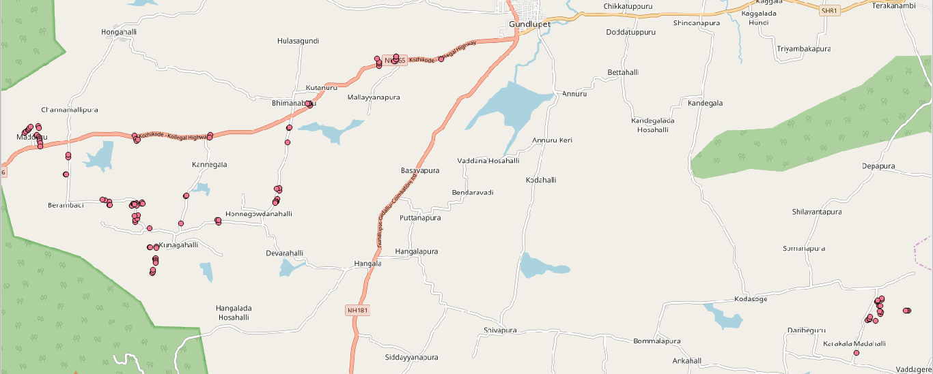
Our Goal
Out of the 112 sites, 92 sites fall on the Berambadi region of Gundlupet Taluk and 20 sites fall in Vaddagare region of Koratagere Taluk.

Slide 6
Field Soil Moisture vs Relative Soil Moisture
‘Relative Soil Moisture’ (RSM) refers to the soil moisture data obtained through satellite which is provided by VATI project of ‘Aapah innovations’. ‘Field Soil Moisture’ (FSM) refers to soil moisture measured from the site manually.
We know that Relative soil moisture is a function of Field Soil Moisture (FSM) and saturation capacity of the soil. Hence, at a particular site, the relative soil moisture should give a proper correlation with field soil moisture.

Slide 7
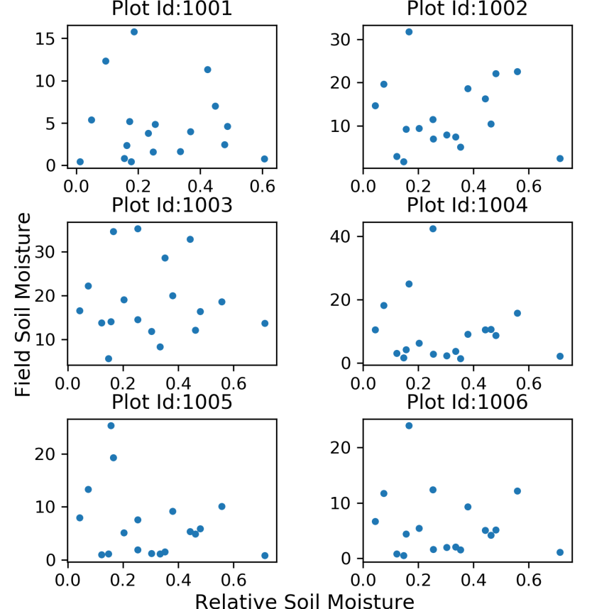
Field Soil Moisture vs Relative Soil Moisture
When we try to make scatter plots of ‘relative soil moisture’ vs ‘field soil moisture’, it does not show a good correlation. And, this leads to further thought why such variation.
Plot showing Field Soil Moisture vs Relative Soil Moisture (for 6 sites)

Slide 8
Literature Review
Though we can rely on moisture data given by satellite to a certain extent, we cannot rely on it completely as it is affected by many factors and it may not give the actual soil moisture.
H. McNairna,*, C. Duguayb, B. Briscoc, T.J. Pultza examined the effect of soil and crop residue characteristics on polarimetric radar response. This study reveals that radar parameters are most sensitive to volume and multiple scattering perform best at characterizing these surface conditions. The scattering mechanisms associated with standing senesced vegetation are varied.
Jun Wen, Zhongbo Su examined that the radar backscattering coefficient is mainly determined by surface soil moisture, vegetation and land surface roughness under a given configuration of the satellite sensor.

Slide 9
Literature Review
B.J. Choudury, T.J. Schmugge, R.W. Newton and A.Chang studied the effect of surface roughness on the brightness temperature of a moist terrain through the modification of Fresnel reflection coefficient and using the radiative transfer equation.
J.R. Wang, P.E. O'Neill, T.J. Jackson, E.T. Engman conducted experiment on remote sensing of soil moisture content was conducted over bare fields with microwave radiometers at the frequencies of 1.4 GHz, 5 GHz, and 10.7 GHz. Three bare fields with different surface roughnesses and soil textures were prepared for the experiment. The experimental results show that the effect of surface roughness is to increase the soils' brightness temperature and to reduce the slope of regression between brightness temperature and moisture content.

Slide 10
Literature Review
Thus, it is seen that the relative soil moisture determined by the satellites cannot be blindly correlated with the field soil moisture measured manually even though the saturation capacity of the soil is known.
The main factors that lie in between the correlation of relative soil moisture and field soil moisture are the type of crop, crop coverage or crop growth basically how much the crop has covered the field at a given instance and also the soil class based on texture and type of soil to which it belongs.

Slide 11
Our Problem
Each site is given a Plot ID for analysis purpose.
Plot_ID | Correlation | Plot_ID | Correlation | Plot_ID | Correlation | Plot_ID | Correlation
1001 | -0.066 | 1029 | -0.099 | 1057 | -0.092 | 1085 | 0.850
1002 | -0.004 | 1030 | -0.468 | 1058 | -0.016 | 1086 | 0.881
1003 | -0.030 | 1031 | -0.088 | 1059 | 0.135 | 1087 | 0.816
1004 | -0.127 | 1032 | 0.009 | 1060 | 0.101 | 1088 | 0.936
1005 | -0.308 | 1033 | 0.010 | 1061 | -0.057 | 1089 | 0.223
1006 | -0.169 | 1034 | -0.032 | 1062 | -0.007 | 1090 | 0.300
1007 | 0.038 | 1035 | -0.071 | 1063 | 0.176 | 1091 | 0.342
1008 | 0.059 | 1036 | -0.075 | 1064 | 0.082 | 1092 | 0.194
1009 | -0.016 | 1037 | -0.084 | 1065 | 0.197 | 1093 | 0.438
1010 | 0.016 | 1038 | -0.036 | 1066 | 0.088 | 1094 | 0.190
1011 | 0.088 | 1039 | 0.014 | 1067 | 0.238 | 1095 | 0.232
1012 | 0.082 | 1040 | -0.058 | 1068 | 0.110 | 1096 | 0.092
1013 | 0.456 | 1041 | -0.023 | 1069 | 0.030 | 1097 | 0.987
1014 | 0.103 | 1042 | -0.178 | 1070 |  | 1098 | 0.973
1015 | -0.142 | 1043 | -0.104 | 1071 |  | 1099 | 0.262
1016 | 0.145 | 1044 | -0.042 | 1072 |  | 1100 | 0.479
1017 | -0.174 | 1045 | -0.058 | 1073 |  | 1101 | 0.465
1018 | -0.131 | 1046 | -0.156 | 1074 |  | 1102
1019 | -0.089 | 1047 | -0.115 | 1075 |  | 1103 | -0.138
1020 | -0.063 | 1048 | 0.028 | 1076 |  | 1104 | -0.040
1021 | -0.182 | 1049 | 0.090 | 1077 |  | 1105 | -0.190
1022 | -0.209 | 1050 | 0.043 | 1078 |  | 1106 | -0.282
1023 | -0.239 | 1051 | 0.144 | 1079 |  | 1107 | -0.093
1024 | -0.058 | 1052 | 0.083 | 1080 |  | 1108 | -0.355
1025 | -0.357 | 1053 | 0.072 | 1081 |  | 1109 | -0.700
1026 | -0.009 | 1054 | 0.109 | 1082 | 0.217 | 1110 | 0.068
1027 | -0.023 | 1055 | 0.131 | 1083 | -0.338 | 1111 | 0.007
1028 | -0.172 | 1056 | -0.217 | 1084 | 0.860 | 1112 | 0.096
Table showing correlation between ‘relative soil moisture’ and ‘field soil moisture’ for each site

Slide 12
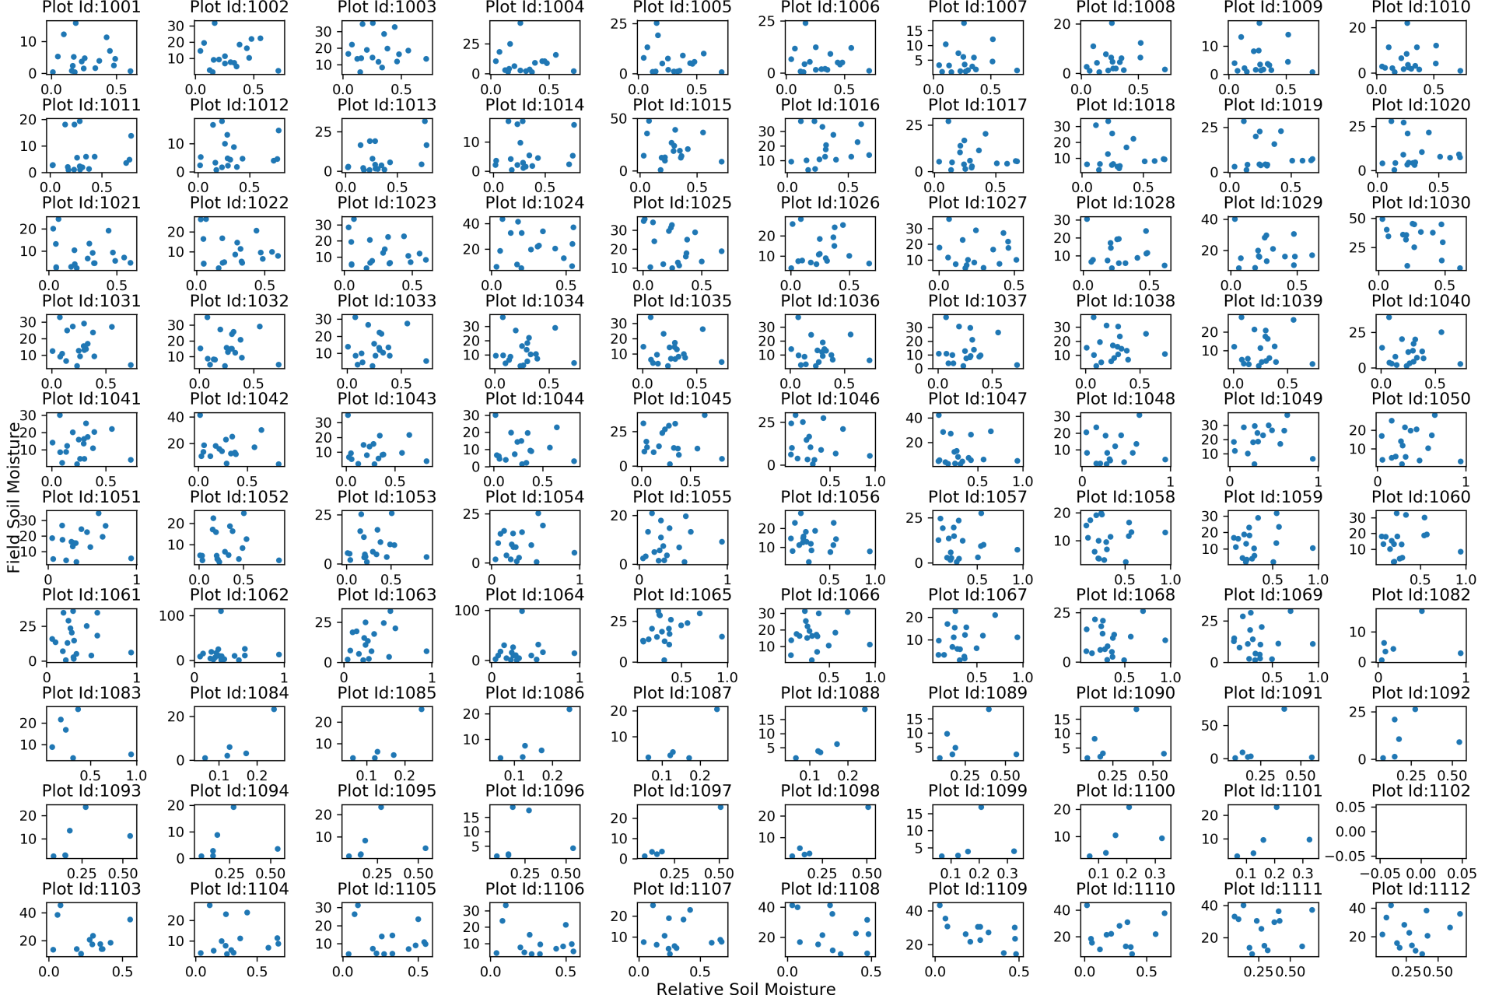
Field Soil Moisture vs Relative Soil Moisture Scatter Plot (for all 112 sites)

Slide 13
Our Problem
From the correlation table, it is seen that most of the sites have very poor correlation, mostly having R² values of less 0.1. Thus, to bring a good result, just comparing between these two is not sufficient, but it is required to bring other parameters which cause this problem.
It is seen in the literature review that relative soil moisture measured using satellite gets affected by various factors such as the type of crop, crop coverage or crop growth basically how much the crop has covered the field at a given instance and also to the soil class based on texture and type of soil to which it belongs.

Slide 14
Our Problem
Now, to understand how this relative soil moisture works along with parameters mainly crop type, crop period and soil class, machine learning algorithms are used.
Before moving on to analysis, the data for analysis has to defined and organized in a manner to feed into machine learning algorithms.
The compiled data used in these algorithms are derived from different sources and has been compiled into an excel sheet.

Slide 15
Software Utilized
The software utilized for extracting and organizing data are
(i) Quantum GIS, commonly called as QGIS – an open source software, extended its capability with “PyQGIS”.
(ii) Geospatial Data Abstraction Library, in short “GDAL”, for making pixel level calculations on the satellite data obtained.
(iii) The programming language used is Python – second most popular language after Java.

Slide 16
Data Feeds used for ML Algorithms
Crop Type:
The type of crop that is grown in farmer’s field is available along with date. Frequency of data available is approximately twice a month for year 2016 and 2017.
Total number of types of crop available from all 112 sites is 51.
 | Less coverage | Medium coverage | Dense coverage
Short | 1 | 2 | 3
Medium | 4 | 5 | 6
Tall | 7 | 8 | 9

Slide 17
Data Feeds used for ML Algorithms
Crop period:
Crop period is computed using python code snippets. Here, the crop period is defined in percentage that when crop is sown, it is considered as 0% and during the harvest, it is considered as 100% and interpolated linearly in between days.
Maximum relative soil moisture:
As saturation capacity is a property of soil at a site, maximum relative soil moisture can be defined as one property of site where at a site, the value of relative soil moisture in any time does not exceed the maximum saturation capacity.

Slide 18
Data Feeds used for ML Algorithms
Soil Class:
The soil classes are available as vector file, ie., dbase file. Hence, the easiest approach that is followed is to get the soil class of all sites based on nearest neighbor algorithm. To feed into machine learning algorithms, the soil types are mapped to integer types accordingly.
Soil_Type | Int_Type
Clay | 1
Gravelly_Sandy_Clay | 2
Gravelly_Sandy_Clay_Loam | 3
Sandy_Clay | 4
Sandy_Clay_Loam | 5

Slide 19
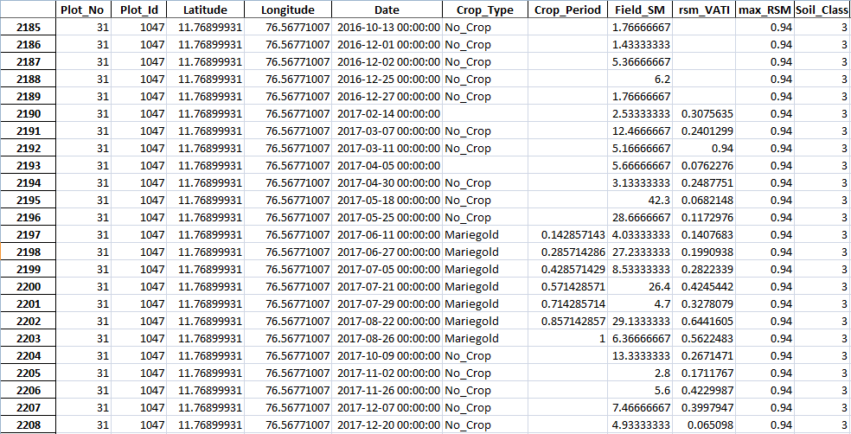
Snap of ML Excel Feed

Slide 20
Methodology - Machine Learning
Thus, the different features that can be used in machine learning are (i) crop type, (ii) crop period, (iii) maximum relative soil moisture, (iv) soil class.
We can separate learning problems in a few large categories:
supervised learning, in which the data comes with additional attributes that is to be predicted.
unsupervised learning, in which the training data consists of a set of input vectors x without any corresponding target values.
Here, our problem has name features and we want to classify them into classes. Thus, the nature of problem we have, falls into supervised learning and it is a classification problem.

Slide 21
Methodology - Machine Learning
Scikit-Learn is a famous machine learning module available in python programming language.
It features various classification, regression and clustering algorithms including support vector machines, random forests, gradient boosting, k-means and DBSCAN, and is designed to interoperate with the Python numerical and scientific libraries NumPy and SciPy.

Slide 22
Approach
Basically here, two types of problem are tried:
Finding Crop Type Class
In finding crop type class problem, the mandatory features are Relative Soil Moisture and Field Soil Moisture and the Crop Type is kept as ‘to be predicted’ feature. Thus, other features namely crop period, maximum relative soil moisture and soil class are kept as optional features, and hence they are fed into algorithms as combinations.
Finding Field Soil Moisture Class
In finding field soil moisture class problem, the mandatory feature is Relative Soil Moisture only and Field Soil Moisture is kept as ‘to be predicted’ feature. Thus, other features namely crop type, crop period, maximum relative soil moisture and soil class are kept as optional features, and hence they are fed into algorithms as combinations.

Slide 23


Slide 24
ML Classifiers
There are many classifiers available in scikit. But not all classifiers work in all the problem cases.
Hence, after analyzing with most of them, it is decided to use three ensemble classifiers which works well with our data.
They are basically ensemble classifiers – (i) Bagging classifier, (ii) ExtraTrees classifier, (iii) GradientBoosting classifier.

Slide 25
ML Classifiers
Bagging Classifier:
A Bagging classifier is an ensemble meta-estimator that fits base classifiers each on random subsets of the original dataset and then aggregate their individual predictions (either by voting or by averaging) to form a final prediction.
Extra-Trees Classifier:
This class implements a meta estimator that fits a number of randomized decision trees on various sub-samples of the dataset and use averaging to improve the predictive accuracy and control over-fitting.
GradientBoosting Classifier:
GB builds an additive model in a forward stage-wise fashion; it allows for the optimization of arbitrary differentiable loss functions. In each stage n_classes_ regression trees are fit on the negative gradient of the binomial or multinomial deviance loss function.

Slide 26
Approach
In all the two problems, 92 sites that fall on the Berambadi region of Gundlupet Taluk have been used for training the machine learning algorithms and 20 sites that fall in Vaddagare region of Koratagere Taluk have been kept as test datasets for testing purpose.
Pickle:
One awesome tool available in python is ‘pickle’. As soon as the classifier is trained with the training dataset, the classifier variable can be dumped into local storage for further use and hence reduces the computation time. The dumped file can be loaded again easily and can be used for prediction without the need for bringing ‘training datasets’ into picture.

Slide 27
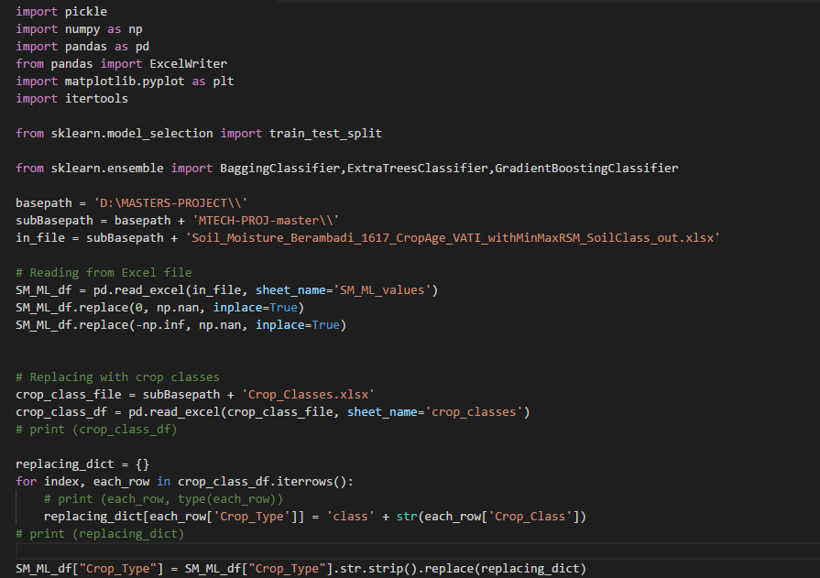
Code Snippet

Slide 28
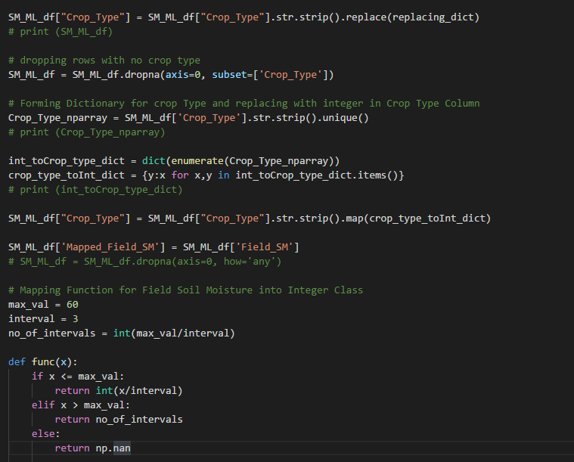
Code Snippet

Slide 29
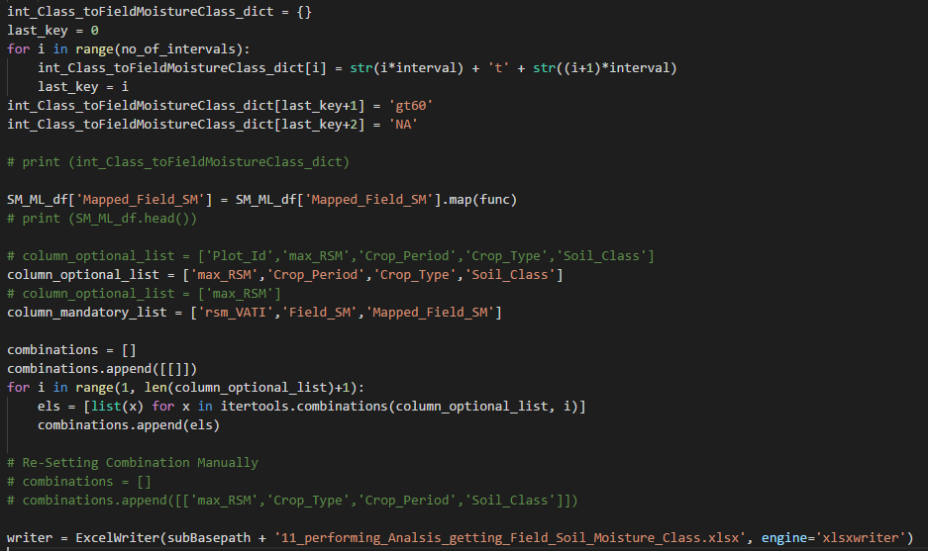
Code Snippet

Slide 30
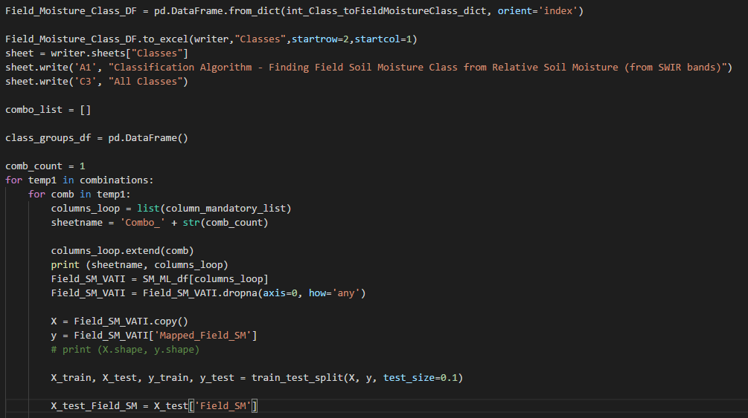
Code Snippet

Slide 31
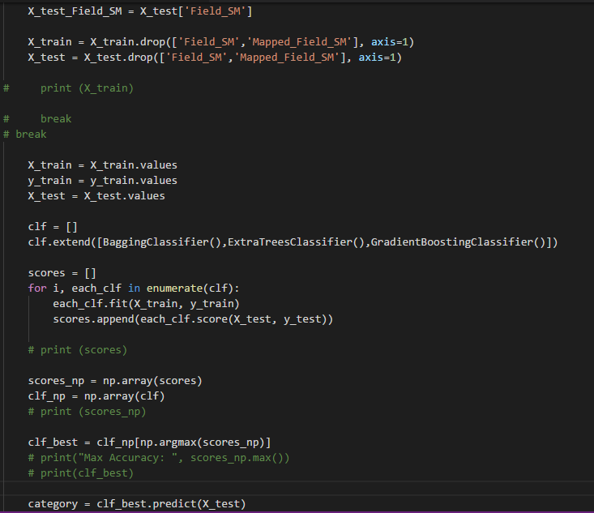
Code Snippet

Slide 32
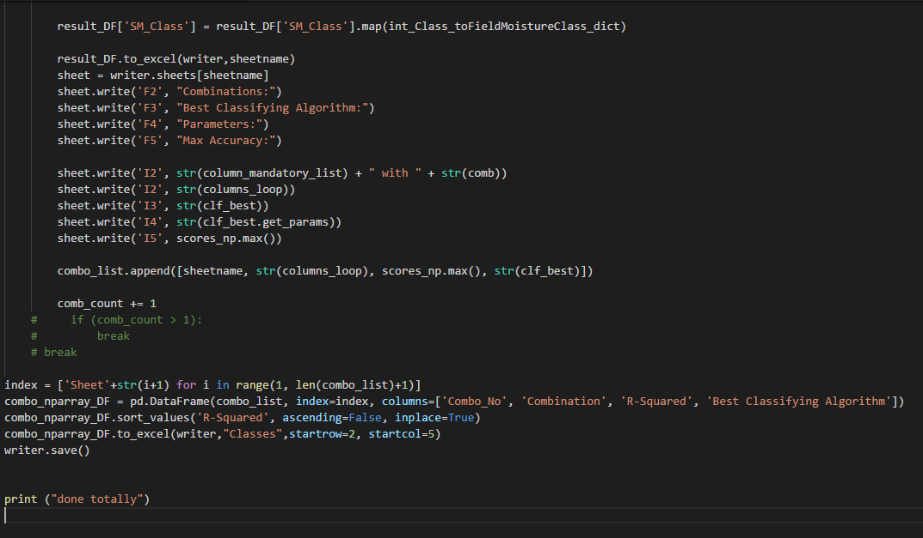
Code Snippet

Slide 33
Results and Discussions
The code is programmed in a way to automatically use the best classifier based on accuracy for each classifier.
And also, the best classifying algorithm for each combination is identified and sorted out as a table based on accuracy obtained from the test datasets.

Slide 34
Results and Discussions
Problem 1: Finding Crop Type Class
Combination | R-Squared | Best Classifying Algorithm
['rsm_VATI', 'Field_SM', 'Crop_Type', 'Crop_Period', 'Soil_Class'] | 0.565217 | ExtraTreesClassifier
['rsm_VATI', 'Field_SM', 'Crop_Type', 'max_RSM', 'Soil_Class'] | 0.486842 | GradientBoostingClassifier
['rsm_VATI', 'Field_SM', 'Crop_Type', 'max_RSM'] | 0.469799 | BaggingClassifier
['rsm_VATI', 'Field_SM', 'Crop_Type', 'Soil_Class'] | 0.447368 | GradientBoostingClassifier
['rsm_VATI', 'Field_SM', 'Crop_Type', 'max_RSM', 'Crop_Period', 'Soil_Class'] | 0.434783 | BaggingClassifier
['rsm_VATI', 'Field_SM', 'Crop_Type'] | 0.389262 | ExtraTreesClassifier
['rsm_VATI', 'Field_SM', 'Crop_Type', 'max_RSM', 'Crop_Period'] | 0.376471 | ExtraTreesClassifier
['rsm_VATI', 'Field_SM', 'Crop_Type', 'Crop_Period'] | 0.294118 | ExtraTreesClassifier
In this problem, the combinations column shows the features that has been used in performing the classification in machine learning. The features that helped classify this problem best are crop period and soil class. The best classifying algorithm that has been found out is ExtraTrees Classifier. It could seen that after using machine learning algorithms the R-squared value which was earlier less than 0.1 has been improved to more than or equal to 0.56.

Slide 35
Results and Discussions
Problem 2: Finding Field Soil Moisture Class
Combination | R-Squared | Best Classifying Algorithm
['rsm_VATI', 'Field_SM', 'max_RSM', 'Soil_Class'] | 0.381579 | BaggingClassifier
['rsm_VATI', 'Field_SM', | 0.369128 | BaggingClassifier
['rsm_VATI', 'Field_SM', 'Crop_Type', 'Soil_Class'] | 0.368421 | GradientBoostingClassifier
['rsm_VATI', 'Field_SM', 'Soil_Class'] | 0.355263 | BaggingClassifier
['rsm_VATI', 'Field_SM', 'max_RSM'] | 0.348993 | ExtraTreesClassifier
['rsm_VATI', 'Field_SM', 'Crop_Period', 'Soil_Class'] | 0.326087 | GradientBoostingClassifier
['rsm_VATI', 'Field_SM', 'Crop_Period', 'Crop_Type', 'Soil_Class'] | 0.326087 | GradientBoostingClassifier
In this problem, the combinations column shows the features that has been used in performing the classification in machine learning. The features that helped classify this problem best are maximum relative soil moisture and soil class. The best classifying algorithm that has been found out is Bagging Classifier. It could seen that after using machine learning algorithms the R-squared value which was earlier less than 0.1 has been improved to more than or equal to 0.38.

Slide 36
Conclusion
Thus we are able achieve good correlation between relative soil moisture and field soil moisture to a greater extent which did not make any sense before machine learning algorithms were applied even though we don’t have data of maximum saturation capacity of each site and the classifier could be used for prediction of future values of field moisture content from satellite data.
Using machine learning, we could extract many interesting features from the datasets rather than just correlating. Thus, problem 1 – identifying the crop type from the variances shown between relative soil moisture and field soil moisture.

Slide 37
References
H. McNairna,*, C. Duguayb, B. Briscoc, T.J. Pultza (2002). The effect of soil and crop residue characteristics on polarimetric radar response. Remote Sensing of Environment, Volume 80, Issue 2, Pages 308-320.
Jun Wen, Zhongbo Su (2003). A time series based method for estimating relative soil moisture with ERS wind scatterometer data. Geophysical Research Letters, Volume 30, Issue 7.
B.J. Choudury, T.J. Schmugge, R.W. Newton and A.Chang (1978). Effect of Surface Roughness on the Microwave Emission from Soils. Journal of Geophysical Research, Volume 84, Issue C9, Pages 5699–5706
J.R. Wang, P.E. O'Neill, T.J. Jackson, E.T. Engman (1982). A Multi-Frequency Measurement of Thermal Microwave Emission From Soils: The Effects of Soil Texture and Surface Roughness. International Geoscience and Remote Sensing Symposium, Munich.
L. Breiman, “Pasting small votes for classification in large databases and on-line”, Machine Learning, 36(1), 85-103, 1999.
L. Breiman, “Bagging predictors”, Machine Learning, 24(2), 123-140, 1996.
T. Ho, “The random subspace method for constructing decision forests”, Pattern Analysis and Machine Intelligence, 20(8), 832-844, 1998.
G. Louppe and P. Geurts, “Ensembles on Random Patches”, Machine Learning and Knowledge Discovery in Databases, 346-361, 2012.
P. Geurts, D. Ernst., and L. Wehenkel, “Extremely randomized trees”, Machine Learning, 63(1), 3-42, 2006.
J. Friedman, Greedy Function Approximation: A Gradient Boosting Machine, The Annals of Statistics, Vol. 29, No. 5, 2001.
Friedman, Stochastic Gradient Boosting, 1999
T. Hastie, R. Tibshirani and J. Friedman. Elements of Statistical Learning Ed. 2, Springer, 2009.

Slide 38
Future Scope of Study
Though we have compared values corresponding to GPS coordinates accurately, still the field moisture datasets which we used are points and the relative soil moisture is averaged over a larger grid. An attempt can be made to cluster two or more field moisture data points that lie in a single grid as an average or some mapping can be done and check if the accuracy is improving. More accuracy could be obtained if the resolution of the satellite products is improved.
Still the problem can be better understood using deep learning algorithms (a subset of machine learning tools) using ANN (Artificial Neural Networks), TensorFlow is one such tool which is an open-source machine learning ANN framework and will help achieve it in a better way.

