Slide 1
Covex, LLC
Requirements

Slide 2
Definitions
Requirement
Any need or expectation for a system or it’s software
Specification
A document that states requirements (a collection thereof)

Slide 3
User Reqs → Functional Reqs → Tech Specs
User Requirements define WHAT the user wants the system to do
Functional Requirements focus on WHAT the system should do to satisfy the User Requirements
Designs provide the technical details of HOW the developer will BUILD the system functionality that achieves the requirements’ goal.

Slide 4
When to define requirements?
Often before the decision to buy/build
Often before the final vendor selection is made (for buy decisions)
Remember the SDLC?

Slide 5
Transforming (User/Business) Requirements to Specifications
Depends on the initial intent of the requirements
Depends on the value of the individual requirements (weighting)
Depends on the expertise of the specification writer
Depends on the governing rules of validation (your SOPs)

Slide 6
CSV Guidance on Requirements (Product focused)
All inputs & outputs
All necessary and desired functions
All performance requirements (e.g., data throughput, reliability, and response times)
All external and user interfaces, & internal software-to-system interfaces
Error identification & handling as well as data ranges, limits, defaults, and specific values
The intended operating environment for the software
All safety related requirements

Slide 7
Sample Contents - URS
Typical good business documents stuff
Table of Contents
Purpose / Scope
Project Goals / Background
Document controls / Revision history
Approvals
Glossary
Appropriate References & Attachments

Slide 8
Sample Contents - URS (typical – not a rule for everyone!)
User Access & Roles
Specific Application Requirements (group by function)
Specific System Requirements (infrastructure/environment)
Regulatory Requirements
Input/Output/Interface Requirements

Slide 9
Good Requirements:
Assure correct system functionality
Support robust Technical Specifications
Reduce re-work
Facilitate better testing
Support strong traceability
Reduce project time / cost
Are good business

Slide 10
Requirements Development Process
Translates user needs and expectations into a comprehensive set of “SMART” requirements
Requires both business and technical expertise
Often an iterative process

Slide 11
Format
A good rule of thumb is to begin a requirement with the words,
“The system shall...”
Creates uniformity
Invokes the positive condition
Example: “The system shall display all GMP data in blue, bolded, 20 point Ariel font.”

Slide 12
SMART Requirements
Specific (Clear / Unambiguous / Precise)
Measureable (Verifiable / Testable)
Attainable (Achievable / Actionable)
Relevant ( Meaningful / Coherent)
Traceable (Testable/Time-bound)

Slide 13
Specific / Unambiguous / Precise
“The screen will display GMP-related information”
Not Specific
“The system shall display the following GMP-related information in blue, bolded, 12 point Ariel font at the top of each page:
Study ID
Product Code
Lot Number
Expiration Date”

Slide 14
Measureable / Verifiable / Testable
“The system availability will be achieved soon after the nightly cycle is completed.”
Not Measureable
Not Specific
“The system shall be available to users after nightly cycle completion before 2:00 AM ET daily”

Slide 15
Attainable / Achievable / Actionable
“The system shall never lose data.”
Not Attainable
“The system shall provide daily backup.”

Slide 16
Relevant / Meaningful / Coherent
“Prescribing data will be properly displayed”
Not Relevant
Not Measureable
“The system shall display prescribing data without truncation.”

Slide 17
Traceable/Testable/Time-bound
“The system will display product dosing information.”
not Time-bound
“The system shall retrieve and display product-related dosing information in real time from the secure product master database.”

Slide 18
User Access & Roles
Will the system need provide varying levels of access? (Regular user, super user, administrator, custom groups)
Will the system provide various means of access (local, server, web)?
Will the system provide appropriate security (should it be open or closed?)

Slide 19
User Access & Roles - Examples
“The system shall provide the ability to enforce security through a unique logon ID and password.”
“The system shall provide the ability to assign permissions based upon User ID or role.”

Slide 20
Specific Application Requirements
The largest and most system specific section
Common components may include:
Look and feel requirements
Specific data capture, storage and manipulation
Reporting

Slide 21
Specific Application Requirements - Examples
“The system shall provide an interface for HR to run training reports for trending and compliance.”
“The system shall provide the ability to capture changes to trainee job titles or roles, along with a date of change.”

Slide 22
Regulatory Requirements
Does Part 11 Apply?
Specific section for Part 11 requirements including:
Electronic Signatures
Access Controls
Audit Trail
Training/Qualifications of Developers
Control of Records (retention rules)

Slide 23
Regulatory Requirements - Examples
“The system shall prompt the user prior to executing an electronic signature that this action is equivalent to a legally binding signature. “
“The system shall provide the ability to include the date and time, user name, reason for change, and event in the audit trail entry. “

Slide 24
Input/Output/Interface Requirements
Will the system need to receive information from other system(s)?
Will the system need to feed information to other system(s)?
What interfaces with other hardware or systems may be required?
Will your company “own” the system or will it be “hosted”?

Slide 25
Input/Output/Interface Requirements
Examples:
“The system shall be compatible with existing email clients (both Lotus Notes and MS Outlook).”
“The system shall provide the ability to import data from common file types such as Excel or .csv.”
“The system shall be compatible with the existing IT infrastructure and not require additional system hardware.”

Slide 26
Other Tips & Tricks
Numbering Requirements
Makes traceability easier
Weighting Requirements
Helps separate the must haves from the nice to haves
Ensure they are OBJECTIVELY VERIFIABLE
Ensure there are NO conflicting requirements

Slide 27
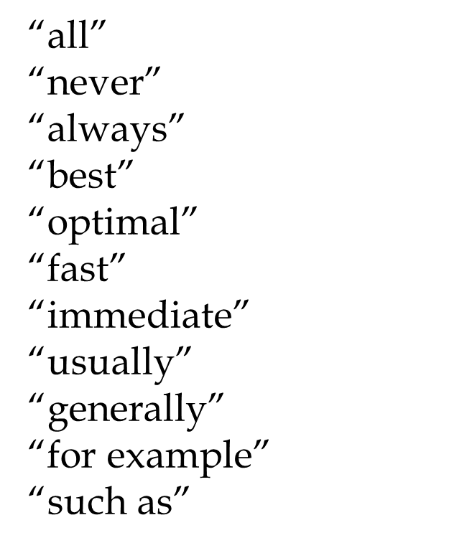
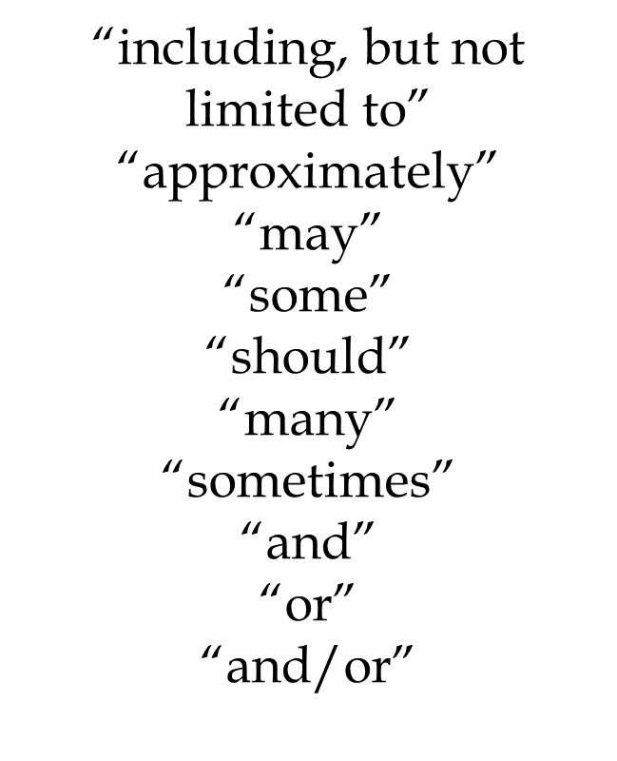
Words to Avoid

Slide 28
Other Requirements Types
Depends on the Type of System
COTS may be URS only (rest are vendor proprietary)
Configurable & Custom will have more – ownership is variable
Actual types will have varying detail and naming conventions (next slide)

Slide 29
Other Requirements/Specifications
Functional Requirements Specification (Detail Requirements)
Design Requirements Specification / Technical Requirements Specification
Configuration Requirements Specification
Coding Requirements Specification
Not an inclusive/exclusive list!

Slide 30
Functional/Detail Requirements
May be incorporated into URS depending on size and complexity of system
URS – what do you need it to do
Functional Spec – how will it do it for you?
Needs to trace back to URS

Slide 31
Design Specification
How does this become reality?
Architecture
Look and Feel - Prototyping
Traceability to Business/User Requirements
Listed in the CSV due to product related practices
System Architect level

Slide 32
Configuration Specification
Class 4 Systems
Identifies what must be configured and how
(When the configuration changes the behavior of the system)
Example – custom workflows

Slide 33
Coding Requirements Specs
Coding Language(s)
Industry / company standards
Rules for naming conventions & commenting
Use of external or custom objects
Error handling, value verification, etc
What to code (pseudocode)

Slide 34
Examples
URS: Training system shall record the date training was completed. The completion date should be visible to the trainee’s manager.
FS: When the trainee completes an online course, the system shall record the current date in the training record and display as dd-mon-yyyy.

Slide 35
Examples
FS: When a trainer creates a training record, the system shall record the course completion date in the training record.
FS: The trainee record for all personnel shall include a supervisor value.
FS: Persons designated as supervisors may view training records for their direct reports.

Slide 36
Examples
DS: The system shall provide an interface to the HR system to record reporting status. It shall synchronize reporting status in HR system with that of the training system at configured intervals.
DS: The system shall enforce date integrity rules by utilizing the system date of the training server.

Slide 37
Examples
CS: When the save is initiated by the trainee, verify the online completion flag is set to true, then retrieve the training system date and write it to the training record, else send warning message indicating incomplete course cannot be saved.

Slide 38
Key Points to Remember
Without requirements there is NO VALIDATION
The worth of the system and the validation are directly determined by the quality of the requirements
Requirements need to be objectively verifiable

Slide 39
Key Points to Remember
Requirements should be incorporated into Specifications (signed, approved, version controlled documents)
Qualified personnel should prepare these specifications
The number and type of specifications is almost always a factor of the system class

Slide 40
Key Points to Remember
Requirements should tie together, e.g. be traceable across specifications
The specifications need to exist PRIOR to the development of the system
It’s a good idea to have them prior to the selection/purchase too!

Slide 41

Questions?
COVEX, LLC

Slide 42
EXERCISE
Develop a set of user requirements for SharePoint
Consider the following criteria:
Data Storage/Retention
Access control / Security
Audit History
Creation, Modification, Deletion of Files

