Slide 1







<Stack Overflow Developer Survey Analysis>
<Rupanjal Dasgupta>
<July, 28, 2022>

Slide 2



OUTLINE
Executive Summary
Introduction
Methodology
Results
Visualization – Charts
Dashboard
Discussion
Findings & Implications
Conclusion
Appendix

Slide 3

EXECUTIVE SUMMARY
Current Technology Usage Trend
Language used
Database used
Platform used
Web frame used
Future Technology Trend
Language desired
Database desired
Platform desired
Web frame desired
Demographics
Respondent classified by gender
Respondent count for countries
Respondent count by age
Respondent count by gender and classified by education level

Slide 4

INTRODUCTION
Analyze trends in software / web development technology
Find top 10 in demand programming languages, databases and web-frames along with trendy platforms
Identify gap between number of male / female respondents and education level of those respondents
Identify countries where most respondents live
Analyze age of respondents
Audience:
Computer Science / IT students and programmers
Leaders in IT industry

Slide 5

METHODOLOGY
Data Collection
Stack Overflow Developer Survey
Data Wrangling / Cleaning
Remove duplicate rows / handle null values
Exploratory Data Analysis
Descriptive statistics etc.
Data Visualization
Presentation

Slide 6
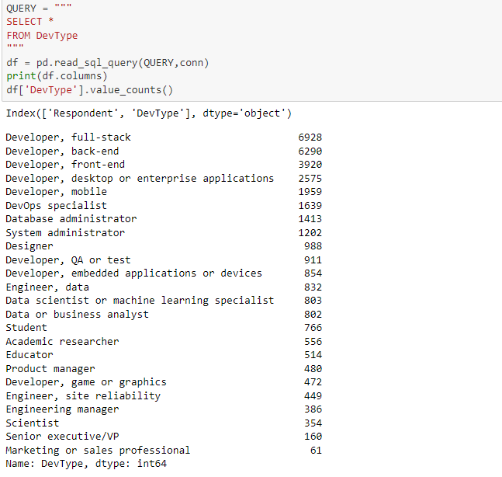
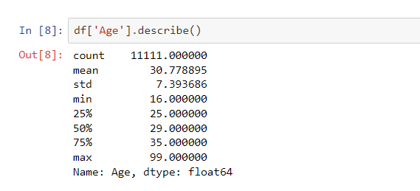
RESULTS
Notes:
Minimum age among 11111 respondents is 16 while maximum age is 99 and median age is 29.
Majority of survey responders are full-stack developers followed by Back-end and Front-end.

Slide 7
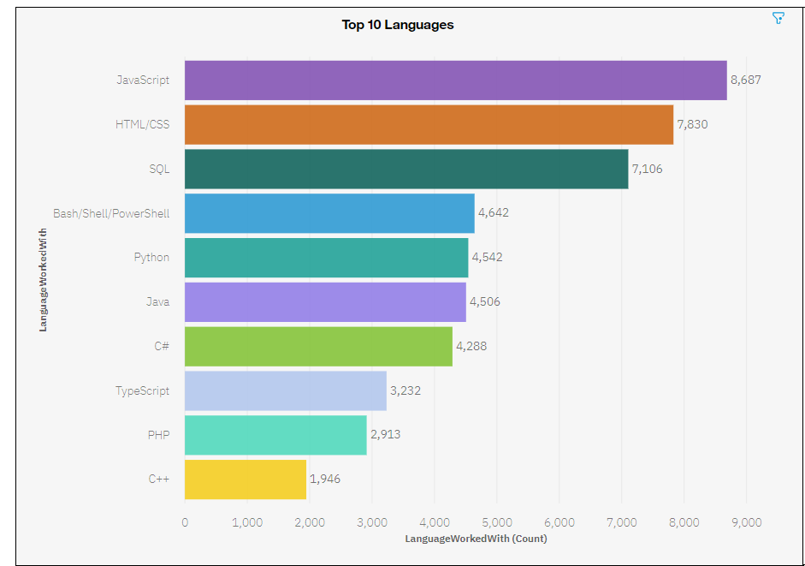
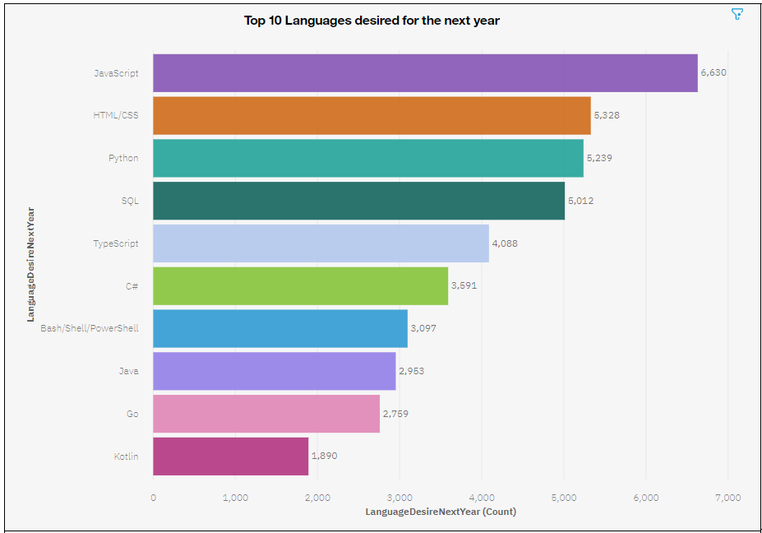
PROGRAMMING LANGUAGE TRENDS
Current Year
Next Year

Slide 8
PROGRAMMING LANGUAGE TRENDS - FINDINGS & IMPLICATIONS
Implications
Web Development is still in demand
New languages like Go and Kotlin need to be learned.
Need to be adaptive to change as popularity of languages change with new languages emerging.
Findings
For current year, JavaScript is mostly used programming language followed by HTML / CSS in 2nd and SQL in 3rd used language.
This is a little different from languages desired next year as here Python is 3rd most desired with SQL being fourth
There are new languages like Go and Kotlin coming up in top 10 desired language list while PHP and C++ seem to be losing popularity.

Slide 9
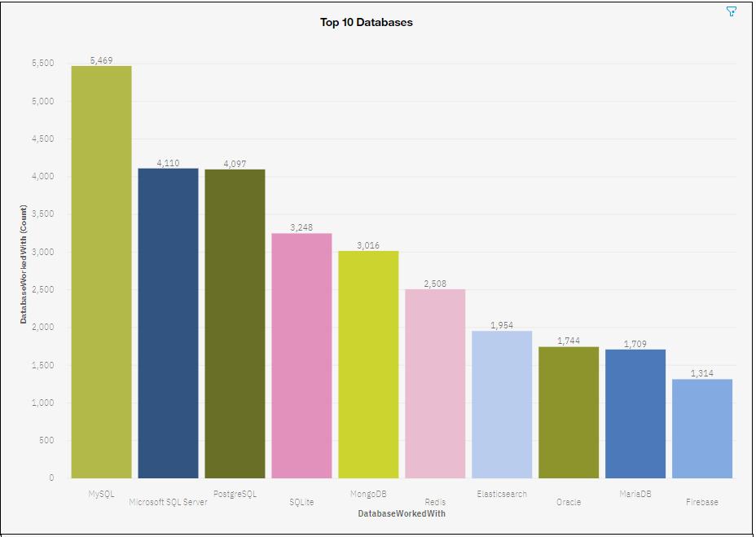
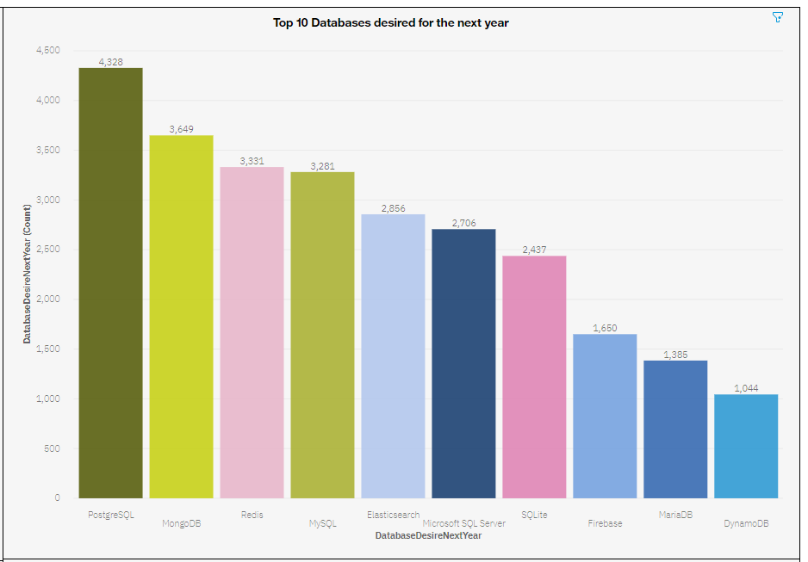
DATABASE TRENDS
Current Year
Next Year

Slide 10
DATABASE TRENDS - FINDINGS & IMPLICATIONS
Findings
Currently, MySQL is most used database followed by Microsoft SQL Server and PostgreSQL
This is different from databases desired next year as PostgreSQL is most desired language followed by MongoDB and Redis.
DynamoDB is emerging as new database in top 10 while Oracle seems to be losing popularity.
Implications
Apart from Oracle, the other currently used databases in top 10 are still relevant with changing popularity.
DynamoDB needs to be learned due to increase in demand.
NoSQL databases are increasingly gaining popularity.

Slide 11

DASHBOARD
https://dataplatform.cloud.ibm.com/dashboards/01246807-aee6-42d7-a9ef-167127f467b6/view/6504e128798e35d574b2f6e4079b2b527537240fb2bb835784d37b495b362297f3681590c82b430ed2195431f5e81b50cb

Slide 12
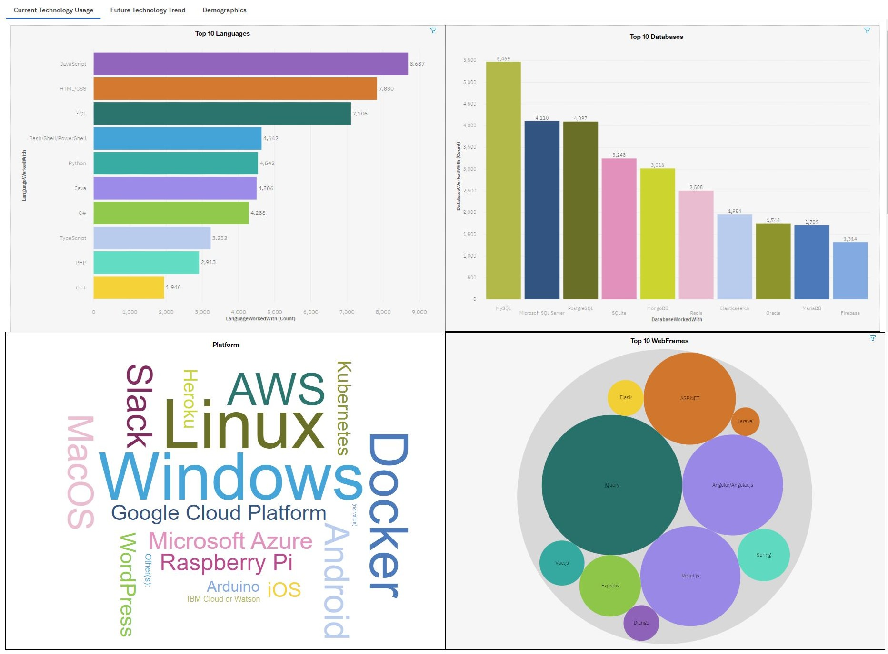
DASHBOARD TAB 1

Slide 13
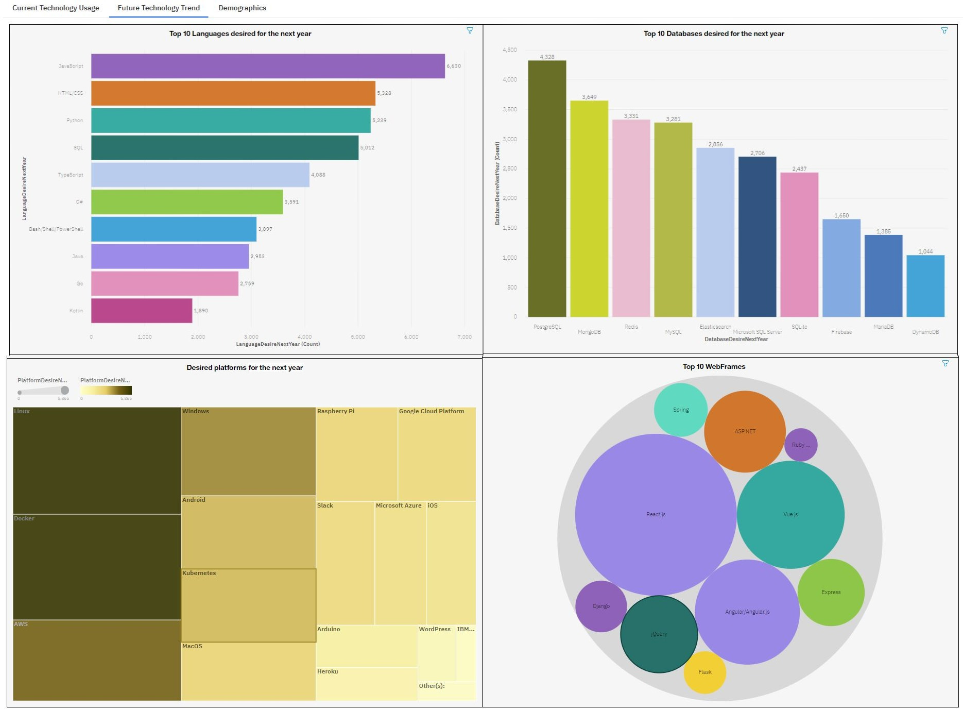
DASHBOARD TAB 2

Slide 14
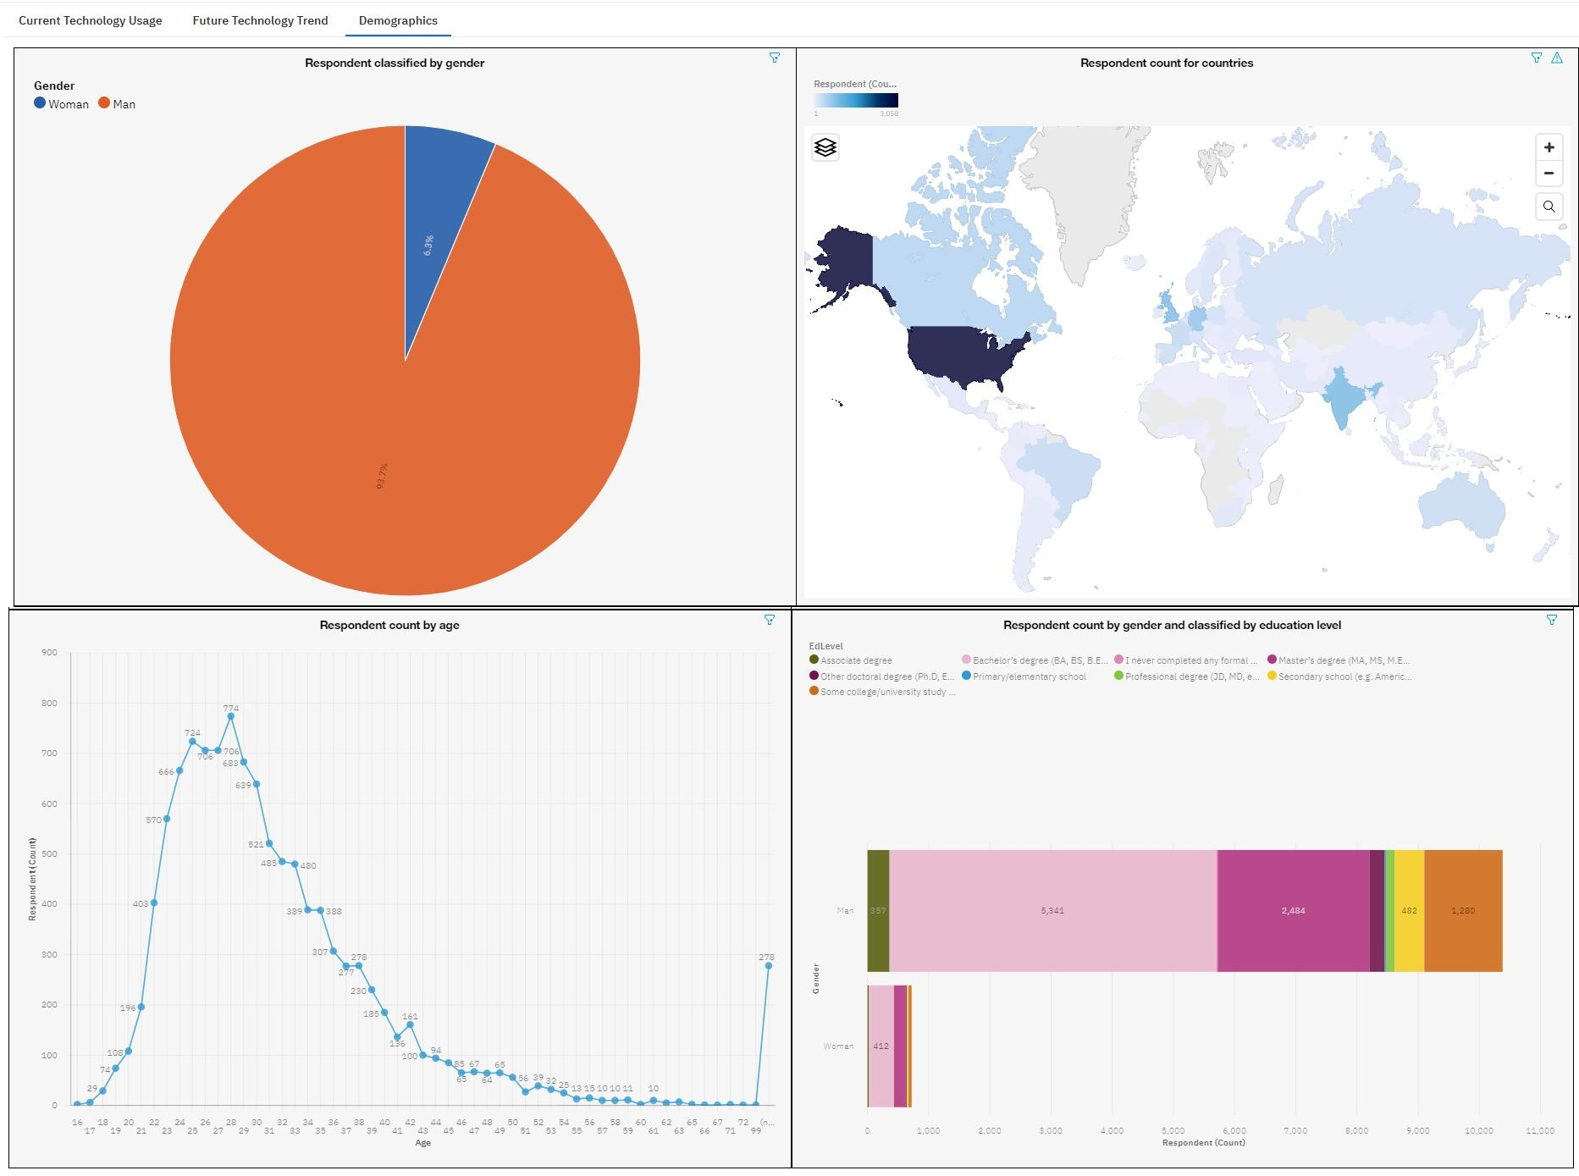
DASHBOARD TAB 3

Slide 15
DISCUSSION
Trend in current / future technology usage and the emergence of new technology.
Discrimination in IT industry related to gender, age and education level.

Slide 16
OVERALL FINDINGS & IMPLICATIONS
Findings
Trends in technology change each year
Gender and age related discrimination still exists.
Most of the survey respondents are from USA.
Implications
On-demand technology trends should be followed which means programmers have to be adaptive to change.
There must be equality in workplace with regards to gender, age and education level.
More countries should have access to new technology.

Slide 17

CONCLUSION
Technology related language, database and platform etc. trends changing each year.
Trends in demography hinting at discrimination.

Slide 18
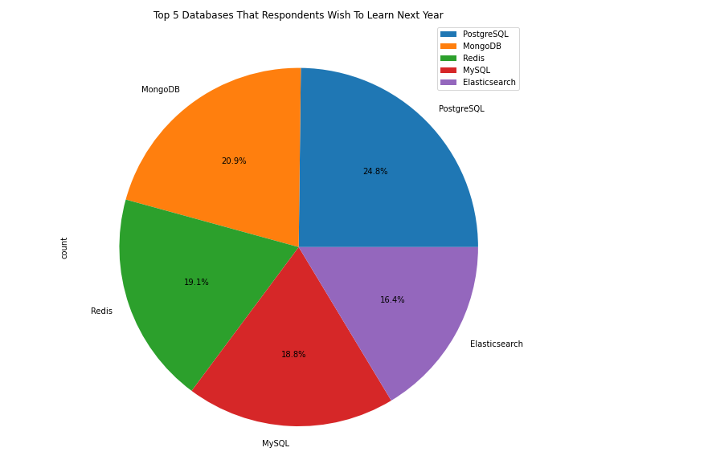
APPENDIX
Data Sources:
https://cf-courses-data.s3.us.cloud-object-storage.appdomain.cloud/IBM-DA0321EN-SkillsNetwork/LargeData/m5_survey_data_demographics.csv?utm_medium=Exinfluencer&amp;utm_source=Exinfluencer&amp;utm_content=000026UJ&amp;utm_term=10006555&amp;utm_id=NA-SkillsNetwork-Channel-SkillsNetworkCoursesIBMDA0321ENSkillsNetwork21426264-2022-01-01
https://cf-courses-data.s3.us.cloud-object-storage.appdomain.cloud/IBM-DA0321EN-SkillsNetwork/LargeData/m5_survey_data_technologies_normalised.csv?utm_medium=Exinfluencer&amp;utm_source=Exinfluencer&amp;utm_content=000026UJ&amp;utm_term=10006555&amp;utm_id=NA-SkillsNetwork-Channel-SkillsNetworkCoursesIBMDA0321ENSkillsNetwork21426264-2022-01-01

Slide 19
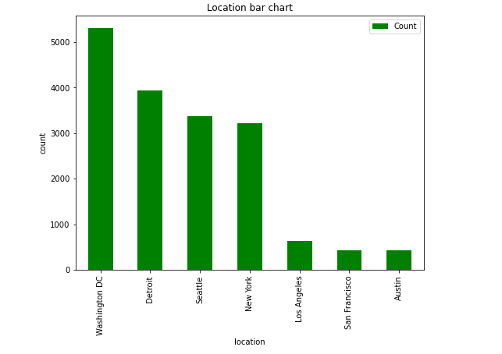
JOB POSTINGS
Notes:
Most job postings are in Washington DC followed by Detroit & Seattle.

Slide 20
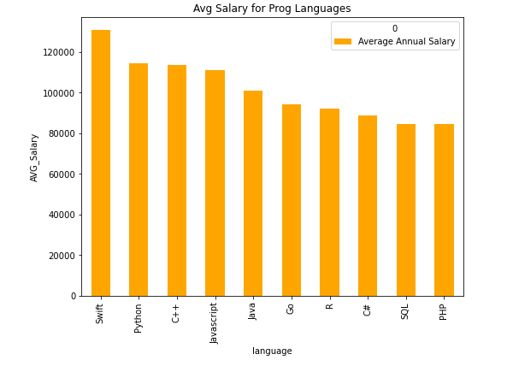
POPULAR LANGUAGES
Notes:
Swift developers have highest average salary followed by Python and C++.

