Slide 1
Vector Quantized Variational Autoencoder for Defect Detection in Products
Presented by- Rupin Gore (24MAS10020)
Aliakbar Poonawalla (24MAS10021)
Prajeet Desai (24MAS10022)
Siddhant Verma (24MAS10034)

Slide 2
Introduction
Defect detection is crucial in manufacturing for quality control.
Traditional methods rely on manual inspection or basic image processing.
Goal: Develop an automated, data-driven defect detection system.

Slide 3
Problem Statement
Manual inspection is time-consuming and prone to error.
Conventional image-based methods struggle with complex surfaces and subtle defects.
Need for a robust, unsupervised approach that detects anomalies without labeled data.

Slide 4
Why VQ-VAE?
Combines Variational Autoencoder (VAE) with Vector Quantization (VQ).
Key advantages:
Learns compact latent representations.
Captures discrete features in data.
Suitable for anomaly detection by reconstructing normal patterns.

Slide 5
Data Preparation
Dataset: Images of products with both normal and defective samples.
Preprocessing: Resizing, normalization, and augmentation.
Training on normal samples only — defects detected as anomalies.

Slide 6
Training Process
Trained model to reconstruct normal images.
Anomalies detected when reconstruction error exceeds threshold.
Hyperparameters tuned: learning rate, batch size, codebook size.

Slide 7
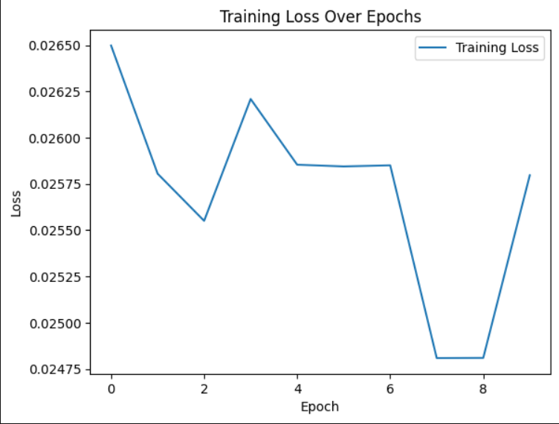

Slide 8
Results
Side-by-side visuals:
Original (Normal) → Reconstruction
Original (Defective) → Failed Reconstruction
Defective areas show high reconstruction error.

Slide 9
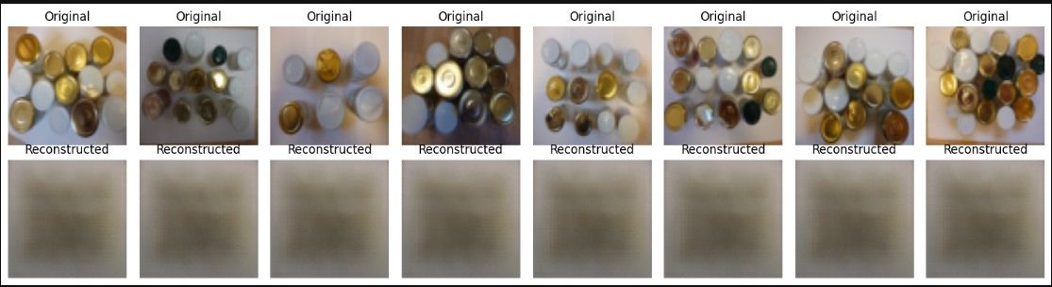

Slide 10
Performance Metrics
Reconstruction Loss: Shows low error for normal images, high error for defective ones.
Precision, Recall, F1-Score: Quantifies detection accuracy.
Heatmap Visualization: Highlights defect regions.

Slide 11
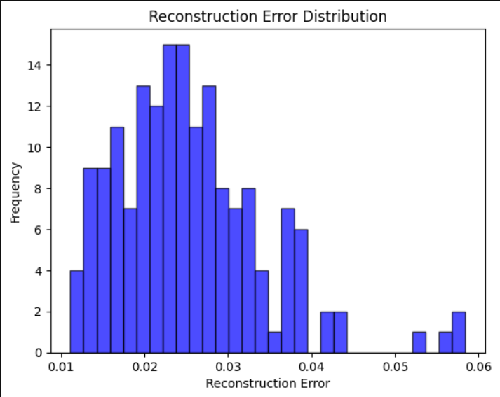

Slide 12
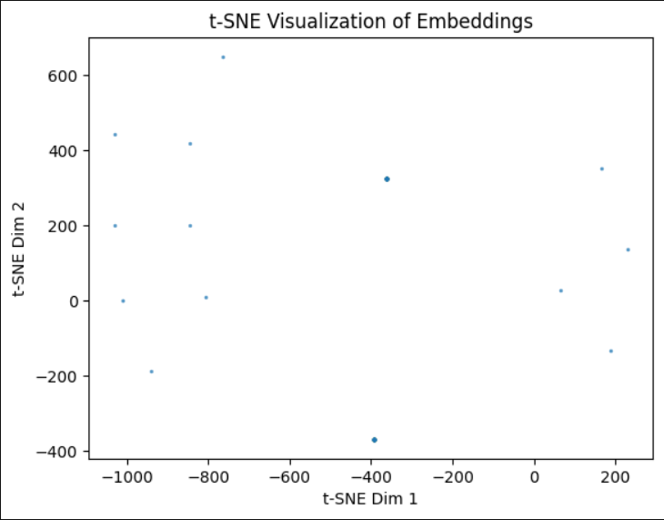

Slide 13
Thank You

