Slide 1
Honors Credit
DDR in assembly
Spring 2024
Rupin Raj Kumar Pradeep

Slide 2
Table of Contents
Project Overview
Specifications
Block Diagram
Functionality Diagram
BOM
Schematic
Results/Outcomes
Possible Improvements

Slide 3
Project Overview
Honors Experience Correlation
Create the popular old rhythm game Dance Dance Revolution in assembly
Include console animation using Putty
Play music during game play
Create a dance pad as input to the game
Creating Dance Dance Revolution in assembly is a culmination of the three classes I currently TA for under my teacher advisor: CSE 241 Digital Systems, CSE 341 Computer Organization, and CSE 379 Microprocessors
CSE 241: The hardware implementation of the dance pad used potentiometers for variable resistance increasing precision of the Analog-to-Digital Converter
CSE 341: Basic organization of assembly code
CSE 379: Experience creating a game in assembly and animating using the Putty serial console

Slide 4
Specifications
Software:
Code Composer Studio - Uploading code to the Tiva C Series TM4C123GH6PM
Arduino - Input processing to play the selected song
Processing - Communication from Arduino to the PC for playing music
Putty - Display the console output of the game at specific settings
Constraints:
The beatmap file must be read at the very beginning of the program and must be small
Arduino and Processing are necessary to play music as Stellaris has no 64 bit drivers

Slide 5
Block Diagram
Computer Audio Ports
Parallel Communication over wires
Keyboard
UART
Arduino
Processing
TIVA C SERIES
ADC
Serial Communication over COM port
UART
Putty
Dance Pad

Slide 6
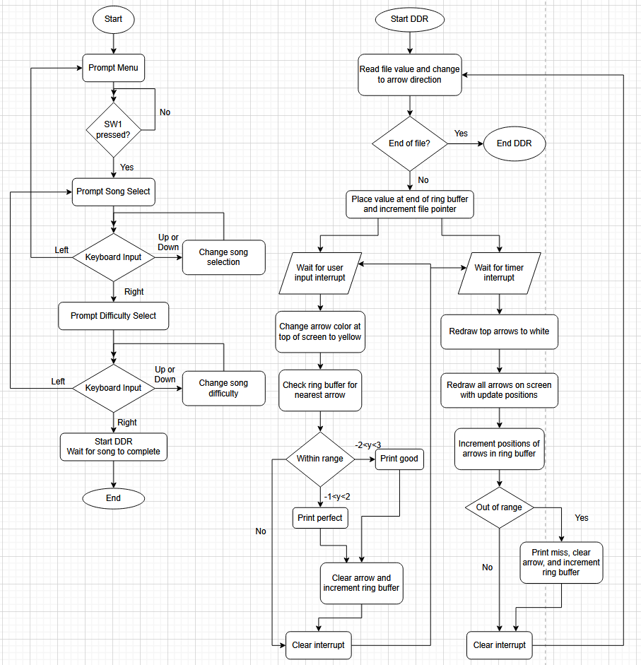
Functionality FlowChart
The game starts with a menu prompt
expecting Switch 1 on the TIVA as input
Then WASD is used to change song,
difficulty, start, or back
Once DDR starts, it mainly waits for
two interrupts, the timer for the game
loop and the user input
User input clears applicable arrows and
prints “good” or “perfect”
Timer is used to move the arrows up the
screen and generate “miss” when arrows
are missed
The song beatmap ends on a * in the file

Slide 7
Bill of Materials
Just the game:
TIVA C Series TM4C123GH6PM
Arduino (preferably UNO)
4 male-to-male or 4 female-to-male wires
One Arduino to PC cable (Arduino USB to USB A)
One Tiva to PC Cable (Micro USB to USB A with data transfer capability)
Additional materials for the dance pad
EVA foam 5ft. x 2ft. thick Cut this and the one below into 1ft x 1ft squares
EVA foam 5ft. x 2ft. thin
4 potentiometers
4 pieces of velostat
Lots of male-to-male wires that will be long enough to connect the dance pad and the Tiva
5 male-to-female wires, 1 GND and the rest are for inputs to pins D0 to D3

Slide 8
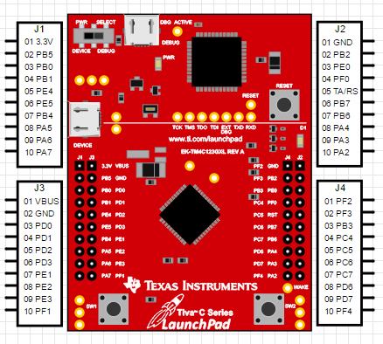
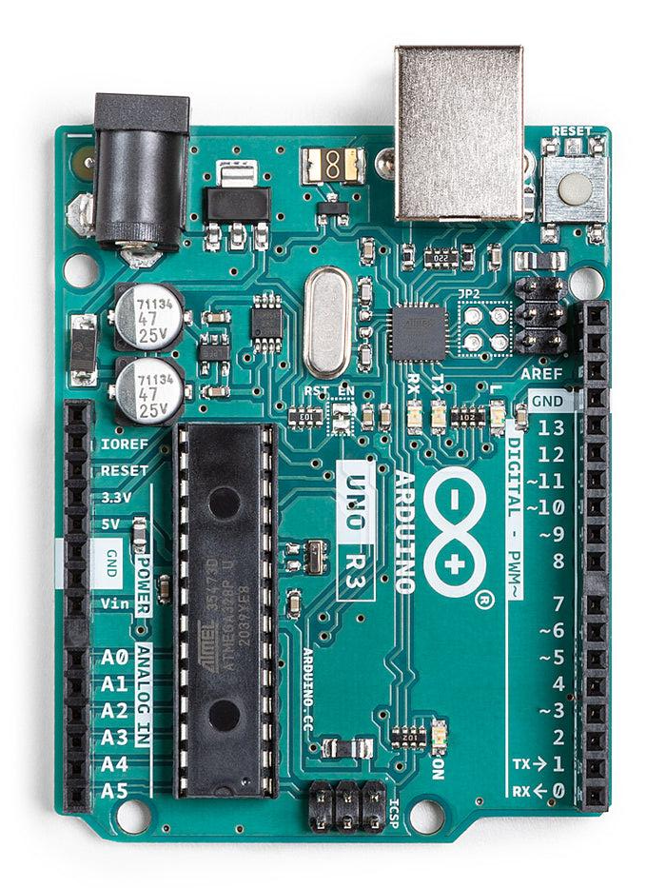
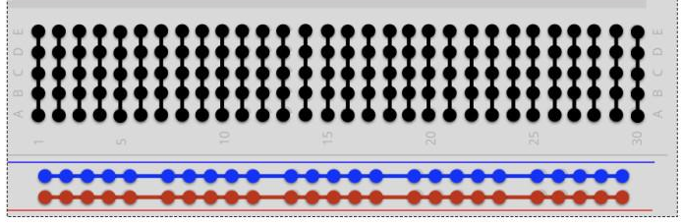
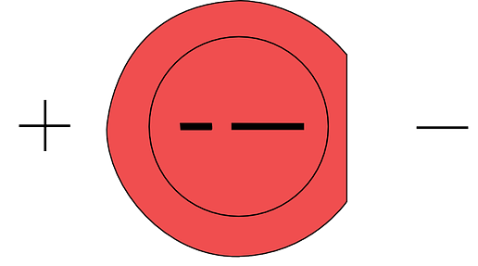
Schematic
Copper tape on different layers (differentiated by color)
Computer
Key: U = Up, D = Down, L = Left,
R = Right, 0 = VCC, 1 = user input
L0
A
C
U0
L1
L0
D1
D0
R0
R1
U1
B
U0
D
R0
D
D0
C
B
A
Pot
Pot
Pot
Pot
L1
R1
U1
D1

Slide 9
Possible Improvements
Using a C library for graphics and a GUI other than console
Better use of velostat for making the dance pad sensors
Using images instead of hardcoded values for each piece of art
Finish more beatmaps
Remove random printing glitches

Slide 10
Links
Github Link: https://github.com/rupin-r/TivaCDownDownRight/tree/main
TIVA documentation: https://cse.buffalo.edu/~kds/cse-410/Docs/tm4c123gh6pm.pdf
Processing download: https://processing.org/download
Arduino download: https://www.arduino.cc/en/software
Code Composer Studio download: https://www.ti.com/tool/CCSTUDIO
Putty download: https://www.putty.org/

