Slide 1
Blood Bank Management System “BBMS”
-Jagmohan Prasad Majhi (373271)
-Kunal Bhattarai (373272)
-Rahila Eram (373275)
-Rupesh Choudhary (373276)
-Saugat Kunwar (373277)
-Sweaksha Jha (373280)

Slide 2
Table of Contents
Introduction to BBMS
Objectives of this Project
Figure
Cost Estimation
Software and Technology Used
Hardware Requirements
Features
Project Screenshots
Scope
Limitations
Conclusion
Future Enhancements

Slide 3
Introduction to BBMS
The Blood Bank Management System (BBMS) refers to the system and processes to manage the stock of blood with the involvement of technology.
This system can be used to store the details of the team members, blood requests and blood available, and update the inventory based on the transactions to tell the staffs and donors when it`s time to donate and collect.

Slide 4
Objectives of this Project
To develop web application that deals with blood management for everyone
To provide detailed information about the stock
To make the stock manageable
To handle the blood quantity
To automate and optimize blood bank operations, ensuring efficient utilization of blood resources and timely response to blood requests.

Slide 5
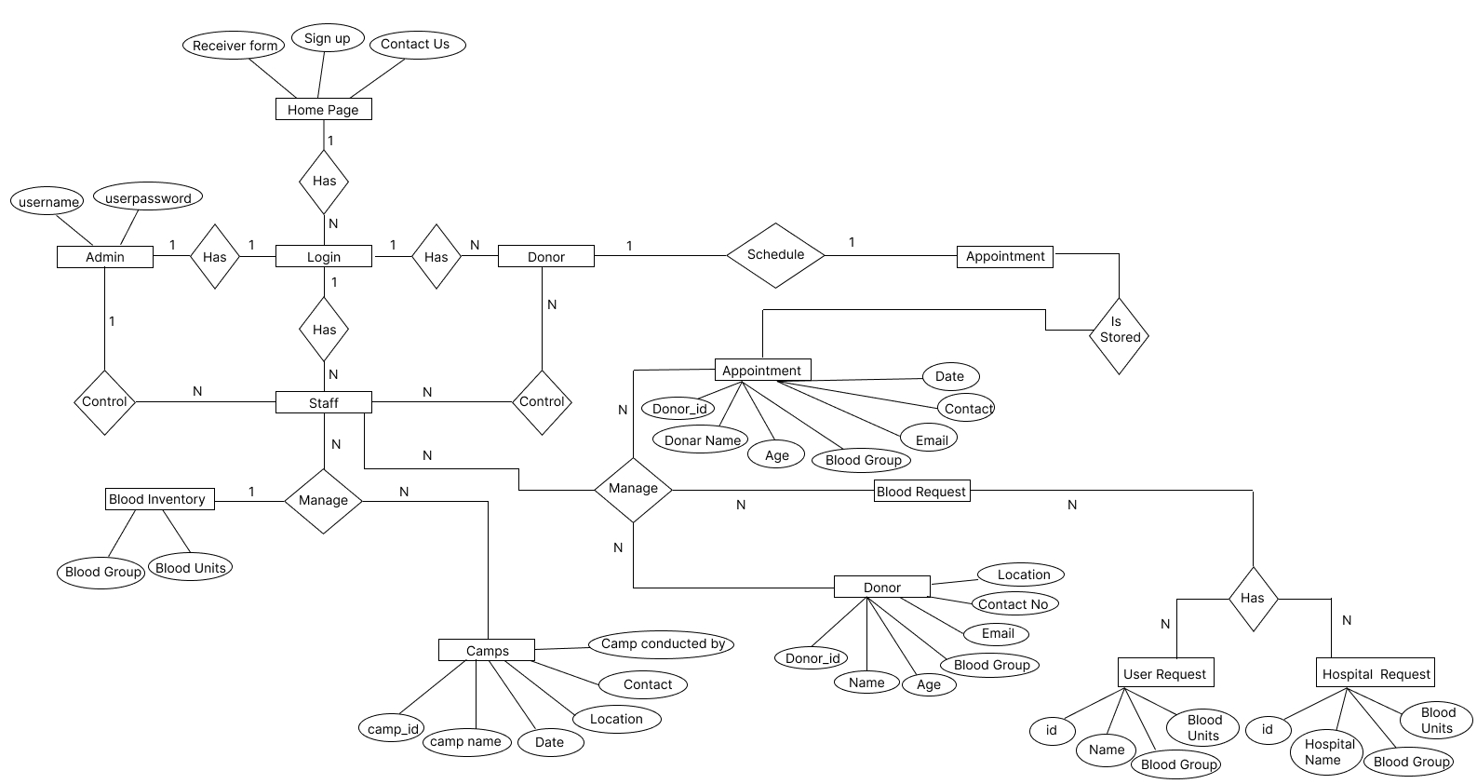
ER Diagram

Slide 6
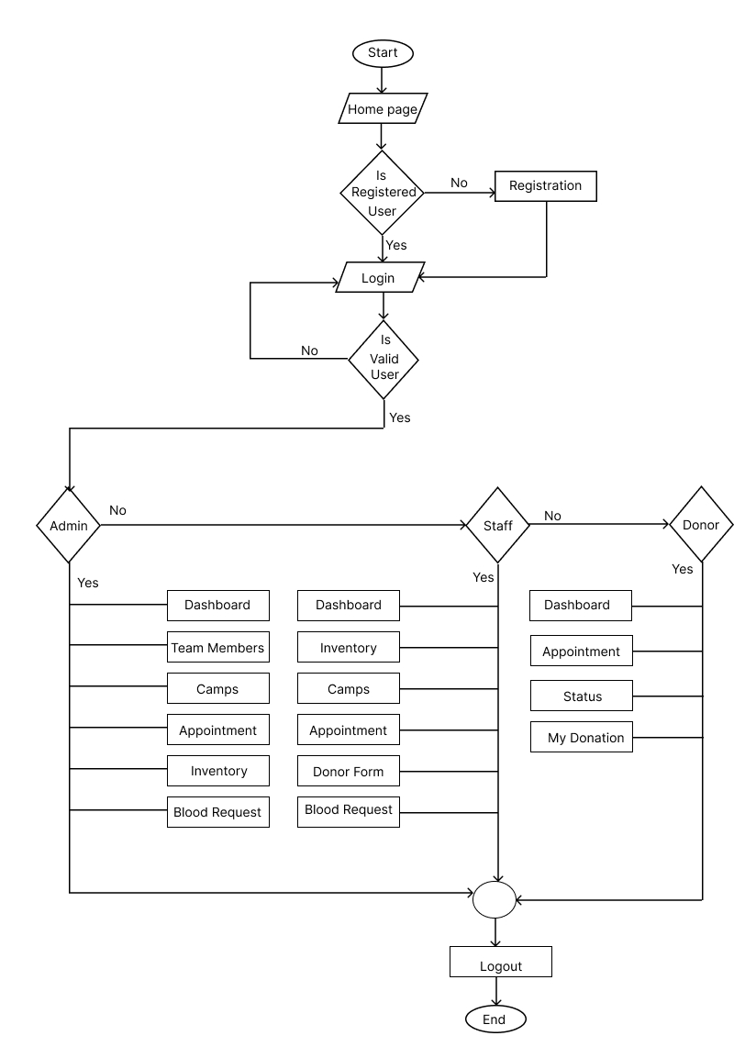
Flow Chart

Slide 7
Cost Estimation
To know the idea of coding and designing many references were taken
Compiling and filtering was costlier
For group decision, meeting was done
In case of searching codes and plugins from internet
This project mainly uses free and open-sources tools, and there won’t be a need for any additional funds outside sources.

Slide 8
Software and Technology Used
Web Server (Apache)
PHP 8.x or later – MySQL 5.x or later
HTML5, CSS3
Code Editor (Visual Studio Code)
Web Browser (Chrome, Firefox, Brave, etc.)

Slide 9
Hardware Requirements
Computer with sufficient processing power and memory for development
Networking devices with good internet speed

Slide 10
Features
Allow individuals to register as blood donors.
Capture essential donor information such as name, contact details and blood type.
Track real-time inventory of blood units available in the blood bank.
Facilitate the submission of blood requests by healthcare facilities or patients
Allow donors to schedule blood donation appointments.
Record donor eligibility status
Define role-based access control to restrict functionalities based on user roles (e.g., administrator, staff, donor).
Provide certificate to donors as appreciation.

Slide 11
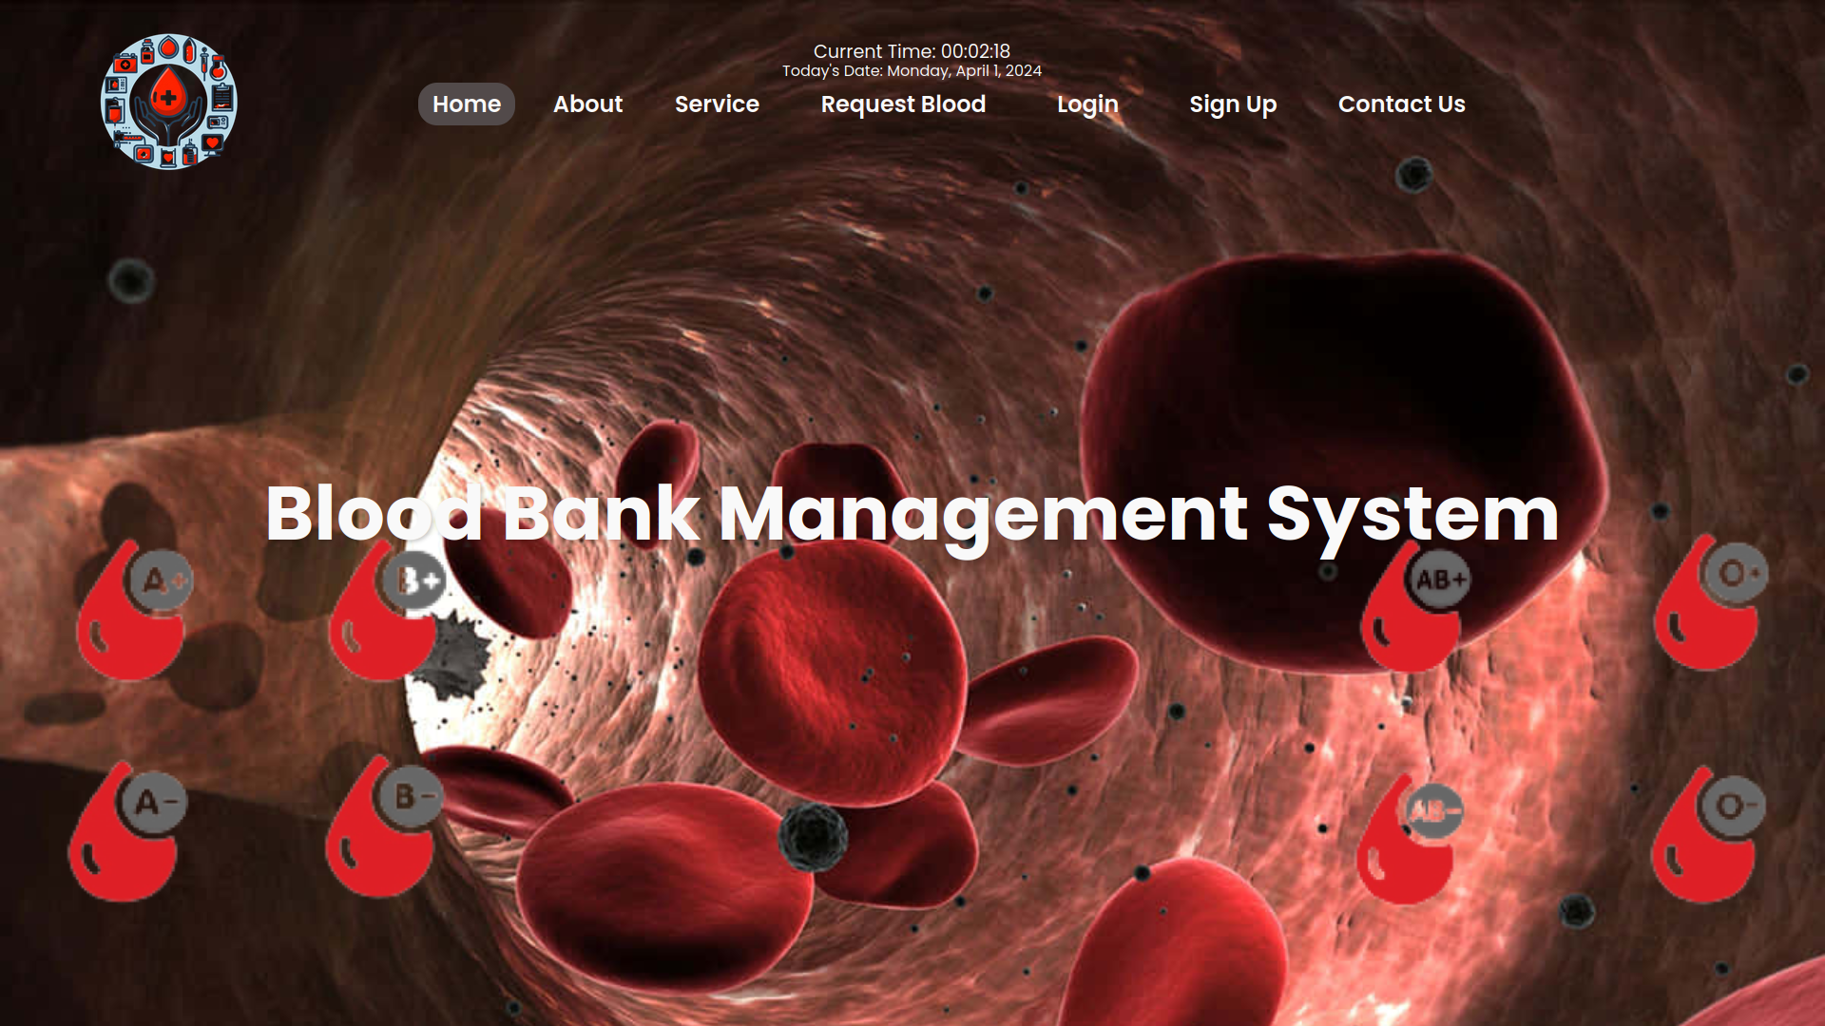
Project Screenshots

Slide 12
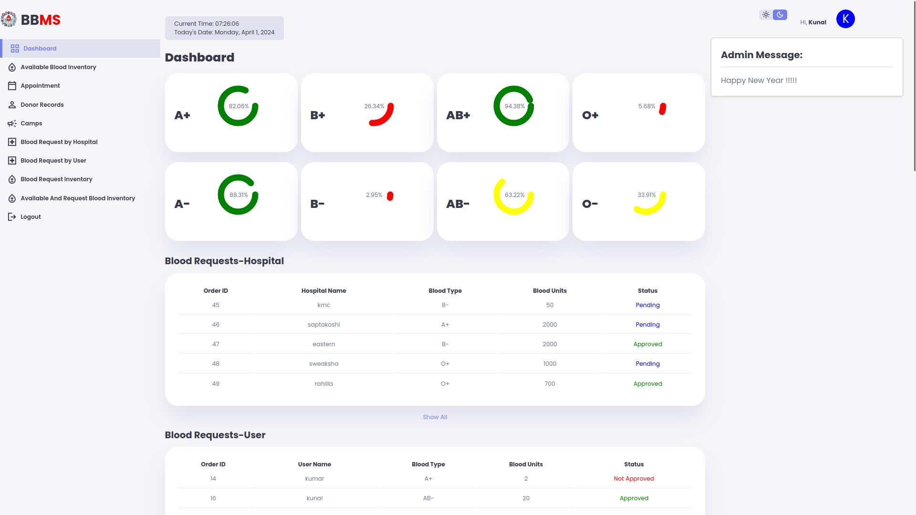
……..

Slide 13
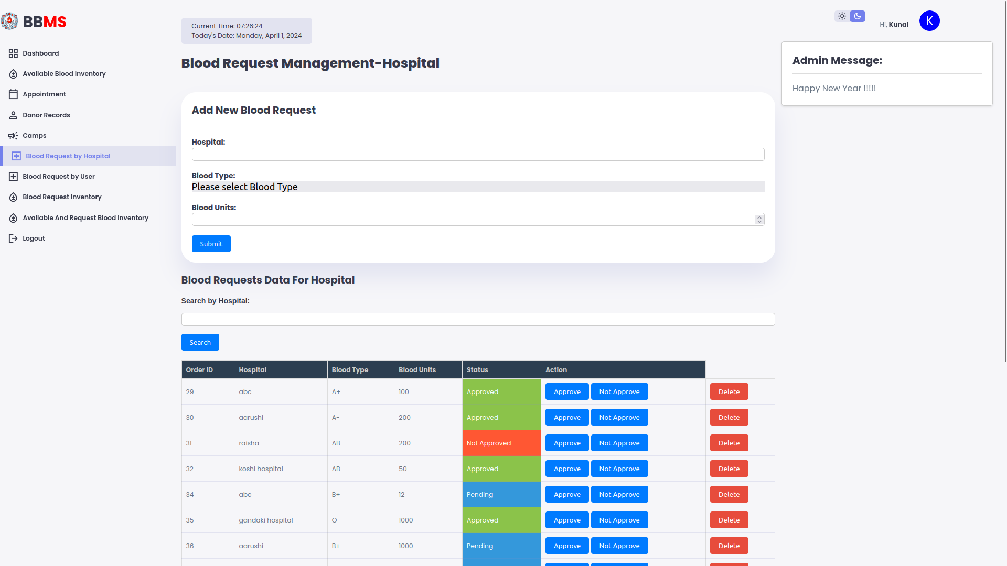
……..

Slide 14
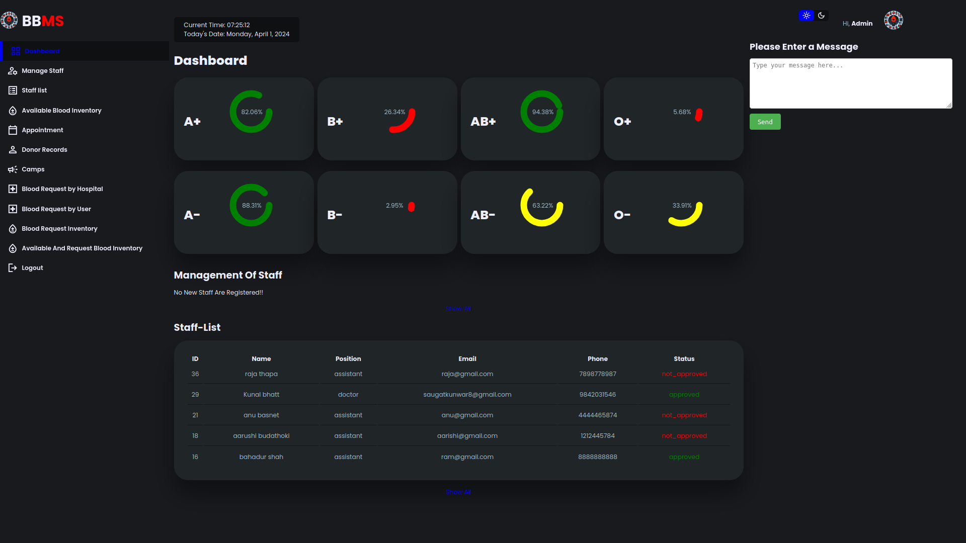
……..

Slide 15

……..

Slide 16
Scopes
Efficient Blood Management
Optimized Inventory Tracking
Improved Communication
User Engagement
Data-Driven Decision Making
Scalability
Public Health Impact

Slide 17
Limitations
No Diagrammatic View
No mobile Compatibility (Responsive Design)
Well knowledge about VS Code and PHP is required for editing the program

Slide 18
Conclusion
The Blood Bank Management System aims to address the challenges faced by blood banks in maintaining an organized and effective blood donation process. By leveraging modern web development technologies, the proposed system will contribute to a more streamlined and user-friendly experience for donors, improve blood inventory management, and enhance the timely distribution of blood to hospitals in need.

Slide 19
Future Enhancements
More interactive user interface
Manage stock in larger amount
Cross platform compatibility
SMS and Notifications alert features

Slide 20
Thank You

