Slide 1


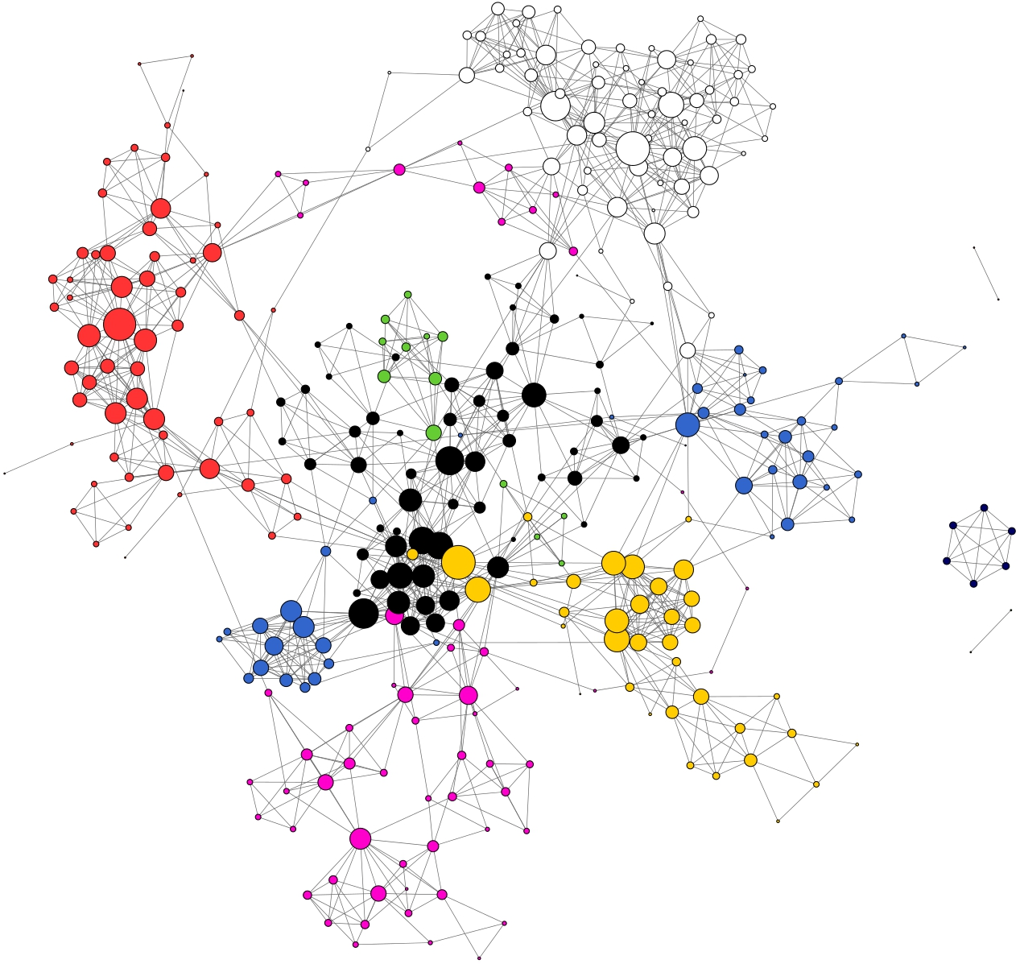



QMiner: Data Analytics Platform for Processing Streams of Structured and Unstructured Data
Blaž Fortuna, Jan Rupnik, Janez Brank, Carolina Fortuna, Viktor Jovanoski, Mario Karlovčec, Blaz Kažič,
Klemen Kenda, Gregor Leban, Andrej Muhič, Blaz Novak, Jošt Novljan, Miha Papler, Luis Rei, Blaž Sovdat,
Luka Stopar, Marko Grobelnik, Dunja Mladenić
AI Lab, Jožef Stefan Institute, Jamova cesta 39, Ljubljana, Slovenia
Architecture components
Storage and index layer
Stream aggregates
Feature extractors
Linear algebra
Analytics
Main Features:
Connecting storage, indexing and analytic
Multi-modal data support
Streaming processing
Probabilistic joins between tables
Efficiency and fast prototyping
Text processing and classification
Time series processing
// Loading in the dataset. qm.load.jsonFile(Movies, "./sandbox/movies/movies.json"); // Declare the features we will use to build classification models
var genreFeatures = [
{ type: "constant", source: "Movies" },
{ type: "text", source: "Movies", field: "Title" },
{ type: "text", source: "Movies", field: "Plot" },
{ type: "join", source: { store: "Movies", join: "Director"} }
];
// Create a model for the Genres field, by training on all movies
var genreModel = analytics.newBatchModel(
Movies.recs, genreFeatures, Movies.field("Genres"));
// Predict genres of a new movie
var newMovie = qm.store("Movies").newRec({
Title:"Unnatural Selection",
Plot:"When corpses are found with organs missing ...",
Genres:["Horror", "Sci-Fi"], Director:{Name:"Baggs Bill", Gender:"Male"}
}); var predictedGenre = genreModel.predict(newMovie);
Raw store
resample
Resampler [sr]
add rec
Resampled store
connect
Delay [s3]
smooth
Tick [s0]
smooth
update regression
EMA 1m [s3]
EMA 10m [s2]
Model [linreg]
update regression
Enrichment Regression [s4]
enrich
Graph analysis
// Create and connect stream aggregates to the stores. // These correspond to blue boxes in figure 1. var sr = Raw.addStreamAggr({name: ”rs", type: "resampler", outStore: "Resampled" }); var s0 = Resampled.addStreamAggr({name: ”s0", type: "timeSeriesTick" }); var s1 = Resampled.addStreamAggr({name: ”s1", type: "ema", interval: 60 }); var s2 = Resampled.addStreamAggr({name: ”s2", type: "ema", interval: 600 }); var s3 = Resampled.addStreamAggr({ name: ”s3", type: "recordBuffer", size: 6 });
// Declare features from the resampled timeseries
var ftrSpace = analytics.newFeatureSpace([ { type: "numeric", source: "Resampled", field: "Value" }, { type: "numeric", source: "Resampled", field: "Ema1" }, { type: "numeric", source: "Resampled", field: "Ema2" }, { type: "multinomial", source: "Resampled", field: "Time", datetime: true }
]);
// Initialize linear regression model var linreg = analytics.newRecLinReg(/*model parameters*/); // Add the stream aggregate that enriches the record with current
// EMAs, computes its feature vector and updates the model var s4 = Resampled.addStreamAggr(new function() {
onAdd: function (rec) { // Enrich record with latest EMAs rec.Ema1 = s1.getFlt(); rec.Ema2 = s2.getFlt(); // Get the ID of the record from a minute ago. var trainRecId = s3.val.last; // Compute feature vector of the record var ftrVec = ftrSpace.ftrVec(Resampled[trainRecId]);
// Update the regression model: the input is delayed
// by 1 minute and the output is the current value
linreg.learn(ftrVec, rec.Value);
} });
// Loading a graph file and creating a new undirected graph var g = snap.newUGraph("biotechnology_2013.edg"); // Simplifying graph by removing all the nodes with degree <= 3 var g = snap.removeNodes(g, 3); // computing communities using Clauset-Newman-Moore algorithm var CmtyCNM = snap.communityDetection(g, "cnm"); // plotting the graph with colors corresponding to communities
viz.drawGraph(g, "graphCNM.html", { "color": CmtyCNM });
http://qminer.ijs.si/
https://github.com/qminer/qminer
SYMPHONY

