Slide 1
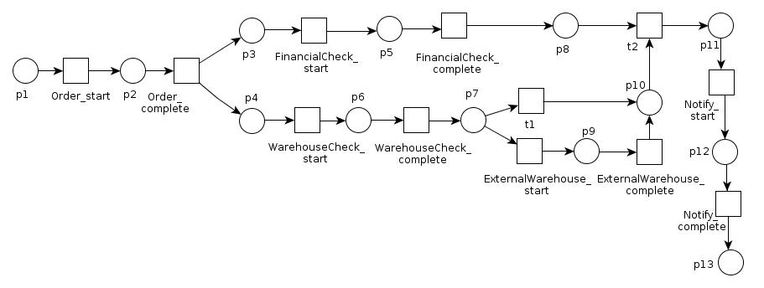
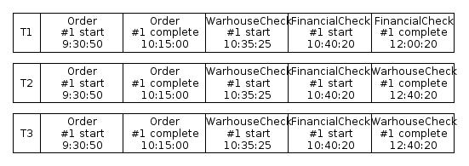
Process Model
Ideal Behavior
Event logs
Real Behavior
Process Analysis
Conformance Checking
Performance Checking

