Slide 1
RUPOS
Prom 5.2

Slide 2
Example activities
RegisterUser
Draft
Study
Review
Published

Slide 3
ProM 5.2 Log files
WorkflowLog (the root)
  Process (a single process definition)
    ProcessInstance (a single process instance)
      AuditTrailEntry (a single event)
        WorkflowModelElement (e.g. Draft, RegisterUser)
        EventType (e.g. start, complete)
        Timestamp
        Originator (e.g. username)
Example

Slide 4
ProM 5.2 Process Mining
Process Discovery
  Alpha algorithm
    Discover activity relationship (e.g. A always before B)
  LTS inference
    Build a LTS representing the log information
    Synthesize a Petri Net using region theory
Conformance
  Log replay
Performance
  Log replay

Slide 5
Discovery sequential processes
Register User
Draft
Review
Published

Slide 6
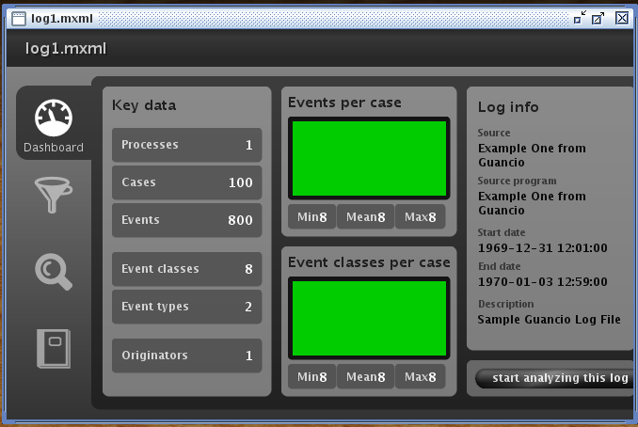
ProM 5.2 Opening Log File

Slide 7
Sequential Processes

Slide 8
Discovery choices
Register User
Draft
Review
Published or Rejected

Slide 9
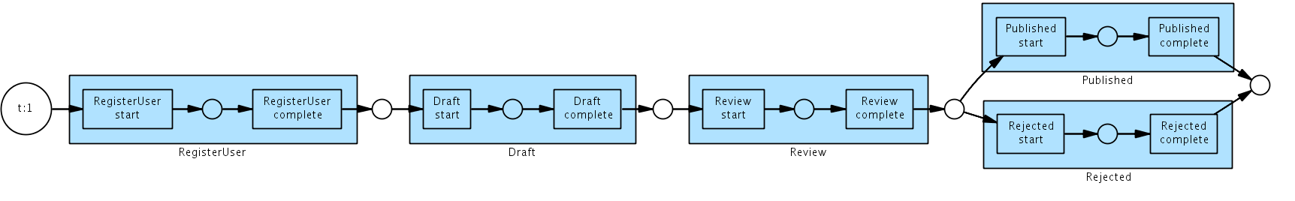
Choices

Slide 10
Discover Concurrency
Register User
Draft while Study
Review
Published or Rejected

Slide 11
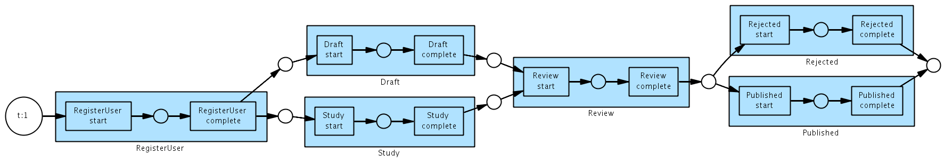
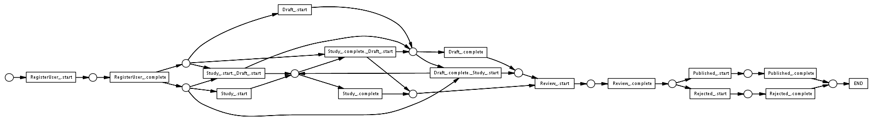
Concurrency

Slide 12
Discover Loop
Register User
Draft while Study (0 to n times)
Review
Published or Rejected

Slide 13
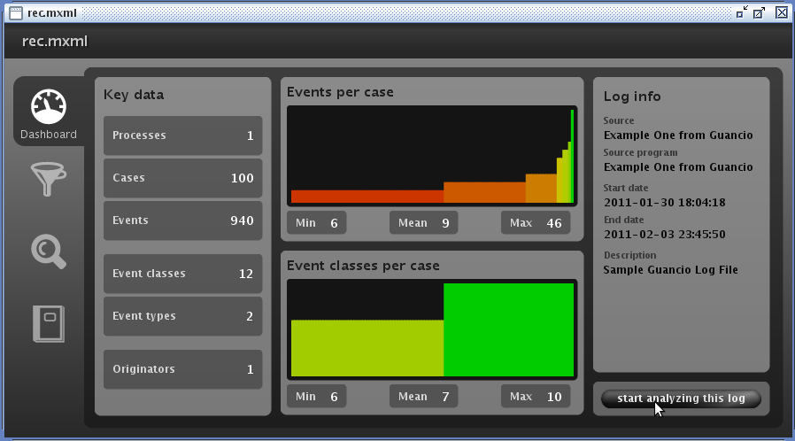
Loop

Slide 14
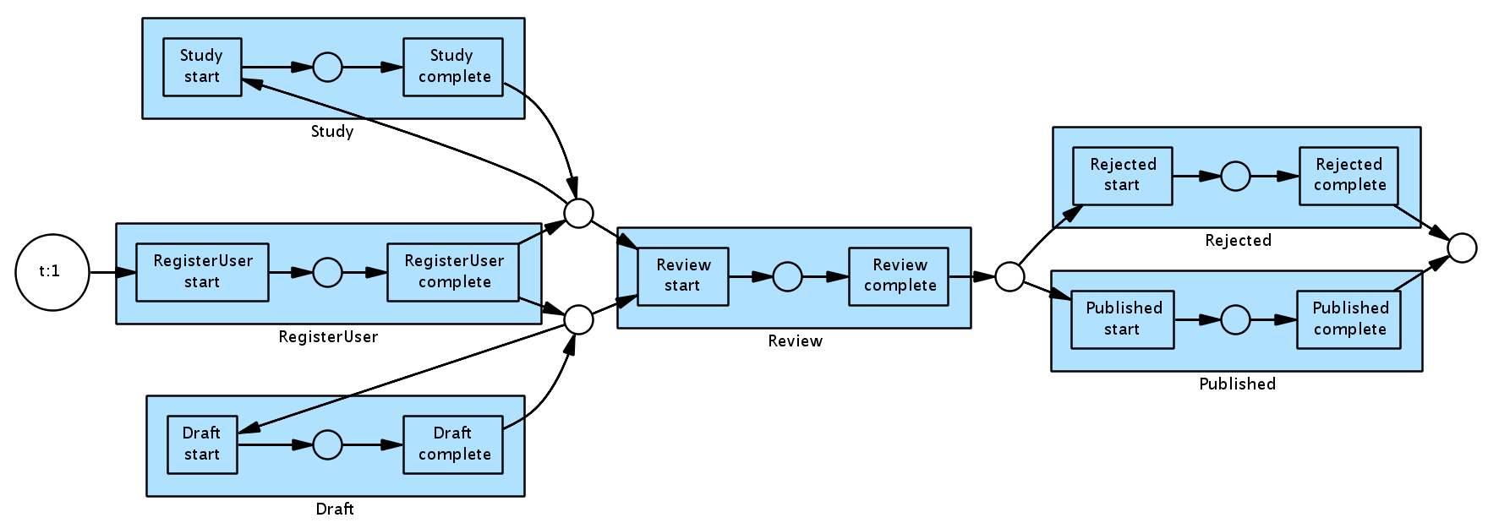
Loop

Slide 15
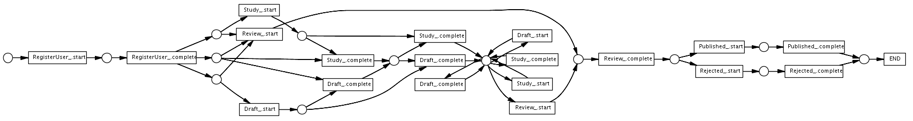
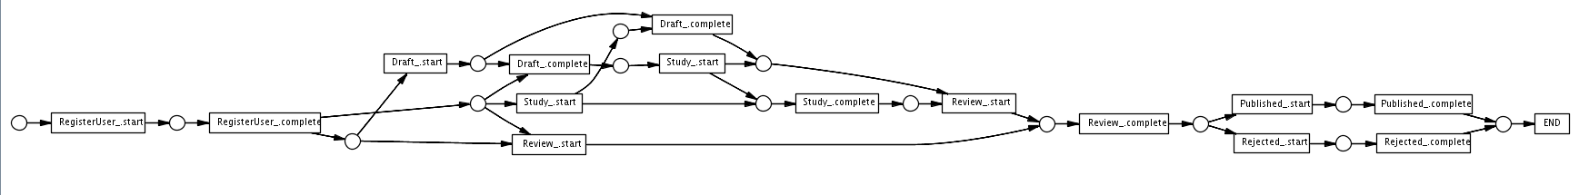
Loop
Standard
Kill Loops

Slide 16
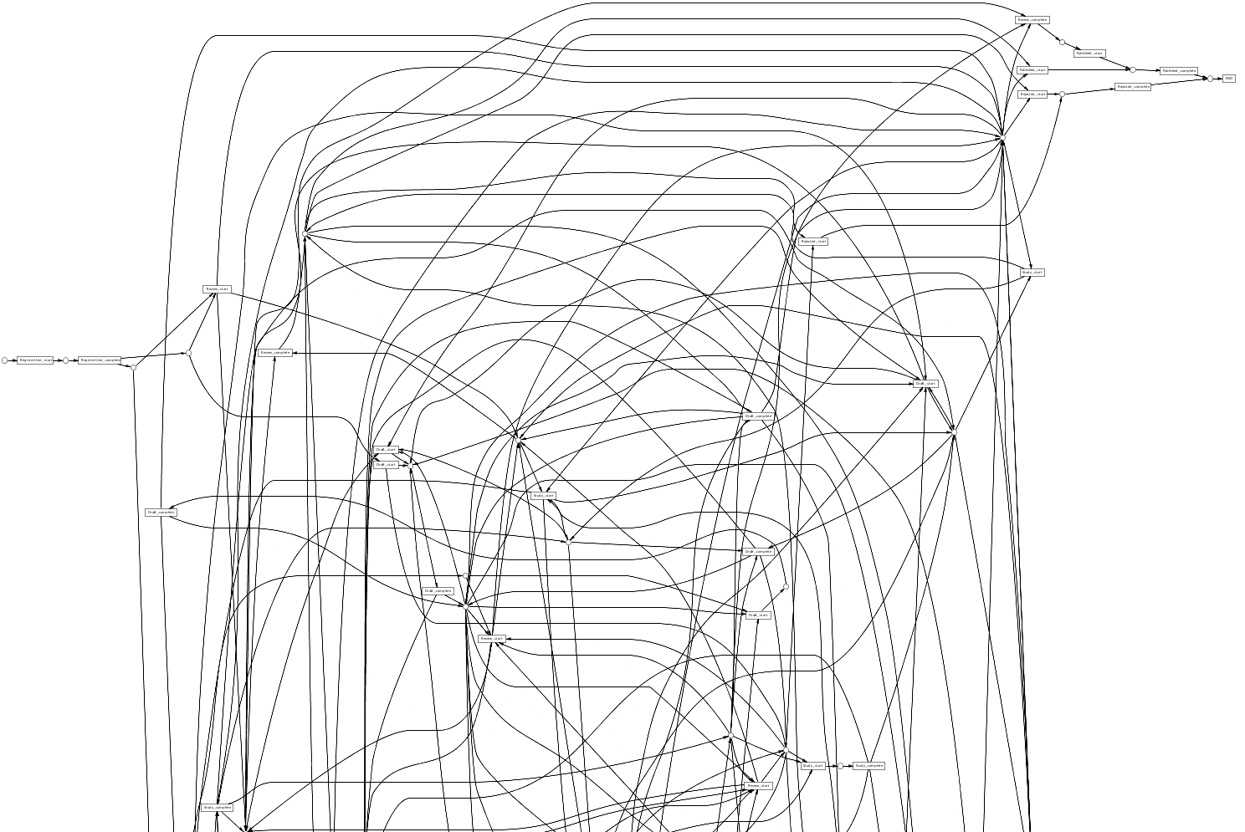
Bags

Slide 17
Discover Loop
Register User
Draft while Study (1 to n times)
Review
Published or Rejected

Slide 18
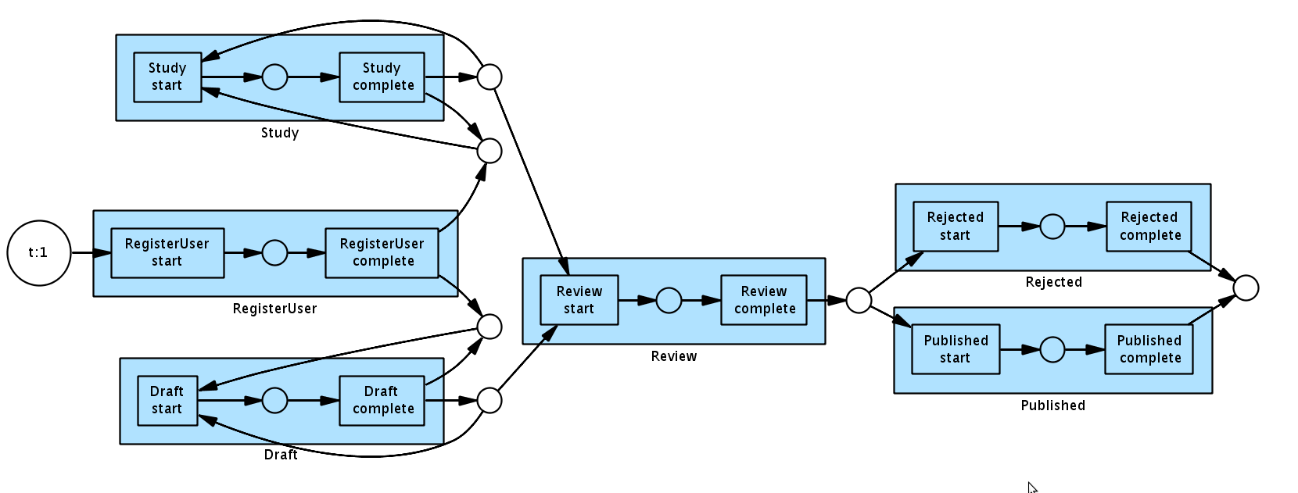
Loop

Slide 19
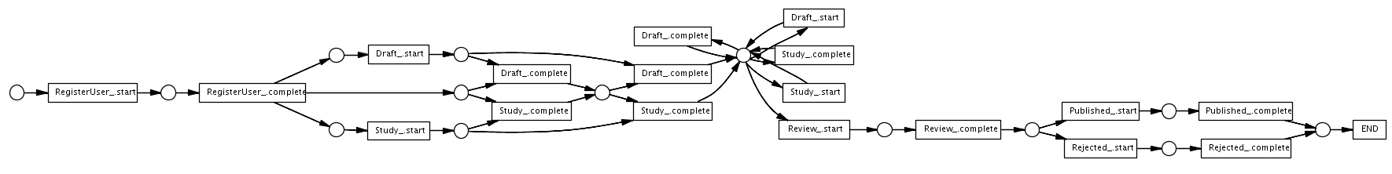
Loop

Slide 20
Discover Loop
Register User
Draft while Study (1 to n times)
Explicit Loop guard (restart)
Review
Published or Rejected

Slide 21
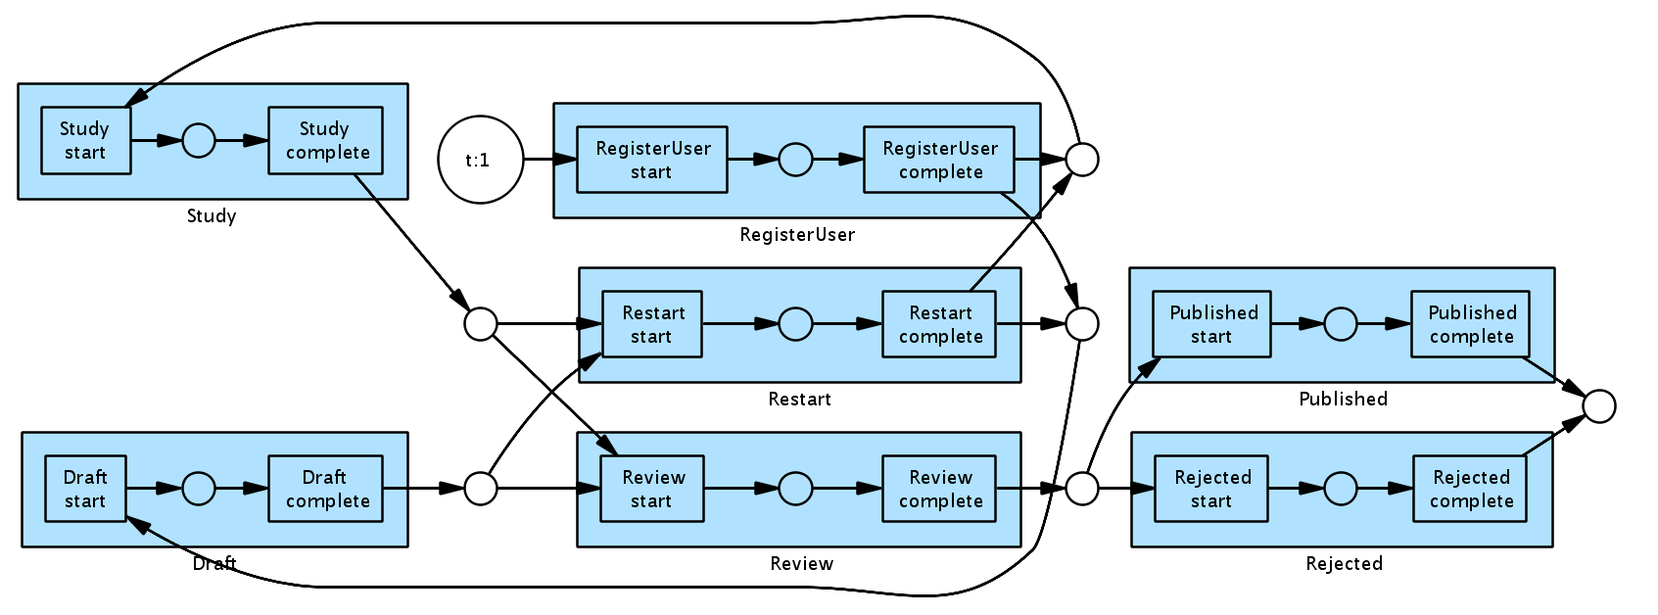
Loop

Slide 22
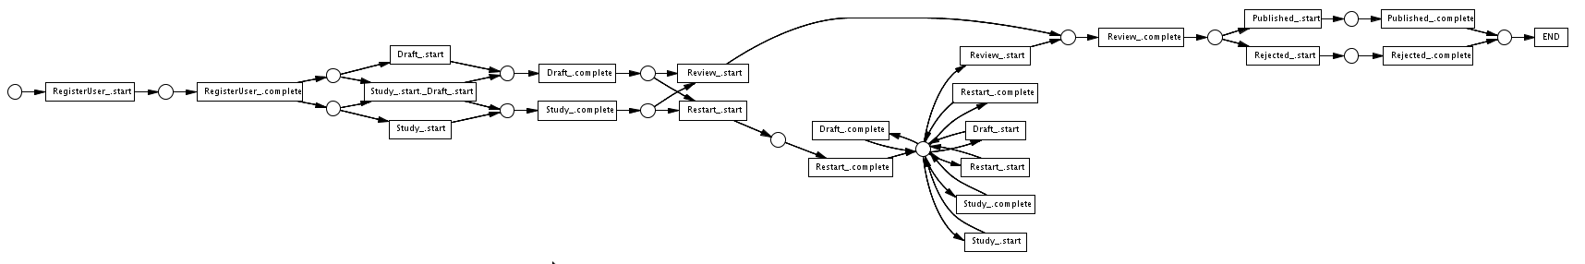
Loop

Slide 23
Discover For
Register User
Draft while Study (0 to 2 times)
Review
Published or Rejected

Slide 24
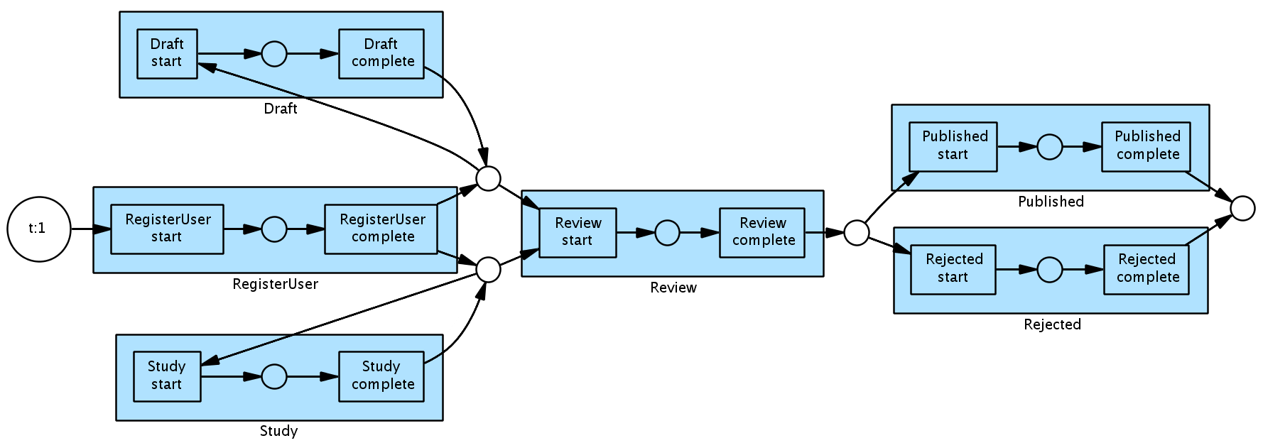
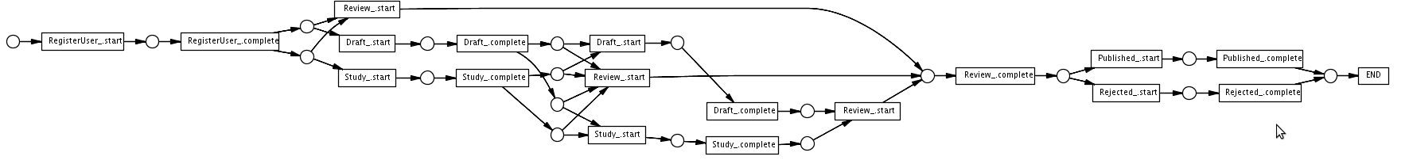
For

Slide 25
Managing exceptions
Register User
Draft
Review
Published
Sometime draft resubmitted after
  review (warning)
  published (error)

Slide 26
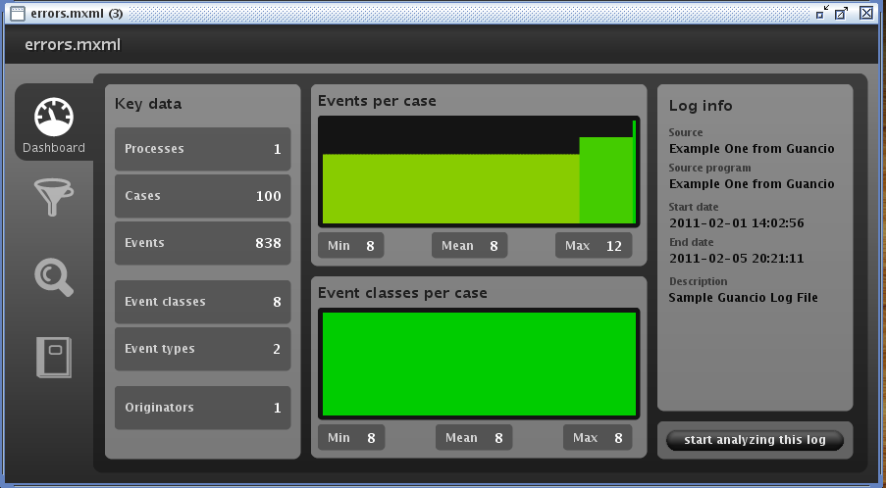
Exceptions

Slide 27
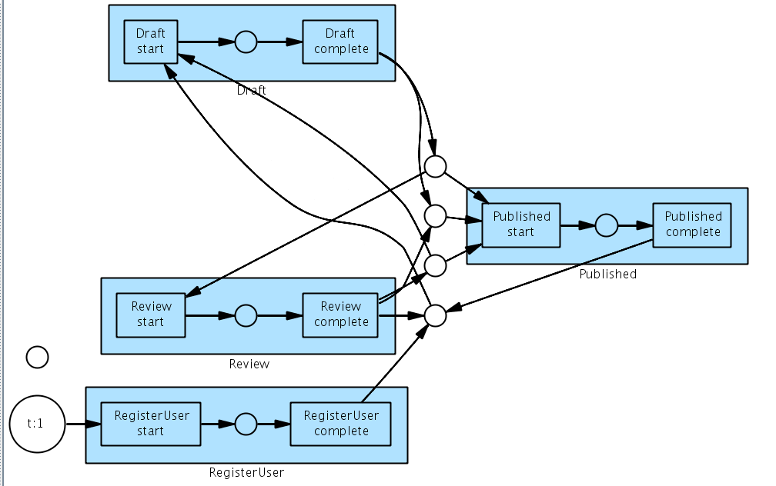
Exceptions

Slide 28
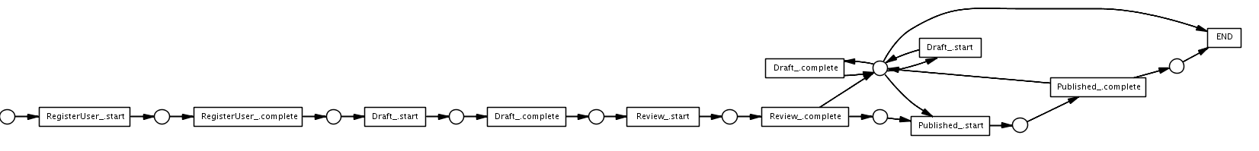
Exceptions

Slide 29
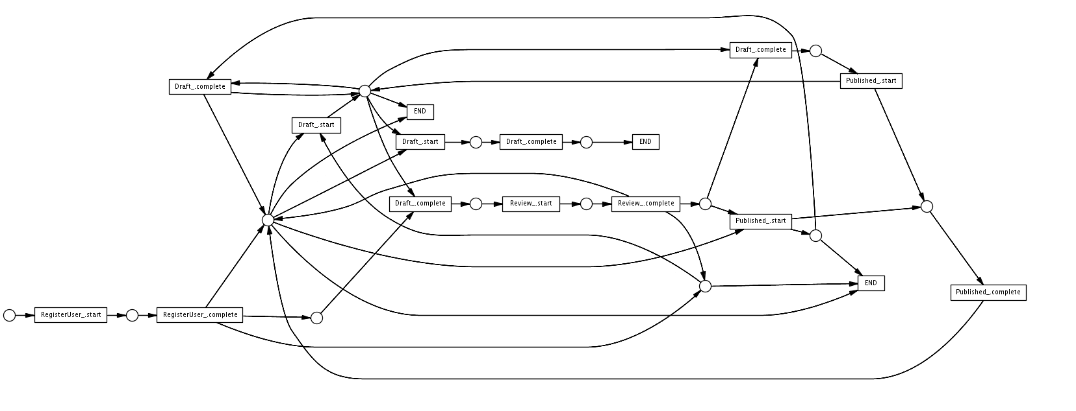
Exceptions

Slide 30
Demo Log Group and Filtering
Group log instances by patterns
Discard by frequency
Discover

Slide 31
Demo Conformance

Slide 32
Demo Performance

Slide 33
Log Storage
SQL:
  XML message as CLOB, date as column
  Scheduled Xpath key index
  No transitive closure
CouchDB
  XML message as Json documents
  Map functions to index keys
  No transitive closure
  No inline updates

Slide 34
Log Storage
MongoDB
  XML as Json
  Query language similar to Xpath
  No Transitive closure
  Inline update
Neo4J
  XML as JSON
  Graph traversal language (Transitive closure) on (explicit) relations
  Indexing using Lucene

