Slide 1
Contractor Performance Assessment Reporting System (CPARS) & Past Performance Information Retrieval System (PPIRS)
Presented by Doreen F. Powell
Naval Sea Logistics Center, Portsmouth

Slide 2
Agenda
Past Performance Process Overview
What Areas of Performance Are Rated?
What Does an Evaluation Consist Of?
Best Practices for Submitting a Quality Evaluation
Upcoming Improvements
Resources
CPARS & PPIRS Help Desk

Slide 3


Past Performance Process Overview
Government Contracting & Program Officials
Government Source Selection Officials
CPARS
PPIRS
Contractor Representative
Contractor Senior Management

Slide 4
What Areas of Performance Are Rated?
Quality
Product Performance Relative to Contract’s Performance Parameters
Performance in Terms of Contract’s Quality Objectives
Use Quantitative Indicators Wherever Possible
Contractor’s Management of the Quality Control Program
Quality of the Work or Service

Slide 5

What Areas of Performance Are Rated?
Schedule
Timeliness of Delivery
Timely Completion of Contract/Order
Milestones
Timely Completion of Administrative Requirements

Slide 6

What Areas of Performance Are Rated?
Cost Control
Forecasting Cost
Managing Cost
Controlling Cost
Overrun?
Underrun?
Not Required for Fixed Price Contracts/Orders

Slide 7
What Areas of Performance Are Rated?
Management
Integration and Coordination of Activity
Problem Identification
Corrective Action Plans
Reasonable and Cooperative Behavior
Customer Satisfaction
Subcontract Management
Program Management
Management of Key Personnel

Slide 8
What Areas of Performance Are Rated?
Utilization of Small Business
Compliance with Terms and Conditions for Small Business Participation
Achievement of Small Business Subcontracting Goals
Good Faith Effort to Meet Small Business Subcontracting Goals

Slide 9
What Areas of Performance Are Rated?
Regulatory Compliance
Compliance with Regulations and Codes
Financial
Environmental
Labor
Safety
Reporting Requirements

Slide 10

What Does an Evaluation Consist Of?
Administrative Information
Contractor Identification Information
Dollars
Dates
Subcontractors
Contract Effort Description

Slide 11

What Does an Evaluation Consist Of?
Ratings
Grading Scale Defined in Federal CPARS Guidance Document
Assessing Official Narrative
Required for Each Area Evaluated
Provides Detail to Support Rating Given

Slide 12

What Does an Evaluation Consist Of?
Contractor Comments
Response to Government’s Evaluation
Indicates if “Concur” or “Do Not Concur”
Reviewing Official Comments
Resolves Disputes
Only Required When Contractor Does Not Concur With Evaluation

Slide 13

Best Practices for Submitting a Quality Evaluation
Ratings & Narrative Consistent with Rating Definitions in Federal CPARS Guidance Document
Supported by Objective Evidence
Status, Progress, Production, Management Reviews
Earned Value Management Data
Cost & Schedule Metrics
Technical Reviews
Quality Assurance Evaluations
Earned Contract Incentives & Award Fee Determinations
Subcontract Reports
Safety & Labor Standard Compliance

Slide 14

Best Practices for Submitting a Quality Evaluation
Address Benefit & Impact of Contractor’s Performance to Government
Detail Contractor’s Strengths & Weaknesses
Address Government’s Role in Contractor’s Inability to Meet Requirements (if applicable)
Document Problems & Solutions
Contain Objective & Non-Personal Statements

Slide 15
Upcoming Improvements
CPARS Merge
Consolidating Architect-Engineer Contract Administration Support System (ACASS) & Construction Contractor Appraisal Support System (CCASS) Modules Into Overall CPARS Application
Single Evaluation Form
Single Workflow Process
Coming July 1, 2014

Slide 16

Upcoming Improvements
Improved PPIRS Metrics Display
Better Search & Display Capabilities for More Efficient Access to Relevant Reports
PPIRS Ad Hoc Reports
Ability for Source Selection Officials to Tailor Reports to Best Meet Their Needs
Coming December 2014

Slide 17

Resources
CPARS Website: https://www.cpars.gov
Training Link
Online Training
Automated Training
On-Site Training
Guidance Link
Federal CPARS Guidance Document
CPARS User Manual
Office of Federal Procurement Policy (OFPP) Memos

Slide 18
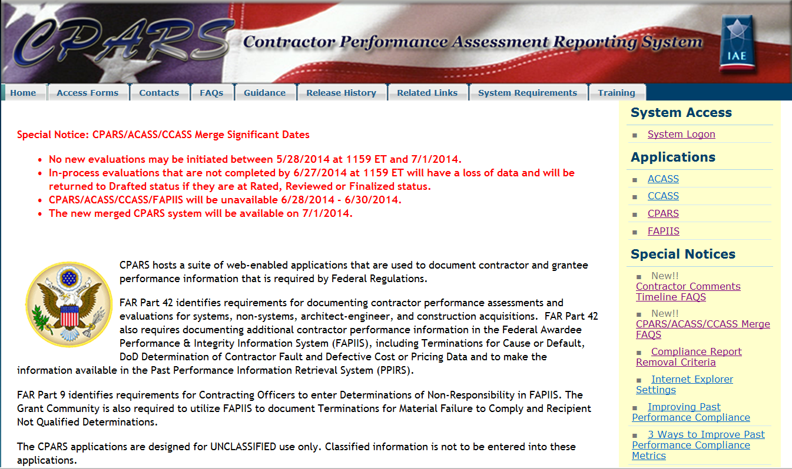
CPARS Home Page https://www.cpars.gov
Guidance
Training

Slide 19
Resources
PPIRS Website: https://www.ppirs.gov
Training Link
Online Training
Reference Link
User Manuals
Compliance Report Information
Guidance Link
OFPP Memo

Slide 20
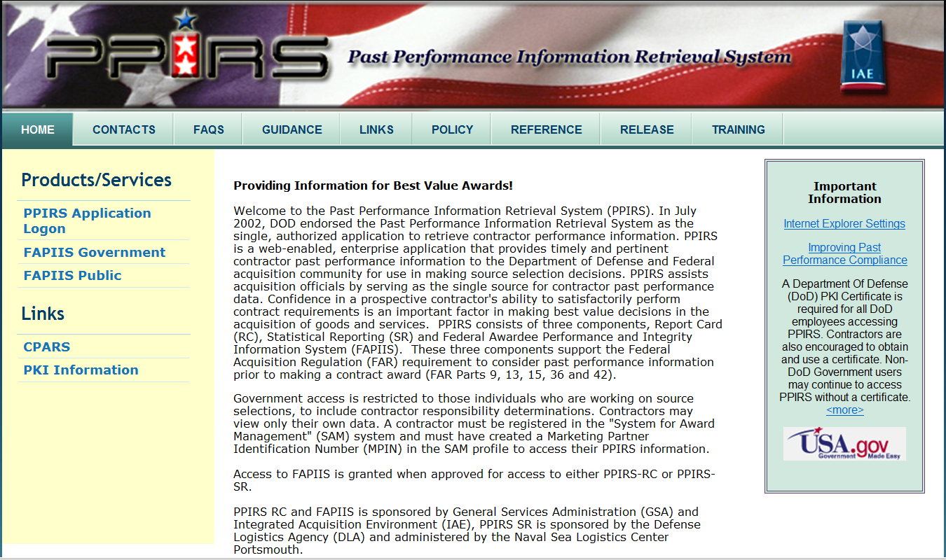
PPIRS Home Page https://www.ppirs.gov
Guidance
Reference
Training

Slide 21
CPARS & PPIRS Help Desk
Phone: 207-438-1690
DSN: 684-1690
Email: webptsmh@navy.mil
Help is available Monday – Friday, 6:30 am – 6:00 pm ET.

