Slide 1
DHS - Improving Quality and Timeliness of Contractor Performance Evaluations
Presented by Laura Auletta
Executive Director, Procurement Policy and Oversight
Office of the Chief Procurement Officer
Department of Homeland Security

Slide 2
Improving Quality and Timeliness of Contractor Performance Evaluations
Leadership Commitment
Accountability/Internal Controls
Communication, Policy, Training, Tools

Slide 3
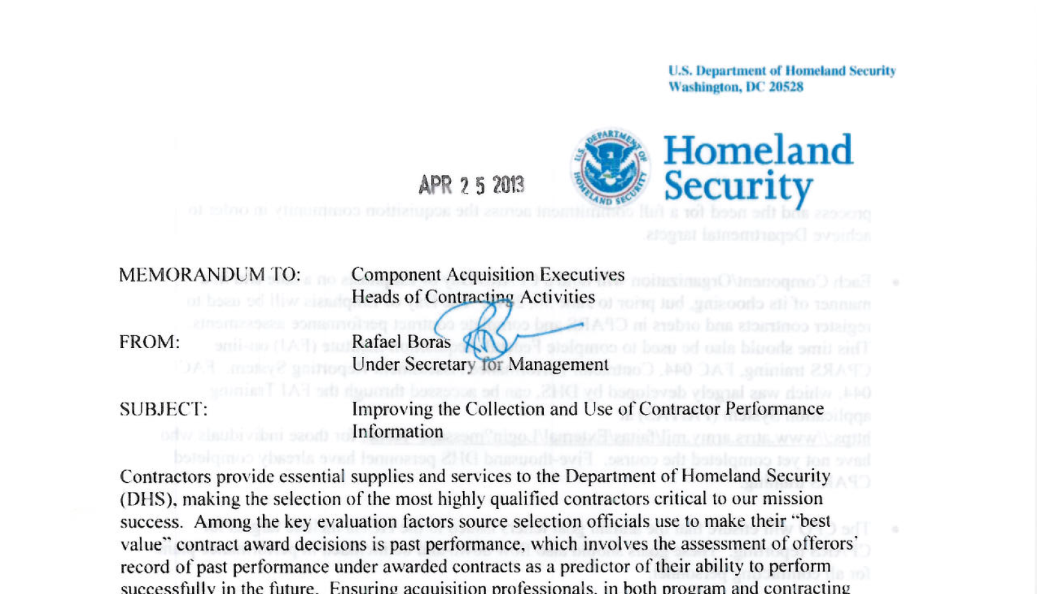

Leadership Commitment

Slide 4
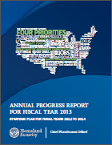
Accountability/Internal Controls
The Chief Procurement Officer’s Four Priorities
Quality Contracting
Quality People
Quality Program Support
Quality Industry-Government Communication
Performance measured quarterly
HCA Performance Goal Letters
Formal Procurement Health Assessments
Performance metric issues are immediately addressed with Component HCAs
Oversight Reviews
CPO Strategic Plan for FY 2012 – 2014
Performance Evals
CPO Annual Progress Report for FY 2013

Slide 5
Communication, Training, Policy
Communications
Communicate directly with the workforce
Recognize progress
Identify opportunities for improvement

Slide 6

Communication, Training, Policy
Training
Trained 4,000+ in FY 2013
Hosted “Day of Emphasis” events
Dedicated operations staff to monitor and address system issues
Notes:
Senior Procurement Executive (SPE) mandated compliance: At the beginning of fiscal year 2013, the SPE issued memoranda to the senior leadership of all EPA program staff and regional offices as well as to all contracting staff emphasizing the importance of contractor performance evaluations and directing immediate completion of all overdue reports.
Assigned the right people to monitor the program: Our number one success determinant was assigning the right people to the right roles. We assigned an 1102 senior procurement analyst versus a 2210 IT specialist as our Department Point of Contact (DEPOC). The DEPOC then assigned another 1102 to act as an Agency POC and assist with the program.
EPA specific policy: The DEPOC wrote EPA specific policy (EPA Contracts Management Manual 42.15, Feb 2014) establishing roles and responsibilities for past performance reporting to include mandating EPA personnel take CPARS training in line with the recommendations in the September 2013 Guidance for the Contractor Performance Assessment Reporting System.

Slide 7
Communication, Training, Policy
Policy
Provided policy and guidance to 1102s and non-1102s
Delivered job aids to the workforce, such as quality checklists
Offered policy and technical support

