Slide 1
PAST PERFORMANCE INFORMATION
Key Elements
Presented by Julia Wise, Office of Federal Procurement Policy
JUNE 2014

Slide 2
Overview
Background
Policies and Regulations
Elements of Past Performance Information -
What, Why, When, and Who is Responsible for Reporting Timely and Quality Information
Past Performance Information Systems -
Where and How Quality Information is reported
Agency Best Practices For Reporting Timely And Quality Past Performance Information -
Accountability, Compliance, and Transparency
Summary

Slide 3
Background
OFPP Act required the Administrator to prescribe guidance for executive agencies regarding consideration of the past contract performance of offerors in awarding contracts. (41 U.S.C § 1126)
Federal Acquisition Streamlining Act of 1994 codified the requirement to consider past performance in making awards. It required the Administrator to provide guidance for using past performance and ensure that a system for collecting and evaluating procurement data was capable of collecting and evaluating appropriate data
OFPP Policy Letter No. 92-5, Past Performance Information was developed and later incorporated into the Federal Acquisition Regulation (FAR) under FAC 90-26.
The FAR reflects this letter and FASA’s approach to past performance information.
Notes:
FASA was designed to eliminate “red tape” and to permit the Government to behave more like the private sector.Modeled private sector practice of awarding to companies with strong performance records
It is appropriate and relevant that a contracting official consider a contractor’s past performance as an indicator of the offeror’s ability to perform the contract successfully.
FASA required use of past performance as an evaluation factor in competitively negotiated awards and required OFPP to establish policies that encourage use of PPI in award decisions.

Slide 4
Policy
OFPP has issued the following policy memoranda to improve agency use and reporting of past performance information:
1) July 29, 2009 Memorandum, Improving the Use of Contractor Performance Information.
2) January 21, 2011 Memorandum, Improving Contractor Past Performance Assessments: Summary of the Office of Federal Procurement Policy’s Review, and Strategies for Improvement
3) March 6, 2013 Memorandum, Improving the Collection and Use of Information about Contractor Performance and Integrity
4) 2014 - Additional policy guidance encouraging agencies to make better use of contractor performance information.
Notes:
1) OFPP’s July 29, 2009 Memorandum, Improving the Use of Contractor Performance Information, described new FAR requirements to strengthen the use of contractor performance information, included agency management responsibilities, and established OFPP’s review process for evaluating agencies’ effective reporting of contractor performance information.
2) OFPP’s January 21, 2011 Memorandum, Improving Contractor Past Performance Assessments: Summary of the Office of Federal Procurement Policy’s Review, and Strategies for Improvement included OFPP’s initial assessment of agencies’ reporting of contractor performance information and additional strategies for improving the collection of past performance information.
3) OFPP’s March 6, 2013 Memorandum, Improving the Collection and Use of Information about Contractor Performance and Integrity, provides agencies with several strategies to improve reporting compliance and required CAOs and SPEs to primarily: emphasize the need for FAPIIS data; establish past performance reporting baseline and set aggressive quarterly targets to improve reporting compliance; think creatively to motivate employees and acknowledge employees who report timely and quality information into CPARS/FAPIIS; encourage employees to communicate performance issues with contractors through interim evaluations; and train employees on how to report and use past performance and integrity information.
4) OFPP Memorandum (to be released in June 2014 memorandum), Making Better Use of Contractor Performance Information, requires agencies to take additional outreach and research steps on, at a minimum, acquisitions for complex information technology (IT) development, systems, and services over $500,000 (with some exceptions), and other acquisitions identified by the agency that present significant risk.

Slide 5
Regulatory Changes
The Federal Acquisition Regulatory Council has made a number of changes to improve agency use and timely and quality reporting of performance information:
Contractor Performance Information (FAR Case 2006-022) Final rule published on 7/1/2009
Termination for Default Reporting (FAR Case 2008-016) -Final rule published on 9/29/2010
Documenting Contractor Performance (FAR Case 2012-009 -formerly 2009-042) Final rule published on 8/1/2013
Contractor Comment Period (FAR Case 2012-028) -Final rule to be published in the June 2014
Enhancements to Past Performance Evaluation Systems (FAR Case 2014-010)
Federal Awardee Performance & Integrity Information System (FAR Case 2008-027) -Final rule published on 3/23/2010
Public Access to FAPIIS Information (FAR Case 2010-016) Final rule published on 1/3/2012
Information on Corporate Contractor Performance and Integrity (FAR Case 2013-020)
Notes:
FAR Case 2006-022, Contractor Performance Information, revised the FAR to emphasize the use of a standard performance information reporting system, the Past Performance Information Retrieval System (PPIRS). (issued April 2008 and finalized in July 2009)
FAR Case 2008-016, Termination for Default Reporting, amended the FAR to establish procedures for contracting officers to provide contractor information, such as terminations for cause or default and defective cost or pricing data, into the Past Performance Information System (PPIRS) and Federal Awardee Performance and Integrity Information System (FAPIIS) module within PPIRS. (finalized on September 29, 2010)
FAR Case 2012-009 (formerly FAR Case 2009-042) Documenting Contractor Performance established to provide Governmentwide standardized past performance evaluation factors and performance rating categories and require that past performance information be entered into the Contractor Performance Assessment Reporting System (CPARS). (issued September 2012)
FAR Case 2012-028, Contractor Comment Period proposes to amend the FAR so that contractors are provided “up to 14 calendar days from the date of delivery” of past performance evaluations “to submit comments, rebuttals, or additional information pertaining to past performance” for inclusion in the database. In addition, it will also require that agency evaluations of contractor performance, under DoD contracts, including any information submitted by contractors, be “included in the relevant past performance database not later than 14 days after the date of delivery of the information” to the contractor. (This will implement section 806(c) of the National Defense Authorization Act for Fiscal Year 2012 (Public Law 112-81)).
FAR Case 2014-010, Enhancements to Past Performance Evaluation Systems revises FAR subpart 42.15 to accommodate ACASS and CCASS as modules within the CPARS database.

Slide 6

What is Past Performance Information (PPI)?
Past performance information is relevant information for source selection purposes regarding a contractor’s actions under previously awarded contracts and orders.
The past performance evaluation report includes the contractor’s:
Record of conforming to requirements and to standards
Record of estimating and controlling costs
Adherence to contract schedules (including administrative aspects of performance)
History of reasonable and cooperative behavior and commitment to customer satisfaction
Record of integrity and business ethics
Business-like concern for the interest of the customer
Notes:
The guidance shall include—
(1) standards for evaluating past performance with respect to cost (when appropriate), schedule, compliance with technical or functional specifications, and other relevant performance factors that facilitate consistent and fair evaluation by all executive agencies;
(2) policies for the collection and maintenance of information on past contract performance that, to the maximum extent
practicable, facilitate automated collection, maintenance, and dissemination of information and provide for ease of collection, maintenance, and dissemination of information by other methods, as necessary;
(3) policies for ensuring that—
A) offerors are afforded an opportunity to submit relevant information on past contract performance, including performance under contracts entered into by the executive agency concerned, other departments and agencies of the Federal Government, agencies of State and local governments, and commercial customers; and (B) the information submitted by offerors is considered; and
(4) the period for which information on past performance of offerors may be maintained and considered.
(b) INFORMATION NOT AVAILABLE.—If there is no information on past contract performance of an offeror or the information on past contract performance is not available, the offeror may not be evaluated favorably or unfavorably on the factor of past contract performance.

Slide 7
Why is PPI Used?
FAR parts 9, 15 and 42 all discuss why past performance is used –
Pre-award – Contractor Qualification 9.104-1
Addresses past performance as one factor in determining contractor responsibility.
Contracting by Negotiation – FAR 15.304
Validates statements made in proposal- capability, experience, risks.
Addresses past performance as an evaluation factor in source selection - 15.608(a)(2).
Agencies use PPIRS data that is within 3 years (6for construction and architect-engineer contracts) of the completion of performance of the evaluated contract or order, and information contained in FAPIIS
Post Award- Contract Administration – FAR 42.15
Addresses the collection of contractor performance information during the performance of the contract .
Notes:
Why evaluate past performance? To aid the government’s decision process and award contracts to those companies that consistently produce and deliver quality products, on time and within cost!
Reported benefits include:
l Higher customer satisfaction
l Better performance
l More value for the dollar
l Reduced process time (in some cases)

Slide 8
Benefits of Using PPI in Source Selection
Performance information is beneficial to source selection officials during the source selection process because it:
Represents useful information about a contractor's past performance record and tells the story of the contractor’s performance (both good and bad);
Is a key indicator for predicting future performance in the performance quality, technical ability, and customer satisfaction;
It gives insight into the contractor's actual ability to perform the work as opposed to relying strictly on proposal promises;
It can be a powerful incentive for contractors to maximize performance and customer satisfaction on their current contracts.
Performance information outside of PPIRS provides a full view of contractor’s performance ability on contracts of similar size and scope from commercial, state, local, and foreign governments.

Slide 9

PPI Importance in Contract Administration
Performance information is an important contract administration because it:
Documents contractor performance annually to make sure contractors are performing the work and government contract deliverables are received;
Promotes communication with your contractors;
Motivates contractors to strive for performance excellence and customer satisfaction;
Recognizes good performance; and
Reduces performance risk and supports contract oversight.
Past Performance evaluation report is equivalent to an annual performance appraisals or school report card.
Why document ?

Slide 10
When Is a Past Performance Evaluation Required?
Past performance evaluations are required for contracts and orders for supplies, services, research and development, and contingency operations, including contracts and orders performed inside and outside the United States, expected to exceed the simplified acquisition threshold which is now $150,000 with some exceptions (FAR 42.1502(b)) below:
For each construction contract, the reporting threshold is $650,000 or more;
For each architect-engineer services contract, the reporting threshold is $30,000 or more; and
For some agencies with numerous contracting actions and dollars, reporting thresholds differ from the FAR but these thresholds still allow the agency to capture a substantial number of contracts and orders.
Evaluations in past performance system should be completed, within a timely manner, after the end of the contract or order evaluation period.

Slide 11
Who Evaluates Performance?
Evaluation of a contractor’s performance is a shared responsibility within the acquisition community - program office, requirements office and contracting office.
Agency procedures identify individuals responsible for evaluations. Evaluation input can be obtained from many sources -
Contracting Officer or Contract Specialist , Administrative Contracting Officer
Contracting Officer Representative or Contracting Officer Technical Representative
Program Manager and/or Project Manager,
Performance Evaluator, Quality Assurance Evaluator,
Auditors, End users of the product or service, and
Any other technical or business advisor involved in the contract.
If agency procedures do not specify the individuals responsible for past performance evaluation duties, the contracting officer is responsible for this function.
Interim evaluations should be prepared as required.
Notes:
The principal goal of a past performance evaluation and rating system is to collect and present accurate and relevant contractor performance information to the official making a source selection decision.
Providing quality past performance information gives the selection official a valuable data point to estimate the expected future performance of a contractor.
The government often has to relies on detailed technical and management proposals to compare relative strengths and weaknesses of offers and the contractor’s selected references. In many cases, if not all, this voluminous risk assessment information can be reduced or eliminated by evaluating how well the offerors performed on past similar contracts from commercial sources, state, local, and even from foreign government contracts. Stated another way, the evaluation of past performance information is supposed to streamline the process, not add to it. Accurate and reliable pastperformance information has the potential to allow agencies to significantly reduce the time necessary to evaluate
proposals.
It should be clearly understood, however, there are no guarantees. Using past performance information is not an exact
science. Even at its best, the use of past performance information can only provide a degree of confidence that future
performance will match or exceed that observed in the past.

Slide 12
How is a Contractor’s Performance Evaluated?
Contractor’s performance will be assessed and rated on the following evaluation factors:
Technical (quality of product or service);
(Cost control (not applicable for firm-fixed-price or fixed-price with economic price adjustment arrangements);
Schedule/timeliness;
Management or business relations;
Small business subcontracting; and
Other applicable areas such as late or nonpayment to subcontractors, trafficking violations, tax delinquency, etc.
Each factor/subfactor is evaluated and rated in accordance with a five scale adjectival rating system - exceptional, very good, satisfactory, marginal, and unsatisfactory- and a supporting narrative provided that supports the rating.

Slide 13
Where is PPI Reported?
Agencies report past performance information into Contractor Performance Assessment Reporting System (CPARS) a suite of web-enabled application that are used to document and collect performance information (assessment ratings and clear and completed narrative supporting the ratings).
The evaluation should include:
a clear, non-technical description of the principal purpose of the contract or order;
reflect how the contractor performed;
clear relevant information that accurately depicts the contractor’s performance, that is based on objective facts supported by program and contract or order performance data; and
tailored to the contract type, size, content, and complexity of the contractual requirements.
Assessing officials should discuss contract/order performance with the contractor during the performance period and during the CPARS process.
Assessing officials should document positive and negative performance, how problems are resolved, adjustments made to mitigate risk, and any other relevant information about the contractor’s performance.

Slide 14
Past Performance Systems
CPAR evaluations, including any contractor-submitted information, are automatically transmitted to Past Performance Information Retrieval System (PPIRS) at http://www.ppirs.gov not later than 14 days after the date on which the contractor is notified of the evaluation’s availability for comment. PPIRS is a central warehouse for performance assessment reports received from CPARS.
PPIRS is updated with any contractor comments provided after 14 days, as well as any subsequent agency review of comments received.
Agencies shall monitor their compliance with the past performance evaluation requirements (see 42.1502), and use the Contractor Performance Assessment Reporting System (CPARS) and Past Performance Information Retrieval System (PPIRS) metric tools to measure the quality and timely reporting of past performance information.
Access to Past Performance Information
Appropriate management and technical controls should be in place to ensure that only authorized personnel have access to the CPARS and PPIRS data.
Contractors can only view their own evaluation reports.

Slide 15
Integrity Information
Federal Awardee Performance and Integrity Information System includes information regarding performance and integrity on contractors and grantees.
1. Contractors self-report their criminal convictions, civil liability, and adverse administrative actions where there was a finding of fault or damages of $5000 or more ($100,000 for administrative agreements) if the contract value is expected to exceed $500,000 and contractor or grantee has Federal contracts and grants with total value greater than $10,000,000
2. Government Reported Documents include:
Termination for Default
Termination for Cause
Non-Responsibility Determination
Defective Pricing
Administrative Agreements (FAR 9.406-3 & 9.407-3)
Termination for Material Failure to Comply
Recipient Not-Qualified Determination
DoD Determination of Contractor Fault
Notes:
Section 872 of NDAA of 2009, (enacted on October 14, 2008) required the General Services Administration to develop and maintain a ‘database’ containing specific performance and integrity information on potential awardees to support award decisions for actions >$500K.
Section 3010 of the Supplemental Appropriations Act of 2010 requires that the information in FAPIIS , excluding past performance reviews, be made publicly available.
FAPIIS highlights and help record negative performance and grants
T for D = contractor fails to deliver as promised in their proposal i.e. statement of work
T for C = same but for commercial (i.e. off the shelf, supplies, etc.)
T for MFTC = for grants (not for profit)
Defective Pricing = not termination but, contractor overcharged for product
Non Responsibility = pre-award can’t obtain financing, labor, product, etc.
Recipient Not-Qualified – grants same as non-responsibility for contracts
Agencies shall ensure information is accurately reported in the Federal Awardee Performance and Integrity Information System (FAPIIS) module of CPARS within 3 calendar days after a contracting officer
(i) Issues a final determination that a contractor has submitted defective cost or pricing data;
(ii) Makes a subsequent change to the final determination concerning defective cost or pricing data pursuant to 15.407-1(d);
(iii) Issues a final termination for cause or default notice; or
(iv) Makes a subsequent withdrawal or a conversion of a termination for default to a termination for convenience.
Per FAR 42.1503(h)

Slide 16
FAR Performance and Integrity Information Citations
FAR 9.104 - Contracting Officer’s review and documentation duties prior to making a non-responsibility determination.
FAR 9.105 - PPIRS/FAPIIS- Information Shall Be Used to Support Responsibility Determinations/ Documentation is required in FAPIIS
FAR 9.406-3 & 9.407-3 - Enter administrative agreement in FAPIIS
FAR 15.304 - Past Performance Shall Be Evaluated in All Source Selections for Negotiated Competitive Acquisitions (Includes Construction)
FAR 36.303-1 - Past Performance Shall Be Included as an Evaluation Factor for Two-Phase Design-Build Source Selections
Notes:
Federal Acquisition Regulation (FAR) Citations:
3.104 - past performance reports generally represent Source Selection Information - Not for release except to Government and the contractor.
9.105-2(b)(2)(iv) - With regard to past performance information that may be covered by a disclosure exemption under the Freedom of Information Act (FOIA), the contracting officer shall follow agency FOIA procedures.
12.206 - Subpart 12.2 Special Requirements for the Acquisition of Commercial Items
15.305 - Subpart 15.3 Source Selection
36.2 - Subpart 36.2 Special Aspects of Contracting of Construction
36.604 - Subpart 36.6 Architect-Engineer Services
42.15 - Subpart 42.15 Contractor Performance Information (reports good only for 3 years from the date of contract completion -see 42.1503(e))

Slide 17
FAR Citations
FAR 36.602 - Agency Must Consider Offeror Past Performance in Selection of Firms for Architect-Engineer Contracts
FAR 42.1502 and 42.1503 - Agencies Shall Prepare an Evaluation of Contractor Performance and Submit to PPIRS for contracts and orders over the simplified acquisition threshold, require agencies to establish internal controls, and identify officials responsible for completing evaluations, consider the achievement of small business goals in performance evaluations when the contract includes a small business subcontracting plan
Agencies required to report defective cost or pricing data and terminations for cause or default notice.
FAR 52.209-5, 52.209-7, and 52.209-9
Certification Regarding Responsibility Matters
Information Regarding Responsibility Matters
Updates Semi-Annually of Publicly Available Information Regarding Responsibility Matters

Slide 18
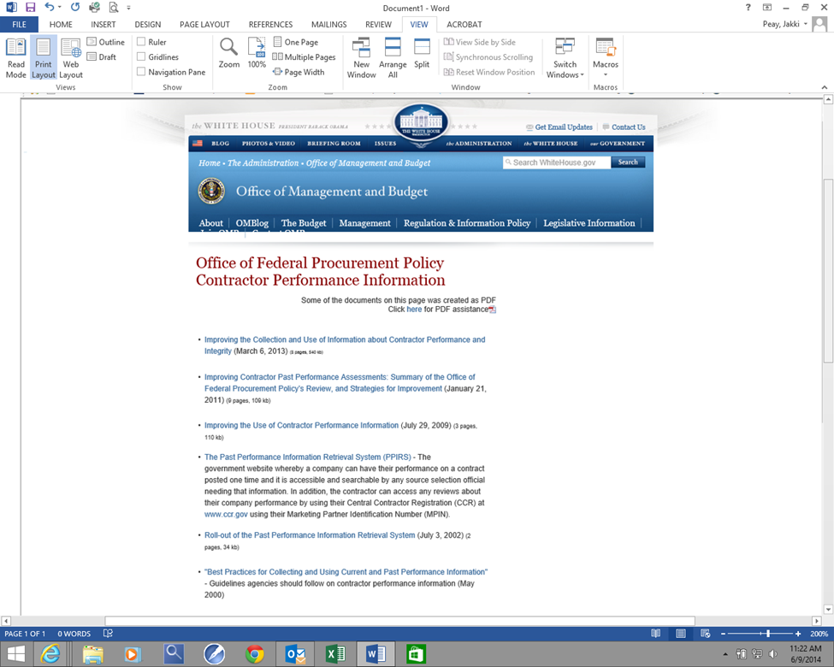
Past Performance Policy Resources
OFPP Policy Guidance - Website at http://www.whitehouse.gov/omb/procurement_index_contract_perf/
Agency specific procedures as required by FAR 42.1503.

Slide 19
Past Performance Information
Please submit questions about OFPP Past Performance Policies to Julia Wise at jwise@omb.eop.gov.
Agency Best Practices and Procedures can be submitted to
https://max.omb.gov/community/x/JoNKJQ.

