Slide 1
Dodging the Fiscal Sharks…….. Thriving in Today’s Environment
May 8, 2013

Slide 2
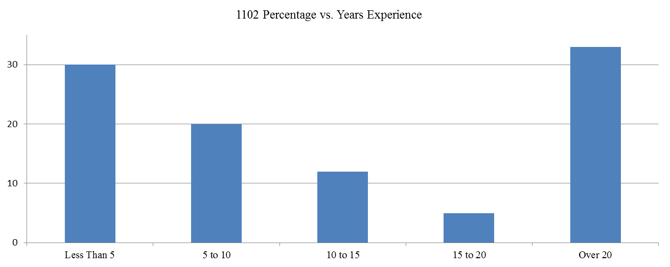
Effective Vendor Engagement: Industry-led Seminars and Industry Liaison Council
Department of Homeland Security
Bob Namejko (Name-ko)
Industry Liaison, DHS Headquarters
2

Slide 3
How do we introduce our 1102 workforce to the “Ways that Industry Does Business with the Government?”
DHS 1102 workforce comprises about 1,400 contracting professionals. Nearly 30% will be retirement eligible in 2018, and approximately 30% have under 5 years of experience.
Most have never worked in industry and are thus unaware of the issues/problems that industry faces in dealing with the Government.
DHS needed to find a method to expose our 1102s to how and why their actions affect industry during the procurement cycle.
DHS’ four procurement priorities: quality contracting, quality people, quality program support, and quality industry-government communication.
k

Slide 4
DHS has developed a cadre of Industry Liaisons (IL) that work in conjunction with our Small Business Specialists (SBS) to interact with our stakeholders and the vendor community.
We have found that a very effective way to communicate with industry is through collaborating with many of the Associations and Interest Groups whose membership comprise nearly 80% of the DHS vendor community (approximately 15,000 vendors).
Working with these associations, the Procurement Ombudsman/Industry Liaison office is working with each association to develop a seminar chaired and presented by their membership.
These seminars are conducted at our Homeland Security Acquisition Institute and are open to the entire DHS 1102 community.

Slide 5
To date, two seminars have been conducted
The first seminar was hosted by:
Washington Homeland Security Roundtable
Title: Strategic Communications-Industry Perspective
  • Tools for Strategic Communications
  • Resources
  • Best Practices
  • Benefits to Industry and DHS
The second seminar was hosted by:
Homeland Security Defense and Business Council
Title: How Industry Assesses Risk
  • Identifying Risk throughout the Acquisition Process
  • Decision-making based on Risk
  • Costs associated with Risk

Slide 6
Next planned seminar
Government Technology Services Coalition (GTSC)
Title: Headed for the Cliff: Challenge for Small Companies that Grow to Mid- Tier at DHS
  • What is the lifecycle of a company in the Federal marketplace?
  • Why would a company decide to enter the Federal Marketplace?
  • What happens when a company is listed as other than small?
  • What are the pitfalls of becoming other than small?
  • How does industry form a joint venture?
Feedback from the 1102 community and the industry participants has been excellent. DHS 1102s gain an understanding of the industry perspective which improves their procurements.

