Slide 1
Overview Lifting the Curtain - Debriefings
FAI Acquisition Seminar

Slide 2
Goals
At the end of this training session, one will:
Be refreshed on information, concepts, and principles associated with debriefings
Recognize oral debriefings as a critical and useful tool for improving vendor/industry relationships
View oral debriefings as a positive opportunity for providing information to the vendor on ways to improve as well as learning about how the Government can improve future acquisitions

Slide 3


Intent
The intent of debriefing is to provide information to offerors (whether successful or unsuccessful) so they gain knowledge that will assist them in improving their chances of success for future source selections
Notes:
Debriefings may be performed verbally, in writing, or by any other method acceptable to the Government contracting officer. (see 15.505(c))
Also, there is no specific requirement to hold face-to-face/oral debriefings. Nonetheless, as the contracting office responsible for making the decision as to the debriefing location and method the needs of the offeror should be afforded due consideration.
A debriefing is not “required” if not timely requested. FAR 15.505(a)(3); 15.506(a)(4)
--For purposes of Pre-award the timeframe is within 3 days after receipt of the notice of exclusion from the competition while for purposes of post-award the timeframe is within 3 days after the date on which that offeror has received notification of contract award.

Slide 4
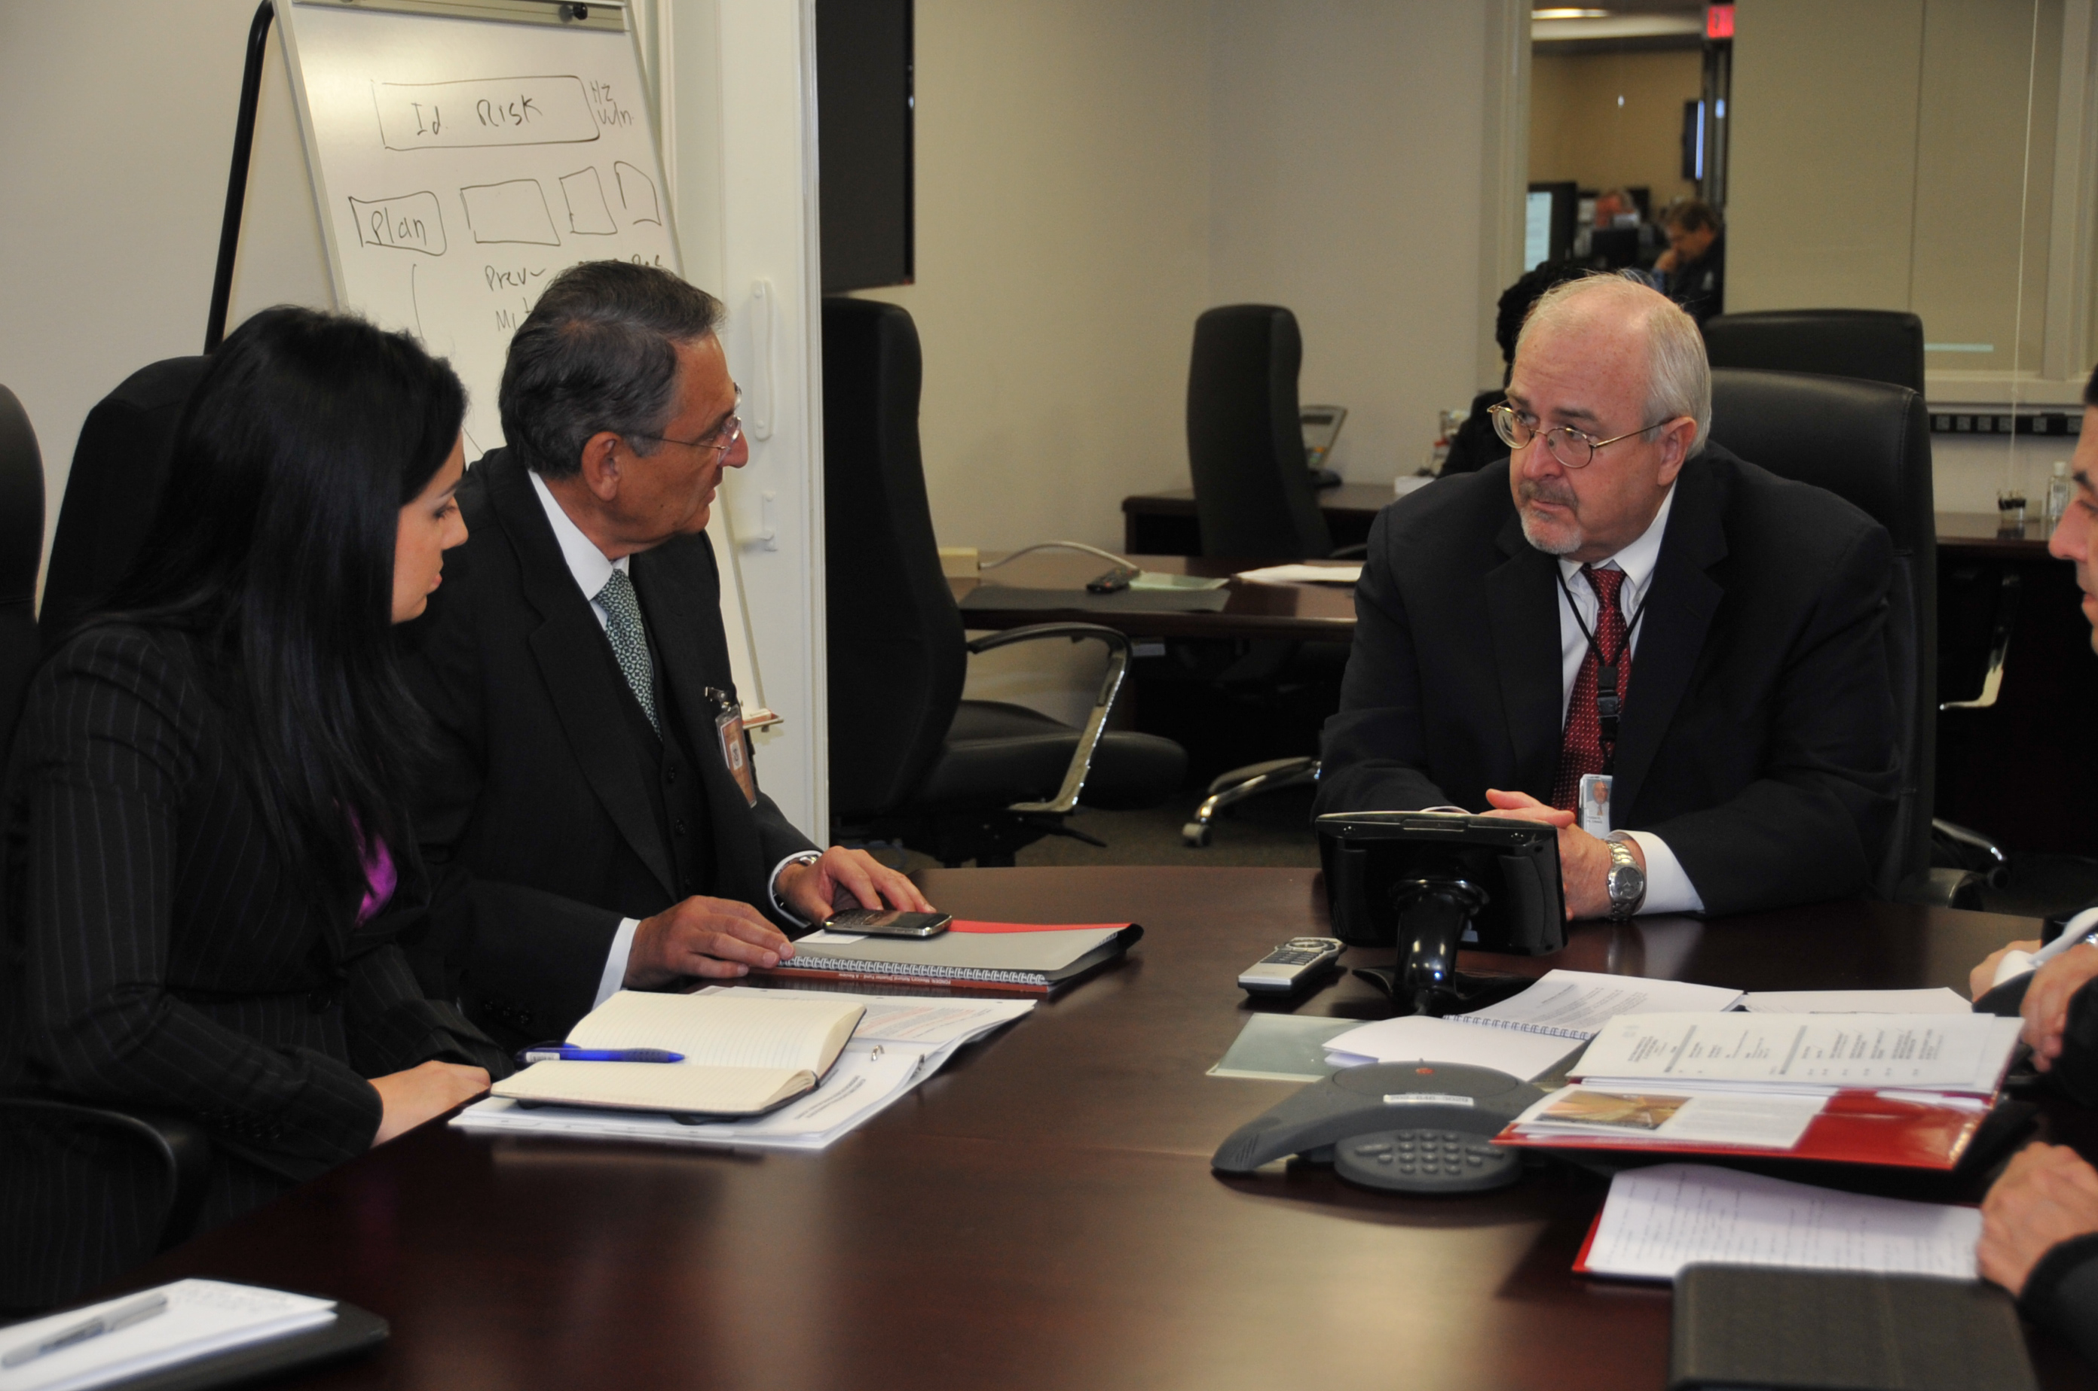
Types of Debriefings
Pre-award: Held for those excluded from competitive range or otherwise excluded from competition prior to award¹.
Post-award: Held after award to either unsuccessful or successful offerors² .
DON’T FORGET to include an official summary of the debriefing in the contract file.
Notes: 1. See FAR 15.505 2. See FAR 15.506.
Notes:
There are two types of debriefings – Pre-award debriefings which are held for those excluded from competitive range or otherwise excluded from competition prior to award. And Post-award debriefings, which are held after award to either unsuccessful or successful offerors.
Some key aspects to remember are:
If a pre-award debriefing is provided then provide no post-award is not to be provided
Always ensure that all parties are clearly aware of the conclusion of the debriefing (in the event the offeror responds with written questions) because the conclusion of the debriefing process triggers protest time-lines.
Always solicit an offeror attendee list, inclusive of titles as the number of attendees and titles may aid in the development of the agenda and indicate the tone of the debriefing.
Always document the debriefing and include an official summary of the debriefing in the contract file.

Slide 5
Pre-Award Debriefing Does and Don’ts
DO Discuss | DO NOT Discuss
Agency’s evaluation of significant elements in offeror’s proposal Summary of the rationale for eliminating the offeror from the competition Reasonable responses to relevant questions about whether source selection procedures contained in the solicitation, applicable regulations, and other applicable authorities were followed in the process of eliminating the offeror from the competition | Number of offerors Identity of offerors/or those in the competitive range Content of other proposals Ranking of other offerors Government’s evaluation of other offerors Trade secrets Proprietary information/pricing Names of individuals providing past performance references Point-by-point comparison with other offers Information not releasable under FOIA
Notes:
See FAR 15.505(e) & (f)
(1) The agency’s evaluation of significant elements in the offeror’s proposal;
(2) A summary of the rationale for eliminating the offeror from the competition; and
(3) Reasonable responses to relevant questions about whether source selection procedures contained in the solicitation, applicable regulations, and other applicable authorities were followed in the process of eliminating the offeror from the competition.
(f) Preaward debriefings shall not disclose-
(1) The number of offerors;
(2) The identity of other offerors;
(3) The content of other offerors’ proposals;
(4) The ranking of other offerors;
(5) The evaluation of other offerors; or
(6) Any of the information prohibited in 15.506(e).
(e) The debriefing shall not include point-by-point comparisons of the debriefed offeror’s proposal with those of other offerors. Moreover, the debriefing shall not reveal any information prohibited from disclosure by 24.202 or exempt from release under the Freedom of Information Act (5 U.S.C. 552) including-
(1) Trade secrets;
(2) Privileged or confidential manufacturing processes and techniques;
(3) Commercial and financial information that is privileged or confidential, including cost breakdowns, profit, indirect cost rates, and similar information; and
(4) The names of individuals providing reference information about an offeror’s past performance.

Slide 6
Post-Award Debriefing Dos & Don’ts
DO Discuss | DO NOT Discuss
Offeror’s evaluated significant weaknesses and/or deficiencies Overall evaluated price/cost and technical ratings of the debriefed offeror and awardee Past performance information Overall ranking all offerors Rationale for award summary Summary of rationale for award Make/model of commercial items to be delivered by awardee Reasonable responses to relevant questions about following source selection procedures | Point-by-point comparisons of the debriefed offeror’s proposal with those of other offerors Strengths, weaknesses, and deficiencies in competing proposals Trade secrets, innovative concepts, design, etc. Privileged or confidential manufacturing processes or techniques Privileged commercial or financial information Names of individuals providing reference information about an offeror’s past performance
Notes:
See FAR 15.506(d) and (e)
(1) The Government’s evaluation of the significant weaknesses or deficiencies in the offeror’s proposal, if applicable;
(2) The overall evaluated cost or price (including unit prices) and technical rating, if applicable, of the successful offeror and the debriefed offeror, and past performance information on the debriefed offeror;
(3) The overall ranking of all offerors, when any ranking was developed by the agency during the source selection;
(4) A summary of the rationale for award;
(5) For acquisitions of commercial items, the make and model of the item to be delivered by the successful offeror; and
(6) Reasonable responses to relevant questions about whether source selection procedures contained in the solicitation, applicable regulations, and other applicable authorities were followed.
For further information regarding debriefings please refer to
Pre-Award: FAR 15.505(e) outlines what shall be disclosed while FAR 15.505(f) outlines what shall not be disclosed.
Post-Award: FAR 15.506(d) outlines what shall be disclosed while FAR 15.506(e) outlines what shall not be disclosed

Slide 7

Best Practices - Government
Prepare
Make a detailed agenda
Know your team & their roles
Review all source selection documents
Anticipate questions and prepare answers
Remember this is an opportunity to learn
Notes:
Click - Bullets 1 & 2 – This is important as being unprepared is the surest way to lose credibility and the confidence of the offeror. If time allows one good way to prepare is to conduct a mock debriefing, which enables one to asses strengths and weakness and develop the agenda. Altogether, when preparing for a debriefing try to think like a contractor; thereby be able anticipate and address questions.
Click - Bullets 3 & 4 – Knowing you team and their roles is important as it is critical they understand the debriefing process, their roles and responsibilities during the debriefing as well as the agenda. Otherwise, a disorganized and unprepared team can jeopardize the success of the debriefing.
Click - Bullet 5 – Lastly……to any questions provided by the offeror.

Slide 8

Benefits to Government
Deters protests
Fosters a relationship of trust between Government and Vendor/Industry
Promotes future competition
Improves the quality of future offers
Improves the quality of future solicitations
Demonstrates mutual respect and concern
Notes:
Bullet 1 –
Because:
It provides a clear understanding of the Agency’s evaluation process and the basis for the selection decision;
Instills confidence in the contracting process by affirming that offers were treated fairly.
Click - Bullet 2 – This is a benefit because unsuccessful offerors are able to accept negative findings in a debriefing if they perceive that the Agency has acted with fairness, consistency, objectivity and in accordance with the evaluation criteria described in the solicitation. Altogether, strengthening the Government’s relationship with industry
Click - Bullets 3 – 5 – Read the bullets
Click - Bullet 6 – Recognize that offerors expend a considerable amount of money and time submitting response, thus deserve a thorough and meaningful debriefing.

Slide 9

Benefits to Vendor/Industry
Reduces costs to obtain information
Enhances the quality of future proposals
Improves vendor decision-making capabilities
Provides an opportunity to provide feedback on the Government’s procurement process
Provides the ability to amplify information, ask questions, and understand the customer
Notes:
Bullet 1 –
Click - Bullets 2 & 3 – By reducing misunderstanding
Click - Bullets 4 & 5 – read bullets

Slide 10

Keys to Successful Debriefing
Findings supported by specific reference to solicitation/offer page, paragraph number, etc. where strengths, weaknesses, deficiencies, and clarifications occur
Ensure key points during the debriefing are captured and documented
Tone, Syntax, Technique
Focus on open & positive communication
Notes:
Bullet 1 – Although, the extent of preparation needed varies considerably with the complexity and dollar value of the procurement it is key to ensure….(read bullet)
Click – Bullets 2 thru 4 - Read bullet 2 and then 3
Bullet 3
For tone, syntax and technical some key pointers are:
Maintaining a positive delivery by avoiding the extensive use of “will not” and “cannot” statements
Balancing controlling the meeting with dialogue and interchange
Listening carefully to the offeror’s questions and verify you have answered them
Watching body language and maintain good eye contact and body posture
Using a professional tone and refraining from being condescending or abrupt, or defensive
Bullet 5 – Essentially, keep in mind It is ok to “agree to disagree” on a given evaluation finding. As Contracting officer your job is not to convince them that they are wrong, but rather to explain the rationale behind the evaluation finding and award determination.

Slide 11

Keys to Successful Debriefing - Cont.
Convey confidence in the award process.
Provide specific and honest feedback within regulations.
Avoid hypothetical questions ( e.g., “if we had proposed this, how would you have rated it?”)
Establish the debriefing ground rules upfront
Notes:
Bullet 1 – This is key as the entire solicitation process influences debriefings; Therefore, the requirement; evaluation factors; and evaluation documentation all play a part in the award determination process, thus be confident in the effort the government applied. In addition, ensure meaningful dialogue between both Government and the vendor.
Click - Bullets 2 & 3 –
Bullet 2 - For example, address the concerns such as:
What in their proposal caused them to lose?
What caused the Government to select the other Offeror?
How can they improve for the next competition?
Click - Bullet 4 - For example, make sure it is clear that the debriefing is not a forum for a debate (“We are here to relate, not debate”).

Slide 12
Debriefings Versus Explanations
Debriefing: In general, debriefings are associated with FAR 15 source selections. A debriefing provides detailed information on the debriefed offeror’s proposal and the selection process, including the significant weaknesses or deficiencies in their proposal, an explanation of the evaluation process, an assessment of their proposal in relation to the evaluation criteria, a general understanding of the basis of the award decision, and the rationale for their exclusion from the competition. | vs | Explanation: Explanations of the basis of the award occur at the end of a simplified acquisition; GSA schedule order (FAR 8.405-2); or IDIQ order (FAR 16.505) that is less than $5M. An explanation is short, includes the basis for the selection, and provides the offeror with general areas to improve future proposals. There is no discussion of strengths, weaknesses, deficiencies, ratings, or rankings of other offerors
Notes:
Before concluding, I think it is important to highlight the difference between debriefing and explanation, which is prescribed in FAR 8.4.
As one can see explanations do not afford offerors as much as an opportunity to understand the government’s rationale for award or learn ways to improve.
In closing, I would like to introduce the two role play mock debriefing sessions that will presented.

Slide 13
Mock Debriefings Intro -
Scenario 1 – Treasury awarded a contract for technical services in support of its SharePoint site. Gray Space Corporation (GSC) one of three offerors who responded to the request for proposal has requested a debriefing. GSC believes the Government may have erred in its evaluation process and is confident it answered all of the discussion questions in their final proposal revision. The Government used the Trade-off process in accordance with FAR 15.101-1.
At the conclusion of this role play session, time will be allotted for the participants to provide feedback as well as to provide answers to questions submitted.
Notes:
This mock debriefing session is anticipated to last approximately twenty minutes…at the beginning of this session the role players will introduce themselves and additional information about the scenario…at the conclusion…

Slide 14
Mock Debriefings Intro – Cont.
Scenario 2 – Treasury awarded a contract for engineering and technical services. BelAir Company (BelAir) one of three offerors who responded to the request for proposal has requested a debriefing. BelAir wants to understand why the Government did not “follow the RFP and do a true best value award to them.” (Note: The direct quote is from a call between BelAir and the CO, made during the set up of the debriefing). The Government used the Trade-off process in accordance with FAR 15.101-1.
At the conclusion of this role play session, time will be allotted for the participants to provide feedback as well as to provide answers to questions submitted.
Notes:
As like the scenario one this mock debriefing session is anticipated to last approximately twenty minutes…. at the beginning of this session the role players will introduce themselves and additional information about the scenario…at the conclusion…

Slide 15
Disclaimer
The actions, words, emotions, and opinions expressed by the individuals participating in these role play mock debriefings sessions are completely fictional and not representative or reflective of those involved. These role play mock debriefing sessions are for training purposes only.

