Slide 1
To Bid or Not To Bid: An Industry Perspective
Antwanye Ford, Stuart S. Gittelman, Ph.D., Kathryn Klaus, CPCM, CFCM
2014, October 29

Slide 2
Agenda
The Contractor Perspective
The Bid Decision
Communication Pitfalls
Key Takeaways

Slide 3
The Contractor Perspective
We represent 3 companies of differing size and technical expertise
Enlightened, Inc. – a small, Hub Zone, minority owned business
HP Enterprise Services, LLC –a CAS-covered subsidiary of a large publicly traded IT company
PDRI, a CEB company – a mid-sized human capital consulting firm, a subsidiary of a large, publicly traded company
While very different, we’ve discovered that our processes are very similar with the biggest difference being the level of formality of the process and the number of approvals required.

Slide 4

Industry Goals
Reputation
Growth
Solid balance sheet & Positive cash
flow with profit
Contribute to Mission Outcome

Slide 5

The Bid Decision
Qualify the Deal
Resources
Win Probability
Risk

Slide 6
Qualify the Deal - Pre-RFP Release
Are we ahead of the procurement?
Establish(ed) relationship with client
Likelihood of procurement
Agency mission aligned to capabilities
Integration with other programs
Open communications with industry
RFI’s – Free advice or a small business search?

Slide 7

Qualify the Deal “No-Bid Red Flags”
No RFI, draft, or industry day
Unrealistically short time to respond
Unrealistically short transition timeframes
Evaluation criteria unduly vague
Price evaluation not clearly defined

Slide 8
Qualify the Deal “No-Bid Red Flags”
High number of past performance requirements
High number of detailed qualifications for key personnel
Technical requirements that are too narrowly defined and seem to favor a particular brand, product, or service

Slide 9
Qualify the Deal
Templates and “Re-cycled RFPs”
Questions & Answers

Slide 10
Qualify the Deal
Terms & Conditions appropriate to the contract
Requirements align with Contract Type
Understanding of the contract vehicle

Slide 11
Qualify the Deal
Pricing requirements
Page limitations
Oral presentations

Slide 12
The Bid Decision
Qualify the Deal
Resources
Win Probability
Risk

Slide 13

Resources to Bid
Bid & proposal funds
Schedule
Solution
Development of Team/Subcontractors

Slide 14
Resources to Deliver
Staffing
Location/travel requirements
Transition timing
Standards compliance
Investment

Slide 15
The Bid Decision
Qualify the Deal
Resources
Win Probability
Risk

Slide 16

Can We Win This?
Is the competition fair?
Evaluation criteria (Technical and Price)
Do we have a competitive solution?
Do we have a competitive price?
Competitor Analysis
Do we understand the customer?

Slide 17
The Bid Decision
Qualify the Deal
Resources
Win Probability
Risk

Slide 18

Risk
Company reviews and approvals are necessary to ensure compliance with bid and understanding of any assumed risk to ensure successful delivery
Notes:
company reviews and approvals are necessary to ensure compliance with bid and understanding of any assumed risk to ensure successful delivery

Slide 19

Risk
Delivery
Financial
Contractual
Notes:
company reviews and approvals are necessary to ensure compliance with bid and understanding of any assumed risk to ensure successful delivery

Slide 20
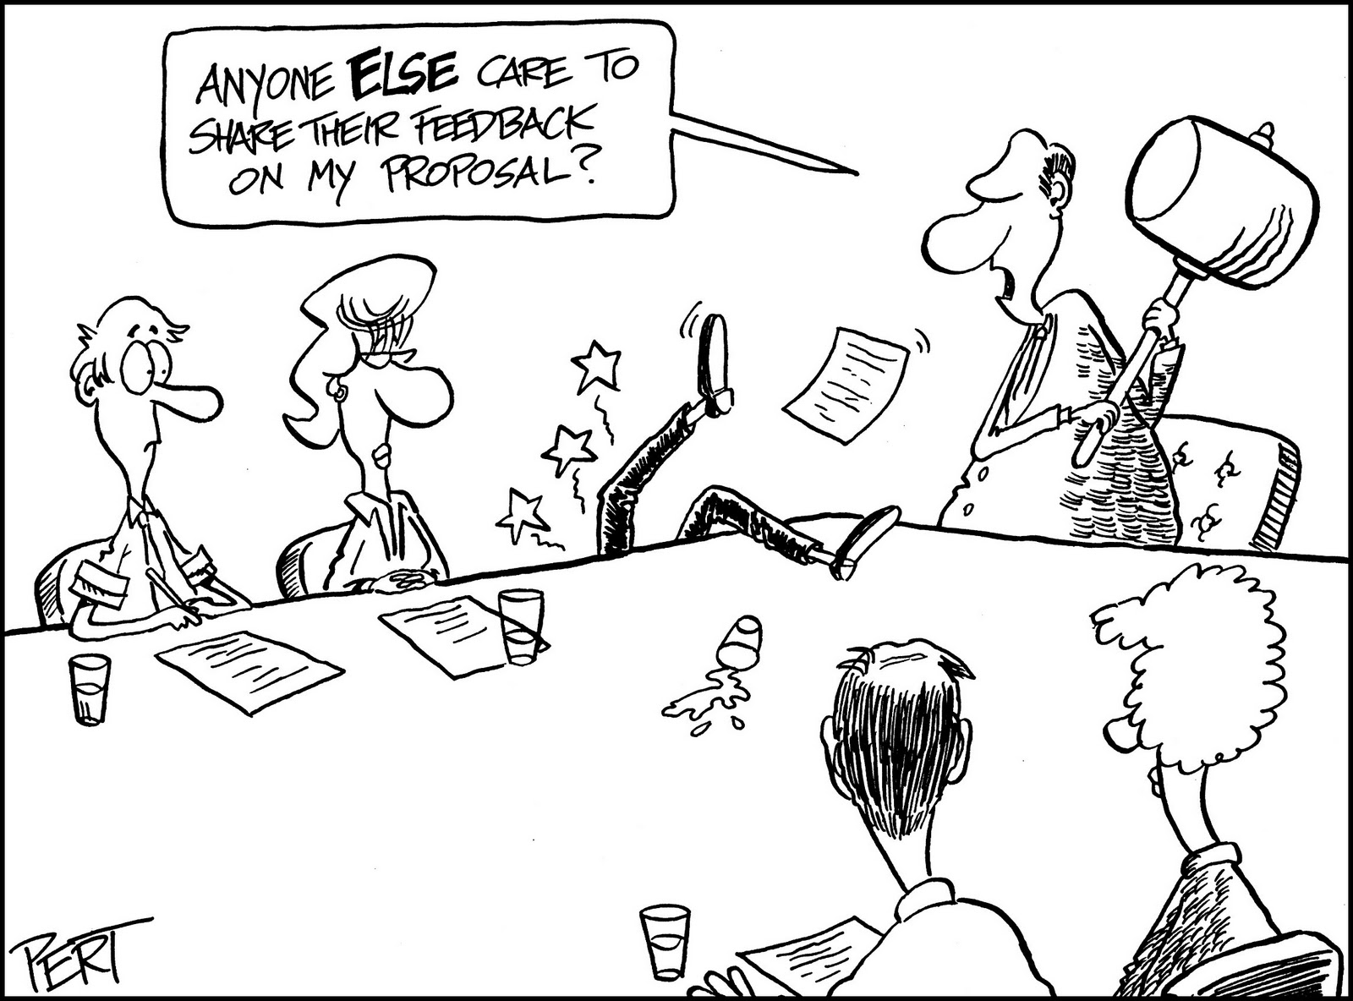
Communication Pitfalls

Slide 21

Communication Pitfalls
Discussions are not occurring with the vendor community either in industry forums and/or 1:1
Draft PWS or SOW issued instead of draft RFPs

Slide 22
Communication Pitfalls
Evaluation criteria is written very generically and doesn’t contemplate customer objectives
Awards are often made with no discussions

Slide 23
Communication Pitfalls
Assumptions - Do you want them? Don’t you want them?
Debriefs and “explanations” do not contain sufficient information.

Slide 24
Communication Pitfalls
Some contracting officers do not communicate any procurement status.
Once we submit a bid, without any communications, we have no idea if/how we should prepare for delivery on a contract.

Slide 25
Key Takeaways
1.
Bid & Proposal funds are limited.
2.
We bid when we believe we can win.
3.
We bid what we know we can deliver.
4.
Communication improves the proposed solution.
5.
Clearly define requirements and evaluation criteria.
6.
Set realistic timelines and expectations.

