Slide 1
HR ATTRITION ANALYSIS
Turning a 34% attrition crisis into a $561K retention opportunity
A Business Analytics Case Study
Python • DuckDB SQL • Power BI
HRDataset v13 | 299 employees | Raw data to decision tool

Slide 2
WHERE IT STARTS
Every analysis begins with a business question
The questions this project set out to answer: How serious is attrition? Why are people leaving? What is it costing? And what is the return on fixing it?
This project answers that question in four steps:
1
2
3
4
Diagnose
Explain
Quantify
Decide
How severe is attrition, and who is leaving?
Why are they leaving — and was it preventable?
What is it costing, and who is at risk next?
What is the return on fixing it?

Slide 3
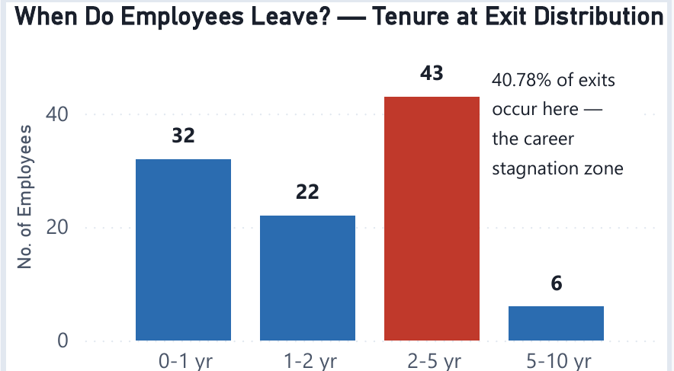
STEP 1 — DIAGNOSE
The problem is real, and worse than it looks
More than 1 in 3 employees left — over double the healthy benchmark
34.45%
Overall attrition rate
85%
of exits are voluntary
2.1 yrs
average tenure at exit
The danger zone is mid-tenure. 40.78% of all exits fall in the 2-5 year band — people leaving exactly when they have become experienced and valuable.

Slide 4
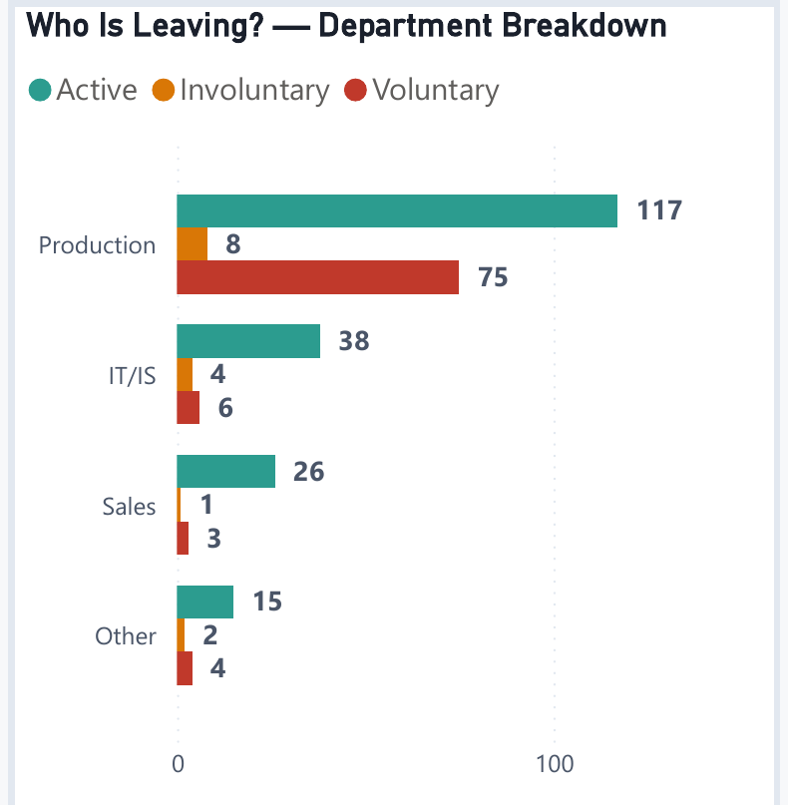
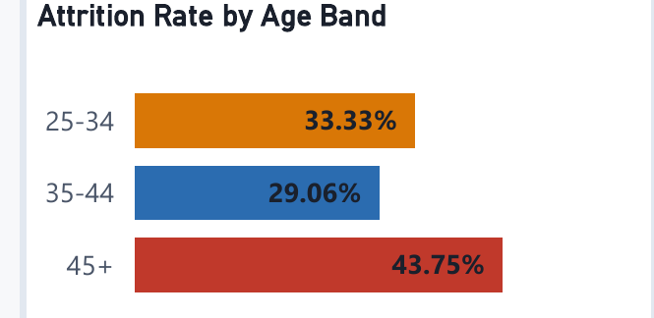
STEP 1 — DIAGNOSE
Who is leaving — and a surprise in the data
Production drives the loss in absolute numbers — but the rate tells a second story.
The 45+ group has the highest attrition (43.75%) — a retirement and late-career signal that only surfaced after a data-quality fix corrected one-third of the age records.

Slide 5
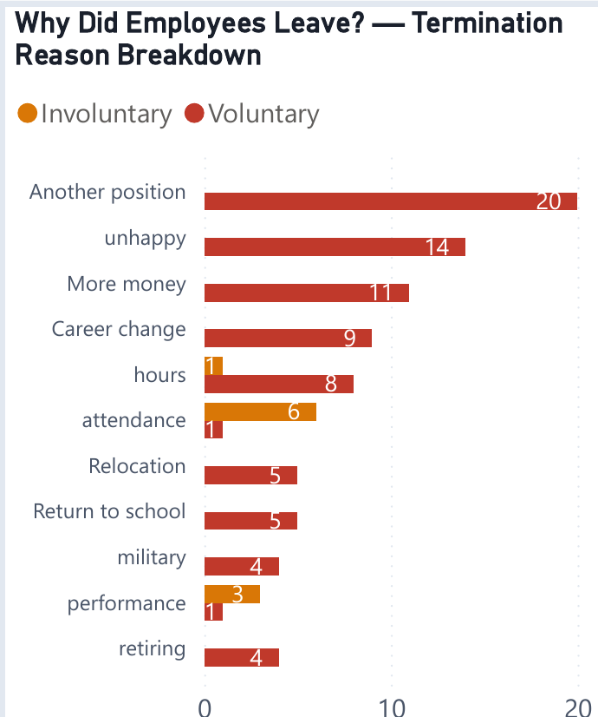
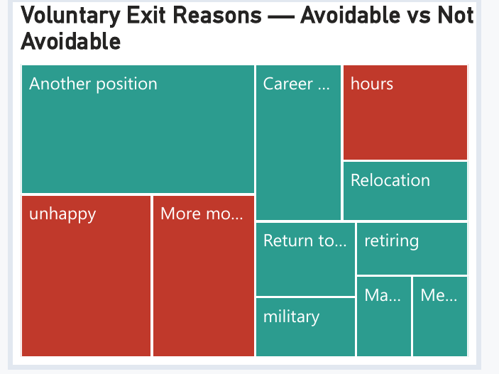
STEP 2 — EXPLAIN
Most of the loss was preventable
The reasons people gave point straight at fixable problems
41% of voluntary Production exits were avoidable. Unhappy (14), more money (11), and hours (6) — 31 of 75 exits — were driven by factors squarely within management control.

Slide 6
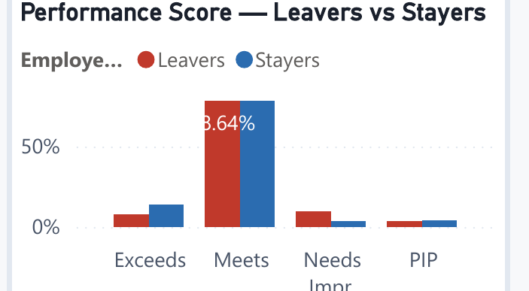
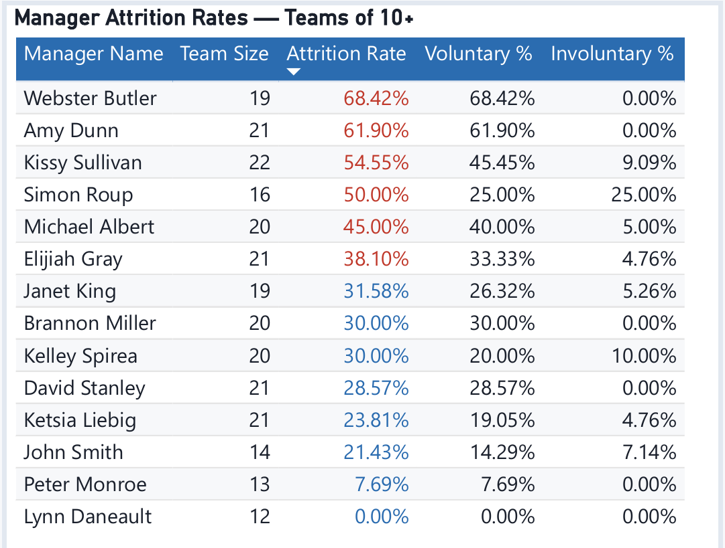
STEP 2 — EXPLAIN
It is the wrong people leaving — and some managers stand out
Underperformers leave 3× more often (9.71% vs 3.57%), and high performers are nearly 2× likelier to stay. The people walking out are disproportionately those the company would most want to keep developing.
Two managers lose staff at double the company rate — Webster Butler (68%) and Amy Dunn (62%), all voluntary.

Slide 7
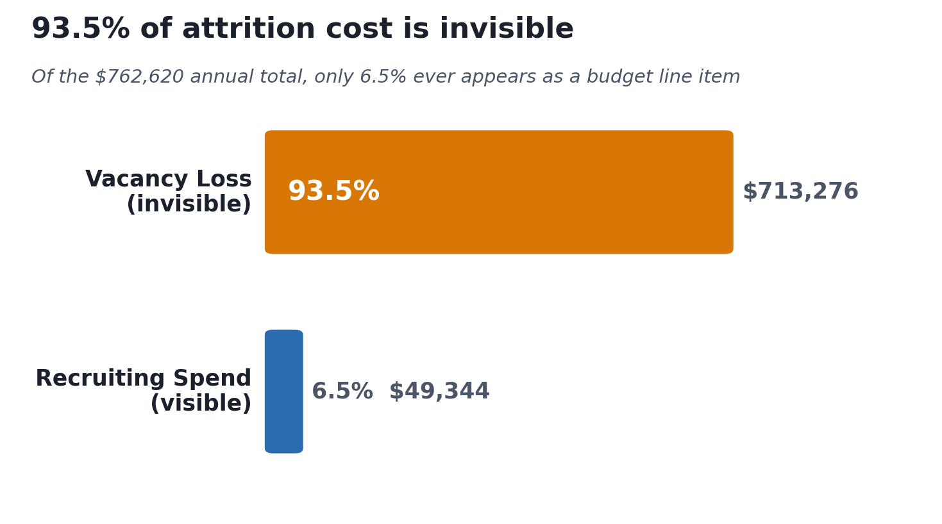
STEP 3 — QUANTIFY
The cost is huge — and almost invisible
$762,620
total annual attrition cost
Only 6.5% is visible recruiting spend. The other 93.5% is productivity lost while roles sit empty — a cost no one budgets for, but everyone pays.

Slide 8
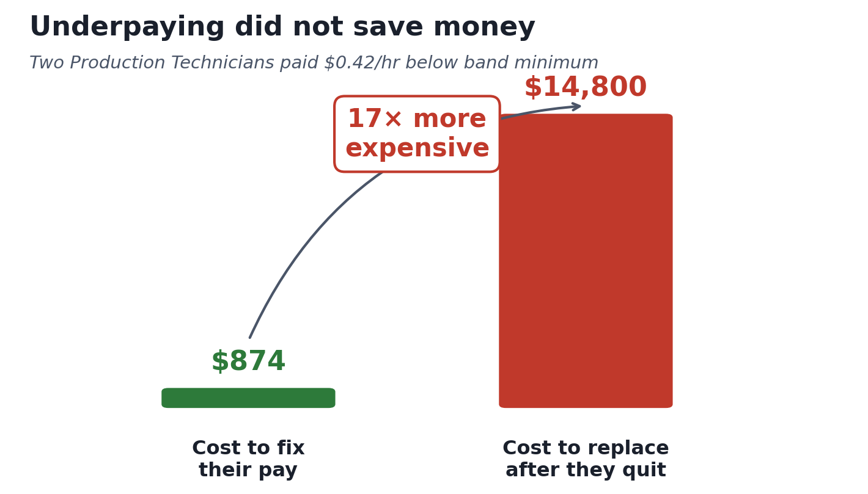
STEP 3 — QUANTIFY
And underpaying made it worse
The pay-equity trap Fixing two below-minimum technicians would have cost $874/year each. Replacing them after they quit cost ~$14,800 each.

Slide 9
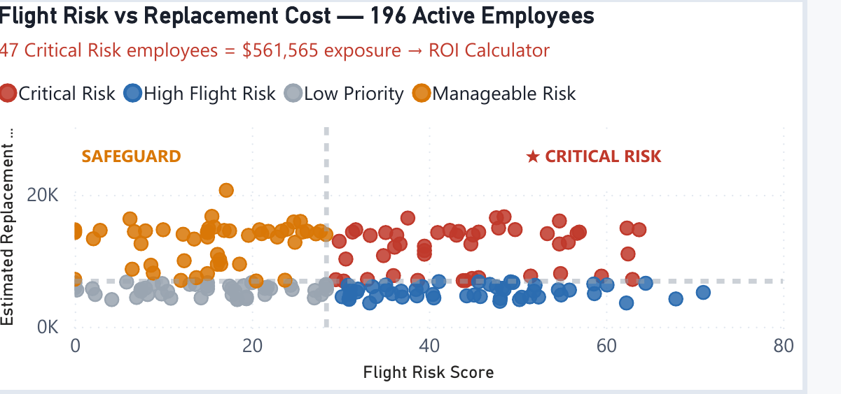
STEP 3 — QUANTIFY
So who is at risk next?
47
Critical Risk employees
Every active employee was scored on flight risk and replacement cost. 47 sit in the top-right: likely to leave AND expensive to lose — $561,565 in exposure.

Slide 10
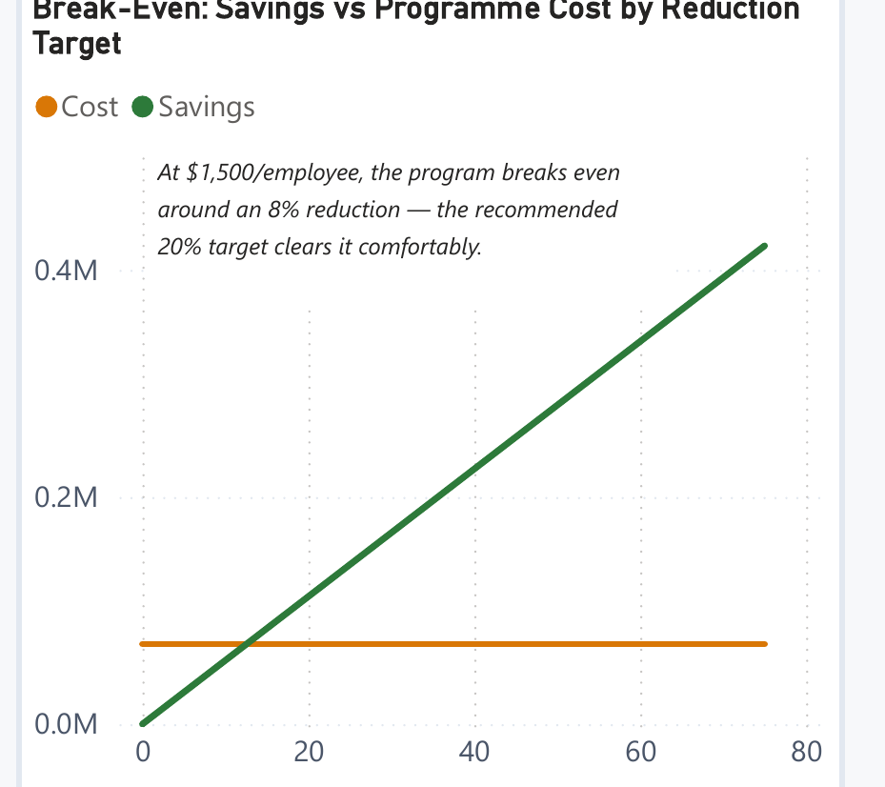
STEP 4 — DECIDE
Retention pays for itself
Recommended scenario — deliberately conservative inputs
$70,500
Programme cost
$112,313
Projected savings
59%
Net ROI
9
Employees retained
$1,500/employee, 20% reduction. $1,500 is ~5% of a technician's salary; 20% is the cautious end of the 15-25% industry range. The dashboard's $1,000/25% default reaches 199% ROI — this is the version that survives a skeptical CFO.

Slide 11
THE ACTION PLAN
Four recommendations, ranked by cost-to-impact
1
Fix below-market pay immediately
Bring 3 active below-minimum technicians to band. ~$2,600/year. Prevents the 17× replacement penalty — lowest cost, fastest payback.
2
Launch a targeted retention programme
Focus on the 47 Critical Risk employees. At a conservative $1,500 each for a 20% reduction, the model returns 59% ROI — $112K saved on $70K, retaining 9 high-value staff.
3
Build progression paths at 2-5 years
This tenure band drives 41% of exits, mostly to 'another position'. Career pathways address the root cause of voluntary loss.
4
Coach high-attrition managers
Webster Butler (68%) and Amy Dunn (62%) lose staff at double the company rate, all voluntary. Investigate management practice.

Slide 12
BEHIND THE ANALYSIS
How it was built
A full pipeline — from four raw CSVs to an interactive decision tool
1
2
3
4
Data Engineering
SQL Analysis
Cost Modelling
Power BI Dashboard
4 linked CSVs cleaned in Python/pandas. Caught a DOB century-bug that had silently corrupted one-third of the age data — a QA catch that reversed a key finding.
DuckDB for attrition rates, a cost engine built on real recruiting spend, and a weighted flight-risk score across 196 active employees.
Replacement cost from actual data — recruiting spend plus 45-day vacancy loss — not generic industry multipliers.
4 pages, a live What-If ROI calculator, custom theme, and every data limitation documented on the page.
Reproducible • Documented • Recruiter-ready

Slide 13
From diagnosis to decision
This project doesn't just report that attrition is high. It explains why, quantifies the cost, identifies who is at risk, and hands leadership a tool to model the return on fixing it.
Download the interactive dashboard to use the live ROI calculator.
Rupsa | Business Analytics Portfolio

