Slide 1

Bayesian Hierarchical Models to Estimate Groundwater Average Arsenic in Mandari Village, Bangladesh
Name: Rupsa Dawn
Registration No.: 100242014000039
Roll No.: 10024017900001
Session: 2024-2026

Slide 2
Contents
Problem statement
Dataset
Bayesian models for finite population
Different models
Comparison of Different Models
Model diagnostics
Conclusion
References

Slide 3
Problem Statement
Arsenic contamination in wells in Bangladesh is a major public health crisis.
Arsenic level according to WHO should be less than 10 µg/L. However, for Bangladesh it is set as 50 µg/L
British Geological Survey carried out a project to find average Arsenic in ground water.
We want to estimate the average arsenic contamination level in Mandari village.
Our estimation is carried out using different Bayesian analysis according to Banerjee (2025).

Slide 4
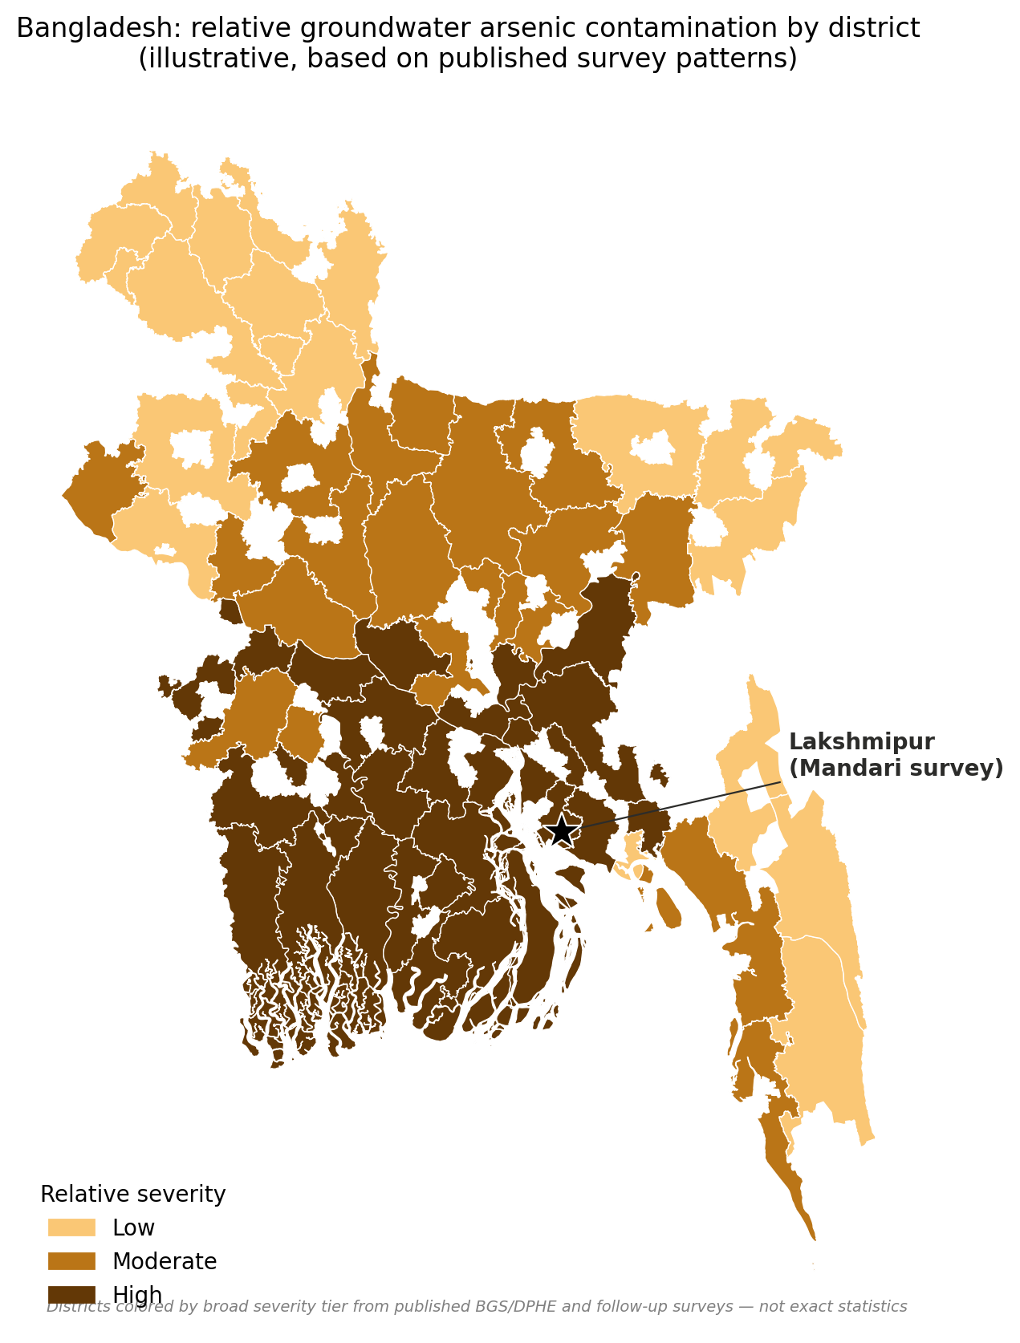
Location: Mandari Village, Lakshmipur District, Chittagong Division, Bangladesh.
The Crisis: Millions of shallow tube wells—originally dug to avoid contaminated surface water—unintentionally tapped into massive, naturally occurring groundwater arsenic.
Geological Trap: Situated in the low-lying Meghna River deltaic floodplain.
Chemical Environment: Young, organic-rich sediment paired with a shallow water table creates a reducing aquifer chemistry that aggressively mobilizes arsenic into the water.

Slide 5
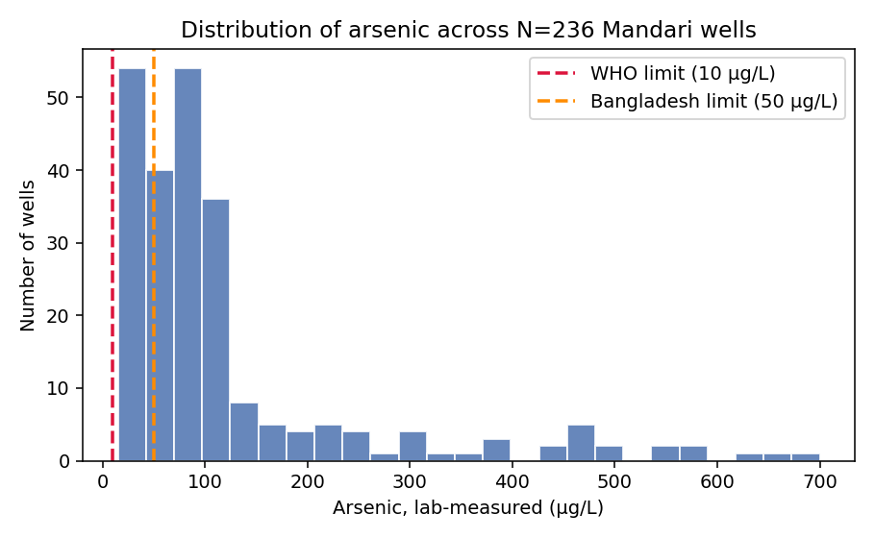
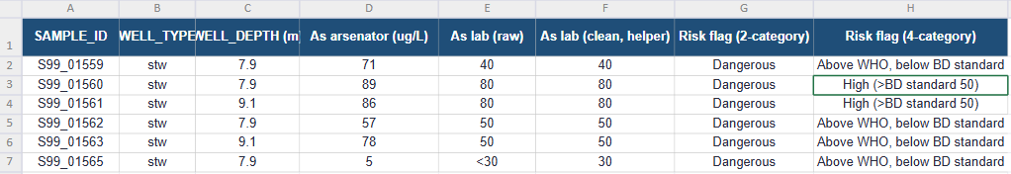
Dataset
This dataset comes from a large-scale groundwater arsenic survey carried out jointly by the British Geological Survey (BGS), the Department for International Development (DFID), and the Department of Public Health Engineering (DPHE), Bangladesh
Wells are sub-categorized from raw column, which mixes numeric readings with censored text such as "<30". A helper column coerces both forms to a single numeric value, and a second column applies the WHO/Bangladesh threshold logic.

Slide 6
Bayesian Models for Finite Population
01
02
03
Model 1
Using SRSWOR
Model 2
Approximate Horvitz Thompson
Model 3
Exact Horvitz Thompson

Slide 7
In methodology, we have applied Predictive approach in estimating population mean. We evaluate the mean of the sample and based on that we use Bayesian prediction to estimate the mean of the unsample part.
17% sampling fraction (n=40, N=236) is being evaluated as our sample.
The true mean of our population is calculated to be 120.78 ug/L which will be used later on for comparison purposes.
For Model 1, sampling is done using SRSWOR but for model 2 and 3, we have used unequal sampling method.

Slide 8
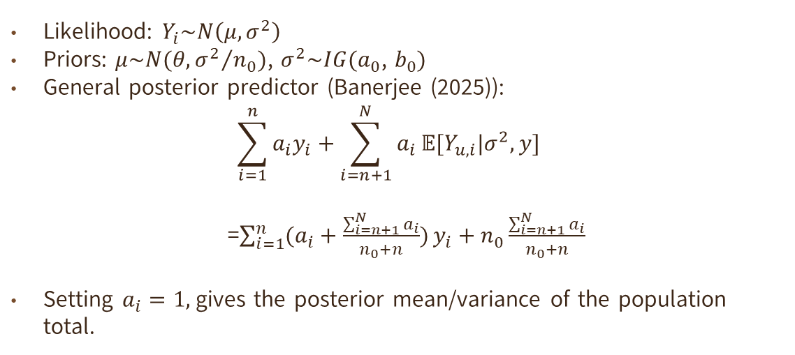
Model 1: Using SRSWOR
Likelihood: $Y_{i}\sim N\left(μ,σ^{2}\right)$
Priors: $μ\sim N(θ, {σ^{2}}/{n_{0}})$, $σ^{2}\sim IG(a_{0}$, $b_{0})$
General posterior predictor (Banerjee (2025)):
$$\sum_{i=1}^{n}{a_{i}y_{i}}+\sum_{i=n+1}^{N}{a_{i}}𝔼[Y_{u,i}|σ^{2},y]$$
=$\sum_{i=1}^{n}{(a_{i}+\frac{\sum_{i=n+1}^{N}{a_{i}}}{n_{0}+n})}y_{i}+n_{0}\frac{\sum_{i=n+1}^{N}{a_{i}}}{n_{0}+n}$
Setting $a_{i}=1,$gives the posterior mean/variance of the population total.

Slide 9
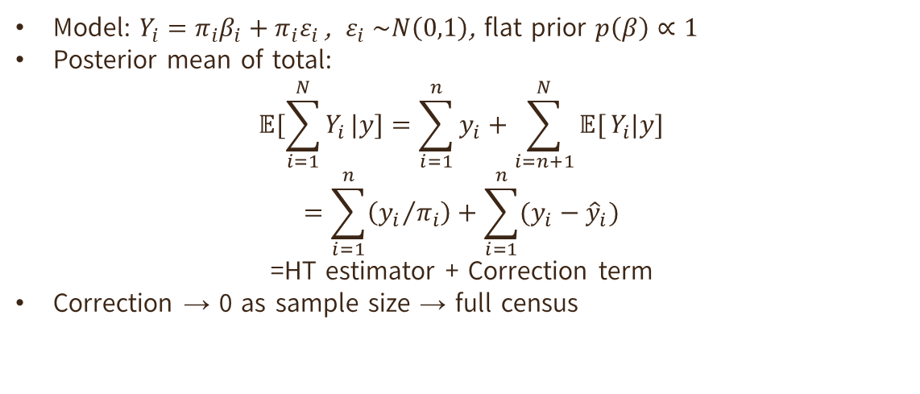
Model 2: Approximate HT
Model: $Y_{i}=π_{i}β_{i}+π_{i}ε_{i }$, $ε_{i} \sim N\left(0,1\right)$, flat prior $p\left(β\right)∝1$
Posterior mean of total:
$$𝔼[\sum_{i=1}^{N}{Y_{i}}|y]=\sum_{i=1}^{n}{y_{i}}+\sum_{i=n+1}^{N}{𝔼[}Y_{i}|y]$$
$$=\sum_{i=1}^{n}{\left({y_{i}}/{π_{i}}\right)+\sum_{i=1}^{n}{(y_{i}−{\hat{y}}_{i})}}$$
=HT estimator + Correction term
Correction → 0 as sample size → full census

Slide 10

Model 3 : Exact HT
Same linear model, but $ε_{i}\sim N(0,σ_{i}^{2})$ with $σ_{i}^{2}=1/(1−π_{i})$
This specific choice makes the correction term vanish entirely.
Posterior mean = $\sum{({y_{i}}/{π_{i}})}$ exactly = classical HT estimator, for any n
This is the theoretical bridge between Bayesian and design-based inference.

Slide 11
Comparison of Different Models

Slide 12
 | Mean(ug/L) | SD | CV(%) | CI length
Model 1 | 100.90 | 15.08 | 14.95 | 60.80
Model 2 | 110.73 | 12.97 | 11.71 | 50.85
Model 3 | 125.22 | 13.24 | 10.58 | 51.95
Model 1 (SRSWOR): Standard predictive model captures simple random sampling distributions cleanly but yields wider intervals.
Model 2 (Approximate HT): Incorporates Horvitz-Thompson weights with an added stochastic correction term to absorb modeling noise produces lower CV and narrower intervals.
Model 3 (Exact HT): Uses exact deterministic structural transformations of sample inclusion probabilities, yields an even lower CV %.

Slide 13
Model Diagnostics

Slide 14
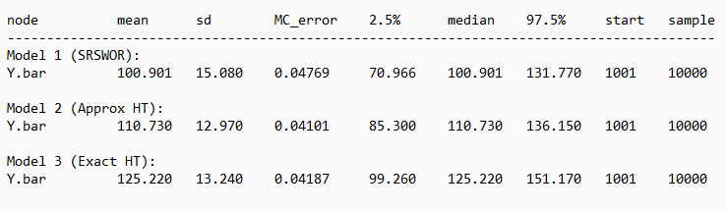
WinBUGS output

Slide 15
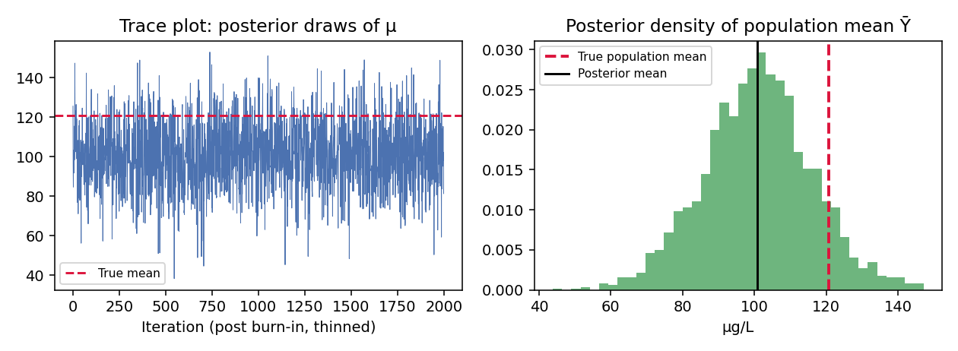
Model 1: Using SRSWOR
Every well, sampled or not, is treated as coming from one shared normal distribution with unknown mean and variance. A weak prior is updated with the sampled readings, then plausible values are simulated for every unsampled well. Repeating this thousands of times builds a full posterior distribution for the population total.
Posterior Mean: 100.90 ug/L
Credible Interval: 70.97 – 131.77

Slide 16
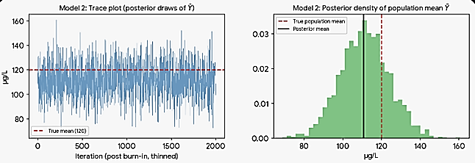
Model 2: Approximate HT
Each well's reading is modelled as proportional to its inclusion probability, scaled by one unknown constant plus random noise. The sampled data fit that constant, which then reconstructs the population total in the classical weighted way — each reading divided by its inclusion chance — plus a small correction that shrinks as the sample grows.
Posterior Mean: 110.73 ug/L
Credible Interval: 85.30 – 136.15

Slide 17
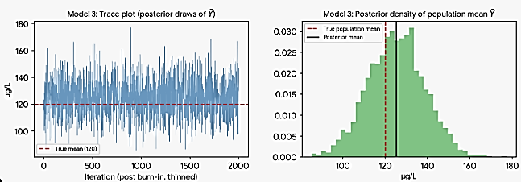
Model 3: Exact HT
Structurally the same as Model 2, but the noise allowed for each well is set exactly in proportion to its inclusion probability. That specific choice cancels the correction term entirely, so the posterior answer matches the classical weighted (Horvitz–Thompson) estimate exactly, regardless of sample size.
Posterior Mean: 125.22 ug/L
Credible Interval: 99.26 – 151.17

Slide 18
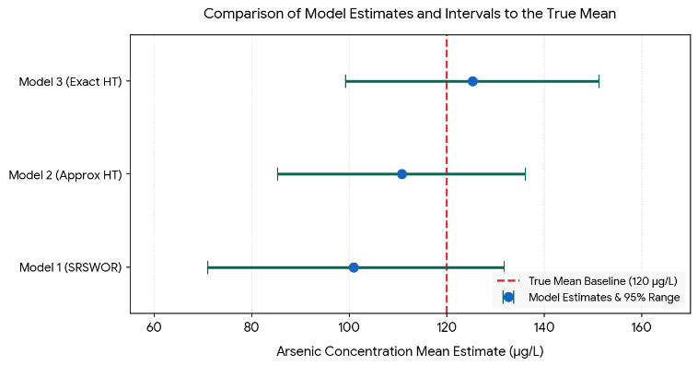
MCMC Convergence: Trace plots confirm stationary, well-mixed chains across 2,000 post-burn-in thinned iterations.
Smooth, unimodal Normal distributions for population mean estimates (Ȳ).
Model 3 (Exact HT) emerges as the superior architecture.
Model 3 minimizes uncertainty, achieving the lowest CV (10.58%) and a compact interval width (51.95 µg/L).
Rigorous interval boundaries prevent understating critical high-exposure public health risks.

Slide 19
Conclusion
Framework Implementation: Implemented a Bayesian predictive SRSWOR model and two Horvitz-Thompson frameworks based on Banerjee (2025).
High Statistical Quality: All three models produced highly reliable estimates with a Coefficient of Variation well below the 20% quality threshold.
Model 3 Superiority: Model 3 (Exact HT) proved most efficient, yielding the lowest CV (10.58%) and a compact 95% credible interval length of 51.95 µg/L.
Public Health Impact: Strict Bayesian uncertainty quantification is essential for environmental monitoring, ensuring risk is not understated where decisions directly impact human lives.

Slide 20
References
[1] Narain, R. (1951). On sampling without replacement with varying probabilities. Journal of the Indian Society of Agricultural Statistics, 3, 169–175.
[2] Horvitz, D. G., & Thompson, D. J. (1952). A generalization of sampling without replacement from a finite universe. Journal of the American Statistical Association, 47(260), 663–685.
[3] Kish, L. (1965). Survey Sampling. John Wiley & Sons, Hoboken, NJ.
[4] Scott, A., & Smith, T. M. F. (1969). Estimation in multi-stage surveys. Journal of the American Statistical Association, 64(327), 830–840.
[5] Ghosh, M., & Sinha, B. K. (1990). On the consistency between model- and design-based estimators in survey sampling. Communications in Statistics – Theory and Methods, 19(2), 689–702.
[6] Malec, D., & Sedransk, J. (1985). Bayesian inference for finite population parameters in multistage cluster sampling. Journal of the American Statistical Association, 80(392), 897–902.
[7] Ghosh, M., & Meeden, G. (1997). Bayesian Methods for Finite Population Sampling. Chapman & Hall, London.
[8] Little, R. J. (2004). To model or not to model? Competing modes of inference for finite population sampling. Journal of the American Statistical Association, 99(466), 546–556.
[9] Ghosh, M. (2012). Finite population sampling: A model-design synthesis. Statistics in Transition new series, 13(2), 235–242.
[10] Rao, J. N. K. (2011). Impact of frequentist and Bayesian methods on survey sampling practice: A selective appraisal. Statistical Science, 26(2), 240–256.
Continued…

Slide 21
References
[11] Rao, J. N. K., & Molina, I. (2015). Small Area Estimation (2nd ed.). John Wiley & Sons, Hoboken, NJ.
[12] Banerjee, S. (2025). Finite population survey sampling: An unapologetic Bayesian perspective. arXiv:2306.10635.
[13] British Geological Survey & Department of Public Health Engineering [BGS & DPHE]. (2001). Arsenic Contamination of Groundwater in Bangladesh (D. G. Kinniburgh & P. L. Smedley, Eds.). British Geological Survey Technical Report WC/00/19, Keyworth.
[14] Chakraborti, D., Rahman, M. M., Das, B., Murrill, M., Dey, S., Chandra Mukherjee, S., Dhar, R. K., Biswas, B. K., Chowdhury, U. K., Roy, S., Sorif, S., Selim, M., Rahman, M., & Quamruzzaman, Q. (2010). Status of groundwater arsenic contamination in the state of West Bengal, India: A 20-year study report. Molecular Nutrition & Food Research / Water Research (relevant summary in PubMed, PMID 19382148).
[15] Gaus, I., Kinniburgh, D. G., Talbot, J. C., & Webster, R. (2003). Geostatistical analysis of arsenic concentration in groundwater of Bangladesh. Environmental and Ecological Statistics (Bayesian geostatistical prediction model for arsenic in Bangladesh).
[16] Shalabh. (n.d.). Sampling Theory – Chapter 7: Varying Probability Sampling. Lecture notes, Department of Mathematics & Statistics, Indian Institute of Technology Kanpur. Retrieved from https://home.iitk.ac.in/~shalab/sampling/chapter7-sampling-varying-probability-sampling.pdf

Slide 22
Thank You!

