Slide 1
Report on Basic Vulnerability Assessment for a Small Business Network
Problem Statement : Simulate a real-world vulnerability assessment for a small business IT infrastructure. Identify security gaps, prioritize risks, and provide mitigation strategies to improve the overall security posture.
Company Name – INFOTACT SOLUTIONS
Project by _____
RUPSA KOLEY (Intern)
RAVI PRAKASH (Intern)

Slide 2
Vulnerability Assessment And Penetration Test Report
Submitted To : INFOTACT SOLUTIONS
Date of Testing : 24th July
Date of Report Delivery : 27th july
TABLE OF CONTENTS
Executive Summary…………………………………………………………………………………………………………………………………………… 3
Scan Results……………........................................................................................................4-5
Methodology……………………………………………………………………………………….6
Practical Approach …………………………………………………………………………….. 7-12
Findings …………………………………………………………………………………………....13
Risk Assessment…………………………………………………………………………………13-14
Recommendations and Mitigation…………………………………………………………….. 15
Conclusion…………………………………………………………………………………………16

Slide 3
1. Executive Summary
This report offers a thorough analysis of a penetration test conducted on a target system that runs vsftpd (Very Secure FTP Daemon) version 2.3.4. The assessment identified a critical vulnerability, a backdoor known as CVE-2011-2523, which was successfully exploited to obtain privileged, root-level access to the machine.
Date Range of the Assessment:
Start Date:5th july
End Date:26th July
B. Purpose and Scope of the Assessment:
The purpose of this assessment was to carry out a focused vulnerability assessment and penetration test on a designated target system to identify, analyze, and exploit known vulnerabilities. The scope was specifically limited to the Metasploitable virtual machine, with a primary objective of identifying and exploiting the vsftpd 2.3.4 backdoor vulnerability. This assessment aimed to illustrate the potential impact of such a vulnerability and provide actionable recommendations for remediation.

Slide 4
2.Scan Results
Explanation of the Scan Results, Including the Categorization and Ordering of Vulnerabilities:
The scanning process utilized Nmap for network discovery and service enumeration, alongside OpenVAS for thorough vulnerability scanning.
• The results from Nmap offered an initial insight into open ports, active services, and their respective versions. This information was essential for pinpointing the vsftpd service and its version, which was the main focus of this evaluation.
• The findings from OpenVAS presented a comprehensive list of detected vulnerabilities, classified by severity (Critical, High, Medium, Low). OpenVAS conducts both authenticated and unauthenticated assessments, cross-referencing the identified services and configurations with its vast vulnerability database.
Vulnerabilities are prioritized by severity, with Critical issues receiving the highest attention due to their potential for significant impact and ease of exploitation.

Slide 5
B. Overview of the Types of Reports Provided:
Nmap Scan Reports: Detailed output regarding port states, service versions, and operating system identification.
Vulnerability Name and Description
II. Severity Rating (Critical, High, Medium, Low)
III. CVSS Score (if applicable)
IV. Affected Hosts/Ports
V. Proof of Concept (where available)
VI. Recommended Solutions

Slide 6
3.Methodology
Tools and Tests Employed for Vulnerability Scanning, Such as Penetration Testing or Cloud-Based Scans:
o Nmap (Network Mapper): An open-source tool designed for network discovery and security auditing.
o OpenVAS (Open Vulnerability Assessment System): A detailed vulnerability scanning tool.
o Metasploit Framework: A powerful framework for penetration testing, used for the development, testing, and execution of exploits.
B. Specific Intent of Each Scan, Tool, and Test:
• Nmap:
Purpose: To perform initial reconnaissance to identify active hosts, open ports, and ascertain running services along with their versions. The Network Mapper (Nmap) was utilized for this purpose, using its aggressive scan option to collect detailed information.

Slide 7
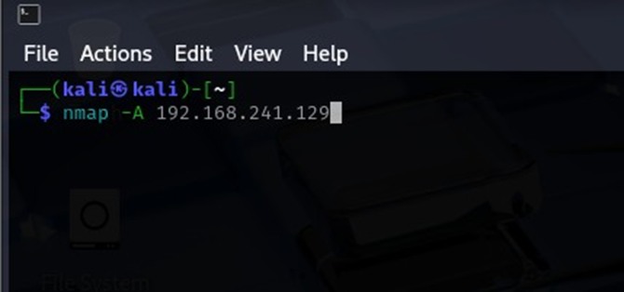
Practical approach
I. Reconnaissance: Service and Version Detection
The initial phase was focused on identifying open ports and services running on the target. The Network Mapper (Nmap) was employed for this purpose, utilizing its aggressive scan option to gather detailed information

Slide 8
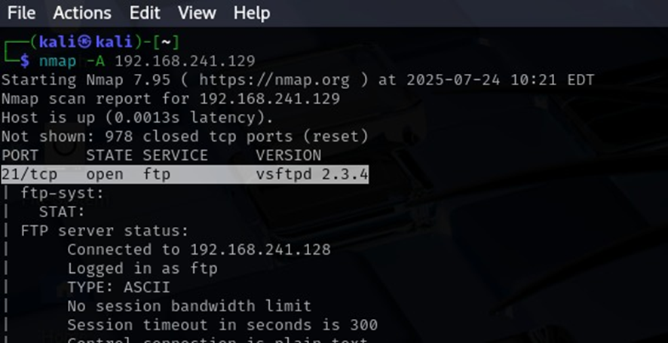
Practical approach
Analysis of Results: The Nmap scan successfully confirmed that the host was operational and detected several open ports. Importantly, it highlighted port 21/TCP as open and running the FTP service with the specific version vsftpd 2.3.4. This was crucial for identifying the vsftpd service and validating its version (2.3.4) through a port-specific version scan.
Command: nmap -sV -p 21 192.168.241.129

Slide 9
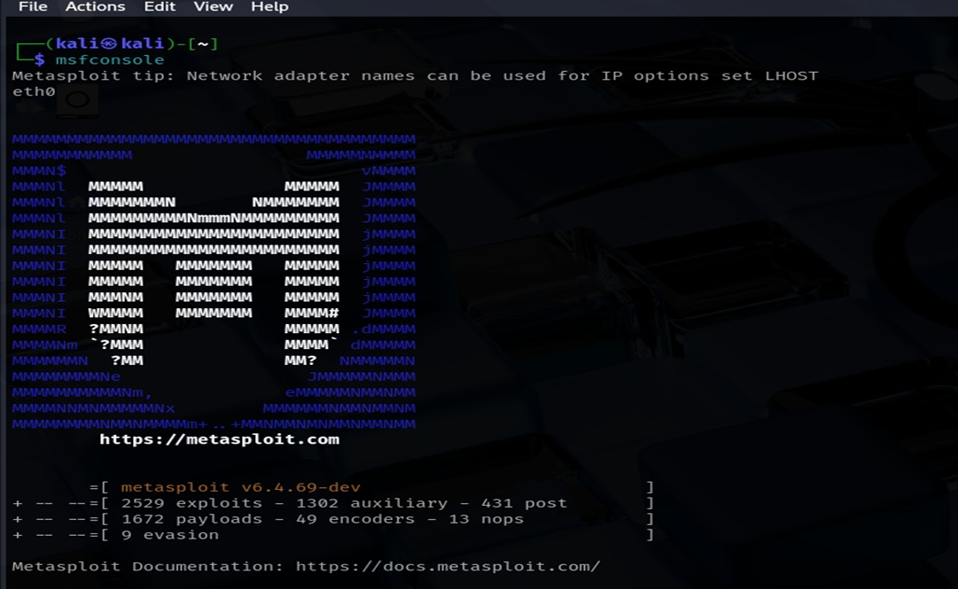
Practical approach
•Metasploit Framework:
Purpose: To exploit the detected vsftpd 2.3.4 backdoor vulnerability, demonstrate remote command execution, and confirm the level of compromise that can be achieved.
To initiate the Metasploit framework : Command -> msfconsole

Slide 10
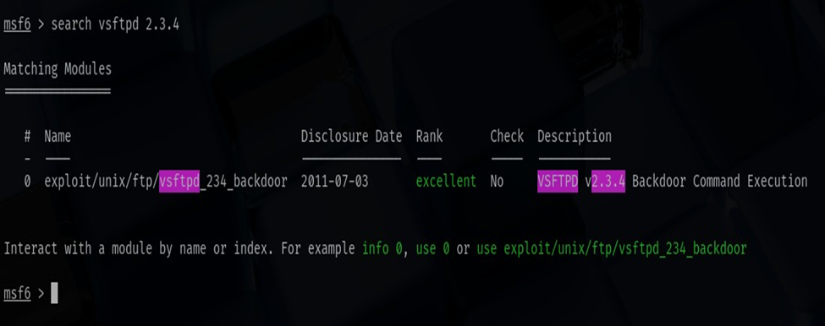
Practical approach
Findings: The search produced a single, highly relevant exploit module: exploit/unix/ftp/vsftpd_234_backdoor. The module's description confirmed that it is designed to target a malicious backdoor in this specific version of vsftpd, with a disclosure date of 2011-07-03 and an "excellent" reliability rating, indicating a high chance of success without causing negative impacts on the target system.
Metasploit Command: search vsftpd 2.3.4

Slide 11
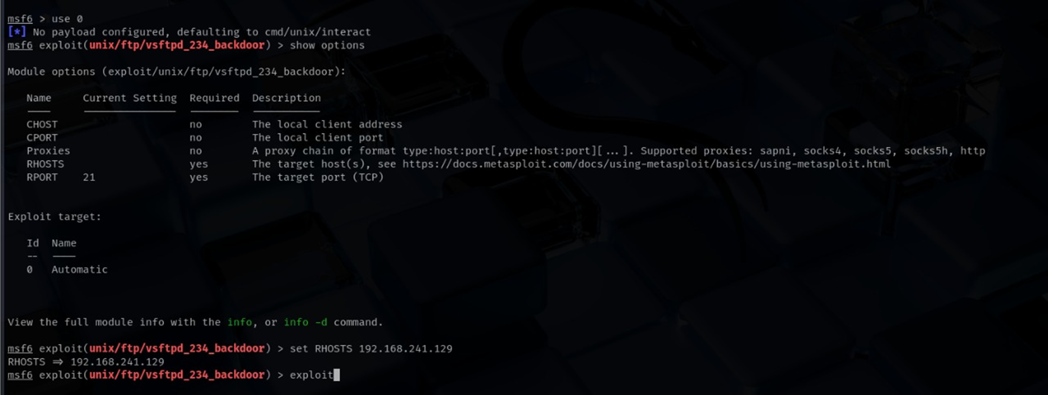
Metasploit Configuration and Execution
.

Slide 12
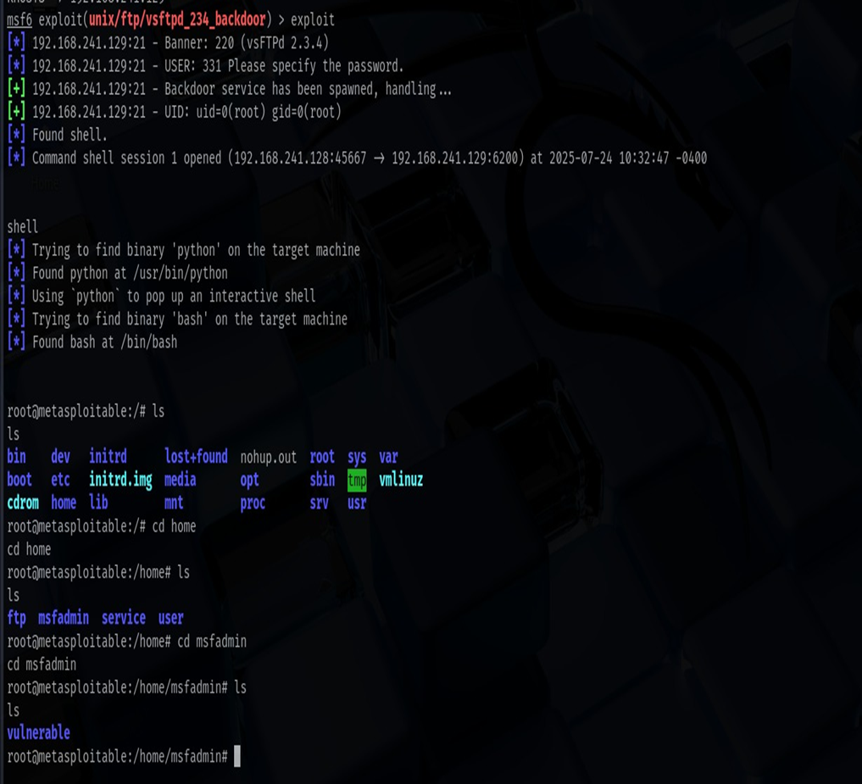
Practical Approach
Steps
1.Command-> use exploit/unix/ftp/vsftpd_234_backdoor - This command selects the appropriate exploit module.
2. Also to configure the target ip we will use this command: set RHOSTS 192.168.241.129
3.Command -> exploit - Launches the attack.
4. Command-> ls /: Displayed the contents of the root directory, confirming the file system's readability.
5. Command: cd /home/msfadmin: Navigated into a user's home directory.

Slide 13
4.Findings
Risk Assessment
A.Vulnerability Details:
Vulnerability Name: vsftpd v2.3.4 Backdoor Command Execution
CVE ID: CVE-2011-2523
Severity: Critical (CVSS v2.0 Base Score: 10.0)
Severity | Vulnerability Name | Count
Critical | vsftpd 2.3.4 Backdoor | 1
Medium | (Other general findings from OpenVAS, e.g., outdated packages, default credentials) | (Variable)
Low | (Informational findings from OpenVAS, e.g., open ports for common services) | (Variable)

Slide 14
Explanation of the Risk Categories
• Critical: Vulnerabilities that enable an unauthenticated attacker to gain root or administrative access, compromise the integrity or availability of the system. Exploitation is often straightforward and has a severe impact.
• High: Vulnerabilities that could lead to significant data loss, privilege escalation (non-root), or denial of service. Exploitation might require some level of authentication or specific conditions, but the impact is still considerable
.
• Medium: Vulnerabilities that could lead to information disclosure, minor privilege escalation, or limited denial of service. Exploitation typically requires specific conditions or user interaction.
• Low: Vulnerabilities that pose minimal risk, such as informational findings, minor configuration issues, or potential security best practice violations that do not directly lead to compromise.

Slide 15
6.Recommendations and Mitigation
4.List of All Vulnerabilities with Details on the Plugin Name, Description, Solution, and Count Information:
• Plugin Name: vsftpd 2.3.4 Backdoor
Solution:
Immediately upgrade vsftpd to a patched version (e.g., 2.3.5 or later) or opt for a different, secure FTP server.
If an upgrade is not feasible at the moment, remove the vsftpd 2.3.4 installation and substitute it with a known good version.
Implement network segmentation to limit direct access to FTP services from untrusted networks.
Utilize an Intrusion Detection/Prevention System (IDS/IPS) to identify and block exploitation attempts.

Slide 16
7. Conclusion
This penetration test effectively demonstrated the presence of a critical backdoor vulnerability in vsftpd 2.3.4 on the target system.
The successful attainment of root privileges underscores a total failure of the system's security measures.
It is crucial that the recommendations presented in this report are addressed without delay to avert a real-world compromise and to enhance the organization's overall cybersecurity resilience.

